Slide 1
Shellharbour Public School Poetry Slam

Slide 2
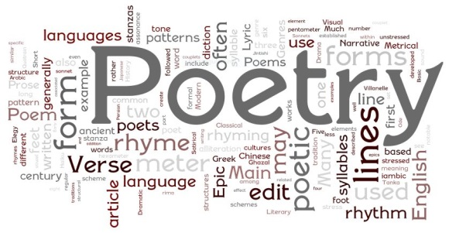
Speaking and Learning Outcome
Students will be able to communicate in a range of informal and
formal contexts by adopting a range of roles in group, classroom,
school and community contexts.

Slide 3
What is poetry slam?
A Poetry Slam is a type of competition where people recite poems without props, costumes, or music. It puts a dual emphasis on the written word and performance, encouraging poets/performers to focus on what they’re saying and how they’re saying it.
The poem can be an original (one you have written yourself) or one from another author.

Slide 4
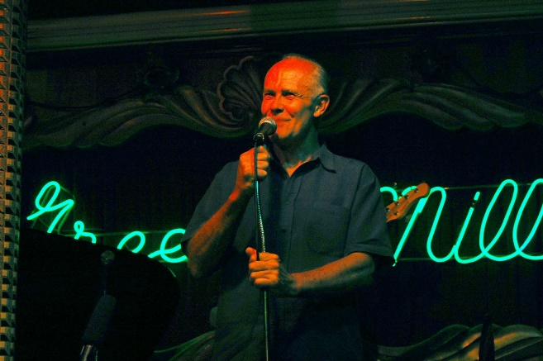
Where it started?
In July 1984, construction worker and poet, Marc Smith, started a weekly poetry reading at the Green Mill Jazz Club in Chicago, looking for a way to breathe life into the open mike format. The series, called the Uptown Poetry Slam, placed emphasis on performance and laid the groundwork for the brand of poetry that would eventually be exhibited in slam. The Uptown Poetry Slam continues to run every Sunday night.

Slide 5
What style of poem can be performed?
One of the best things about poetry slam is the range of poets/performers it attracts. Poets/performers are free to do work in any style, on any subject.

Slide 6
What are the rules?
SPS Poetry Slam rules are:
Each poem can be an original (one you have written yourself) or one from another author. Your job is to engage your audience!
Start your performance with the title and state the author of the poem.
Each poet/performer gets three minutes (plus a ten-second grace period) to recite one poem. If the poet goes over time, points will be deducted from the total score.
The poet may not use props, costumes or musical instruments.

Slide 7
What are the rules?
As the audience, we ask you to give your full attention to the poet/performer while they are performing.
As the audience, we encourage you to respond to the poet/performer in an appropriate manner. Remember, it takes a lot of courage to stand up and perform in front of an audience!
The judges’ scores will be totalled and a grand slam score given. The poet/performer with the greatest total in each stage is the winner and will be awarded a certificate and special prize.

Slide 8
ES1 Grand Slam
Insert photo and first name of finalist #1
Insert photo and first name of finalist #3
Insert photo an first name of finalist #2
Insert photo and first name of finalist #4

Slide 9
S1 Grand Slam
Insert photo and first name of finalist #1
Insert photo and first name of finalist #3
Insert photo an first name of finalist #2
Insert photo and first name of finalist #4

Slide 10
S2 Grand Slam
Insert photo and first name of finalist #1
Insert photo and first name of finalist #3
Insert photo an first name of finalist #2
Insert photo and first name of finalist #4

Slide 11
S3 Grand Slam
Insert photo and first name of finalist #1
Insert photo and first name of finalist #3
Insert photo an first name of finalist #2
Insert photo and first name of finalist #4

