Slide 1
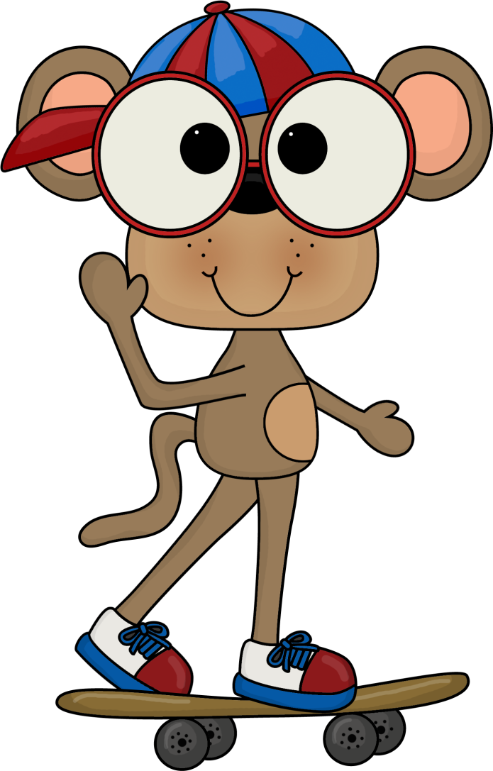
Addition & Subtraction
Problem Solving
Stage Two
Leanne Williamson, 2015 . Problems have been adapted from previous Naplan questions.
Notes:
NSW Syllabus Reference:
MA2-5NA: Uses mental and written strategies for addition and subtraction involving two-, three-, four- and five-digit numbers.
MA2-8NA: complete number sentences involving addition and subtraction by calculating missing numbers, eg find the missing numbers ___ + 55 = 83
NSW Numeracy Continuum Reference: Aspect 2: EAS – Facile
Aspect 4: Place Value Tens and Ones. Aspect 4: Place value: Hundreds, tens and ones; Decimal Place Value.

Slide 2
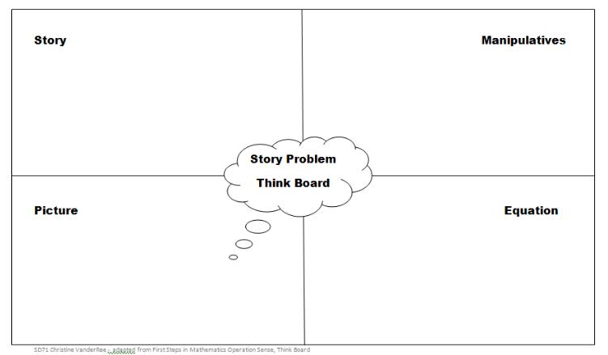
Have students use the following think board to solve the problems……
Leanne Williamson, 2015

Slide 3
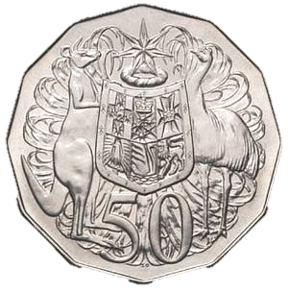
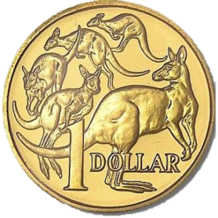
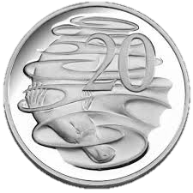
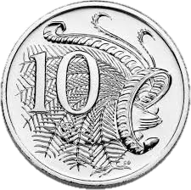
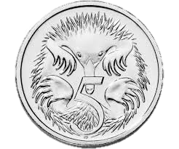
Tanya has the following coins in her wallet.
She buys a bottle of water for $1.15 and an orange for 55 cents. How much money does Tanya have left.
Leanne Williamson, 2015

Slide 4
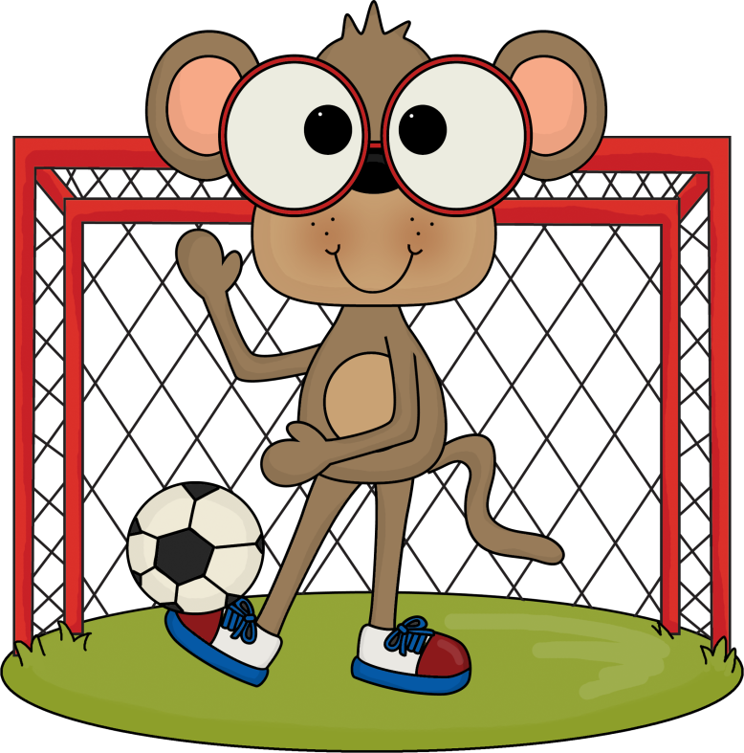
Steve has is hot and thirsty after his game. He this much money in his pocket.
He buys a drink for 75 cents.
How much money does he
have left?
Leanne Williamson, 2015

Slide 5
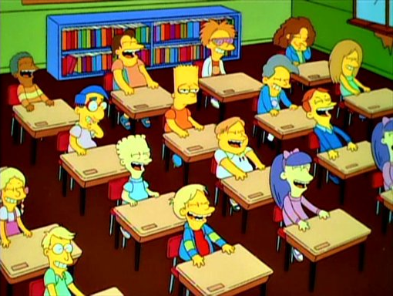
Miss Moisy’s class has 14 boys. There are 5 more boys than girls in the class.
How many students are in the class?
Leanne Williamson, 2015

Slide 6
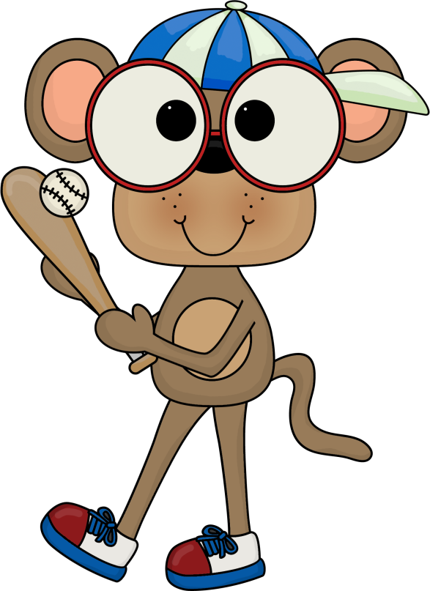
Nathan has some money in his pocket after playing a game of baseball. He spent $1.25 at the canteen and now has $1.95 left.
How much money did Nathan start with?
Leanne Williamson, 2015

Slide 7
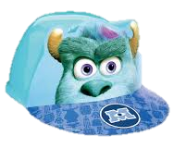
Sulley buys a tennis racket and a new cap.
The total is $25. The racket costs $5 more than cap.
What is the cost of the cap?
Leanne Williamson, 2015

Slide 8
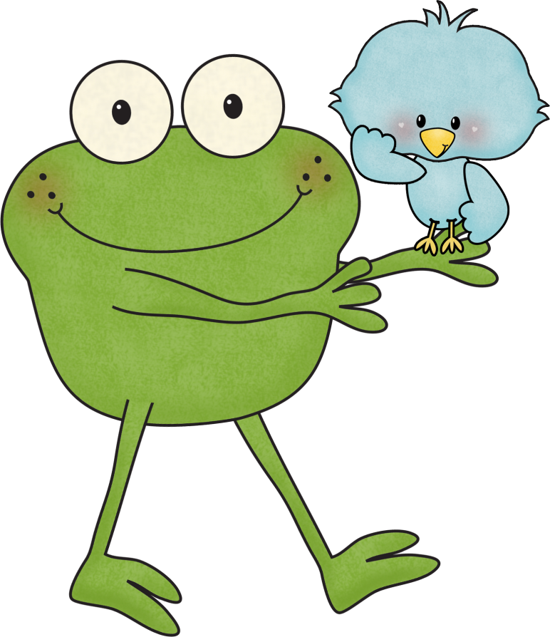
Jeffra walked 5367 steps and Paula walked 3259 steps in a day.
How many more steps did Jeffra walk than Paula?
Leanne Williamson, 2015

Slide 9
With the lid on the mass of the box is 243 grams. With the lid off, the mass of the box is 178 grams.
What is the mass of the lid?
Leanne Williamson, 2015

Slide 10
Laura has 68 sunflowers. Emma has 52 sunflowers.
How many sunflowers should Laura give Emma so they both have the same number of sunflowers?
Leanne Williamson, 2015

Slide 11
Leilana has $ 1.85. She needs 35 cents more to buy this drink.
How much does the drink cost?
Leanne Williamson, 2015

Slide 12
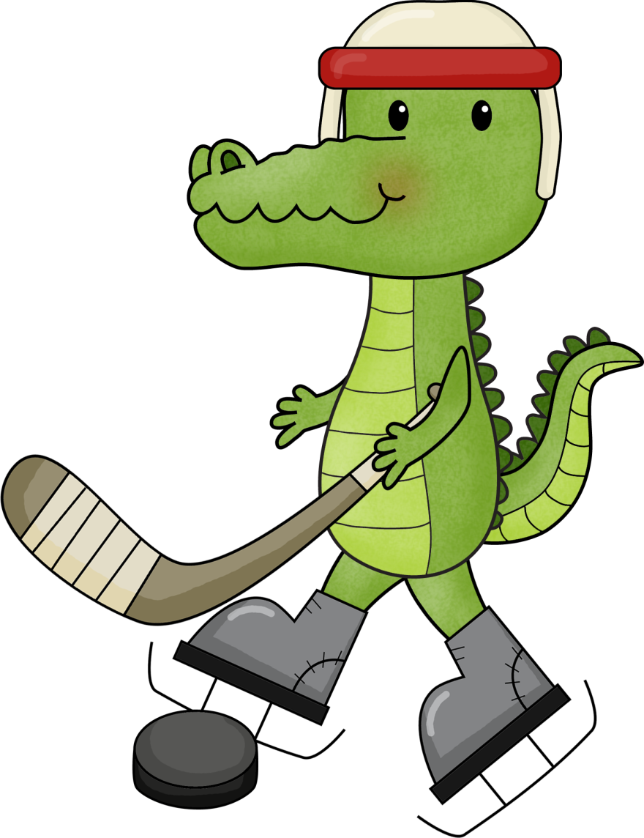
A country hockey game between Roosters and the Gators was attended by 575 people. The Roosters had 268 supporters. The rest supported the Gators.
How many people supported the
Gators?
Leanne Williamson, 2015

Slide 13
Justin collected 86 teddy bears.
Michael collected 117 teddy bears.
How many teddy bears did
Justin and Michael collect
altogether?
Leanne Williamson, 2015

Slide 14
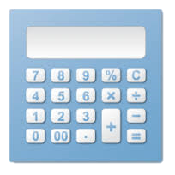
Ahmed showed this number on his calculator.
565
He changed it so that it became this number.
505
What did Ahmed do to change 565 to 505?
Leanne Williamson, 2015

Slide 15
Complete the sum below.
17 + + 6 = 54
Leanne Williamson, 2015

Slide 16
Sophie is 85 years old. Ella is 35 years old.
What is the difference in their ages?
Leanne Williamson, 2015

