Slide 1
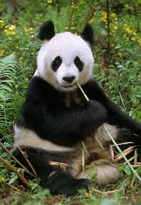
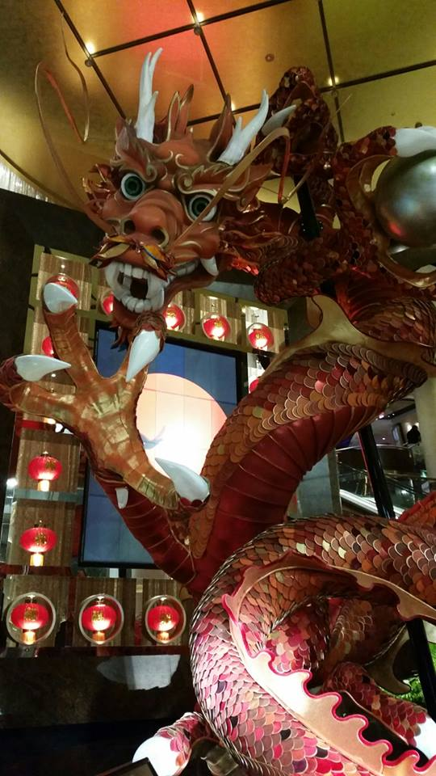
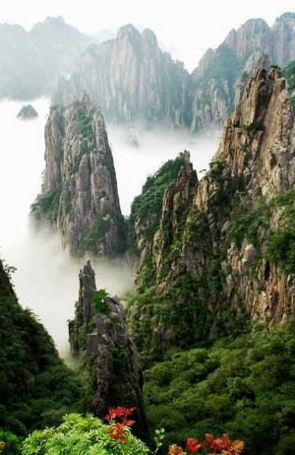
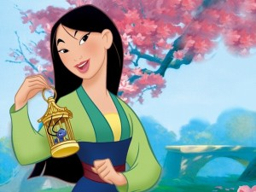
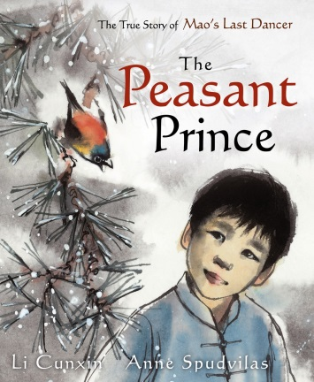
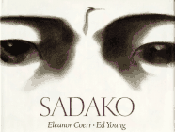
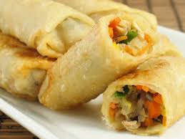
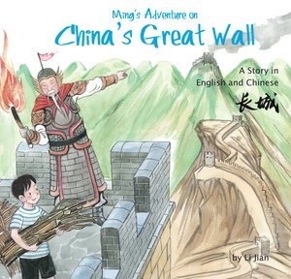
Asia
Writing Prompts
Leanne Williamson 2015

Slide 2
Huangshan Mountains
Write a descriptive story about spending a day/night or week in the Huangshan Mountains in China.
(include your 5 senses)
What can you hear, see, taste smell, touch?
Found on anhui.chinadaily.com.cn
Leanne Williamson 2015

Slide 3
Lon Po Po: A Red-Riding Hood Story from China, by Ed Young.
Which version of the story did you like best, Little Red Riding Hood or Lon Po Po ?
Why?
Sourced: https://www.youtube.com/watch?v=Da1wuXMPDww
Leanne Williamson 2015
Notes:
The tale of Lon Po Po, the wolf, parallels the European tale of “Little Red Riding Hood.” This Chinese version is believed to be more than a thousand years old. As translator and illustrator, Ed Young relied on a combination of ancient Chinese panel art and contemporary pastels and watercolors to create dramatic illustrations that successfully complement a powerful text.
Before Reading Lon Po Po
Ask how many of the children have ever heard the story of “Little Red Riding Hood.” Ask the children briefly to recount the familiar tale, then tell the class that they are about to hear a Chinese version of the same tale. Ask the class to imagine how the story might be the same or different from the (European) version that they are probably familiar with.
After Reading Lon Po Po
Hold a brief discussion about how the two versions of “Red Riding Hood” were, in fact, the same, and how they differed. Invite students familiar with both versions to tell which version they liked better, and why. ( sourced http://www.scholastic.com/teachers/lesson-plan/lon-po-po-teaching-plan)
More activities available for purchase at::
https://www.teacherspayteachers.com/Product/Red-Riding-Hood-and-Lon-Po-Po-1220290

Slide 4
Giant Panda
Write a description of this Giant panda which lives in the bamboo forests in central China.
Sourced : Google images
Leanne Williamson 2015

Slide 5
Mulan!
The Chinese legend of Mulan centres on a young woman who disguises herself as a man to take the place of her elderly father in the army.
Write about the challenges you believe Mulan would have encountered as a man in the Chinese army.
Found: http://socialnewsdaily.com/50084/disney-to-create-live-action-mulan/
Leanne Williamson 2015
Notes:
Read the story or have students view the movie trailer before completing this task.

Slide 6
Chinese New Year …
Chinese New Year is a traditional and very important Chinese holiday. It was originally a festival to honour ancestors as well as holy or sacred beings. It is also known as the Spring Festival.
Design your own dragon and then write a description to match.
Photography taken by Leanne Williamson, 2015
Leanne Williamson 2015
Notes:
Interesting Chinese New Year Facts: Traditionally Chinese New Year lasted from the last day of the Chinese calendar to the 15th day of the first month. It is a major Chinese holiday. In countries and territories that have high populations of Chinese, Chinese New Year is also celebrated. Hong Kong, Taiwan, Singapore, Indonesia and the Philippines are only a few. Chinatowns in other cities also celebrate Chinese New Year. The exact date of Chinese New Year changes each year because it originated in 2600 B.C. At that time people followed the lunar calendar. The Chinese New Year is symbolic of letting go of the past and welcoming new beginnings. It's a popular time for spring cleaning. Each year of the Chinese New Year calendar is named after an animal. This is a 12 year cycle. Once the 12 year cycle is over the animal list begins again. The list in order is: rat, ox, tiger, rabbit, dragon, snake, horse, ram, monkey, rooster, dog, and pig. As the longest festival in the Chinese calendar, Chinese New Year can last as many as 15 days. Children take an entire month off of school. It's common for Chinese families to have a reunion dinner the night before Chinese New Year festivities begin. The decorations used on doors and windows are red colored paper-cuts (made similar to the way we make snowflakes). The themes of these paper-cuts are of happiness, good fortune, longevity and wealth. Firecrackers are popular during the Chinese New Year. They are thought to scare off evil spirits. Children receive red envelopes full of money instead of wrapped gifts that other nationalities give at Christmas. The amount they receive is usually an even number. The amount cannot be divisible by four. In Chinese, the number 4 means death. Dragon dances and street fairs are very popular. Dancers dress up as lions and dragons and perform for onlookers. One of the traditional treats is a candied crab-apple on a stick. Since the 1980s China Central TV broadcasts the celebration. This is an evening-long variety style show and it is watched by the entire country. On the last day of Chinese New Year, everyone carries beautiful paper lanterns and walks along the streets. This is supposed to light the way for the New Year. This day is called Lantern Day. In Singapore and Malaysia, Lantern Day is their form of Valentine's Day. On Chinese New Year everyone is a year older. It doesn't matter when you were born; this is like a national birthday. Another name for Chinese New Year is: The First Day of the Great Year.
Sourced: http://www.softschools.com/facts/holidays/chinese_new_year_facts/143/

Slide 7
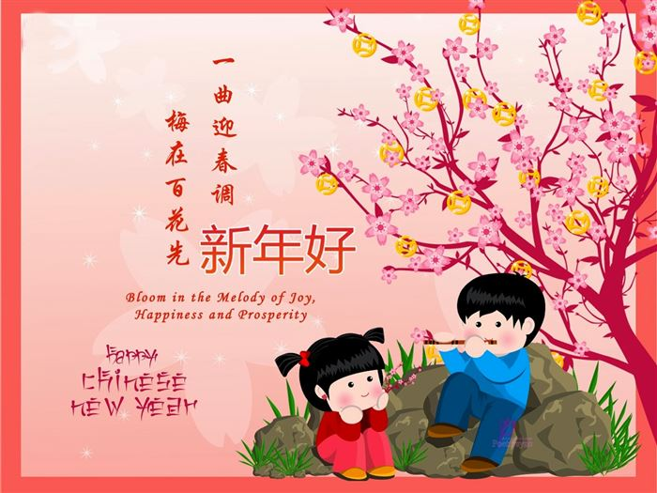
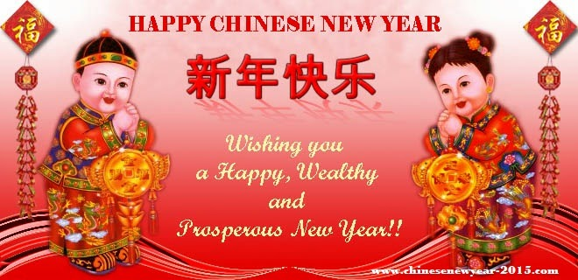
Chinese New Year Poster…
Create your own poster for Chinese New Year.
Sourced : Google images
Leanne Williamson 2015
Notes:
Interesting Chinese New Year Facts: Traditionally Chinese New Year lasted from the last day of the Chinese calendar to the 15th day of the first month. It is a major Chinese holiday. In countries and territories that have high populations of Chinese, Chinese New Year is also celebrated. Hong Kong, Taiwan, Singapore, Indonesia and the Philippines are only a few. Chinatowns in other cities also celebrate Chinese New Year. The exact date of Chinese New Year changes each year because it originated in 2600 B.C. At that time people followed the lunar calendar. The Chinese New Year is symbolic of letting go of the past and welcoming new beginnings. It's a popular time for spring cleaning. Each year of the Chinese New Year calendar is named after an animal. This is a 12 year cycle. Once the 12 year cycle is over the animal list begins again. The list in order is: rat, ox, tiger, rabbit, dragon, snake, horse, ram, monkey, rooster, dog, and pig. As the longest festival in the Chinese calendar, Chinese New Year can last as many as 15 days. Children take an entire month off of school. It's common for Chinese families to have a reunion dinner the night before Chinese New Year festivities begin. The decorations used on doors and windows are red colored paper-cuts (made similar to the way we make snowflakes). The themes of these paper-cuts are of happiness, good fortune, longevity and wealth. Firecrackers are popular during the Chinese New Year. They are thought to scare off evil spirits. Children receive red envelopes full of money instead of wrapped gifts that other nationalities give at Christmas. The amount they receive is usually an even number. The amount cannot be divisible by four. In Chinese, the number 4 means death. Dragon dances and street fairs are very popular. Dancers dress up as lions and dragons and perform for onlookers. One of the traditional treats is a candied crab-apple on a stick. Since the 1980s China Central TV broadcasts the celebration. This is an evening-long variety style show and it is watched by the entire country. On the last day of Chinese New Year, everyone carries beautiful paper lanterns and walks along the streets. This is supposed to light the way for the New Year. This day is called Lantern Day. In Singapore and Malaysia, Lantern Day is their form of Valentine's Day. On Chinese New Year everyone is a year older. It doesn't matter when you were born; this is like a national birthday. Another name for Chinese New Year is: The First Day of the Great Year.
Sourced: http://www.softschools.com/facts/holidays/chinese_new_year_facts/143/

Slide 8
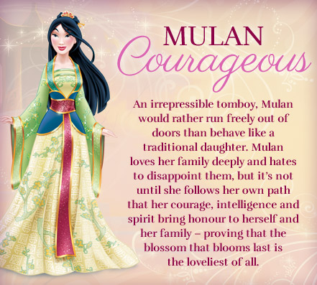
Mulan
Use the information that you know of Mulan to write a description.
Sourced : http://disney.wikia.com/wiki/File:Mulan-disney-princess-
Leanne Williamson 2015

Slide 9
Kung Fu Panda!
Write a story about one of Kung Fu Panda’s adventures in China.
Sourced: https://www.youtube.com/watch?v=PXi3Mv6KMzY
Leanne Williamson 2015

Slide 10
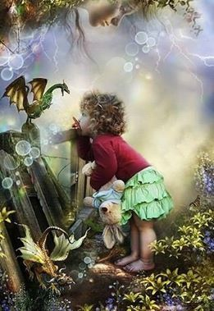
Ping and the baby dragon
Ping believes that no-one will ever find her hiding spot on the mountain of Tai Shan in China. She thinks that she can go on caring for the baby dragon left in her care but she is soon proven wrong.
.
Write what goes wrong…
Found on s3.photobucket.com
Leanne Williamson 2015

Slide 11
Creative Writing…..
Tell the story about what was happening when this picture was taken.
Sourced: http://wallippo.com/wallpaper/little-girl-and-dragon
Leanne Williamson 2015

Slide 12
Literary Recount
Write a literary recount of “Ming’s Adventure on China’s Great Wall”
A literary recount gives details about what happened, including who was involved, when and where the event took place, and what may have resulted.
Found on http://www.artgallery.nsw.gov.au/shop/item/9781602209879/
Leanne Williamson 2015
Notes:
What is a literary recount?
A literary recount is similar to a factual recount. Both types of recounts give details about what happened, including who was involved, when and where the event took place, and what may have resulted. A literary recount can be about real or fictional events and characters.
A literary recount is different from a factual recount because it includes more than just facts. A literary recount:
retells a series of events with characters
gives facts and feelings about the events
often uses dialogue between characters
creates an emotional connection with the reader
uses descriptive language.
Examples of a literary recount
Literary recounts include more emotional connections between the reader and the story than factual recounts. Some examples of literary recounts are:
short stories and novels
biographies and letters
fables, myths and legends
plays, films and television programmes
poems and songs
picture books.
Structure of a literary recount
A literary recount must begin with a title or a heading. The title should relate to the text, but can be creative.
The introductory paragraph is called the orientation. In this paragraph the setting and characters are introduced. This may also give the reader a general idea of what the text will be about, or may contain background information that helps to explain the first scene of the text.
The body of the text contains the sequence of events. The sequence of events is usually written in chronological order (the order they occurred). The purpose of these events is to tell the story. This includes what happened, how characters (or people) within the text felt about the events, and how any problems were dealt with.
The concluding paragraph is called the reorientation. This paragraph sums up the recount. This is where the sequence of events ends and any issues or problems are completely resolved by the characters. The emotional responses of the characters involved may also be included in this s
Source: http://www.skwirk.com/p-c_s-6_u-124_t-340_c-1179/WA/6/Literary-recountsLiterary-text-typesText-typesEnglish/

Slide 13
Spring Rolls Procedure
Write a procedure for making Spring Rolls.
Source : Google Images
Leanne Williamson 2015
Notes:
Visit the following site for recipe and ingredients. Make these with the students before writing the procedure:
http://www.kidspot.com.au/best-recipes/Chinese-food+117/Spring-rolls-recipe+2747.htm

Slide 14
Sadako and the Thousand Paper Cranes….
Write an Acrostic poem for Sadako.
Leanne Williamson 2015
Notes:
Other activities can be sourced from: http://hbavenues.com/highpoint/library/pdf/hp_ll_tg_a5_3.pdf

Slide 15
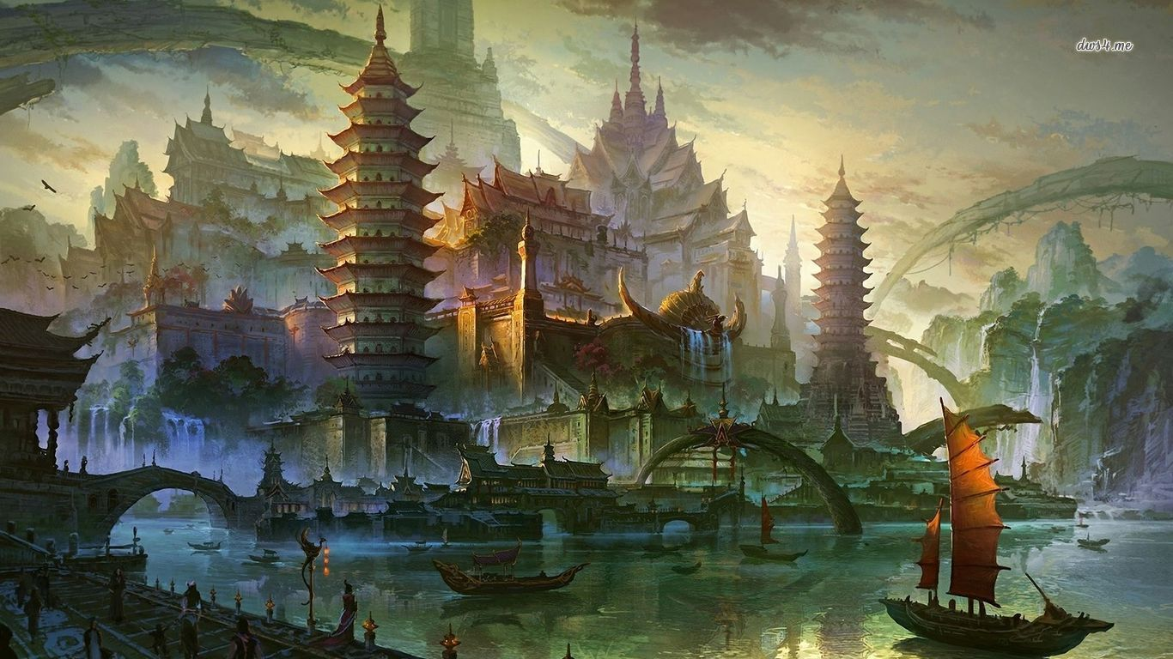
Creative Writing…..
Write a story that takes place in this setting.
Sourced: http://www.desktopwallpapers4.me/fantasy/ancient-chinese-marina-17024
Leanne Williamson 2015

Slide 16
The Peasant Prince….
Put yourself in Li’s situation, he was eleven years old when he moved to a new city; he didn’t know anybody, lacked confidence in his training at the Bejing Academy and was home sick. Yet on the other hand, Li was being given the opportunity to change his life and realise his dreams.
What would Li be feeling at this point in time?
How would you feel in the same situation?
What does it tell us about Li’s character?
Sourced: https://www.youtube.com/watch?v=v_aBxOXea00
Leanne Williamson 2015
Notes:
Other activities for this book can be sourced at: http://www.scool.scholastic.com.au/schoolzone/toolkit/assets/pdfs/Peasant%20Prince%20-%20Scholastic.pdf

