Slide 1
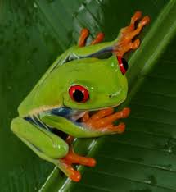
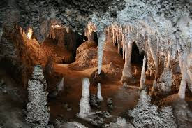
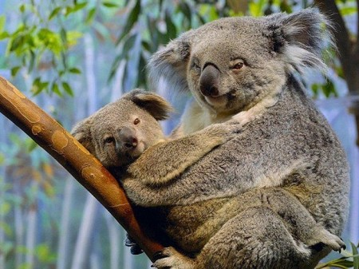
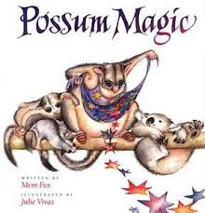
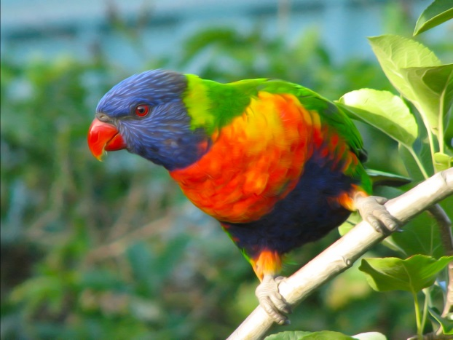
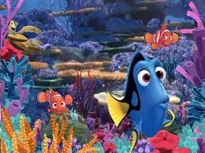
Writing Prompts
Leanne Williamson 2014

Slide 2
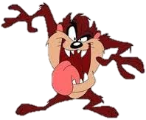
This is Taz, an animated cartoon character featured in the Warner Bros. "Looney Tunes". He can’t understand why he can’t keep friends.
Write why you think he can’t make any friends.
Then write a list of things he can do to change that.
Leanne Williamson 2014

Slide 3
You have just discovered this secret cave. Located in Jenolan caves, Imperial Cave, in the Blue Mountains, New South Wales, Australia; 175 kilometres west of Sydney.
Explain why your parents should allow you to play in the cave.
or
Explain why you don't think
children should be allowed
to play in the cave.
Leanne Williamson 2014, inspired by Steph Westwood

Slide 4
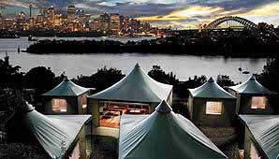
Write a descriptive story about spending a night at Taronga Zoo in one of these tents
(include your 5 senses)
What can you hear, see, taste smell, touch?
Leanne Williamson 2014, inspired by Steph Westwood

Slide 5
Creative Writing
After viewing the video, write a story about a magical power.
You can choose only one magical power.
Include why you chose that power and what you would do with it..
Leanne Williamson 2014

Slide 6
Imaginative Writing
In the clear, crystal blue waters of the Great Barrier Reef were two fish named Nemo and Dory. Nemo so longed to grow up. He said, “I wish I knew what it looked like outside this place! Why won’t father let me step out of this part of the reef?” Dory reminded Nemo that his father was a wise fish and that he needed to listen to him. The next day………..
Write what happens next…
Leanne Williamson 2014

Slide 7
Description
Write a description of this Australian Green Tree Frog
Leanne Williamson 2014

Slide 8
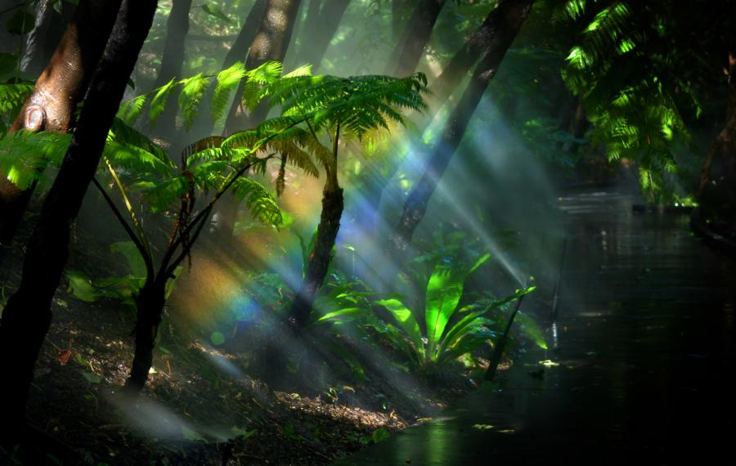
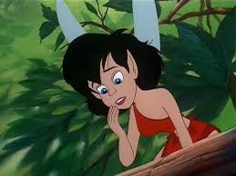
Character and Setting Description
Describe this character and the rainforest setting.
Leanne Williamson 2014

Slide 9
Best Friends
Write about having a best friend.
Leanne Williamson 2014, inspired by Steph Westwood

Slide 10
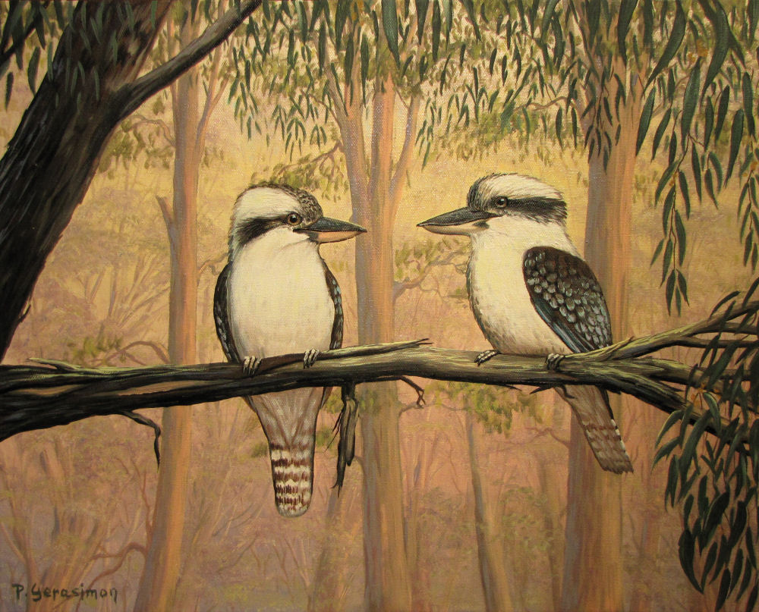
Dreamtime Story
Watch the video and then write a retell of how the Kookaburra got it’s laugh.
Leanne Williamson 2014

Slide 11
Design and write a postcard.
Pretend you are Grace or another member of the family and write a postcard home to Nan telling her all about what you have seen.
Leanne Williamson 2014

Slide 12
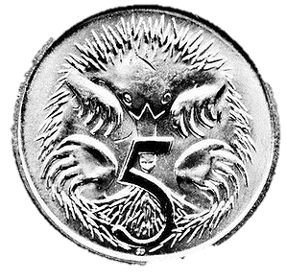
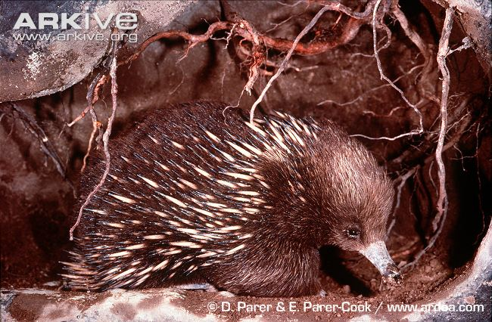
Echidna Report
View Bindi and Robert Irwin’s video on Echidnas. Use this information and your own knowledge to help you write a brief report.
Leanne Williamson 2014

Slide 13
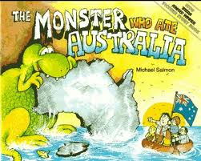
What do you think would have happened to Burra the Boggabri if he didn't get to take his trip around Australia.
Leanne Williamson 2014

Slide 14
Description
Write a description of this Australian Rainbow Lorikeet
Leanne Williamson 2014

Slide 15
The Rescuers Down Under
The story starts off in which Australian capital city? Write what Bianca and Bernard would have seen if they stayed there.
Leanne Williamson 2014

Slide 16
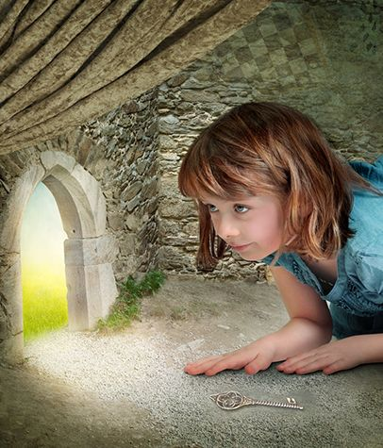
The Little Door
The little girl bent down to look through the tiny door at the back of the room. She couldn't believe what she saw! In the Australian bush……..
What happens next?
Steph Westwood 2014

