Slide 1
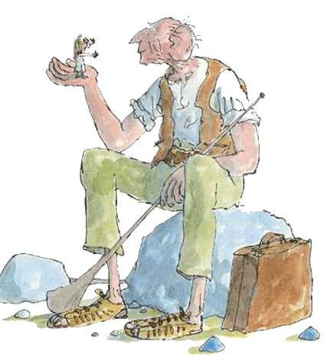
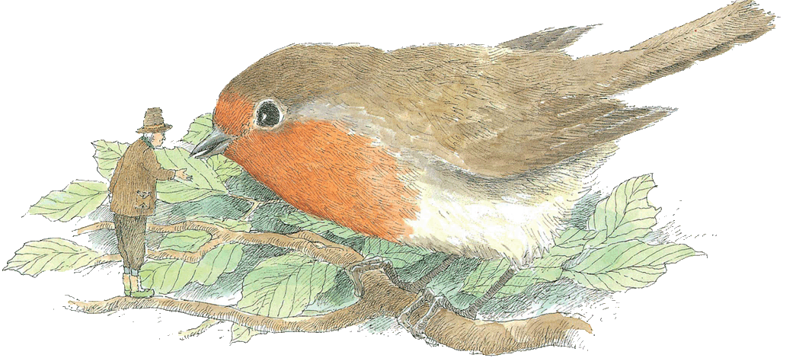
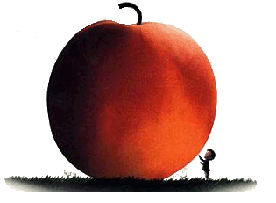
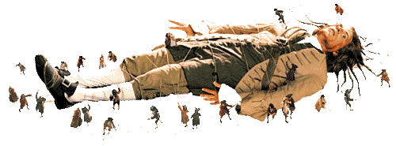
Big and small
An English unit for Year 3
Compiled by Jennie Newton

Slide 2
Why are studying this topic?
By the time we are finished it is hoped you can …
Respond to books and films in an original, thoughtful and creative way that shows you are thinking carefully
Explain some of the ways writer keep you interested
Relate some things you read or view to your own life
Make some connections between the ways that different authors show similar stories and ideas
Say how you decide whether a book, film etc. is good
Discuss how language can change over time
Give some points of views from books and films and explain whether you feel the same way or not

Slide 3
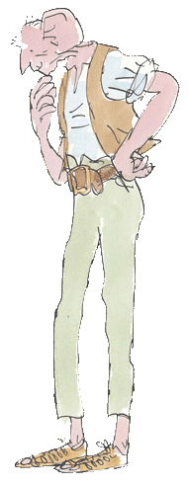
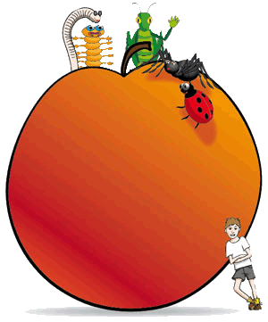
Introduction
The idea of being very big, or very small has been fascinating people for a very long time, and some great stories have been written about this.
During this unit, we will be looking at:
Gulliver’s Travels – book/film
The Minpins – book
The BFG – film
The Borrowers – film
James and the Giant Peach – film

Slide 4
Characterisation
When authors create books and films, they build a ‘picture’ about the character in the mind of the reader. They do this in 5 different ways
S speech: what does the character say, and how do they say it?
T thoughts: what is revealed through their thoughts and feelings?
E effects: How do other characters feel or behave in reaction to them?
A actions: what does the character do? How do they behave?
L looks: what does the character look like? How do they dress?

Slide 5
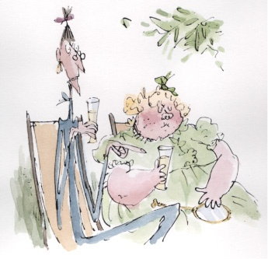
Speech
What characters say, tells us a lot about them. Look at what Aunt Sponge from James and the Giant Peach said about James. What does it tell us about the sort of person Aunt Sponge is? What does this tell us about her attitude towards James?
“The nasty little beast will only get into mischief if he goes out of the garden.”
We know from this, that James’ aunt neither likes nor trusts him.

Slide 6
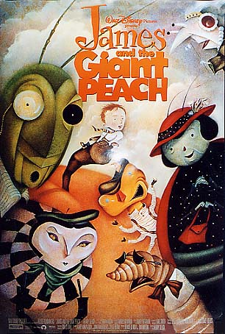
Thoughts
Authors tell us what characters are thinking, so that we can understand them better. What does this tell us about James in James and the Giant Peach?
Then all at once, little shivers of
excitement starting running over the
skin on James’ back.
Something else, he told himself,
something stranger than ever this
time, is about to happen to me again
soon.
We know from this, that James has a premonition that something is going to happen to him and he is excited by it and is kind of looking forward to it, not scared about it. This tells us he is adventurous and curious.

Slide 7
Effects
How other characters react to our character tells us the effect they have on other people, and this tells us about the character. Also how our characters react to other characters can tell us a lot about them. This shows Little Billy’s reaction to the devil whispering in his ear one afternoon when he was feeling bored.
‘These were the words the devil whispered softly into Little Billy’s ears on that sunny summer afternoon.
The next moment, Little Billy had opened the window and was climbing out.
In a jiffy he had dropped silently to the flower bed below.’
This shows us he is brave and adventurous, but also foolish and a bit deceitful as he is careful to make sure his mother doesn’t hear him going out of the window.

Slide 8
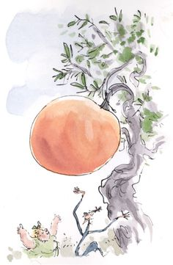
Actions
What people do in stories can tell us a lot about them. The actions of the two aunts from James and the Giant Peach tell you exactly what sort of characters they are.
Quickly, Aunt Sponge and Aunt Spiker called in carpenters and had them build a strong fence round the peach to save it from the crowd; and at the same time, these two crafty women stationed themselves at the front gate with a large bunchy of tickets and started charging everyone for coming in.
This tells us they are greedy, monkey-making people would want to take advantage of a situation. Would you like to meet these two lovely ladies?

Slide 9
Looks
The way people are described as looking in stories helps the reader build a ‘picture’ of them in their mind. Look at this description from James and the Giant Peach – it forms a wonderful description of the character.
Aunt Spiker, was lean and tall and bony, and she wore steel-rimmed spectacles that fixed on to the end of her nose with a clip. She had a screeching voice and long wet narrow lips, and whenever she got angry or excited, little flecks of spit would come shooting out of her mouth as she talked.
Charming, I’m sure!

Slide 10
Keep an eye out
As we read about and look at different stories, see if you can find the five ways the authors build their characters, and let you teacher know when you notice something.
(they will think you are very clever!)
S
T
E
A
L

Slide 11
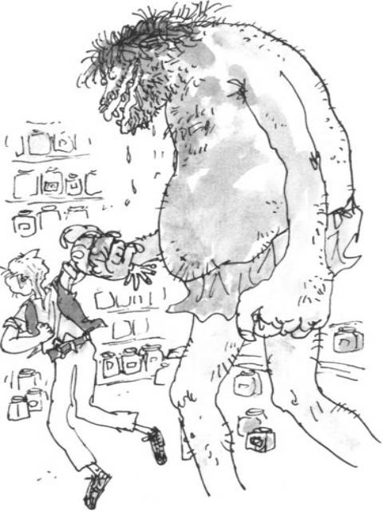
The BFG
What an exciting book and film The BFG is. Authors or composers have lots of ways they keep the reader or viewer caught up in the story. Here are some of the ways they do that …
Characterisation – if the writer builds a really full picture of the character by their looks, words, thoughts, action and the reactions of others around them, the character becomes believable and that helps us to get hooked on the story.
Tension – sometimes authors build tension by making it seem as though something awful may be about to happen. When you watch The BFG look for times when something terrible is about to happen and it makes you gasp while you wait to see what happens next.

Slide 12
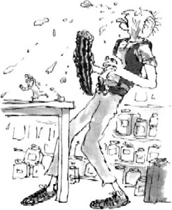
Keeping Us Engaged
Many writers and composers use comedy – Mr Dahl is extremely good at that! The way the BFG gets all his words mixed up is very funny, and what about Mr and Mrs Twit!
Sometimes writers write something that is outrageous. Things that make us squirm are engaging – like Mr Twit’s horrible beard, yuk!
Good authors can keep us amused by making the impossible seem to happen. In James and the Giant Peach, his parents are eaten by a rhino! What?! Rhinos eat grass!
Good writers also use fabulous words and language – what about snozzcumbers! Mr Dahl is especially good with alliteration where several words in a row start with the same letter.
Good writers also use twists and turns so the reader/viewer doesn’t guess what’s coming next. Can you think of some other writers who do that?

Slide 13
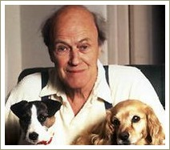
Roald Dahl
His parents were from Norway, but he was born in Wales, 1916. The family used to spend the summer holidays on a little Norwegian island, swimming, fishing and going by boat. When Roald was four years old, his father died. He went to boarding school and was always homesick.
After school, Roald worked for a petrol company, because he was sure they would send him abroad. He was sent to East Africa, where he got all the adventure he wanted. In WWII He was a fighter pilot and shot down German planes and got shot down himself. After 6 months in hospital he flew again.
His books are mostly fantasy, and full of imagination. About his children's stories he said once: "I make my points by exaggerating wildly. That's the only way to get through to children."
Roald Dahl died in November 1990. The Times called him
"one of the most widely read and influential writers of
our generation"
Excerpts from Wikipedia Roald Dahl

Slide 14
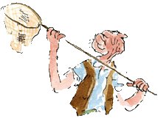
The BFG by Roald Dahl
Watch the film of the BFG and your teacher will give you some activities to complete.
For a homework assignment, you are going to make a ‘dream jar’. Your teacher will tell you all about it.

Slide 15
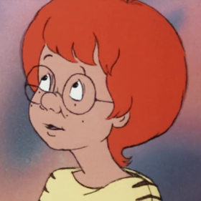
The BFG by Roald Dahl
As you are listening to and watching to the movie, complete a tension graph which shows how exciting the events are. Then think about what the author does to make it so appealing and exciting.

Slide 16
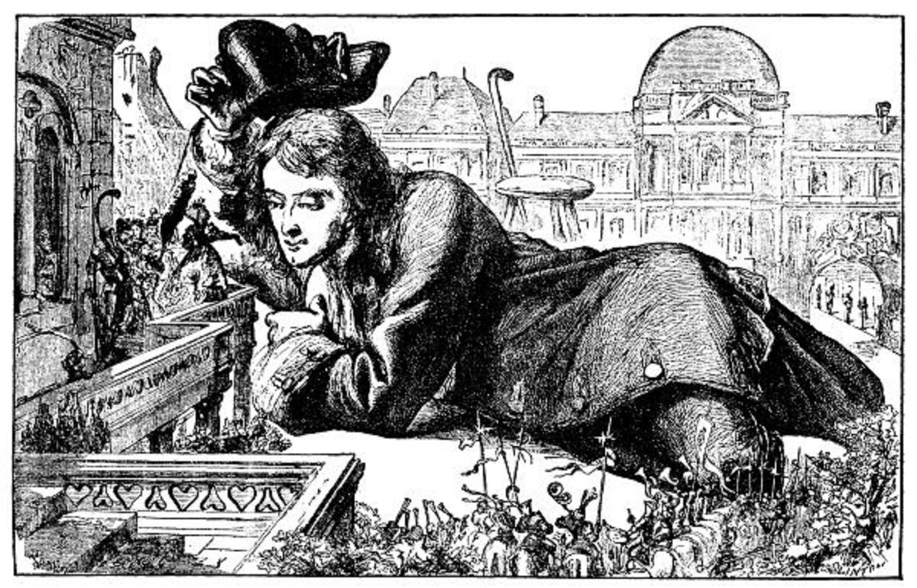
Who’s next?
The next author is one of the very first to write about being very big or very small. It was a man named Jonathan Swift, who wrote a book called Gulliver’s Travels nearly 350 years ago!! It has become a famous classic story and your teacher will read an abridged version of it to you. There may be some strange or difficult words, so you need to think about how our language changes over time. Talk about this with your teacher.

Slide 17
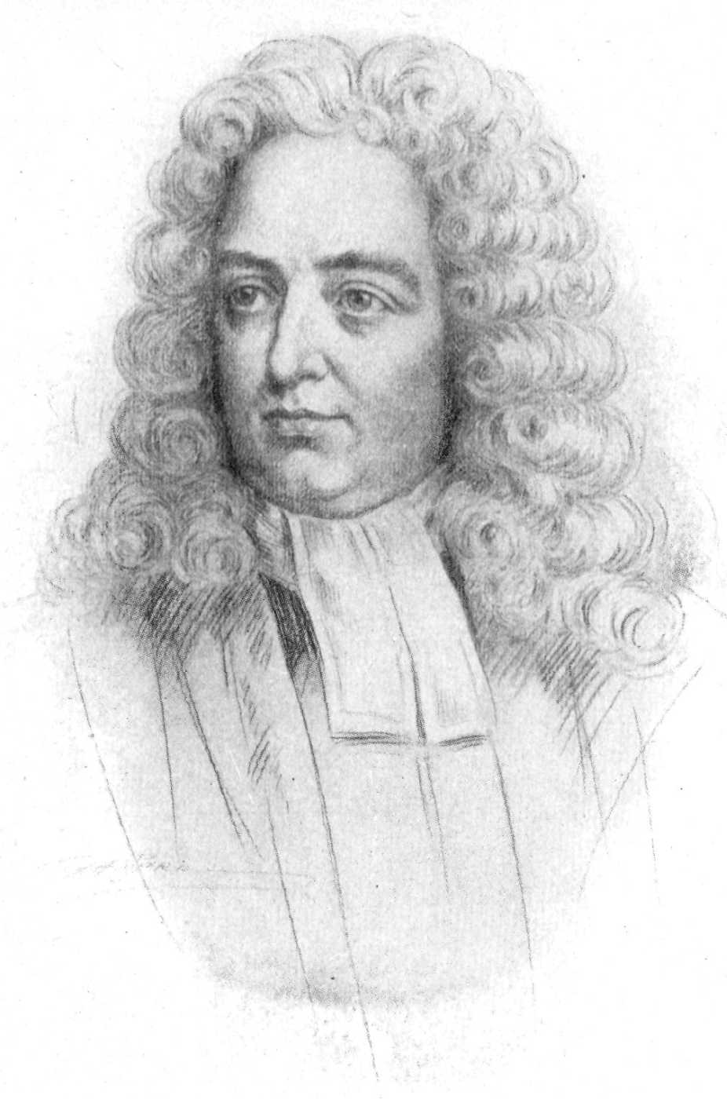
The Author – Jonathan Swift
Jonathan Swift was born in Dublin, Ireland, in 1667, and lived there for most of his life. He published Gulliver’s Travels in 1726. (that’s 68 years before European’s arrived to colonise Australia!)
It was an immediate hit and reprinted three times that year. Although Gulliver’s Travels was written as a satire of human pride, not as a children’s book, many kids have enjoyed this tale of Gulliver’s voyages to Lilliput, Brobdingnag, the flying island, and the land of the Houyhnhnms. Jonathan Swift died on October 19, 1745.
Psst! Do you think that’s his own hair?!
"Alternately considered an attack on humanity or a clear-eyed assessment of human strength and weaknesses, the novel is a complex study of human nature and of the moral, philosophical, and scientific thought of Swift's time which has resisted any single definition of meaning for nearly three centuries. “ Jena O. Krstovic

Slide 18
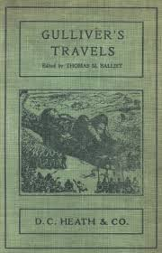
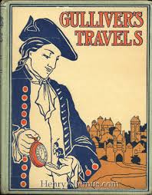
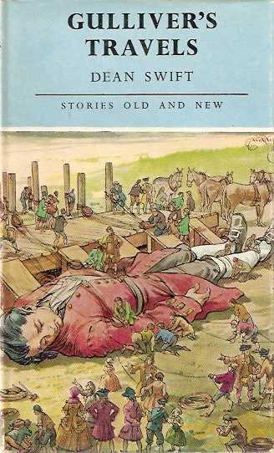
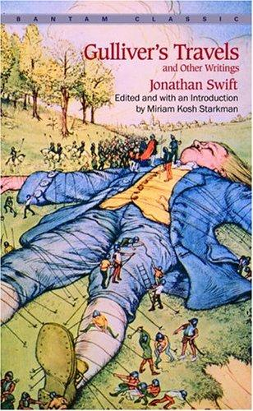
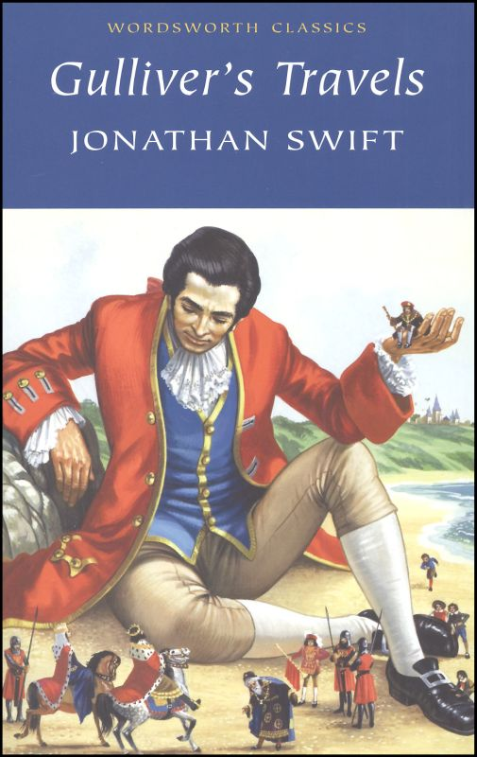
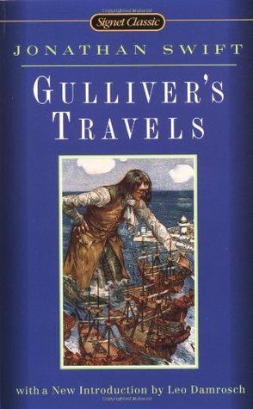
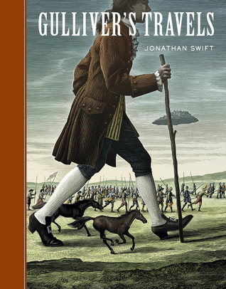
It has had over 1000 (!!!) different editions published and there will doubtless be many more. What might change with each edition?
https://www.goodreads.com/work/editions/2394716-travels-into-several-remote-nations-of-the-world-in-four-parts-by-lemuel
1st edition
Late 1800s
1901
1930s
1964
2007
1980
1984
1997
1999

Slide 19
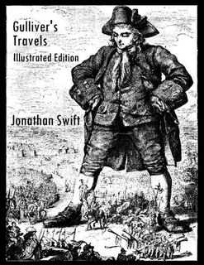
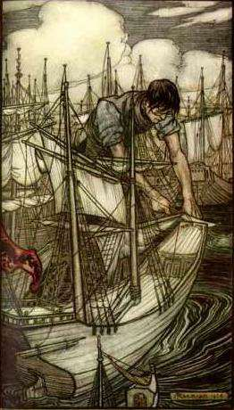
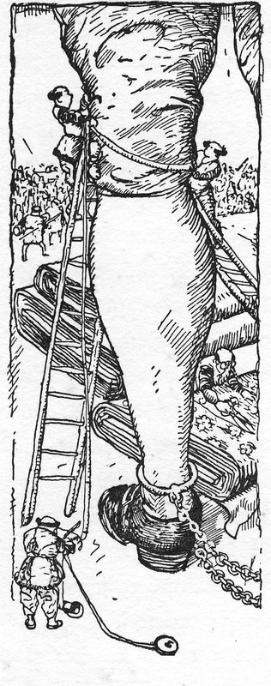
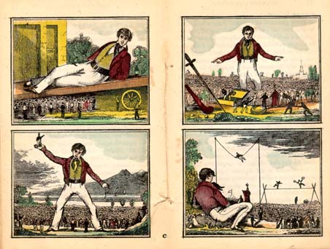
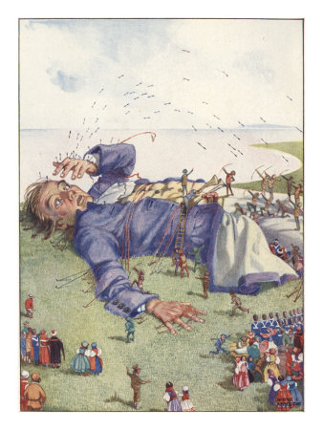
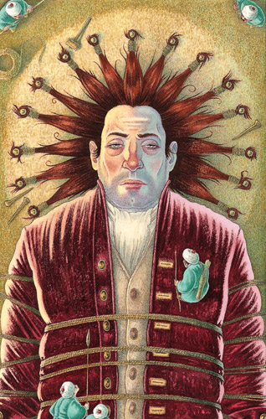
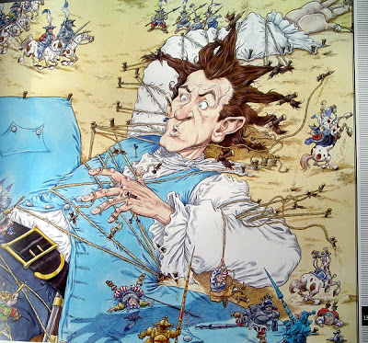
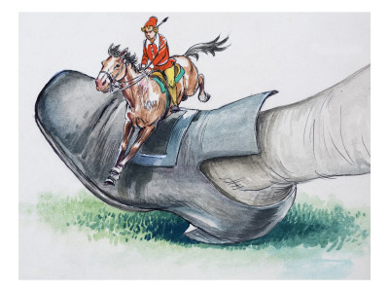
Look at how the style of illustration changes over time – why do you think this might happen?

Slide 20
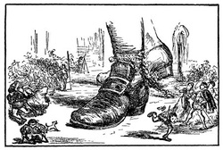
Journey to Lilliput
Imagine that one day someone put a spell on you and you become simply enormous, just like Gulliver was.
What might be good about that?
What might be bad about that?
Write a short story about being very, very, very big in a world where everyone else is very, very small!

Slide 21
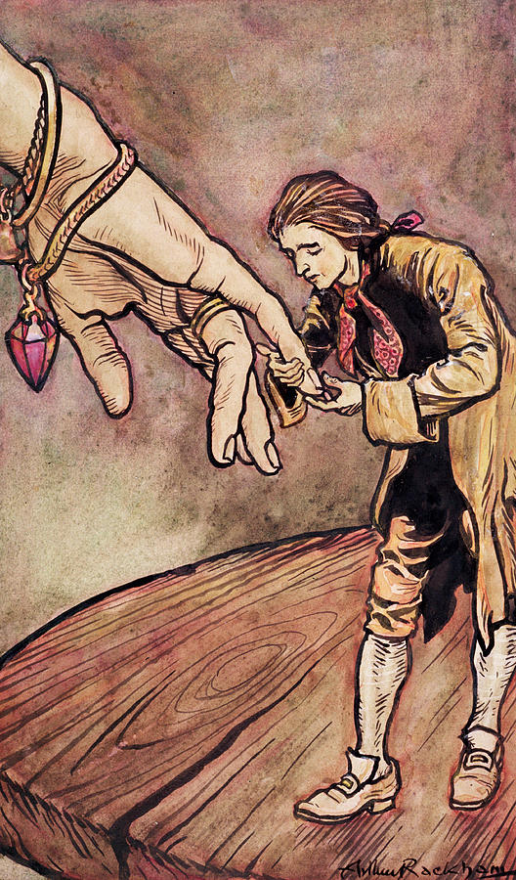
In the Land of Brobdingnag
Imagine you are very tiny and living in the world of Brobdingnag. Write a conversation you might have with the Queen of that country, about your world back home in Australia. Make sure you include her replies and reactions.

Slide 22
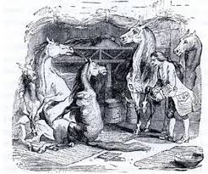
In the Land of Houyhnhnms
Of all the places Gulliver travelled to, he liked this place the best. Why do you think that was? Who are the bestial Yahoos? What point do you think the author is trying to make about humans? Do you agree with this point of view?
What effect did it have on Gulliver, living here?
Lots of things about this land seem very unlikely – think about 3 things that the horses couldn’t really do, yet they seem to in this story and explain why they couldn’t really do them.

Slide 23
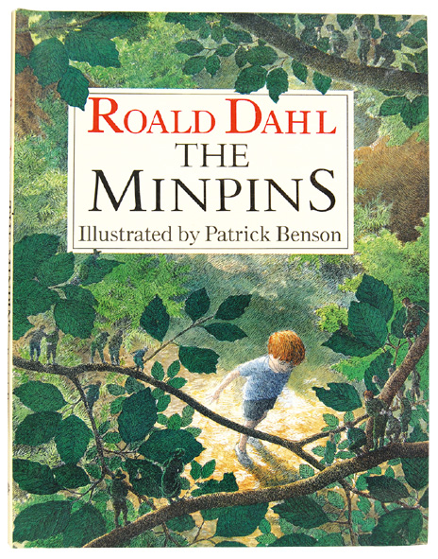
Roald Dahl has written many books that seem to revolve around being either very large or very small.
The Minpins was his final book and was published after his death. It is the only children’s book of his that is not illustrated by Quentin Blake.
“And above all, watch with glittering eyes the whole world around you, because the greatest secrets are always hidden in the most unlikely places. Those who don’t believe in magic will never find it.”
Roald Dahl

Slide 24
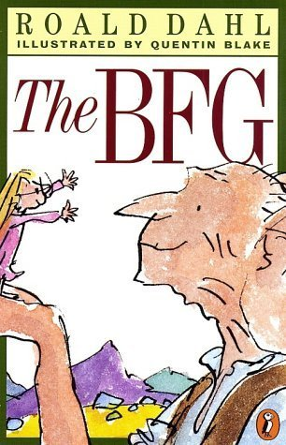
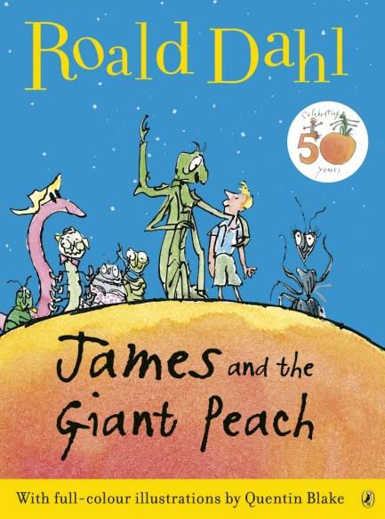
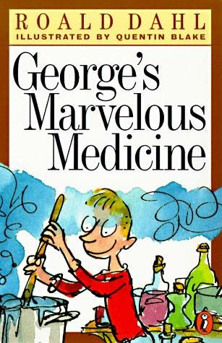
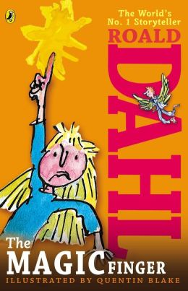
Here are some of his other books that involved people being either very small or very big.

Slide 25
The Minpins
Most things in life can be viewed from different points of view. It can be helpful to understand something if we can see it from different points of view.
Create a wanted poster about the Spittler/Gruncher that the minpins could put up on a tree offering a reward for its capture or death.
Then write a short conversation between the Spittler/Gruncher and its friend from a nearby forest about how awful the minpins are and why its trying to eat them.

Slide 26
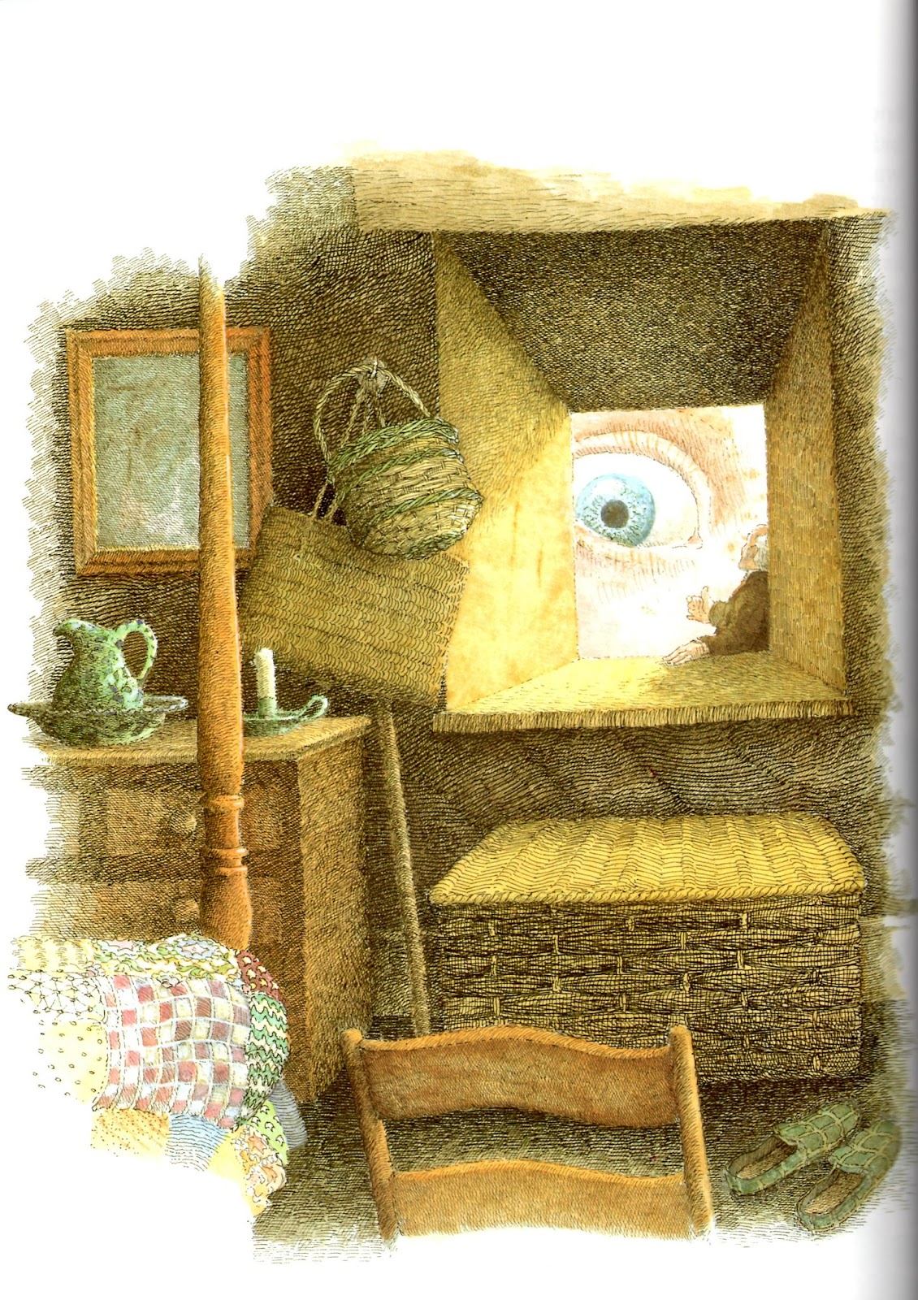
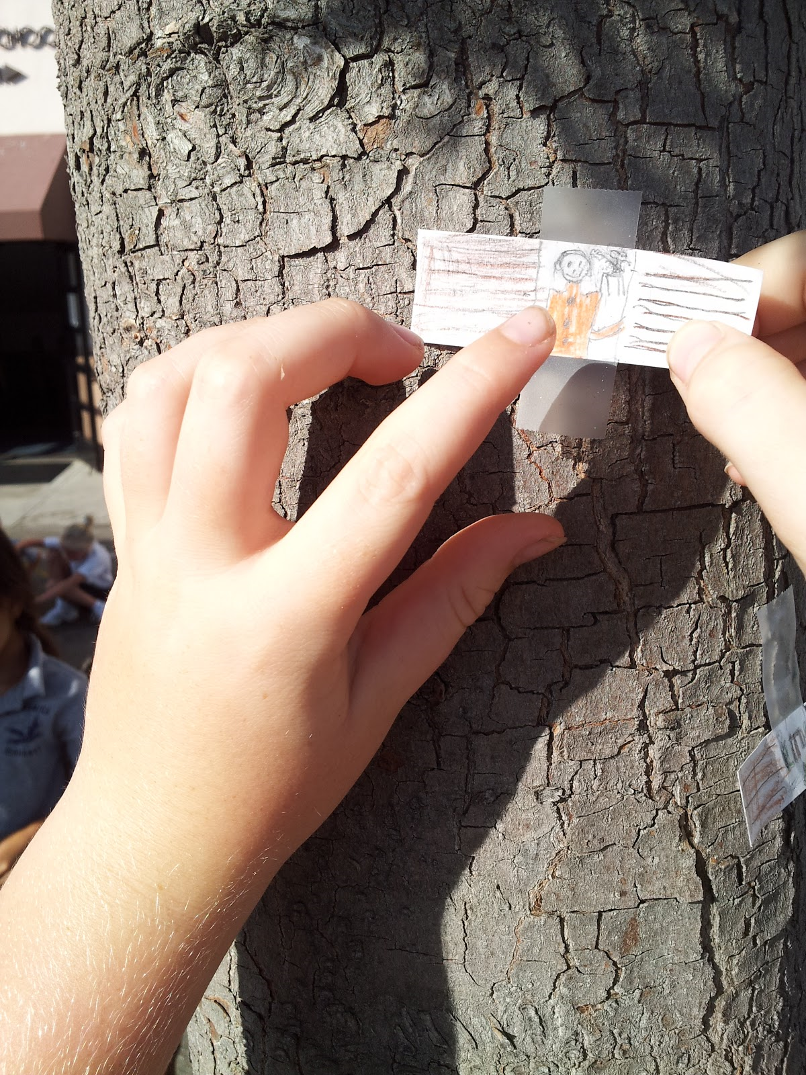
The Minpins
Make a tiny window to stick on a tree outside. Draw what you think you would see if you opened the window and looked inside.

Slide 27
‘Good’ Stories or Books
We make decisions all the time about what makes a book ‘good’ or not, but the simple answer comes down to ‘enjoyment’. If we enjoyed reading it, it was probably a ‘good’ book.
However when we judge whether a book is good or not there are some criteria we can use. A book is considered ‘good’ if it …
Has strong, believable characters who make us feel something and we can identify with them
Has an engaging story or yarn
Makes you think about ideas and characters, not just events
Show the characters grow or change through their experiences
Has rich and interesting language that challenges us just the right amount
Has interesting sentence and story structure
Is exciting, enticing or captivating (I can’t put it down!)
Teaches us something about ideas, the world, events, characters or ourselves without us really realising it
Has layers to it i.e. it’s more than just a simple telling of events
Makes us want to go and read more by the same author

Slide 28
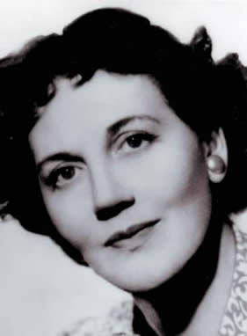
‘The Borrowers’ by Mary Norton
Mary Norton wrote a series of books about ‘the borrowers’, tiny people who lived unseen in our houses, and survived by ‘borrowing’ what they needed of the humans who lived in the house. The characters are delightful and the stories have been made into several films and television series. There is even an anime version, The Secret World of Arrietty.
Norton was born in London in 1903, and brought up in Bedfordshire, which was the setting for The Borrowers. In 1941 she was given a war job in America, and worked for two years for the British Purchasing Commission in New York. It was during this time that she began to write. After the war, she moved back to England with her family and continued writing and acting. Mary Norton died in 1992.
https://www.youtube.com/watch?v=poT-ioUgWHI

Slide 29
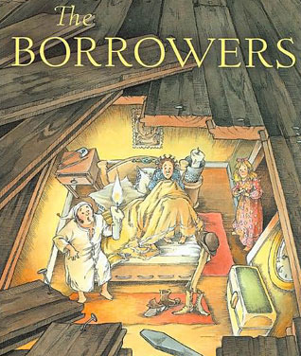
‘The Borrowers’ by Mary Norton
There is an old saying – ‘finders - keepers, losers – weepers’
What do you think this means? Discuss this with your teacher.
Do you think it is right? Is it ok to keep something if you find it?
The borrowers take things that don’t belong to them. Is this ok, or is it stealing? What about if people aren’t going to miss it – is that ok then?
Discuss this with your teacher.
Write a set of ‘rules’ to be a borrower.

Slide 30
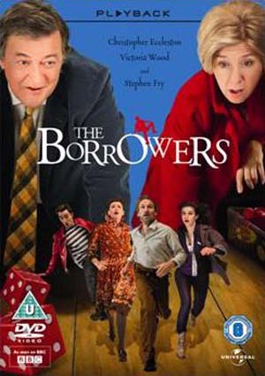
‘The Borrowers’ by Mary Norton
If your teacher shows you the film as well as episode 1 of the television series, compare the two, and look especially at how the characterisation might be different. Is Arrietty the same in both? Her parents?
Which did you prefer? Why?

Slide 31
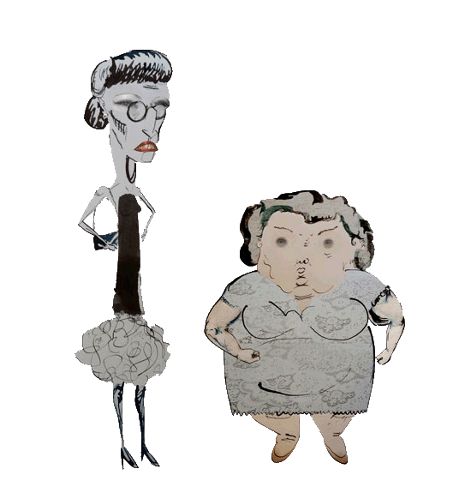
James and the Giant Peach by Roald Dahl
There have been a number of different versions made about this book also. The book itself is very entertaining and the films have been excellent.
Your teacher will show you the film, and again, think about characterisation and also what the writer/director does to keep you engaged in the story.
When you have finished watching, create a new ‘aunt’ for James, just as awful as Aunt Sponge and Aunt Spiker, and also a new creature he might have met in the giant peach. Make sure they are quirky and exciting.

