Slide 1
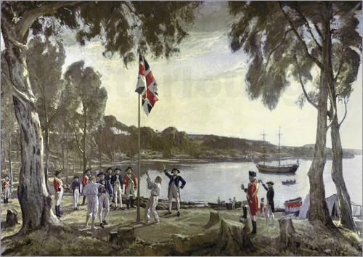
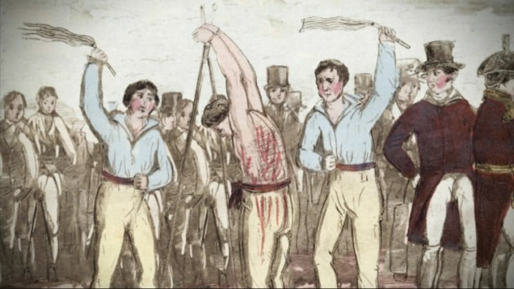
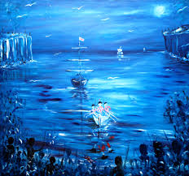
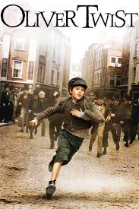
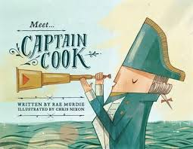
British Colonisation
Writing prompts
Leanne Williamson, 2015
Notes:
View for teaching notes:
http://www.google.com.au/url?sa=t&rct=j&q=&esrc=s&source=web&cd=2&cad=rja&uact=8&ved=0CDoQFjAB&url=http%3A%2F%2Fwww.randomhouse.com.au%2Fcontent%2Fteachers%2Fmeet%2520captain%2520cook.pdf&ei=PVHEVNOmJISg8QWT-4C4DA&usg=AFQjCNGRchI8fwrL3nbI4pOO4RQyZqC_gQ&bvm=bv.84349003,d.dGc

Slide 2
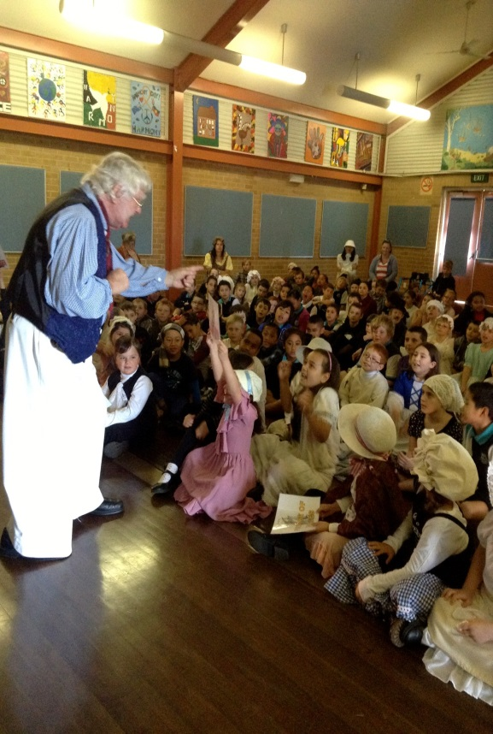
Colonial Day Incursion
Write a recount about our Colonial Day incursion.
Leanne Williamson, 2015

Slide 3
Oliver Twist
Found: https://www.youtube.com/watch?v=mIWmYGxd2AY
Write a story about what life was like for Oliver in England, 250 years ago.
Leanne Williamson, 2015

Slide 4
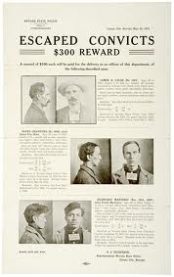
Wanted Poster……….
Design a wanted poster to catch an escaped convict.
Include: physical description with an accompanying picture or photograph, approximate age of the offender, summary of crimes committed, where he/she was last seen, reward offered and who to contact with information.
Found : Google Images
Leanne Williamson, 2015

Slide 5
Acrostic poem
Imagine you are one of the Aboriginal people in Syron’s painting watching from the shore as the European people row towards the land that has been inhabited by your people for thousands of years.
Write four words that describe how you feel as the boats approach the shore.
Select one of your words to use as the basis of an Acrostic poem.
Found : Google Images
Leanne Williamson, 2015
Notes:
In an Acrostic poem the first letter of each line forms a word. Write an Acrostic poem that tells about your feelings as you watch the Europeans approach and reflects the mood and story of Syron’s painting.
Remember you are writing from the perspective of an Aboriginal person watching the Europeans approach your land.
Use an interactive Acrostic poem tool or follow these steps to write an Acrostic poem:
Select one of the emotions you have identified.
Using a computer program or a pen and paper write the word down the side of a page
Use each letter as the start of a word or short phrase that tells more about how you would feel if you were one of the Aboriginal people in Syron’s painting. Your words might also capture ideas from Syron’s painting.
Colour the word you started with.
Here is an example of an Acrostic poem written in response to Syron’s painting. It began with the emotion of fear:
Frightened as I watch the red
Europeans moving through the blueness to my land.
Anger at my loss
Remembering the past.
Source: http://lrrpublic.cli.det.nsw.edu.au/lrrSecure/Sites/Web/13651/13657/convict_first_Aust_nw3.htm
Additional teaching notes can be sourced from: http://lrrpublic.cli.det.nsw.edu.au/lrrSecure/Sites/Web/13651/13657/index.htm

Slide 6
Sydney Cove, 1788
Tell the story about what was happening when this picture was taken.
Found : Google Images
Leanne Williamson, 2015

Slide 7
Literary Recount……….
Write a literary recount of “Meet Captain Cook”
A literary recount gives details about what happened, including who was involved, when and where the event took place, and what may have resulted.
Found : Google Images
Leanne Williamson, 2015
Notes:
What is a literary recount?
A literary recount is similar to a factual recount. Both types of recounts give details about what happened, including who was involved, when and where the event took place, and what may have resulted. A literary recount can be about real or fictional events and characters.
A literary recount is different from a factual recount because it includes more than just facts. A literary recount:
retells a series of events with characters
gives facts and feelings about the events
often uses dialogue between characters
creates an emotional connection with the reader
uses descriptive language.
Examples of a literary recount
Literary recounts include more emotional connections between the reader and the story than factual recounts. Some examples of literary recounts are:
short stories and novels
biographies and letters
fables, myths and legends
plays, films and television programmes
poems and songs
picture books.
Structure of a literary recount
A literary recount must begin with a title or a heading. The title should relate to the text, but can be creative.
The introductory paragraph is called the orientation. In this paragraph the setting and characters are introduced. This may also give the reader a general idea of what the text will be about, or may contain background information that helps to explain the first scene of the text.
The body of the text contains the sequence of events. The sequence of events is usually written in chronological order (the order they occurred). The purpose of these events is to tell the story. This includes what happened, how characters (or people) within the text felt about the events, and how any problems were dealt with.
The concluding paragraph is called the reorientation. This paragraph sums up the recount. This is where the sequence of events ends and any issues or problems are completely resolved by the characters. The emotional responses of the characters involved may also be included in this s
Source: http://www.skwirk.com/p-c_s-6_u-124_t-340_c-1179/WA/6/Literary-recountsLiterary-text-typesText-typesEnglish/

Slide 8
Fruity First Fleet Procedure
Write a procedure for Fruity First Fleet.
Found : Google Images
Leanne Williamson, 2015
Notes:
Make this with the students before they write about it.
Ingredients
30g (1/2 cup) alfalfa sprouts
1/4 rockmelon
3 thin slices of peeled pineapple
1 thin slice of watermelon
3 slices of unpeeled kiwifruit
Method
Divide alfalfa sprouts between serving plates. Cut rockmelon in half lengthways to make the boats. Scoop out seeds. Place each boat on the alfalfa. Cut pineapple in half and thread each onto a bamboo skewer. Insert the base of 3 skewers along the centre of each boat to make the sails. Cut watermelon into 6 small triangles. Stick onto the top of each skewer to make flags. Cut kiwifruit in half and stack at one end of each boat.
Sourced: http://www.taste.com.au/recipes/24053/fruity+first+fleet

Slide 9
What’s Australia Day all about?
Write about how you and your family Celebrate Australia Day.
http://splash.abc.net.au/media/-/m/598639/what-s-australia-day-all-about
Leanne Williamson, 2015
Notes:
Click on the hyperlink to watch the video first.

Slide 10
Australia Day advertisement….
Create your own advertisements for Australia Day
Leanne Williamson, 2015
Notes:
Click on the hyperlink to watch the video first.

Slide 11
Botany Bay….
Source: https://www.youtube.com/watch?v=aEYseM_R6Hk
Write in your own words what this song is about.
Leanne Williamson, 2015
Notes:
See the following websites for more information and resources:
http://alldownunder.com/australian-music-songs/botany-bay.htm
Definitions of Australian terms: rum culls - friends Old Bailey - famous English prison To cut a swell - to make a good impression a swell - well dressed person dookies - not a real word at all but from 'dukes'

Slide 12
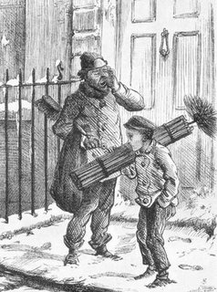
Young children shouldn’t be convicted of crimes!
What do you think about this statement? Write to persuade a reader to agree with your point of view.
Think about:
• if you agree or disagree or if you can see both sides of the topic
• an introduction – clearly say what you think about the topic
• your opinions – give reasons or examples to explain them and be persuasive
• a conclusion – a summary of your main points and a final comment on your opinion
Remember to:
• plan your writing before you begin
• make your writing interesting to read
• write in sentences and stay on the topic
• check your spelling and punctuation
• use words that will persuade your reader
• start a new paragraph for each new idea
• check and edit your writing when you are finished
Found : Google Images
Leanne Williamson, 2015

Slide 13
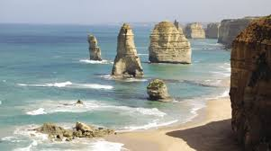
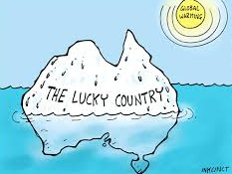
Australia is a great place to call home!
What do you think about this statement? Write to persuade a reader to agree with your point of view.
Think about:
• if you agree or disagree or if you can see both sides of the topic
• an introduction – clearly say what you think about the topic
• your opinions – give reasons or examples to explain them and be persuasive
• a conclusion – a summary of your main points and a final comment on your opinion
Remember to:
• plan your writing before you begin
• make your writing interesting to read
• write in sentences and stay on the topic
• check your spelling and punctuation
• use words that will persuade your reader
• start a new paragraph for each new idea
• check and edit your writing when you are finished
Found : Google Images
Leanne Williamson, 2015

Slide 14
A convicts life…….
Tell the story about what was happening when this picture was taken.
Found : Google Images
Leanne Williamson, 2015

Slide 15
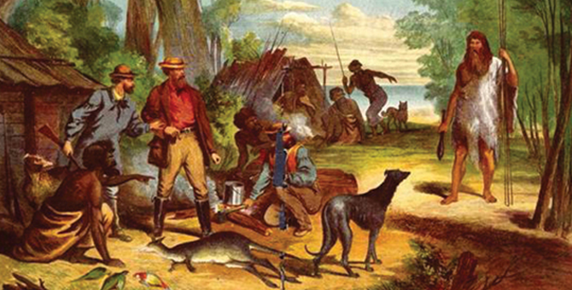
A diary entry…….
Found : Google Images
Write a diary entry from the perspective of a convict who has just arrived at the colony.
Leanne Williamson, 2015

Slide 16
Enora and the black crane
Found : https://www.youtube.com/watch?v=PeuAlybq0Po
Write a description of what life was like for Enora.
Leanne Williamson, 2015

