Slide 1
Chance
Stage 3, Year 6

Slide 2
Teaching and Learning Sessions
Can we determine the probability of an outcome occurring?
Can we determine the chance of an outcome occurring?
Can we describe probabilities using fractions, decimals and percentages?
Can we determine the probability of an event occurring and use fractions, decimals and percentages when examining probability? (Assessment- MA3-19SP)

Slide 3
1. Can we determine the probability of an outcome occurring?
At a birthday party Kaitlin conducted her own investigation into how the lollies were distributed. She found that each person’s lolly bag contained 20 lollies.
How many of each colour are in the bag?
Record the probability on a scale from 0/0% (impossible) to 1/100% (certain)
Use the information above to predict how many of each colour will be in the following bags:
If Stephen and Jane shared their bags of 20 lollies, how many red lollies would they have altogether?
If Krystal, Tanya and Mark shared their bags of lollies, how many green lollies would they have altogether?
If Mary, Emily, Jasper and Courtney poured their lollies into one big bag, how many blue lollies do you think they would find?
Altogether 20 lolly bags were filled. How many purple lollies do you think there were?

Slide 4
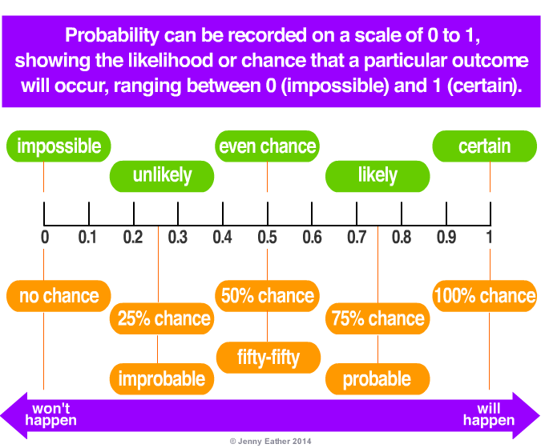

Slide 5
1. Can we determine the probability of an outcome occurring?
Jimmy has bought 100 rainbow ball lollies for his party. They only came in 4 colours. He put his hand in his bag and pulled out the following sample of 10 lollies.
Use the sample to predict how many lollies of each colour were in the bag.
If there was a bag of 500 lollies and Jimmy pulled out the same 10 lollies, how many of each colour do you think there would be in the bag?

Slide 6
2. Can we determine the chance of an outcome occurring?
As a class roll a large dice 10 times and record the observed frequency.
What was the probability of rolling each number as a fraction?
How do I determine the
expected frequency of a
number occurring?

Slide 7
2. Can we determine the chance of an outcome occurring?
Pair Task: Use two dice to determine the answer to the question: Which numbers are rolled most often?
List all the possible totals of the dice.
Determine the possible combinations that could be rolled to make a number. Does this increase the frequencies of some numbers being rolled more than others?
Write, as a fraction, the chance that the dice will have a total of
Use the answers to the question above to determine the expected frequency of rolling those numbers. (Probability x No. of repeats)
Roll two dice 50 times, recording the number of times each number from 2 – 12 is rolled, using tally marks.
Use your results to draw a column graph to show the (observed) frequency of the outcome
Compare your results to another pair →Use the See-Think-Wonder thinking routine to examine observed and expected frequencies: SEE: What similarities and differences do you notice? THINK: What does this make you think, in terms of frequencies and chance? WONDER: What questions does this data raise for you?
2 | 11 | 10 | 5
9 | 7 | 8 | 6

Slide 8
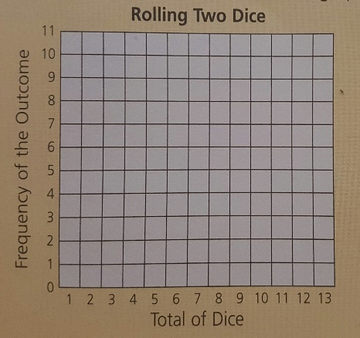

Slide 9
3. Can we describe probabilities using fractions, decimals and percentages?

Slide 10
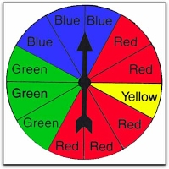
3. Can we describe probabilities using fractions, decimals and percentages?
What is the probability that I will land on each of these colours, as a fraction ?
What is the probability that I will land on each of these colours, as a decimal?
What is the probability that I will land on each of these colour, as a percentage?

Slide 11
3. Can we describe probabilities using fractions, decimals and percentages?

Slide 12
4. Can we determine the probability of an event occurring and use fractions, decimals and percentages when examining probability? (Assessment- MA3-19SP)
→Create a spinner using 4 colours that have an unequal chance of occurring when spun.
→Calculate the probability of each colour being spun, as a fraction, decimal and percentage.
→Use the formula (Probability x No. of repeats) to determine the expected frequency over 20 spins.
→Spin the spinner 20 times and record the observed frequencies of each colour.
→Graph the expected results and the observed results using a side-by-side column graph.
→Compare the results and explain the differences in data using the See-Think-Wonder thinking routine to assist:
SEE: What similarities and differences do you notice?
THINK: What does this make you think, in terms of frequencies and chance? WONDER: What questions does this data raise for you?

