Slide 1
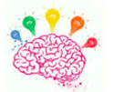
Activating Prior Knowledge
I can use what I already know to help me understand something new.
I can think about what is going to happen based on what I already know and what I have read.
Gayle Pinn

Slide 2
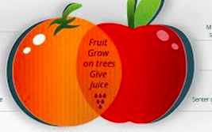
Compare and contrast
I can identify what is the same and what is different.
Gayle Pinn

Slide 3
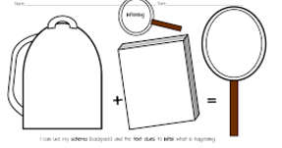
Inferring
I can use clues to find out what the author really means
Gayle Pinn

Slide 4
Determining Importance
I can making judgements about what I have read and explain why.
Gayle Pinn

Slide 5
Keywords and phrases
I can find the most important words or phrases to summarise the text
Gayle Pinn

Slide 6
Making Connections
I can make connections between what I know to what I have read.
Gayle Pinn

Slide 7
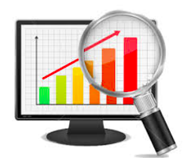
Monitoring
I can stop to think about what I am reading.
I can choose a strategy to help me when I do not understand.
Gayle Pinn

Slide 8
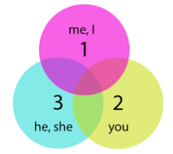
Point of View
I can identify if the story is being told from the first second or third person.
Gayle Pinn

Slide 9
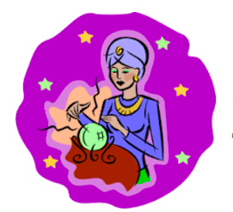
Predicting
I can use information from what I know and from illustrations, graphics and text to anticipate what will be read/ viewed/heard.
Gayle Pinn

Slide 10
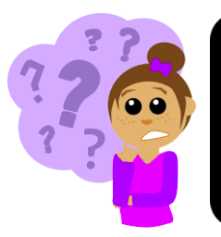
Questioning
I can ask questions to understand what I am reading.
Gayle Pinn

Slide 11
Sequencing
I can sequence events to help me create a picture of what is happening and when.
Gayle Pinn

Slide 12
Summarising
I can identify the most important points and restate them in my own words.
Gayle Pinn

Slide 13
Synthesising
I can put the pieces together and see them in a new way.
Gayle Pinn

Slide 14
Visualising
I can create a movie or picture in my mind while I am reading.
Gayle Pinn

Slide 15
Vocabulary Development
.
I use the sentence to work out the meaning of new words.
I know that words may have lots of meanings.
Gayle Pinn

Slide 16
Icons
Activating Prior Knowledge
Compare and contrast
Determining Importance
Inferring
Keywords and phrases
Making Connections
Monitoring
Point of View
Gayle Pinn

Slide 17
Icons
Predicting
Questioning
Sequencing
Summarising
Synthesising
Visualising
Vocabulary Development
Gayle Pinn

