Slide 1
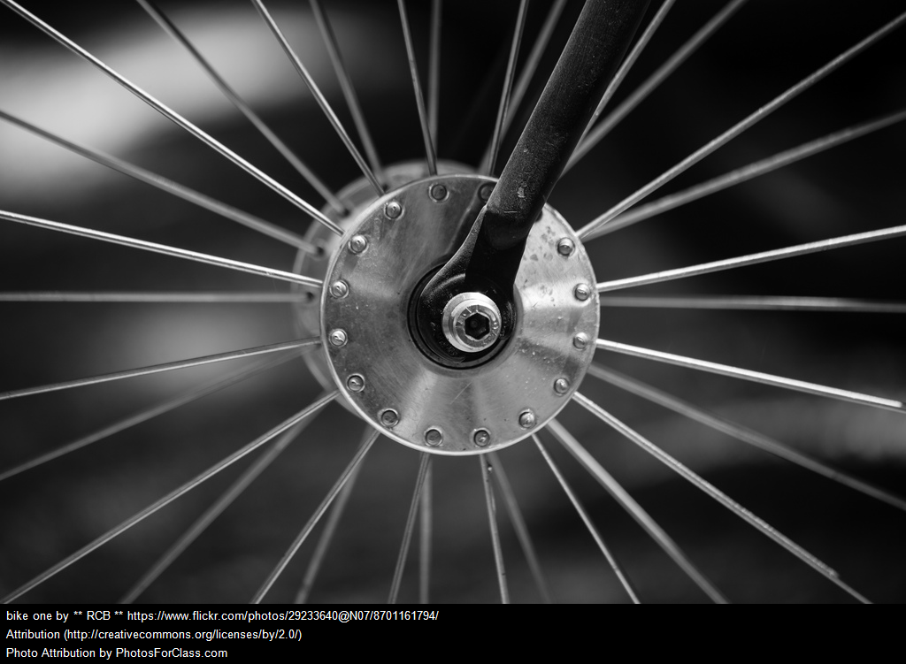
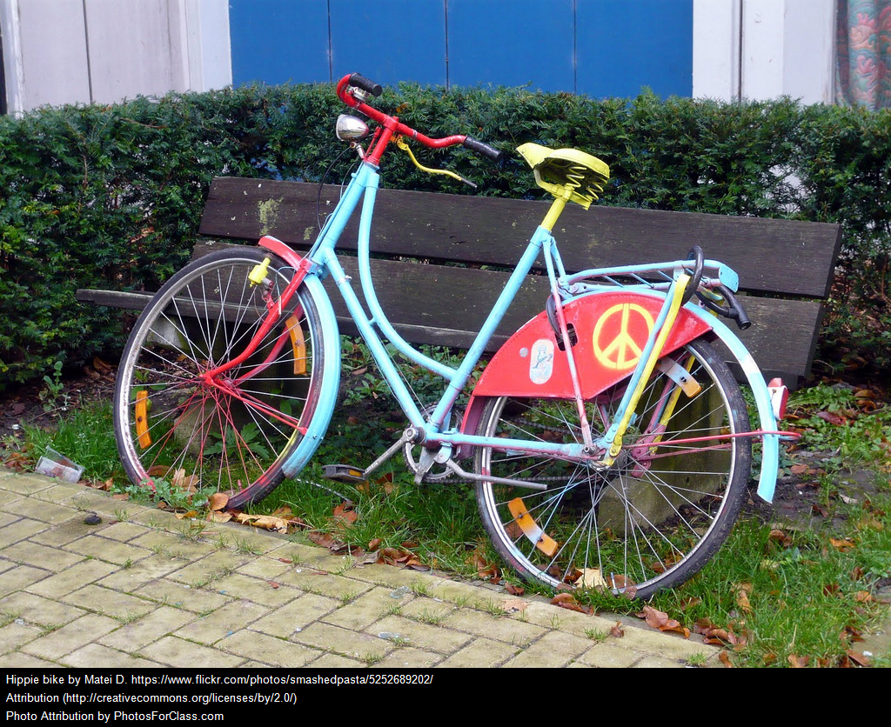
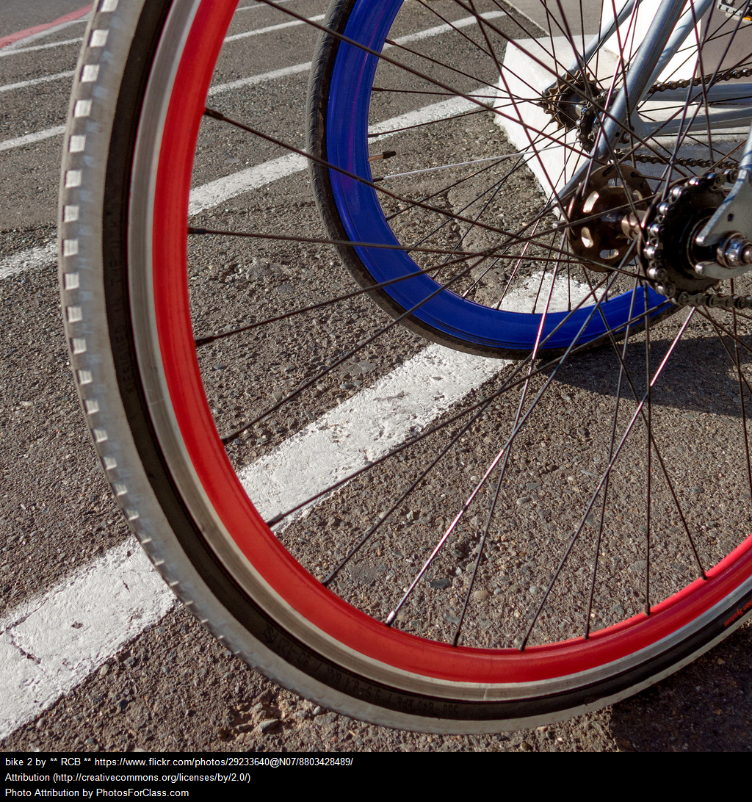
Title of Book
Instructions:
1. Change the design for this presentation.
2. Create images for your work in google drawing.
3. Replace all blue writing with appropriate text.
4. Write your own WALT and Success Criteria (WILF) for this book. There is to be a maximum of two.
5. You can choose your own font but make sure that it is legible.
Venn Diagrams
Author
WALT: e.g Compare arguments for and against.
WILF: e.g create a venn diagram to show ideas for an against an idea.
WALT: e.g.Understand and create an infographic
WILF: e.g.Explain how we can minimise risk in an infographic.
Notes:
Instructions:
1. Change the design for this presentation.
2. Create images for your work in google drawing.
3. Replace all blue writing with appropriate text.
4. Write your own WALT and Success Criteria (WILF) for this book. There is to be a maximum of two.
5. You can choose your own font but make sure that it is legible.

Slide 2
Venn Diagrams
A Venn Diagram is a type of graphic organizer that uses overlapping circles to visually represent things that are the same among sets of information.
The Venn diagram you will be designing will be to show characteristics or information that is the same in your book or characters.
You can use two or more circles; the spaces that don't overlap contain unique details about one book or character. The space where the circles overlap contains information that is the same for each circle.

Slide 3
Venn Diagrams
Go to Venn Diagrams.
Create a Venn Diagram.
Write details that tell how the subjects are different in the outer circles.
Write details that tell how the subjects are alike where the circles overlap.
Insert your completed one on the other half of the page.

Slide 4
Instructions:
1. Create a venn diagram about different types of bikes
2. Decide on your headings.Decide on how many interconnecting shapes you will be using.
3. Replace all blue writing with appropriate text.
4. You can either keep these colours or you can alter them.
Make sure you use the custom colour option to ensure that the second oval is transparent enough to allow the first oval to be seen.
5. You can choose your own font but make sure that it is legible.
A title for your diagram
Notes:
Instructions:
1. Create a venn diagram of different types of Buggies.
2. Decide on your headings.Decide on how many interconnecting shapes you will be using.
3. Replace all blue writing with appropriate text.
4. You can either keep these colours or you can alter them.
Make sure you use the custom colour option to ensure that the second oval is transparent enough to allow the first oval to be seen.
5. You can choose your own font but make sure that it is legible.

Slide 5
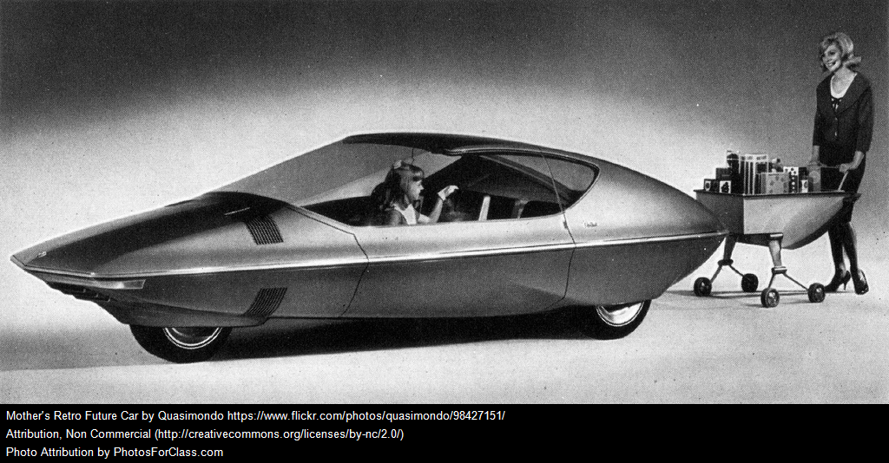
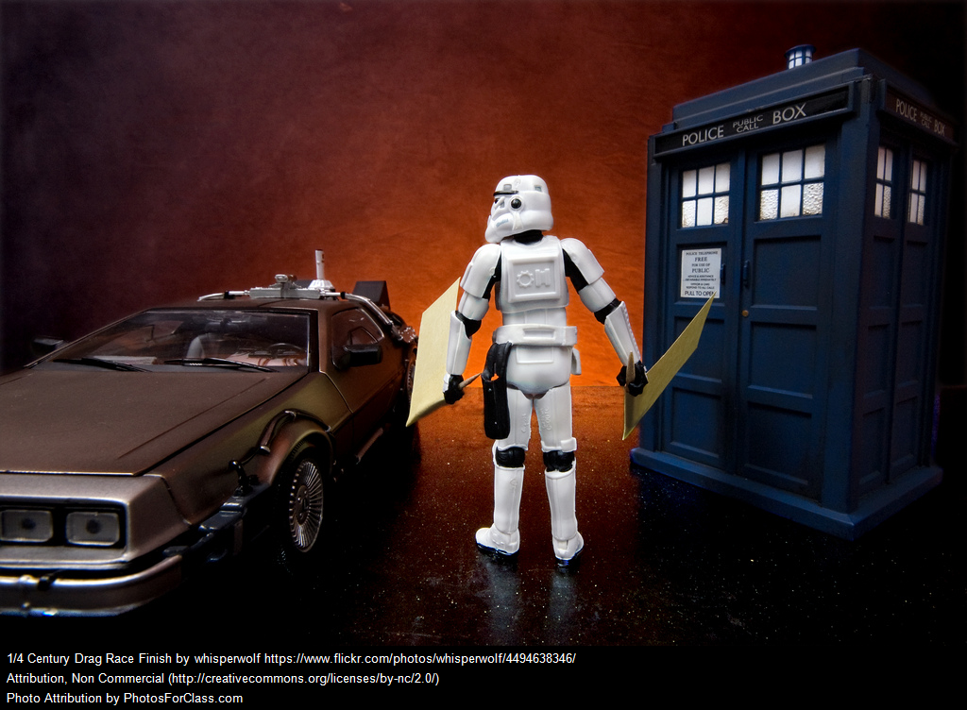
Design a Machine For the Future
Design your own Machine For the Future
1. Brainstorm a list of features for your Machine for the Future.
Remember to think about how it will be powered.
2. Using your best features from the list, draw a diagram of the
machine.
Add labels to explain each feature.
3. Write a list of items you would need before you could build your machine of the future.
4. Use either Minecraft or Lego design to create your design.
5. Take a screenshot and insert on a Poster for your Future Machine.
Notes:
You can make a sketchnote of your design.

Slide 6
Title:
Instructions:
1. Design a machine of the Future.
2. Design one in google drawing or Canva or any other program and insert on this page.
3.. You can choose your own font but make sure that it is legible.
Design a machine of the future, label its features, and give it a title.
Notes:
Instructions:
1. Design a machine of the Future.
2. Design one in google drawing or Canva or any other program and insert on this page.
3.. You can choose your own font but make sure that it is legible.

Slide 7
Glossary Key vocabulary I have learned while reading this text.
Throughout the story, specialised vocabulary associated with bikes is used.
Instructions:
1. Create a Glossary for your book. If you need to duplicate this page
2. Choose at least 10 interesting words with 6 of them being specialised vocabulary about bikes-from your reading.
3. Insert a table with enough columns and rows to enable you to make a glossary that has the following criteria:
*Write the word,
*your definition of the word
*what page it can be found.
* diagram
4. You can choose your own font and colour but make sure that it is legible.
Notes:
Throughout the story, specialised vocabulary associated with bikes is used.
Instructions:
1. Create a Glossary for your book. If you need to duplicate this page
2. Choose at least 10 interesting words with 6 of them being specialised vocabulary about bikes-from your reading.
3. Insert a table with enough columns and rows to enable you to make a glossary that has the following criteria:
*Write the word,
*your definition of the word
*what page it can be found.
* diagram
4. You can choose your own font and colour but make sure that it is legible.

