Slide 1
Reading Strategies
Answer the questions in the picture by adding a comment.
Try not to read other peoples comments.
Drawing Conclusions

Slide 2
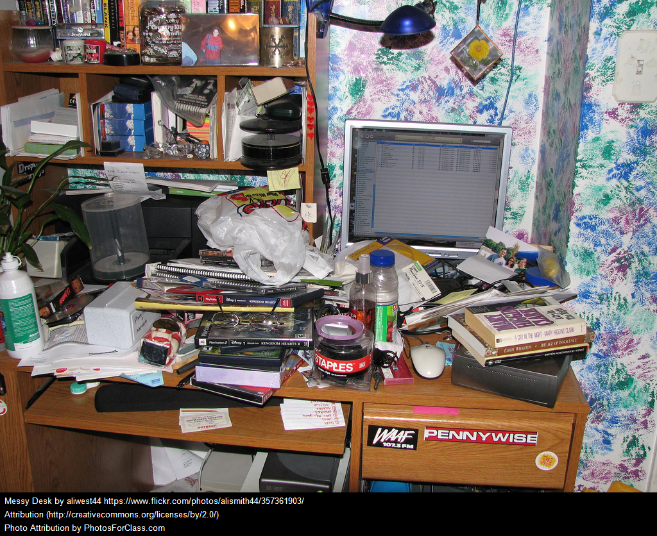
Drawing Conclusions:
When you look at this picture, what conclusions can you draw about the person who works at this desk.
Add your thoughts in the comment box.

Slide 3
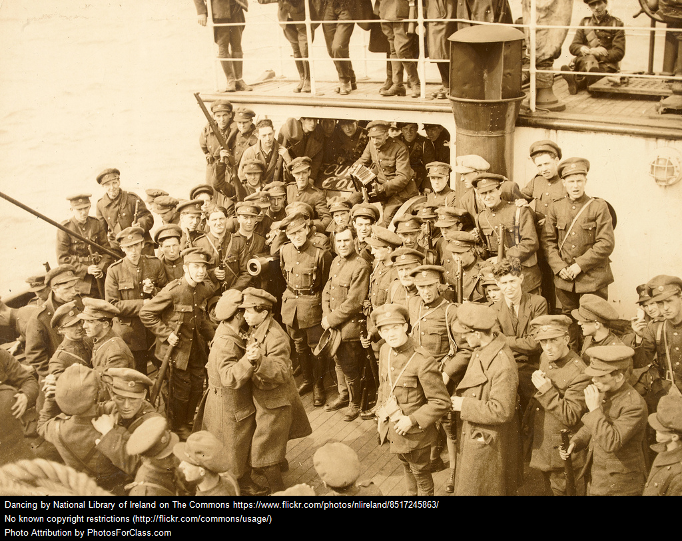
Drawing Conclusions:
When you look at this picture, what conclusions can you draw about what is happening?
Add your thoughts in the comment box.

Slide 4
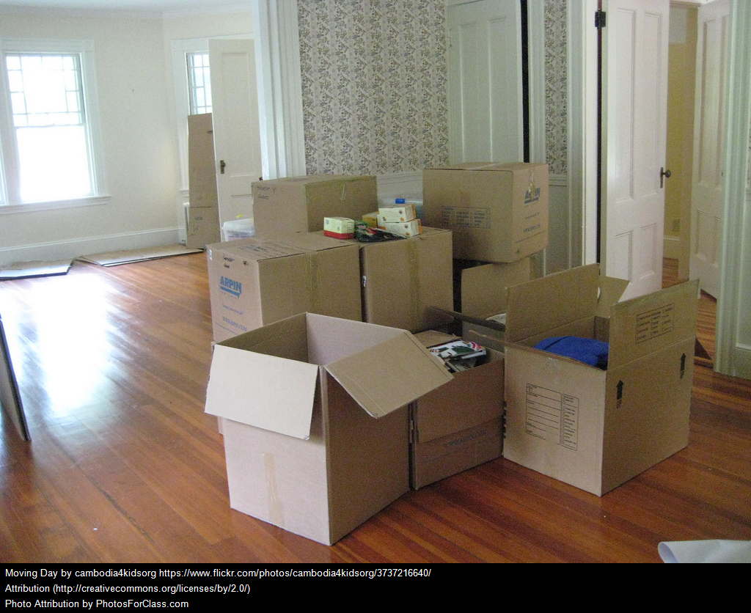
Drawing Conclusions:
When you look at this picture, what conclusions can you draw about what is happening?
Add your thoughts in the comment box.

Slide 5
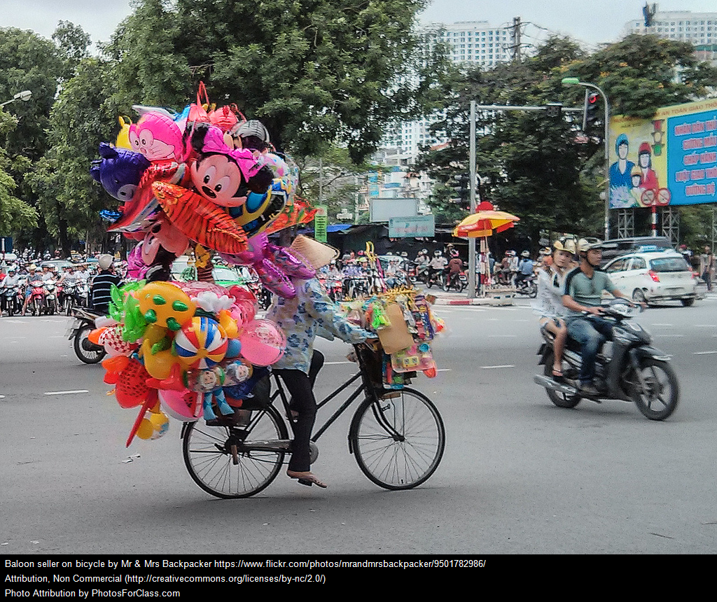
Drawing Conclusions:
When you look at this picture, what conclusions can you draw about what is happening?
Add your thoughts in the comment box.

Slide 6
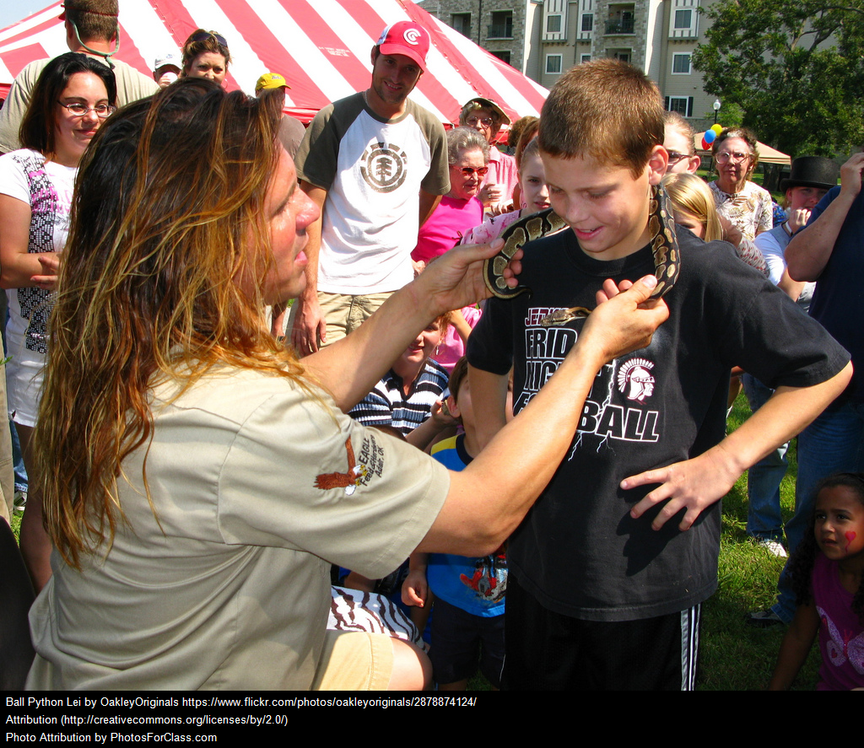
Drawing Conclusions:
When you look at this picture, what conclusions can you draw about how the boy feels?
Add your thoughts in the comment box.

Slide 7
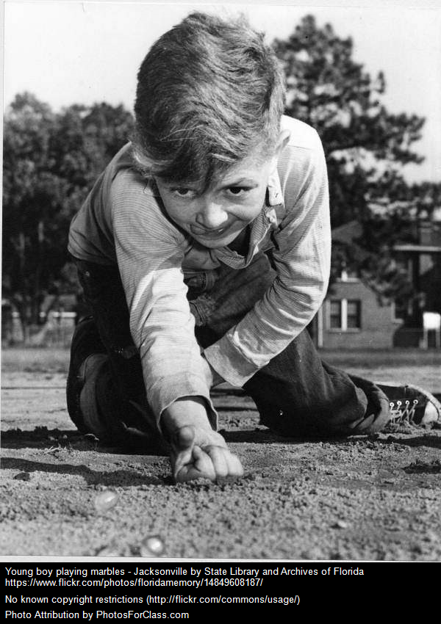
Drawing Conclusions:
When you look at this picture, what conclusions can you draw about why this boy is sticking his tongue out?
Add your thoughts in the comment box.

Slide 8
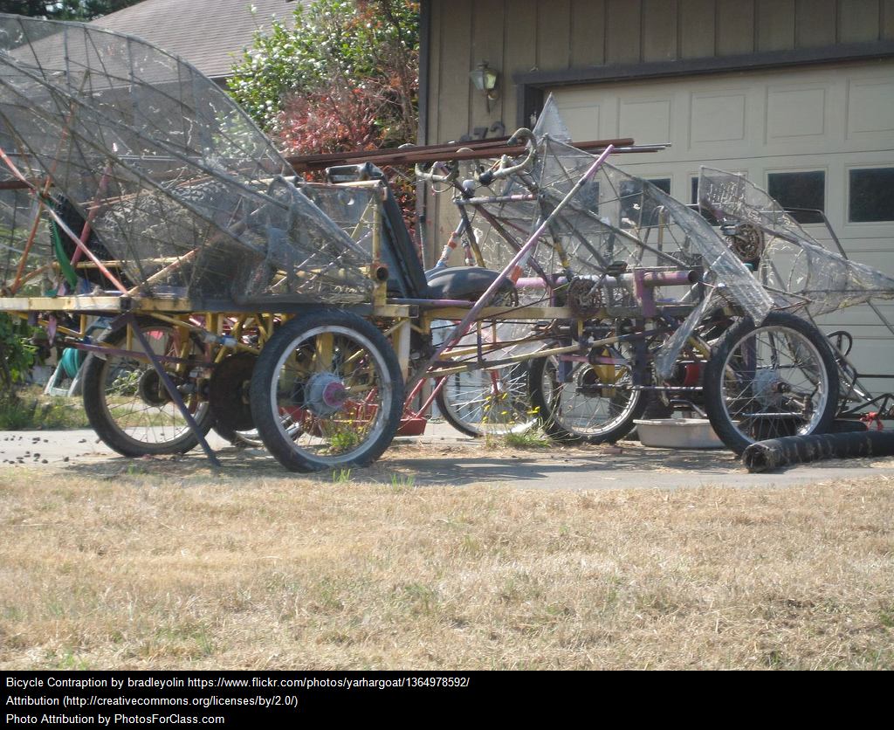
Drawing Conclusions:
When you look at this picture, can you decide what the purpose is?
What in the picture leads you to believe that?
Add your thoughts in the comment box.

Slide 9
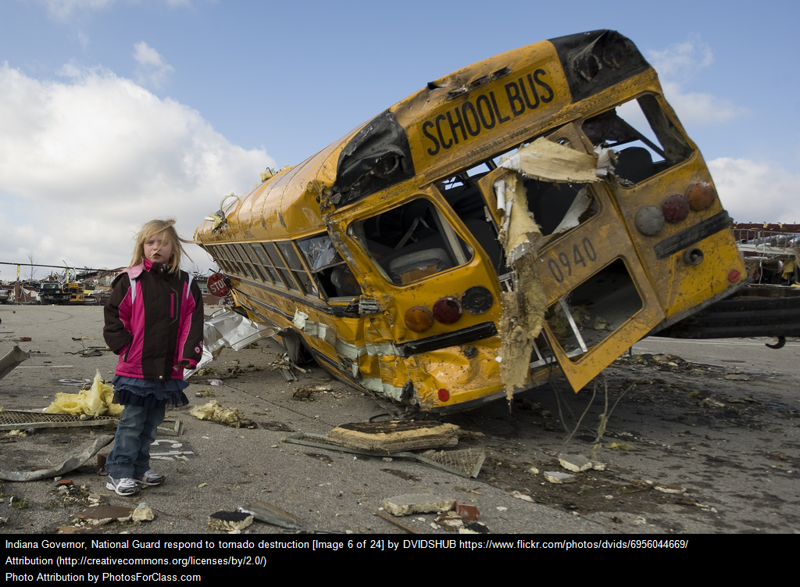
Drawing Conclusions:
When you look at this picture, can you decide what is going on? How do you know?
Add your thoughts in the comment box.

Slide 10
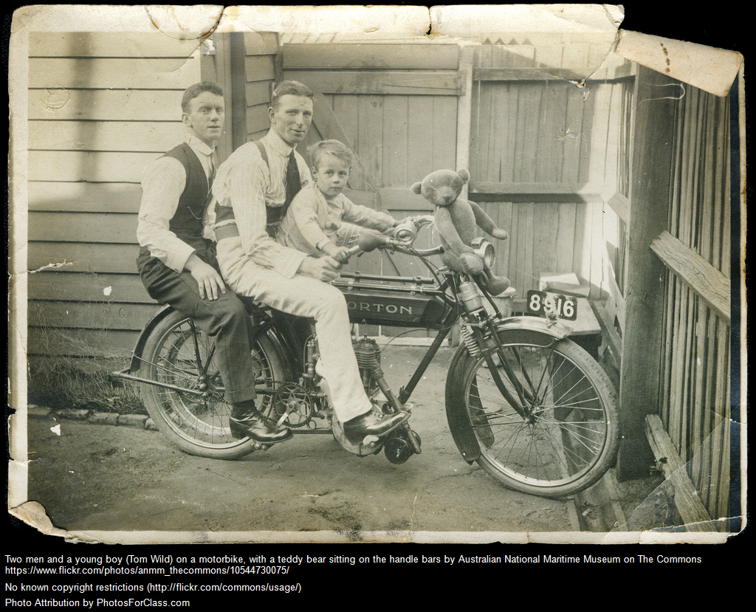
Drawing Conclusions:
When you look at this picture, can you decide what is going on? How do you know?
Add your thoughts in the comment box.

