Slide 1
Welcome to Google Classroom and what you can do .
Steph Westwood 2016
Steph Westwood 2016

Slide 2
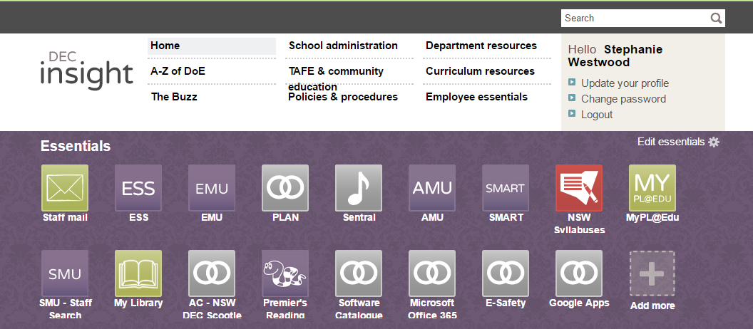
To get into Google Classroom (or Docs, forms etc) click here.
If you don’t have ‘Google Apps’, click here to add it to your essentials. Or go into My Learning tools and add to ‘My Essentials’ from there.
Steph Westwood 2016

Slide 3
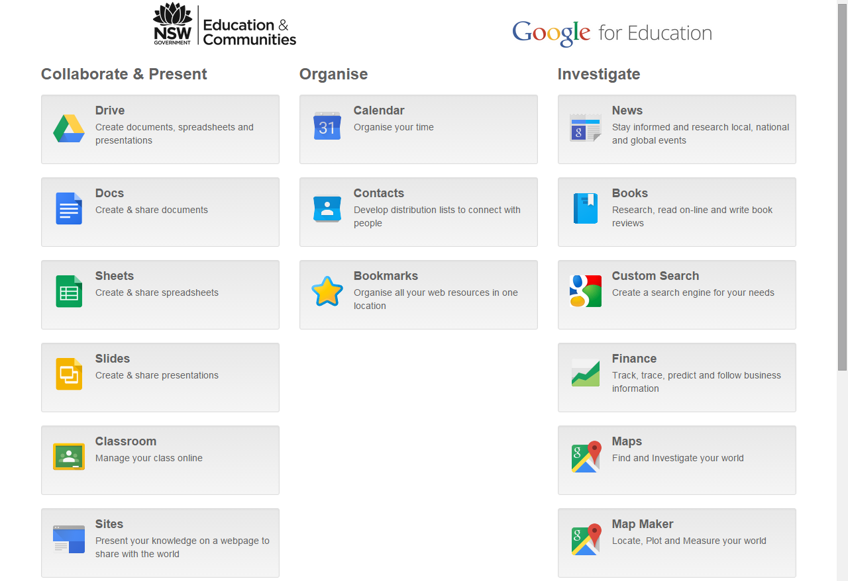
Here is Google Classroom
When you click on Google Apps, this is what you will see.
It is here that you can access Classroom or any other Google App.
Steph Westwood 2016

Slide 4
Click here to add a new class
Steph Westwood 2016

Slide 5
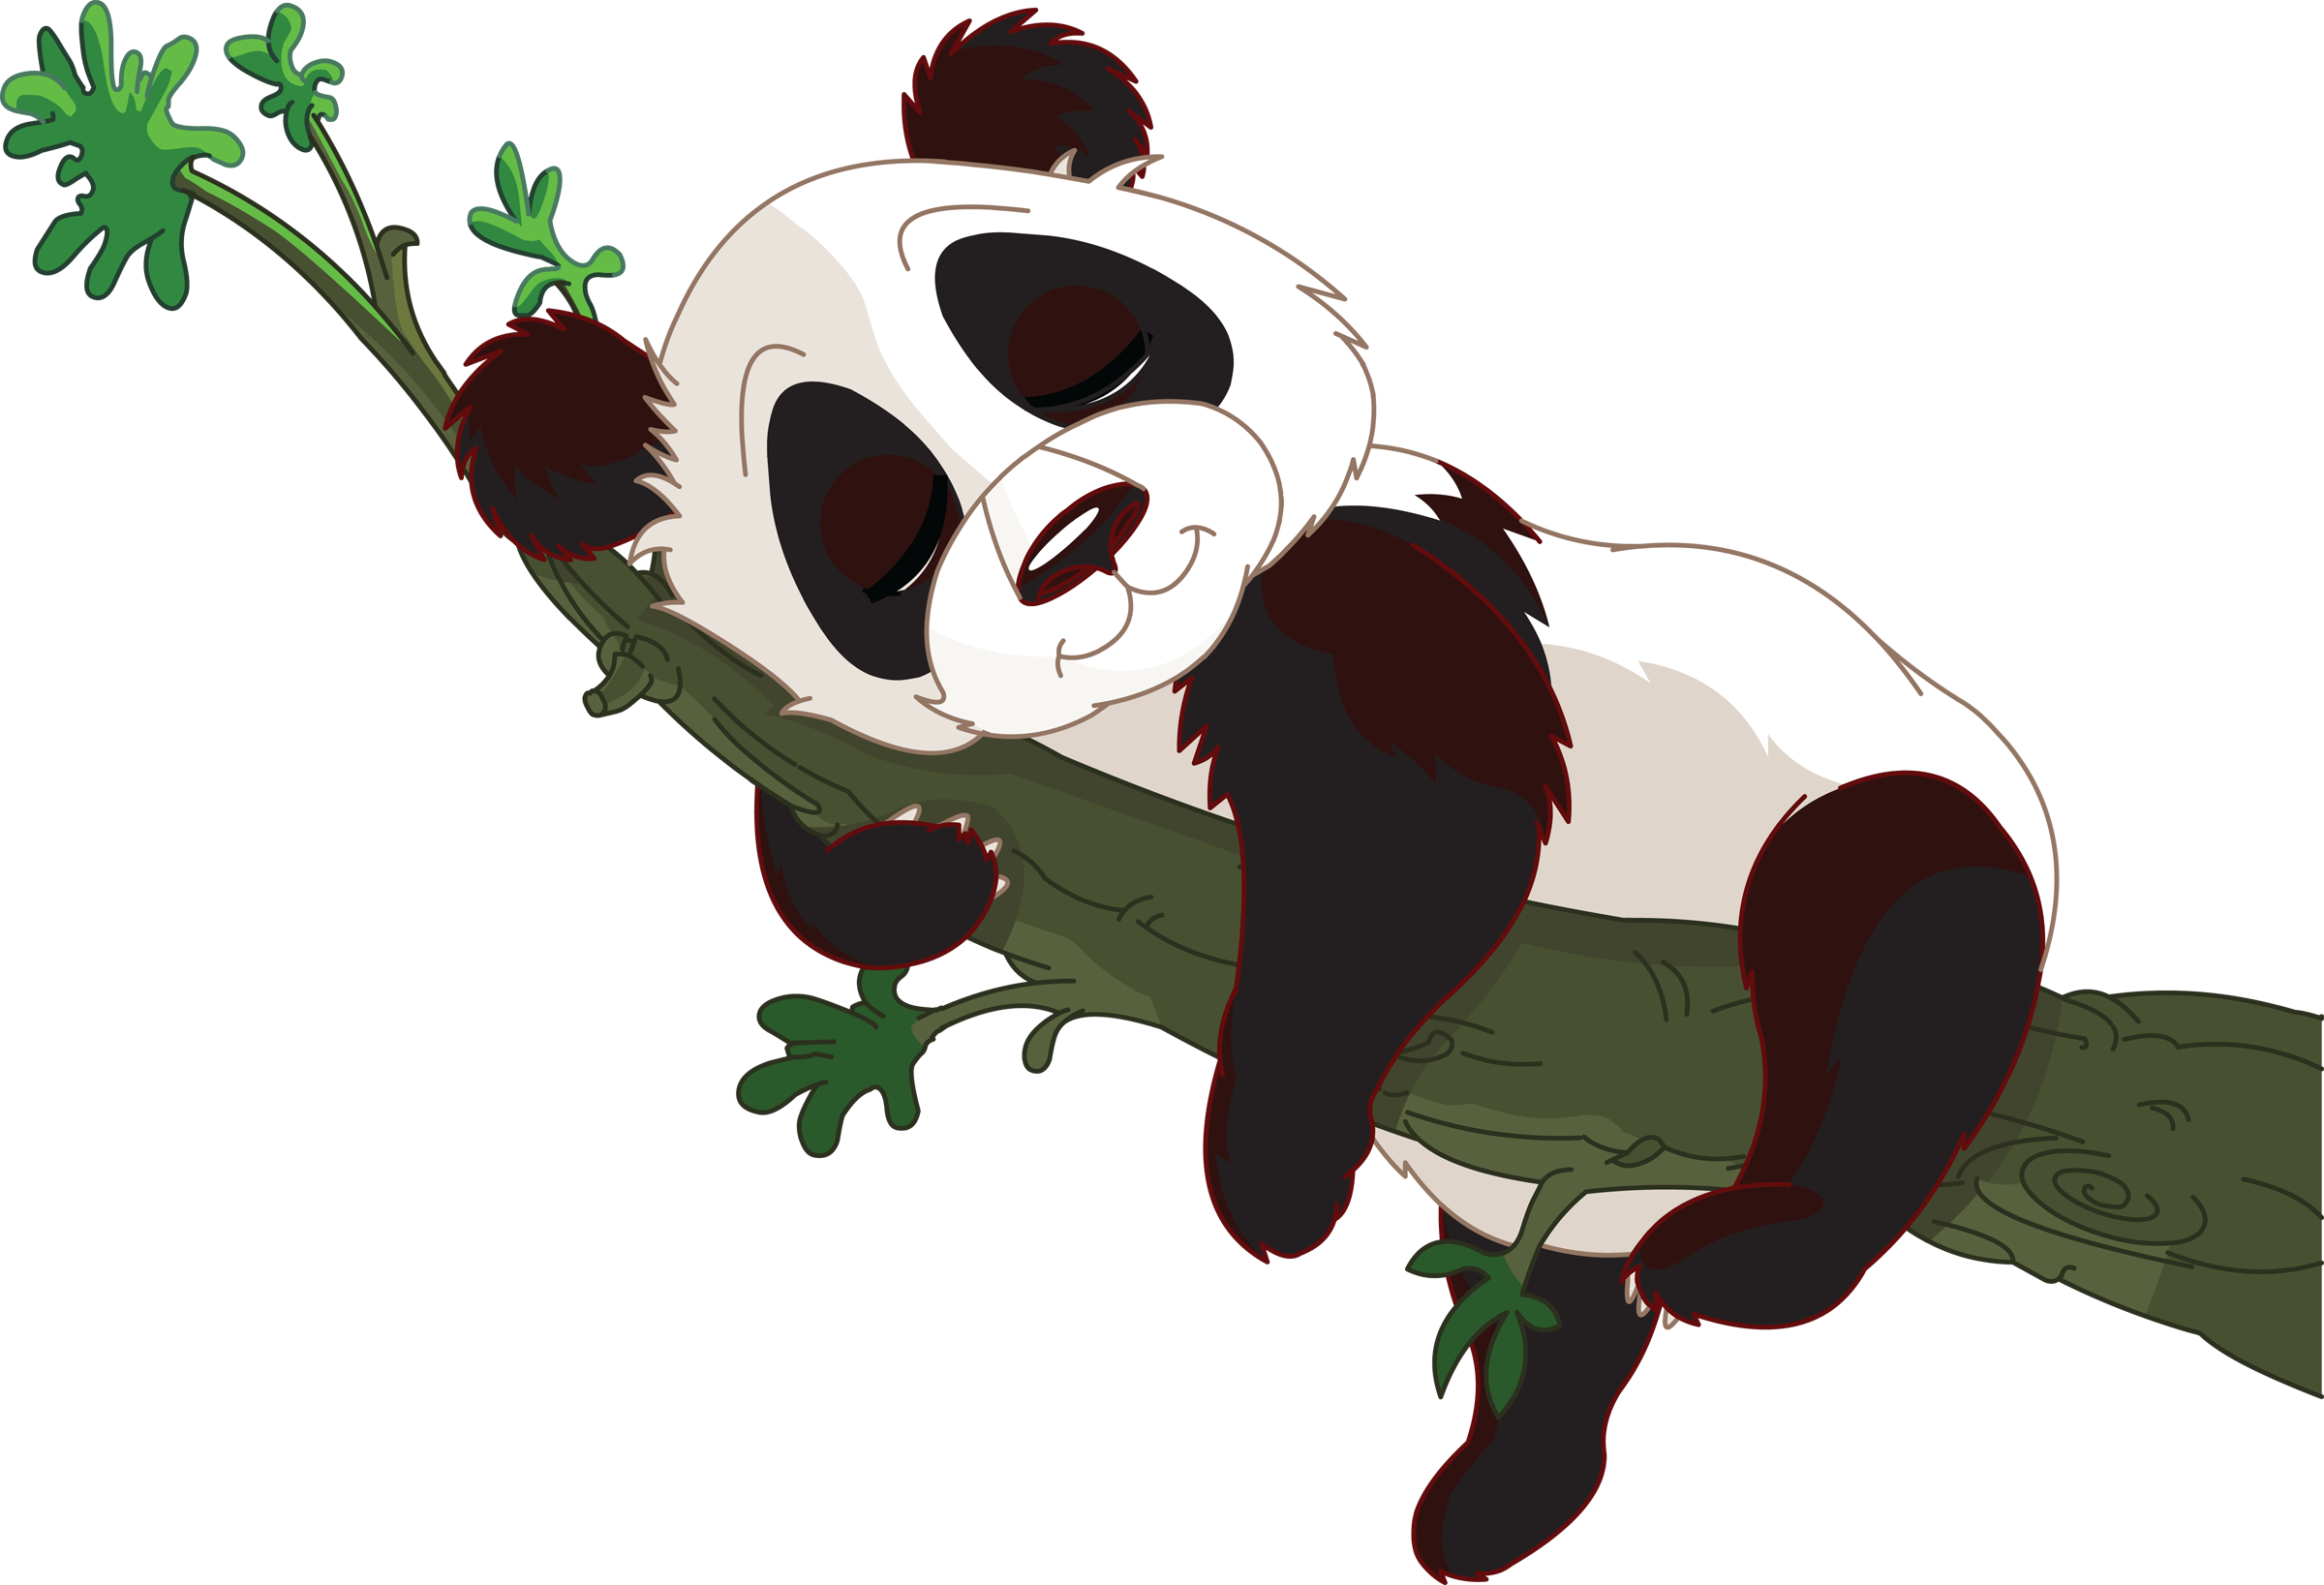
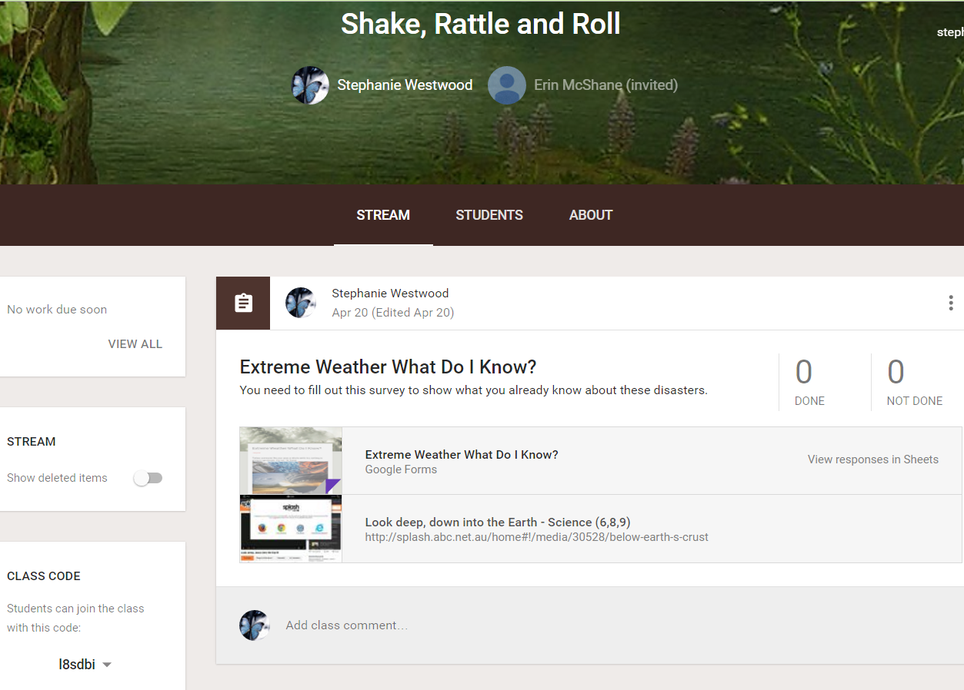
*The code is found in YOUR google classroom
This is the code your students need to join your classroom. I generally write it on a whiteboard or have it written on small cards that the students share. Once students have joined they don't need to join again.
Steph Westwood 2016

Slide 6
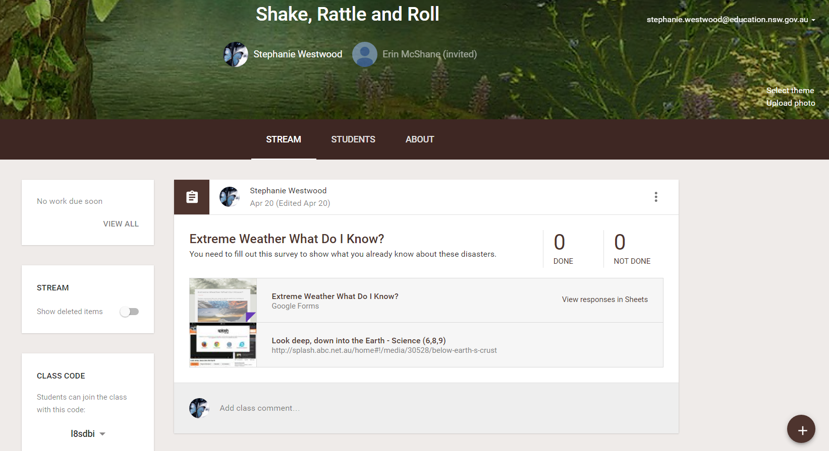
If you don't like the theme
of the classroom it is easily changed.
Click here to
change your ‘theme’
This button adds items to your ‘stream’. You can add announcements, assignments etc.
Steph Westwood 2016

Slide 7
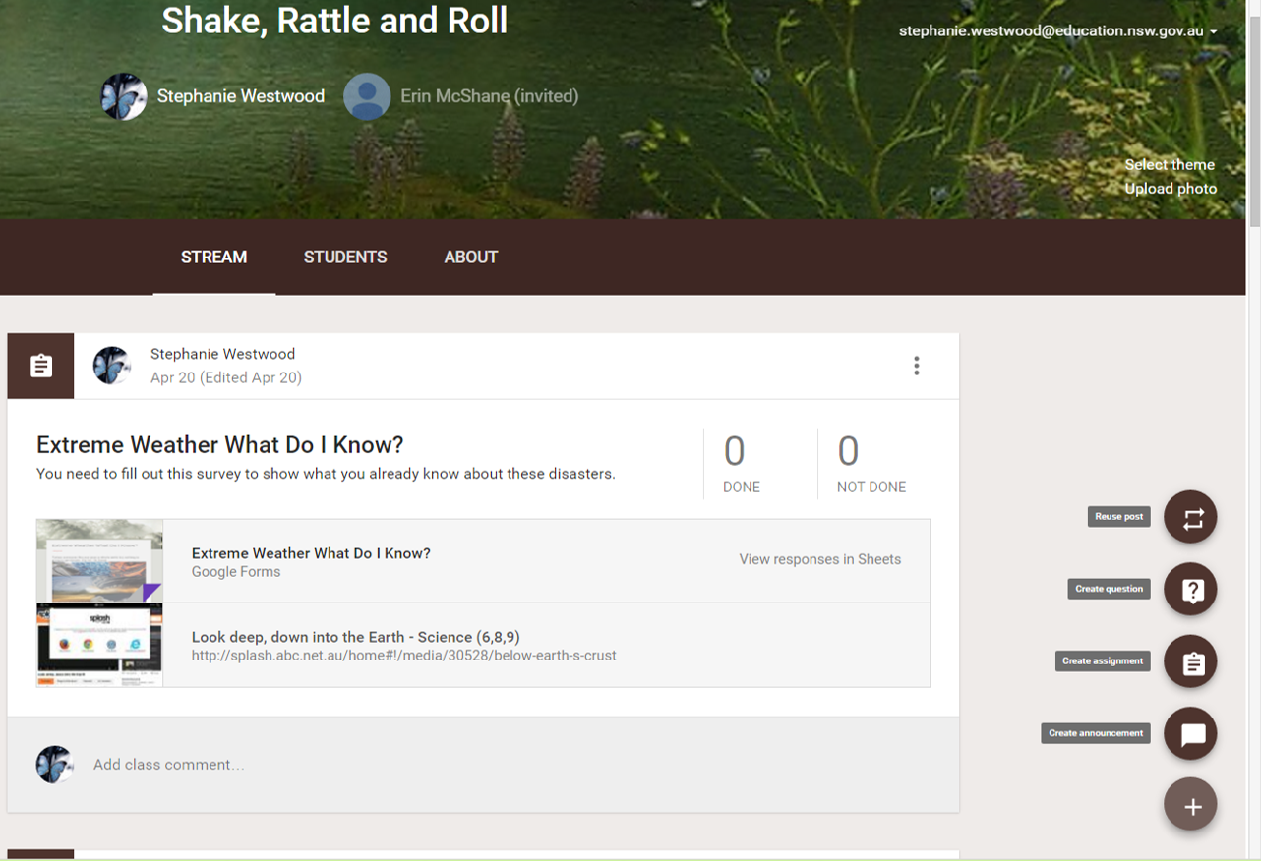
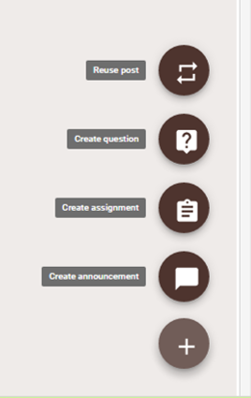
These are your different options for what you would like to add to your Classroom.
Steph Westwood 2016

Slide 8
How do I add an assignment? You need to click on the plus sign to open the menu. Click on the create assignment.
Steph Westwood 2016

Slide 9
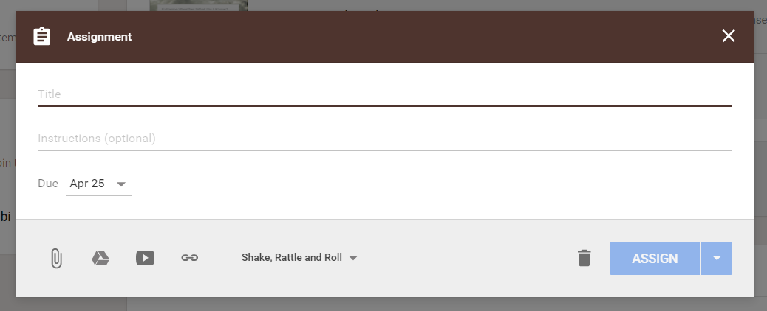
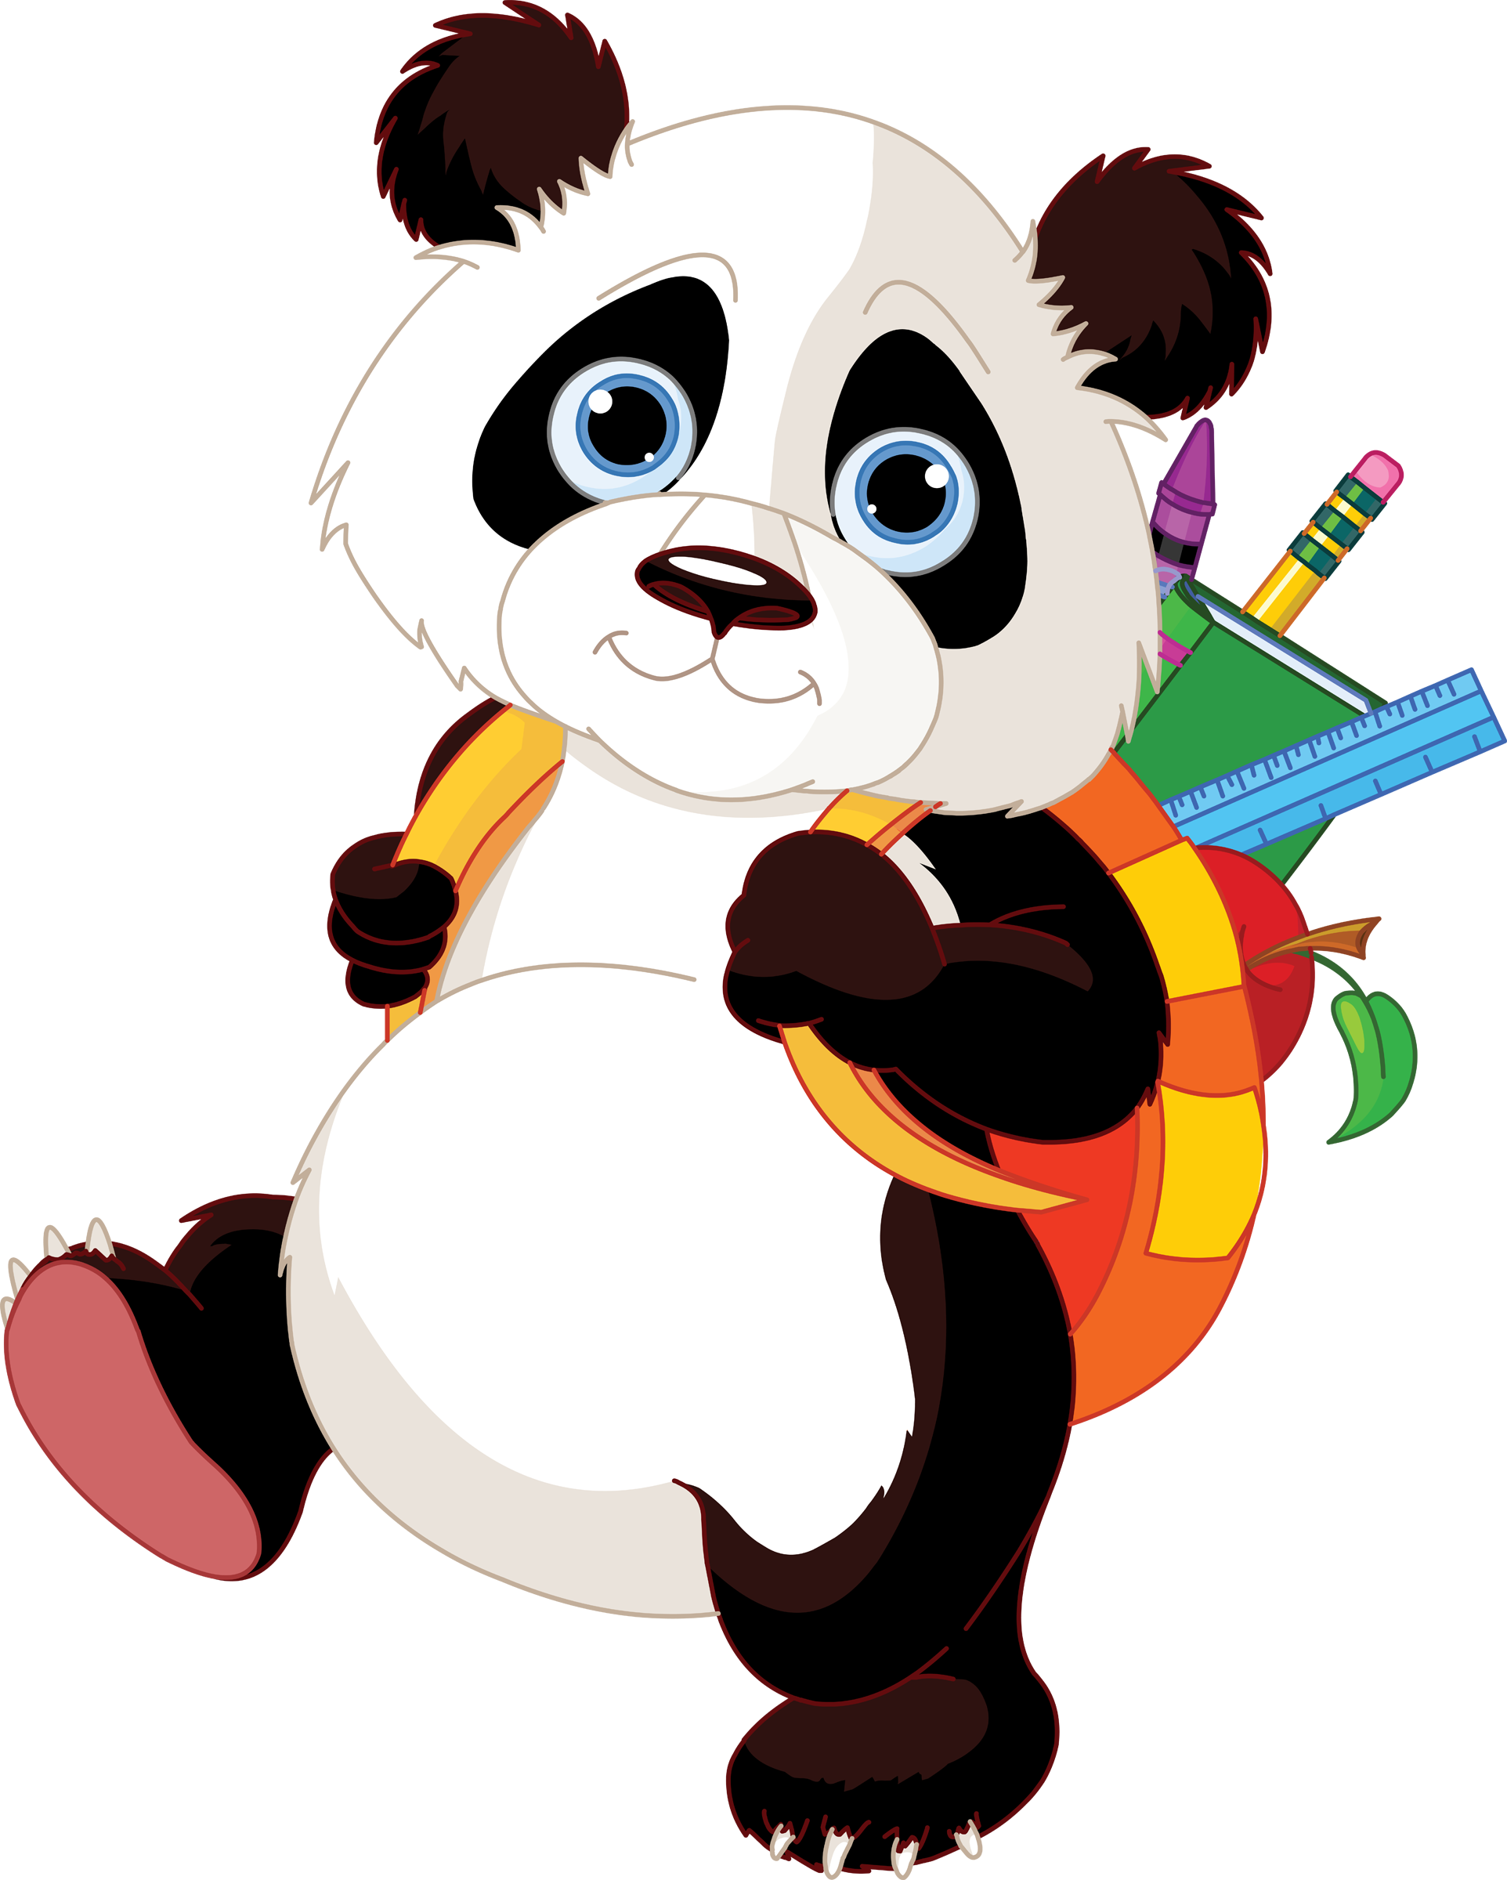
*Give the assignment a title.
Sometimes a great idea to number them.
*Write out instructions if they are needed
*You can add a due date. This will bring up a calendar from which you can choose a date.
*Youtube button. Click here to attach a youtube video.
*Link button. Click here to attach a website URL.
*This paperclip is the attach button. Click here to attach something that is not in your google drive.
*Drive button. Click here to attach something that is in your google drive.
Steph Westwood 2016

Slide 10
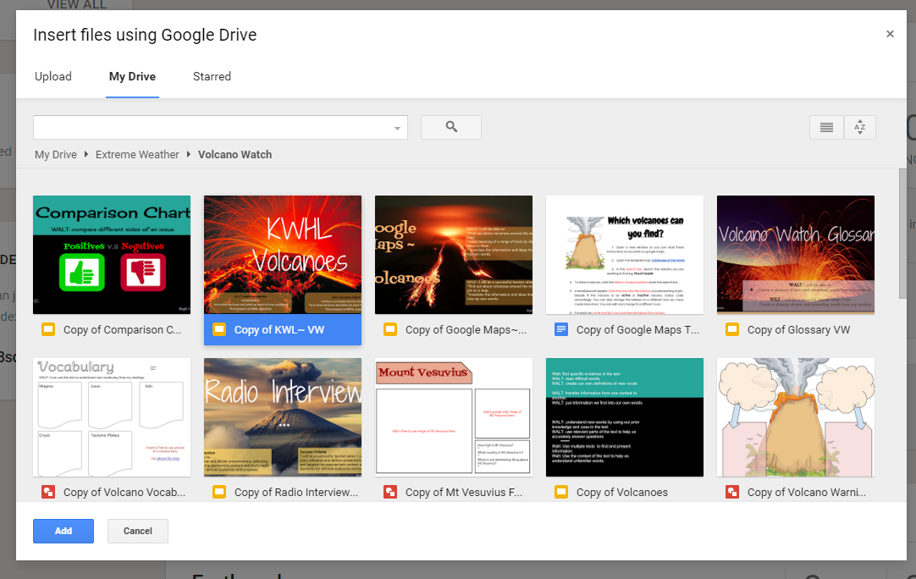
*Choose which file you would like to assign to the students. THen click add.
*Drive button. Click here to attach something that is in your google drive.
Steph Westwood 2016

Slide 11
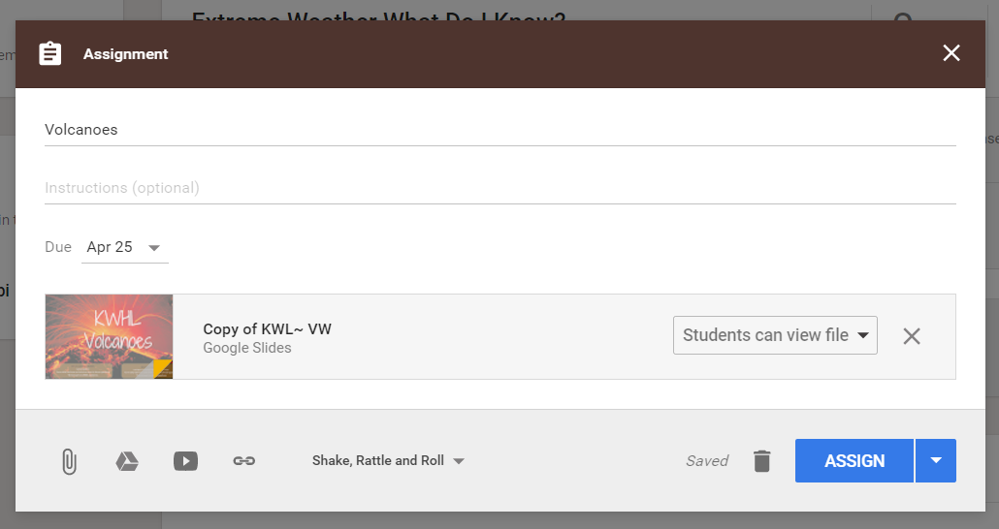
Here is your file that has been added.
Step 1
*make sure that you click on the drop down box to choose-
‘Make a copy for each student’
Step 2
* Click on Assign.
If you forget to “make a copy for each student” there is a fix :)
Steph Westwood 2016

Slide 12
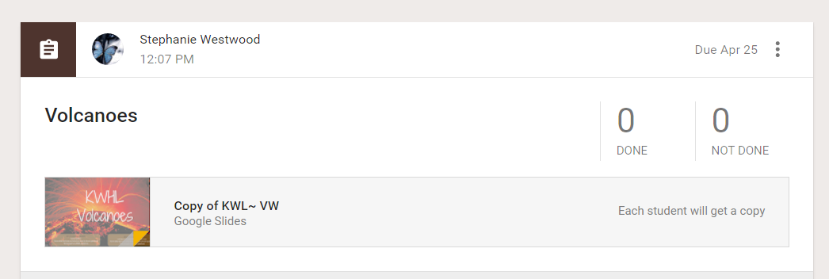
This lets you know when the work that you have set has been submitted. Click on done to see who has completed their work.
Your file has been added to the stream in your Classroom.
This lets you know that each student will get a copy. A copy will be in EACH child’s google drive account. They can access it either through google drive OR google classroom (through this post) when logged into their portal.
Steph Westwood 2016

Slide 13
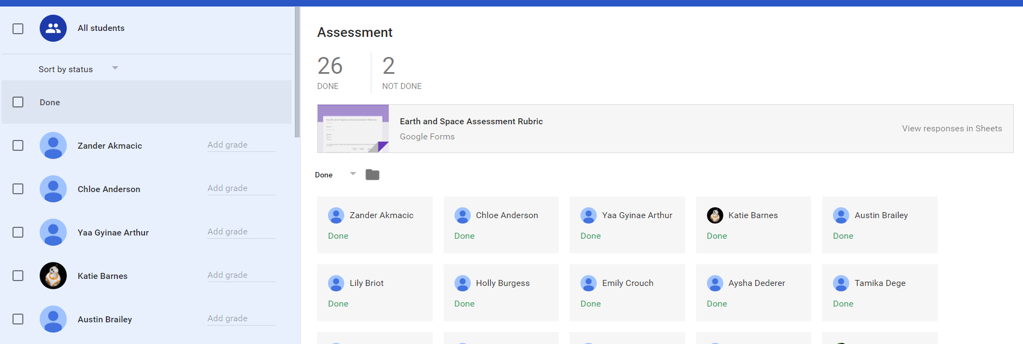
When you click on the checkmark next to the student names you can return their work once graded and commented on.
Click on one of your students work.
Or depending upon the work and how you have set it up- Click on responses in Sheets
This is a list of all the students in the Classroom.
Steph Westwood 2016

Slide 14
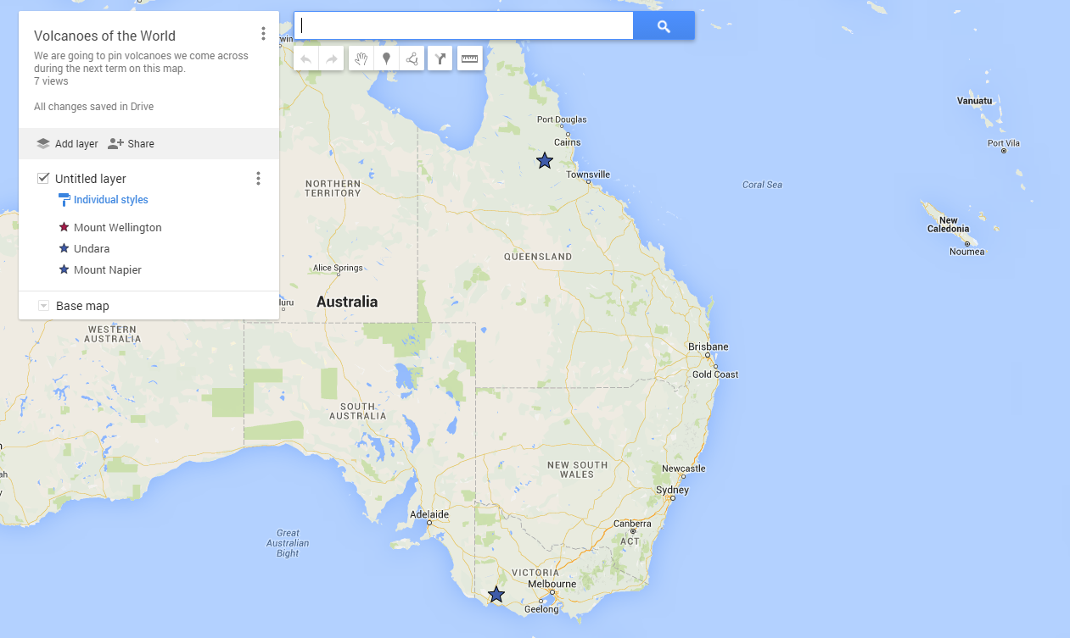
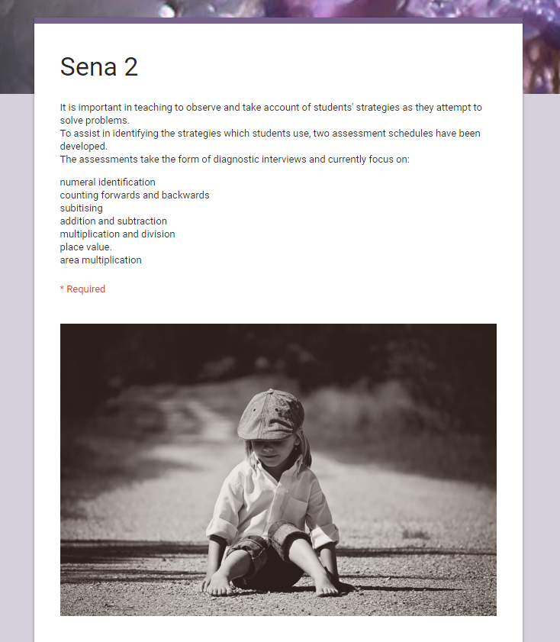
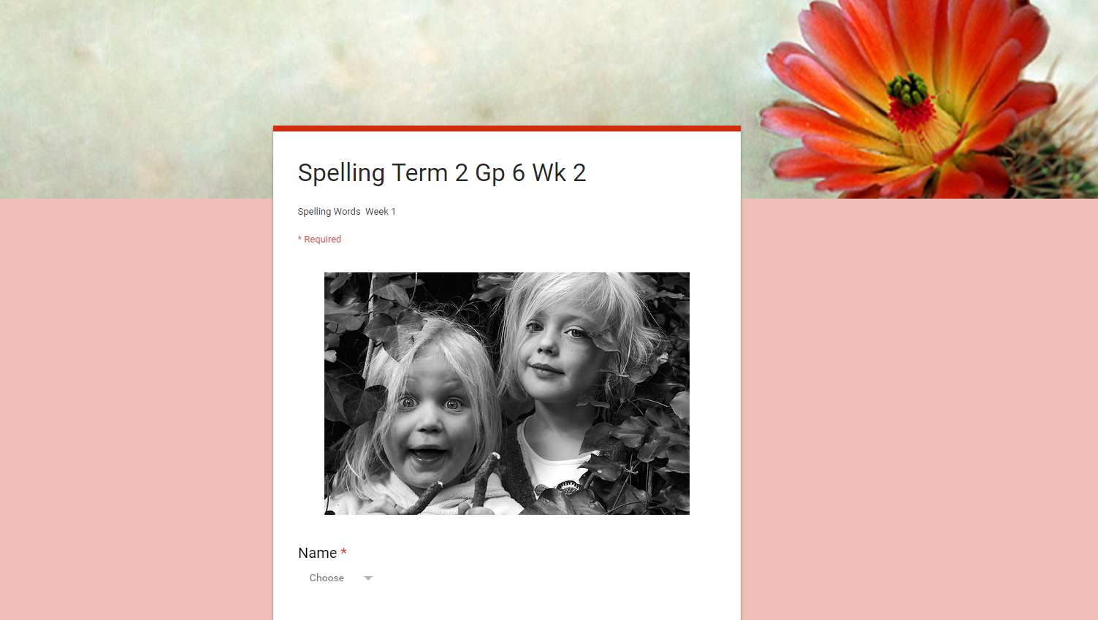
different things you can make
Steph Westwood 2016

Slide 15
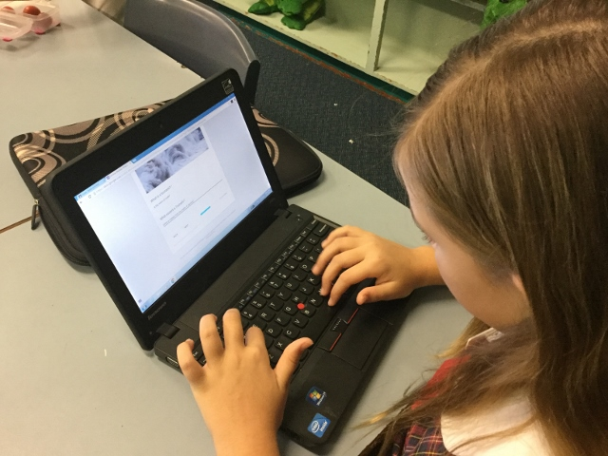
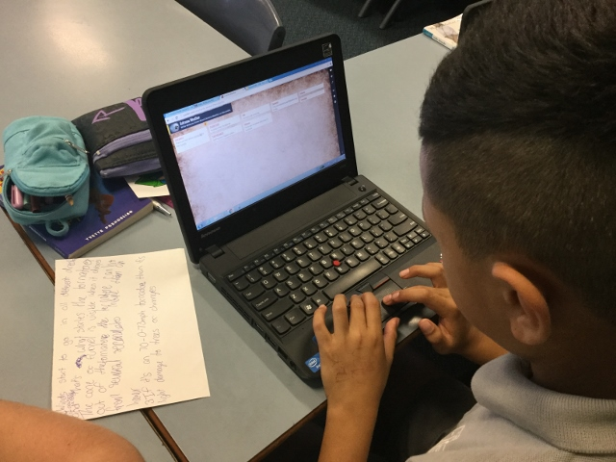
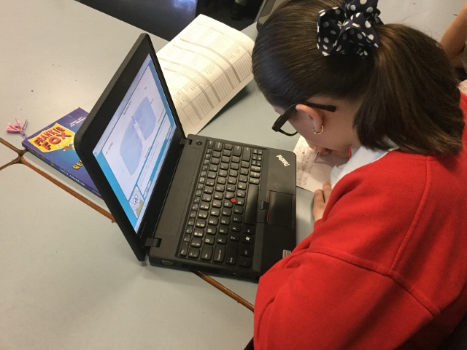
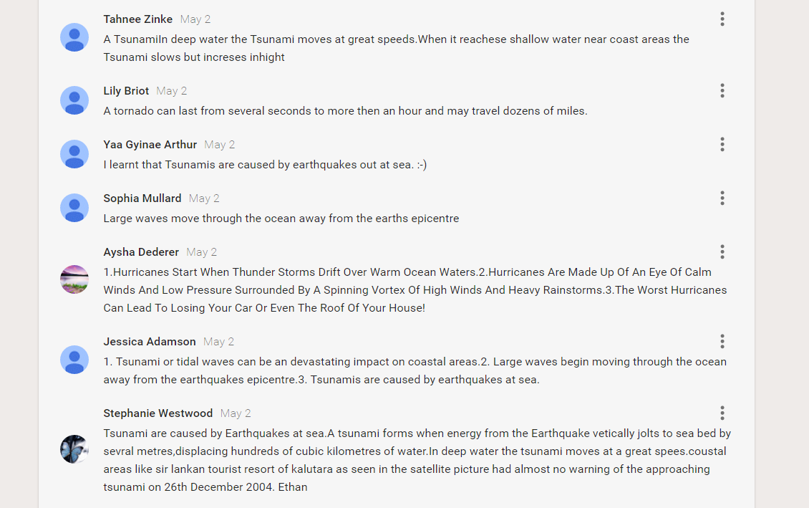
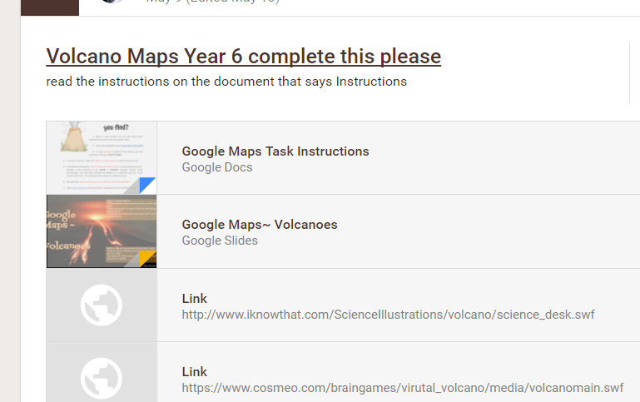
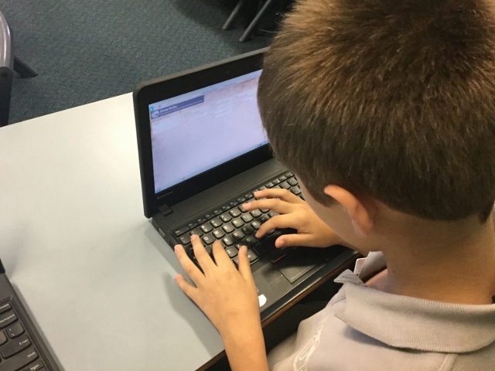
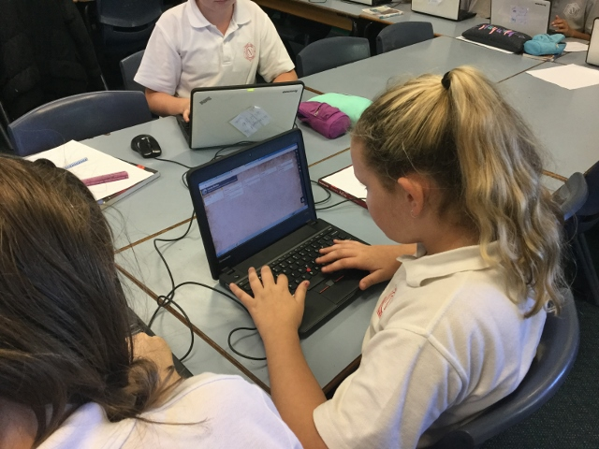
Kids using Google docs through Google Classroom
Steph Westwood 2016

Slide 16
Type this address into your address bar and let's see what happens :)
http://goo.gl/forms/pw0vC6kLyb
Steph Westwood 2016

Slide 17
Steph Westwood 2016

Slide 18
So now you will be feeling like this
or wishing it was this :)
Steph Westwood 2016

