Slide 1
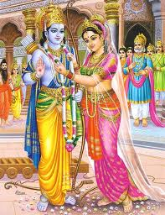
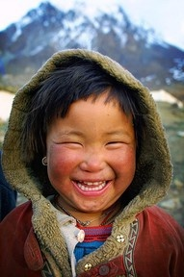
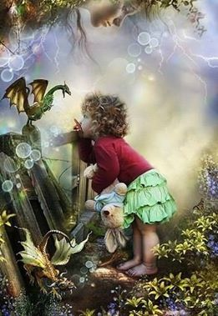
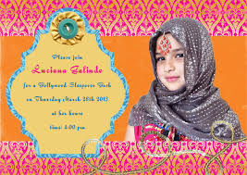
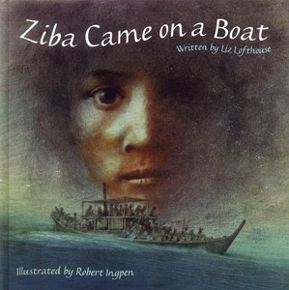
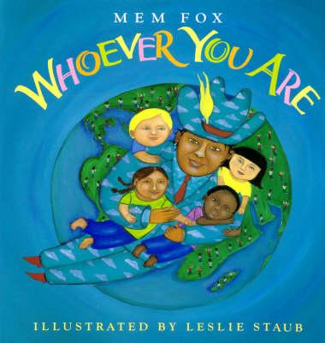
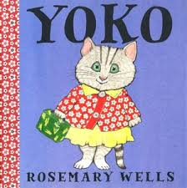
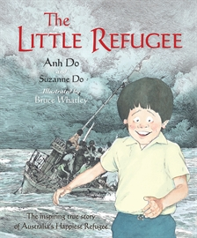
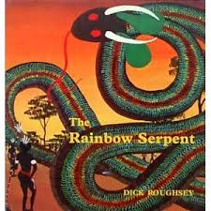
Cultures and their Beliefs
Writing Prompts
Leanne Williamson 2014

Slide 2
We are the same, yet different!
Discuss with your learning partner what the author’s main message was in this book.
Then write two paragraphs.
In the first write what makes you the same as everyone else. In the second, write what makes you different to your friends or family.
Notes:
This story is a celebration of similarities and differences among people. We all have rights and want to be respected. Acceptance of others is a very important lesson for us all! The book Whoever You Are points out that many of us are different in the way we look (hair colour and texture, eye colour, and skin colour), we are different in the way we live (where we live, what our families look like, where we go to school, our geographical location, our language), but we are all the same in that we all need to feel love, we all smile and laugh when we are happy, and we all cry when we are hurt or sad. ( sourced: http://prekcarolyn.hubpages.com/hub/whoever-you-are-lesson-plan).
If you don’t have a copy of the book the story can be viewed online at:
http://www.youtube.com/watch?v=n9swWI5SPKQ

Slide 3
Creative Writing!
Write a story about this character.

Slide 4
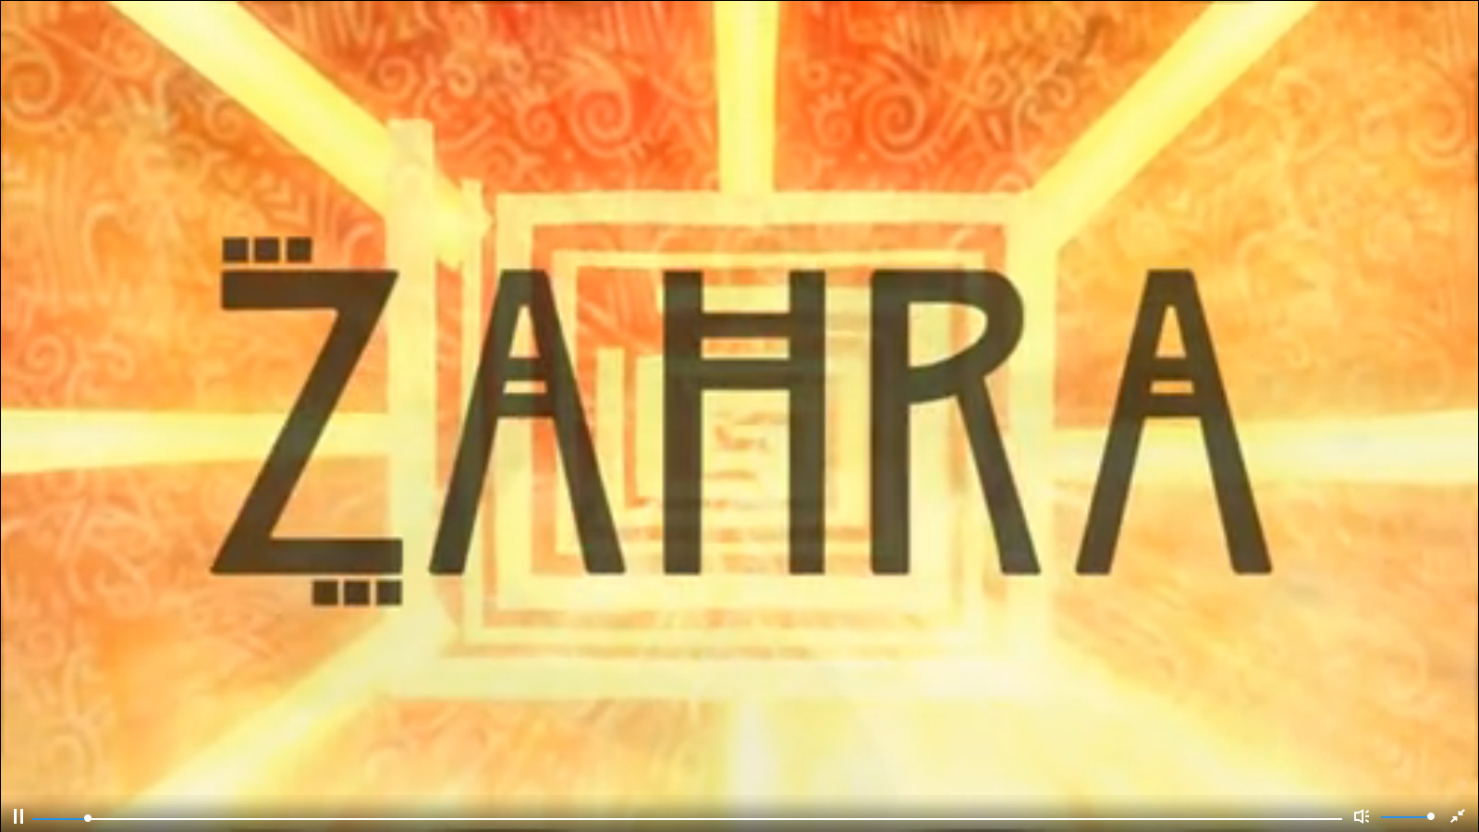
After viewing the brief video of Zahra:
Write a persuasive letter to the government to support funding of water supplies in Africa.
http://www.literacyshed.com/the-other-cultures-shed.html
Notes:
Zahra spends all day collecting water in order to help her tree grow so she can get some shade. She travels back and forth to the water pump but to no avail. The tree won't grow. It is not until a bead of sweat falls on the roots that the tree springs forth and grows protectively in order to protect her from the sun. (sourced: http://www.literacyshed.com/the-other-cultures-shed.html )

Slide 5
Descriptive story: My life
Think about the language the author used to describe what life was like for Ziba. With this in mind, write a descriptive story about what your life is like.
Consider:
What you remember from when you were younger.
Think about where you lived.
What you played.
How you helped your family.
Notes:
Ensure you have read the story a few times before completing this activity. Additional lessons /ideas for this book can be found at:
http://www1.curriculum.edu.au/rel/history/book.php?catrelid=1866

Slide 6
Story of Diwali : Rama and Sita
Watch the story of Rama and Sita.
Then complete the following:
Sequence the pictures that have been provided with.
write a caption for each so that you are retelling the story in your own words
Notes:
Another version of Rama & Sita can be found at: http://www.iboard.co.uk/ ( need to subscibe)
The Story of Rama and Sita (IWB) – Level A text and sound
http://www.iboard.co.uk/iwb/Rama-and-Sita-Story-Book-Reading-Level-A-1794
The ancient story of Rama and Sita is pivotal to Diwali celebrations – here we retell the story simply, with beautiful illustrations, in a digital format suitable for sharing at the IWB. Supporting materials (below) are available to extend learning and understanding.
Rama and Sita - Sequence and Retell (IWB)
http://www.iboard.co.uk/iwb/Rama-and-Sita-Sequence-and-Retell-66
This interactive sequencer has scenes from the story of Rama and Sita, with captions (text and audio). Ask pupils to put them into order on the timeline to check their understanding of the story. Once in place, pupils can write their own text next to each scene, to retell the tale in their own words. Ideal to work with the whole class as a quick recap of the events, or for pairs of pupils working together at the computer.
Sequence Images and Captions – Word Doc
A word document to support the above IWB activity. Use flexibly for sequencing, matching, caption writing; or for a retell in your own words writing task.

Slide 7
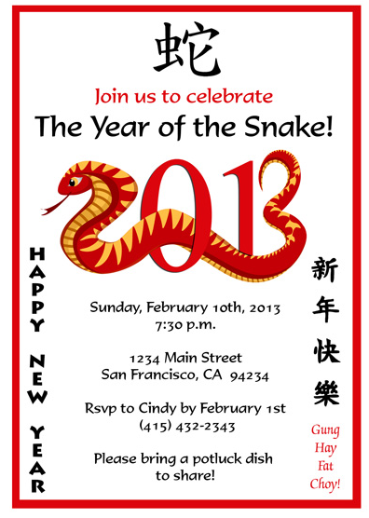
Design an invitation for a celebration which is significant to your culture….
Notes:
Discuss how the tradition of birthday parties started in Europe a long time ago. It was feared that evil spirits were particularly attracted to people on their birthdays. To protect them from harm, friends and family would come be with the birthday person and bring good thoughts and wishes. Giving gifts brought even more good cheer to ward off the evil spirits. This is how birthday parties began. At first it was only kings who were recognised as important enough to have a birthday celebration (which may be how the tradition of birthday crowns began). As time went by, children became included in birthday celebrations. The first children's birthday parties occurred in Germany and were called Kinderfeste.
Discuss other celebrations from various cultures.

Slide 8
Create your own deity and write a description to match
Create your own God/ Goddess.
Write a description of your God/Goddess including:
Name
Relations
Characteristics
Power
Transport
Popularity
Once you have completed the description, draw a picture of your deity.
Notes:
Discuss with students the different Hindu deities and describe their purpose and popularity.
Ensure students have seen the Power point on Hindu Gods before completing this lesson. Power point was created by Anne Rochetto in 2012 when she worked with me as my student teacher.
Ask students to draw their own Deity with an accompanying description that includes their name, characteristics, power, transport and popularity.
Ensure students use information text features including headings, bold print, labels etc…………

Slide 9
Ping and the baby dragon
In the far western mountains of the Han Empire in ancient China, an aging dragon, his wife (who soon dies), and a young slave girl are used, abused and neglected by the cruel Master Lan. Nameless and alone, the slave girl is without hope and her only friend is her pet rat, Hua. After one of the last remaining Imperial Dragons, the mate of the aging one, suddenly dies, the slave girl feels guilty and responsible. She finds herself coming to the last dragon, Danzi. The two escape, but when the emperor finds out that his other dragons are dead, Master Lan blames it on her and she finds herself chased by the imperial guards, who believe she is an evil sorceress. The dragon, Long Danzi (meaning courageous dragon), tells the slave girl her true name: Ping (meaning duckweed). Ping and the dragon must go on a dangerous journey across China to Ocean, an apparent magical healing place. She must protect a mysterious stone that is vital to the dragon's legacy. A dragon hunter named Diao, who are determined to kill the dragon and take the dragon's stone, are chasing her and the dragon. While traveling with Danzi, Ping learns many things that will, in time, help her with her struggles. Ping also learns the value of friendship and courage and discovers her destiny as a Dragon Keeper. After reaching the ocean, Danzi tells Ping he must go over Ocean to reach a river of life and will take Hua, who was hurt by Diao, with him, so that the river can heal them both. The stone (now found to be an egg) hatches into a purple baby dragon. Before Danzi leaves, he gives the baby a name: Long Kai Duan. Ping is now left alone with the baby dragon.
Write what happens next…

Slide 10
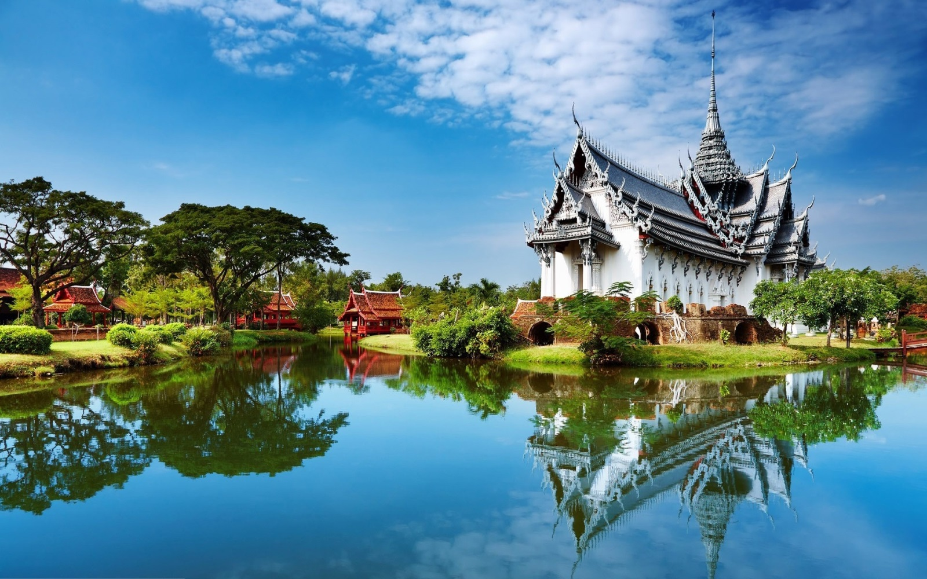
Buddhist Temple
Write a descriptive story about spending a day/night or week at the Buddhist Temple.
(include your 5 senses)
What can you hear, see, taste smell, touch?
Notes:
May wish to leave this writing task until after the excursion to Nan Tien Temple in Wollongong so that students are able to draw on that experience.

Slide 11
The Little Refugee…
Write down 5 – 10 things that you would take with you if you had to flee your home like Anh Do.
They must be able to fit into a backpack and be carried by you.
You need to justify why you would take each item

Slide 12
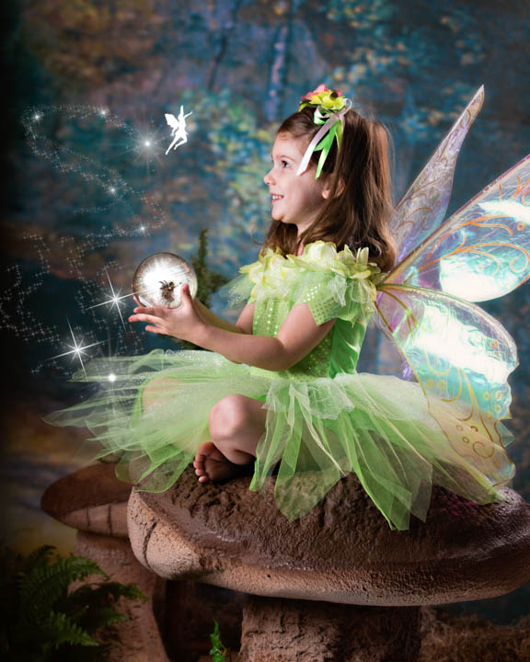
I do believe in fairies! I do! I do! I do!
A young fairy catcher in the enchanted forest near Cranberry Tops sees a bright sparkling light. ” I won't let her go, I caught her and she is mine!”
Write what happens next……

Slide 13
Yoko’s problem…
Pretend you are Mrs Jenkins. Write what would have you done to help Yoko with her problem.

Slide 14
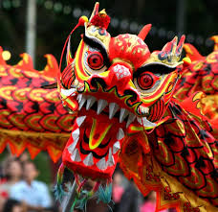
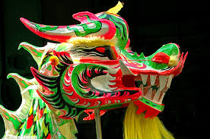
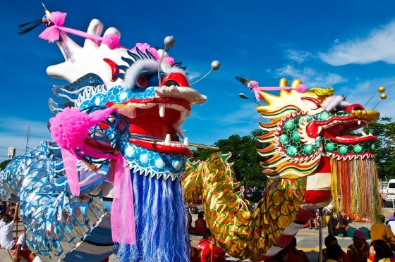
Chinese New Year …
Chinese New Year is a traditional and very important Chinese holiday. It was originally a festival to honour ancestors as well as holy or sacred beings. It is also known as the Spring Festival.
Design your own dragon and then write a description to match.
Notes:
Interesting Chinese New Year Facts: Traditionally Chinese New Year lasted from the last day of the Chinese calendar to the 15th day of the first month. It is a major Chinese holiday. In countries and territories that have high populations of Chinese, Chinese New Year is also celebrated. Hong Kong, Taiwan, Singapore, Indonesia and the Philippines are only a few. Chinatowns in other cities also celebrate Chinese New Year. The exact date of Chinese New Year changes each year because it originated in 2600 B.C. At that time people followed the lunar calendar. The Chinese New Year is symbolic of letting go of the past and welcoming new beginnings. It's a popular time for spring cleaning. Each year of the Chinese New Year calendar is named after an animal. This is a 12 year cycle. Once the 12 year cycle is over the animal list begins again. The list in order is: rat, ox, tiger, rabbit, dragon, snake, horse, ram, monkey, rooster, dog, and pig. As the longest festival in the Chinese calendar, Chinese New Year can last as many as 15 days. Children take an entire month off of school. It's common for Chinese families to have a reunion dinner the night before Chinese New Year festivities begin. The decorations used on doors and windows are red colored paper-cuts (made similar to the way we make snowflakes). The themes of these paper-cuts are of happiness, good fortune, longevity and wealth. Firecrackers are popular during the Chinese New Year. They are thought to scare off evil spirits. Children receive red envelopes full of money instead of wrapped gifts that other nationalities give at Christmas. The amount they receive is usually an even number. The amount cannot be divisible by four. In Chinese, the number 4 means death. Dragon dances and street fairs are very popular. Dancers dress up as lions and dragons and perform for onlookers. One of the traditional treats is a candied crab-apple on a stick. Since the 1980s China Central TV broadcasts the celebration. This is an evening-long variety style show and it is watched by the entire country. On the last day of Chinese New Year, everyone carries beautiful paper lanterns and walks along the streets. This is supposed to light the way for the New Year. This day is called Lantern Day. In Singapore and Malaysia, Lantern Day is their form of Valentine's Day. On Chinese New Year everyone is a year older. It doesn't matter when you were born; this is like a national birthday. Another name for Chinese New Year is: The First Day of the Great Year.
Sourced: http://www.softschools.com/facts/holidays/chinese_new_year_facts/143/

Slide 15
Dreamtime Story
Draw the most important scene from the story and then write a paragraph explaining why it is important.
Notes:
If you don’t have a copy of the book, it can be viewed at: http://www.youtube.com/watch?v=2vh6moD9ZOU
The Rainbow Serpent
A common theme in all Aboriginal mythology is the Rainbow Serpent. The Rainbow Serpent is seen as the inhabitant of permanent water holes and is in control of life's most precious resource, water. It is the sometimes unpredictable Rainbow Serpent, who vies with the ever-reliable Sun, that replenishes the stores of water. Serpent stories vary according to environmental differences. Tribes of the monsoonal areas depict an epic interaction of the Sun, Serpent and wind in their Dreaming stories, whereas tribes of the central desert experience less drastic seasonal shifts and their stories reflect this.
The close affinity between water and snakes may stem from the presence of most snakes in the vicinity of permanent water. The Walmadjari people of the deserts of the Northern Territory see the spirit of water as the Carpet Snake. This is of scientific interest in that carpet snakes cannot survive long without water and are almost always found near water sources. (http://www.bom.gov.au/iwk/climate_culture/rainbow_serp.shtml)

Slide 16
Yamuti Description…
Draw a picture of your own Yamuti. Then write a description to match.
http://www.scootle.edu.au/ec/viewing/S6111/index.html
Notes:
This is an animated short film of a momentous event in the lives of Virdianha, Warrikanha and Unaanha, three Adnyamathanha children of long ago. The story begins at night when the children tell scary tales of an ancient creature, the Yamuti. The next day they go looking for stick-nest rats. At a waterhole they come upon strange tracks that Unaanha believes are the Yamuti's. They follow the tracks and, while sheltering in a cave, they see a white man on a horse. The terrified children think it is a spirit, one of the dead or the Yamuti. The dialogue is in Adnyamathanha language with English subtitles. The characters' voices are those of Salote, Ema and Emori Bovoro. ( source: Scootle)
http://www.scootle.edu.au/ec/viewing/S6111/index.html

Slide 17
Thanksgiving around a ping-pong table
Decide on one thing you are most thankful for and create a thank you card for that person, place or thing. Decorate it and include a short message explaining why you appreciate it/him/her.
Notes:
Source: http://www.teachhub.com/video-writing-prompts
More information on Thanksgiving can be found at: http://kids.nationalgeographic.com/kids/stories/peopleplaces/thanksgiving-traditions/

Slide 18
From Naughty to Nice!
The Christmas crew can identify how naughty or nice kids are. It's not too late to make sure you're nice count is higher than your naughty count.
Write down 3 naughty, or not-so-nice, things you've done this year. For each naughty thing you did, write a way you can make it up to the person your naughty behaviour affected.
Notes:
Source: http://www.teachhub.com/arthur-christmas-video-writing-prompts

