Slide 1
Stage Two
Problem Solving
DATA
Leanne Williamson, 2015 - Problems have been adapted from previous Naplan questions.
Notes:
Outcome:
MA1-17SP Gathers and organises data, displays data in lists, tables and picture graphs, and interprets the results
MA2-18SP selects appropriate methods to collect data, and constructs, compares, interprets and evaluates data displays, including tables, picture graphs and column graphs

Slide 2
Four children have some stickers on a chart.
Leanne
Justin
Rebecca | ?
Emily
Rebecca has more stickers than Leanne but fewer stickers than Emily. How many stickers does Rebecca have?

Slide 3
Four children have bear biscuits in their lunch boxes.
Stephanie
Emma | ?
Amy
Rachel
Emma has more biscuits than Amy but fewer biscuits than Rachel. How many biscuits does Emma have?

Slide 4
This diagram shows the number of pirates in each country.
Australia
Russia
America
Japan
Key:
= 20
Which country has 50 pirates?
Leanne Williamson, 2015

Slide 5
This diagram shows the number flowers each class grew.
3H
3M
3J
4T
4S
Key:
= 12
Who grew the least amount of flowers? What was the difference between them and 4S?

Slide 6
A dance studio teaches Jazz and Ballet. One quarter of all students learn Ballet. The rest of the students learn Jazz. No students learn both.
 | Jazz | Ballet
Boys | 95 | 24
Girls | ? | 26
How many girls learn Jazz?
Leanne Williamson, 2015

Slide 7
This graph shows the number of animals on the farm.
Animals on the farm
Number of animals
Which is statement is true?
There are more goats than cows.
There are more horses than cows.
There are fewer sheep than goats.
There are fewer sheep than horses.

Slide 8
This table shows the three favourite subjects of four students.
 | English | Maths | Art | Sport | Science | Music
Greg |  |  |  |  |  | 
Donovan |  |  |  |  |  | 
Leanne |  |  |  |  |  | 
Yvonne |  |  |  |  | 
Which student chose Science but not Art?
Leanne Williamson, 2015

Slide 9
This table shows the number of books read by some students.
Name | Number of books.
Jessica | 2
Harry | 10
Brad | 2
Megan | 3
Teleah | 7
How many books did Jessica and Teleah read altogether?
Leanne Williamson, 2015

Slide 10
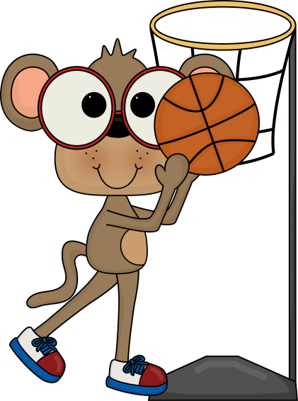
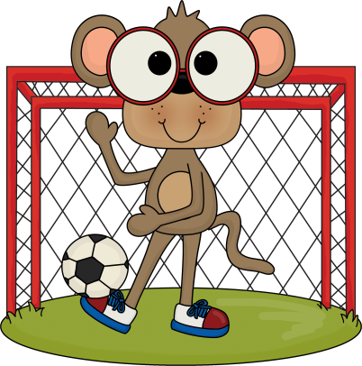
Some students chose their favourite sport. They made a graph.
Tennis was the most popular.
Football was more popular than soccer.
Netball was less popular than football.
Which column shows football on the graph?
Favourite Sport
Number of
students
Sport
Leanne Williamson, 2015

Slide 11
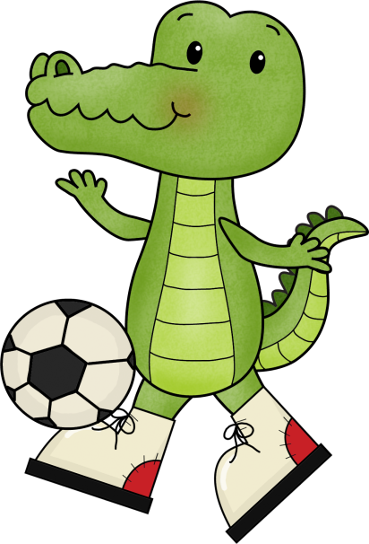
Four friends were trying to kick balls into a net.
This graph shows how many balls each of the friends kicked into the net.
Balls kicked into a net
Aaron | Steph | Amie | Cameron
Steph kicked 6 balls into the net.
Amie kicked 7 balls into the net.
How many more balls did Aaron kick into the net than Cameron?

Slide 12
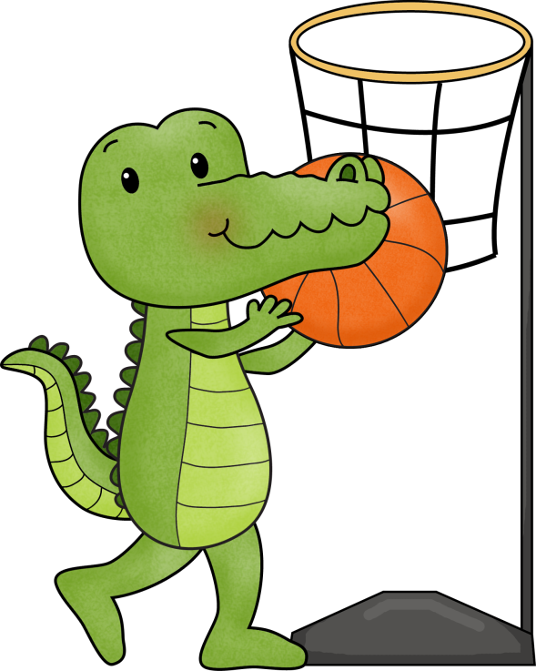
Four friends were trying to shoot baskets.
This graph shows how many balls each of the friends got into the hoop.
Balls shot into the hoop
Kelsey | Steph | Tenniah | Ebonie
Kelsey shot 1 ball into the hoop.
Tenniah shot 7 balls into the hoop.
How many more balls did the girls shoot into the hop altogether?

Slide 13
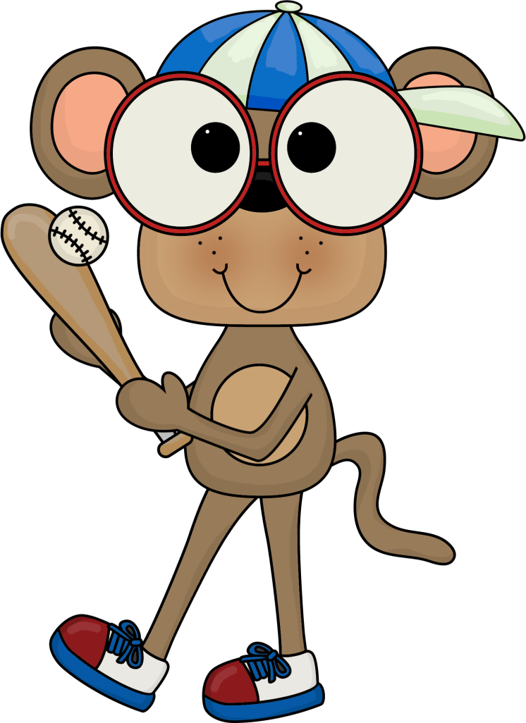
What is the difference in metres between the longest and shortest baseball hit?
Distance baseball travelled
Name | Distance in metres
Justin | 13
Leszek | 10
Michael | 6
Donovan | 22
Greg | 14
Leanne Williamson, 2015

