Slide 1
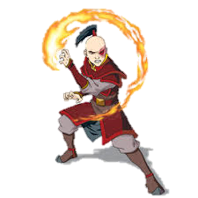
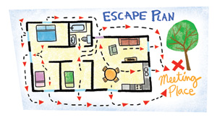
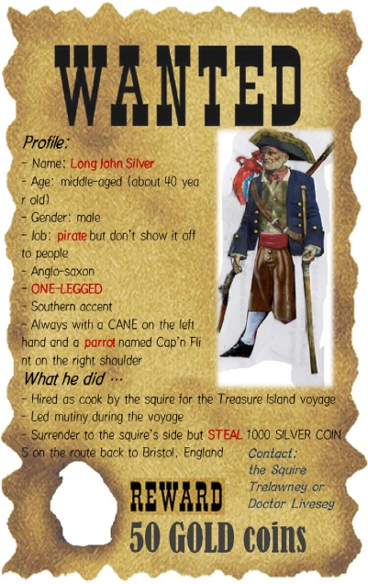
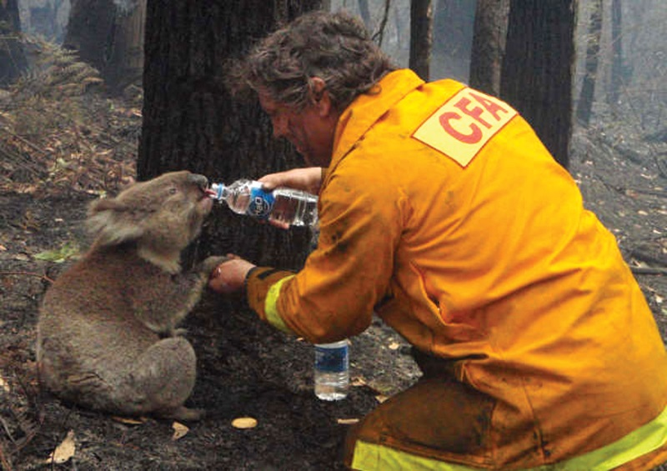
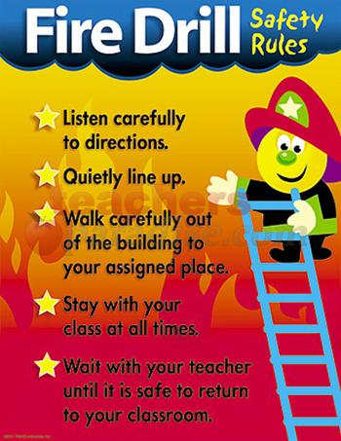
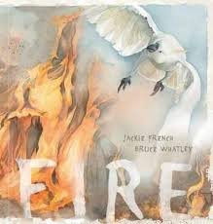
Writing Prompts
Leanne Williamson 2015, inspired by Steph Westwood

Slide 2
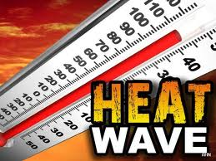
Heat Wave!
Describe what you would do on a hot, sunny Sunday. What would you like to do? Where would you go? How would you cool off – eat ice cream, drink ice-cold drinks, go for a swim, sit under the shade of a tree?
Draw a picture of yourself doing you favourite thing on a hot day and write a paragraph or two about what you are doing and how you are cooling off.
Found : Google Images
Leanne Williamson 2015

Slide 3
How to prevent a bushfire…..
Write a list of all the things that can be done around your home and in the community to help stop a bushfire from starting.
Found : Google Images
Leanne Williamson 2015
Notes:
Shared reading
Ask your class what they know about bushfires. Where are they likely to occur? When? Do they remember recent news stories?
Show your students the front cover of Fire and ask what they recognise and what sort of story they are expecting.
Ask what information the front cover images convey. (The fire is shooting in all directions. Even though it could perhaps fly above the flames, the cockatoo looks frightened, so the book might be about the danger to wildlife.)
Read the back cover blurb and ask your students what they notice. (They may comment on the rhyming; if not, prompt them. Ask where we mostly hear rhyming. They may say in poems, songs, advertising. So maybe the story is in the form of a poem or song.)
Read the first double spread. Discuss the use of metaphorical language in Fire. In what ways might a fire be like a black snake? For older readers point out that this is a simile – a comparison that uses ‘like’ or ‘as’ (Like a snake, fire changes direction quickly, is dangerous to human life and wildlife, colour of burnt bush, the tracks the fire makes, the hissing sound of the fire)
Ask older readers what personification is. (metaphorical language that gives human attributes to inanimate objects or phenomena). What is the effect of saying that the fire wakes? (It is always there, potentially, waiting to spring into action). Why might the fire be ‘laughing’? (It is way more powerful than humans; maybe humans have done foolish things that have set the fire loose – building too close to the bush, not observing fire safety, lighting fires deliberately.)
Ask how bushfires start. (lightning, electrical faults, sparks from machines or tools, tossing cigarettes out of car windows, lighting fires on high risk days, not putting out campfires or barbecues properly, leaving glass in the bush, arson)
Why might there be a helicopter overhead? (news camera operators, rescue, traffic control, firefighting with water or chemicals)
There are only a few images of humans in the book: what do they add to the story? (image of family hugging suggests the importance of community action; child’s distress suggests the vulnerability of humans confronted by fire; image of firefighter’s care for wildlife)
Ask what images are there to suggest that even after a destructive weather event, life goes on? (The blackened stumps of ferns, which even seem to have ghostly faces in them, topped by green leaves; the peaceful scene of the house in the paddock and a clear sky at the end; the white bird with its head bowed almost looks like the dove in the Bible story of Noah’s Ark; or for some readers it will look like the dove of peace – which comes from the same story, but is used in many non-religious contexts.)
Ask finally what your students think is the most important theme in Fire. (Courage, the renewal of life, the vast power of nature and the need for humans to learn to live with it.)
Ask what this font adds to the story.
(It looks as though it has been handwritten in a hurry – maybe as if a fire was heading your way and you had to write the story down quickly. The spots of ink used in the design look like the soot from a fire. City children sometimes find black ashes on cars, clothes and beaches, hundreds of kilometres away from a bushfire.)

Slide 4
Character and Setting Description
Describe this character and the bush fire setting.
Found : Google Images
Leanne Williamson 2015

Slide 5
Wanted Poster….
Design a wanted poster to catch the Ballan firelighter.
Include: physical description with an accompanying picture or photograph, approximate
age of the offender, summary of fires lit and the methods used, where he/she was last seen, destruction caused as a result of the fires, reward offered and who to contact with information
Found : Google Images
Leanne Williamson 2015

Slide 6
Avatar: The Last Airbender - Firebending
Firebending is a term for a mystical martial art featured within the fictional universe of the Nickelodeon animated television series Avatar: The Last Airbender. A moiety of the Fire Nation, Firebenders, as its practitioners are known, are heirs to the pyrokinetic ability to create and control fire. An exclusive few also possess the ability to generate and manipulate lightning.
Write about a character who is a firebender.
Found: https://www.youtube.com/watch?v=huMpG4jkv1U
Leanne Williamson 2015

Slide 7
Cinquain Poetry
Create your own cinquain poem about fire.
Lesson sourced: http://www.cfa.vic.gov.au/kids-schools/primary-school-resources/
Leanne Williamson 2015
Notes:
Cinquain Poetry
Characteristic features of a cinquain poem are:
• Line 1: one word, a subject or an idea.
• Line 2: two words, adjectives describing the subject.
• Line 3: three words, verbs related to the subject.
• Line 4: four words, telling your reaction to the subject.
• Line 5: one word, a synonym for the subject (word which describes the subject).
Students create their own cinquain poem about fire:
• As a class, brainstorm a list of words describing fire.
• Read through the example.
• Reinforce grammar skills by revising an understanding of nouns, verbs and
adjectives.
• Students use a thesaurus to locate synonyms.
Lesson sourced: http://www.cfa.vic.gov.au/kids-schools/primary-school-resources/

Slide 8
This is Elsa, a Disney Princess who was featured in the 2013 film ‘Frozen’. She was born with the power to turn everything into ice and snow.
Write a story about Elsa starring in the feature film - Melted.
Where does the story take place?
What are Elsa’s new powers? Does she use them for good or evil?
What goes wrong?
How does the story end?
Found on trendhunter.com
Leanne Williamson 2015

Slide 9
Fire and Rescue
Write a story about Dusty and one of his fire fighting adventures.
Found: www.youtube.com/watch?v=Uk0D5L0TT30
Leanne Williamson 2015

Slide 10
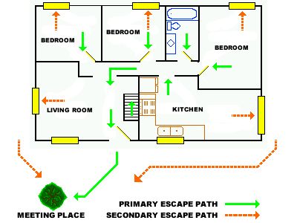
Home fire escape plan………
Design a home fire escape plan for your own home.
Then write out the instructions for safely exiting your home in a fire.
Found : Google Images
Leanne Williamson 2015
Notes:
Home Fire Escape Plans
Discuss the importance of designing a home fire escape plan with your family members
so all family members are aware of their two possible escape routes and of a safe
meeting place in the event of a house fire.
Discuss safe procedures to carry out in a home fire emergency:
• Don't waste time getting dressed, leave in the clothes you are wearing.
• Blow a whistle, kept close to your bed, to alert other family members of the fire.
• At least two smoke alarms should be installed in every home, in or near the bedrooms. The smoke alarm siren should be the signal to evacuate.
• Crawl low in smoke, the cleanest air is nearest the floor.
• Crawl to the door alongside the wall, so you don't get lost.
• Feel the doors before opening and leave if safe to do so, closing the door as you leave. If hot to touch, or smoke is coming under the door, then make your way out through the window. If you sleep in an upstairs bedroom make sure you have an escape ladder kept under the bed to let down over the edge of the window to help you safely climb down.
• Meet your other family members at the predetermined meeting place.
• Ring the fire brigade from a neighbour's phone.
• Once out, stay out. Do not return to the house to find people, pets or a favourite toy or game.
Remember the "Stop, Drop and Roll" technique for putting out flames on personal
clothing.
Lesson sourced: http://www.cfa.vic.gov.au/kids-schools/primary-school-resources/

Slide 11
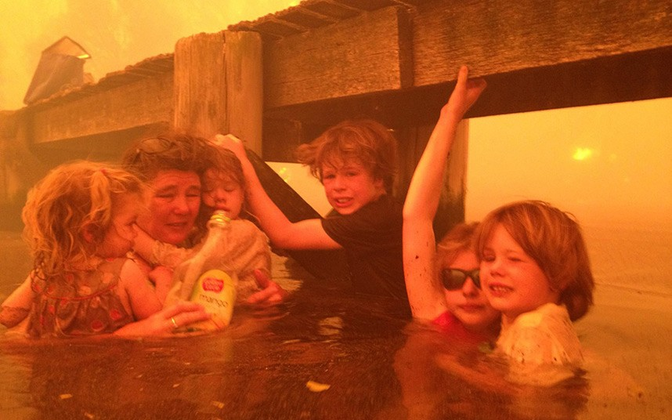
Tell the story about what was happening when this picture was taken.
Found : Google Images
Leanne Williamson 2015

Slide 12
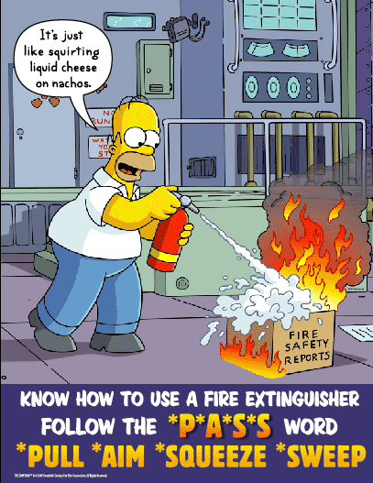
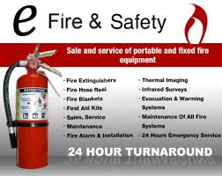
Advertisement….
Create your own advertisements for smoke alarms, fire extinguishers and fire blankets.
Found : Google Images
Leanne Williamson 2015
Notes:
Advertisements
Teacher to collect advertisements for smoke alarms, fire extinguishers and fire blankets. Share these advertisements with the students. Discuss how the advertising company tries to win over the audience with these advertisements — what are the selling points.
Teacher to show and explain the correct use of a fire extinguisher. The two main types of extinguishers you will find in a school are the dry chemical extinguishers and the water extinguishers. If the school has a hose reel, there is no need for a water extinguisher. If purchasing an extinguisher for use in the home, the most common extinguisher bought is the dry chemical extinguisher. There are upright and reversible extinguishers. The recommended extinguisher is the upright extinguisher.
When using an extinguisher to put out a fire:
• Remove the extinguisher from the wall bracket.
• Carry the extinguisher close to the fire.
• Place the extinguisher on the ground. While loosely holding the handle in one hand, pull out the "ring pin" with the other hand.
• Free the discharge nozzle or the handle of the discharge horn from the extinguisher.
• Lift the extinguisher by the handle, carry as close to the fire as possible and point the nozzle or horn at the fire.
• Still carrying the extinguisher, squeeze the discharge lever.
• Point the stream of dry chemical or water at the base of the flames, spraying from side to side.
Discuss appropriate and inappropriate use of the different types of fire extinguishers. What safety problems could occur from incorrect use?
Locate the fire extinguishers in the school. Discuss their placement. Where would the most appropriate storage place be in a home or in a public building? Teacher to also show and explain the correct use of a fire blanket and correct installation of a smoke alarm. Discuss appropriate positioning, maintenance and purpose.
A fire blanket is used to smother flames usually caused through cooking fires or clothing fires. The fire blanket is made out of a fire resistant fabric and should be discarded after use. It is not to be used for electrical fires. A fire blanket should be housed in the kitchen on the wall near the stove. By pulling the visible tabs, the fire blanket is released. In the case of a cooking fire, the fire blanket should be used to cover the vessel, containing the fire completely. Turn off the source of heat, leave the fire blanket in place until cool and call the fire brigade. In the case of a clothing fire, wrap the fire blanket around the victim and roll the victim on the ground.
Smoke alarms require a battery to operate. They should be installed near or inside each bedroom high on the wall or on the ceiling. Regular maintenance of the smoke alarm needs to be carried out every month by activating the alarm through pushing
the alarm button. When the battery is low, the smoke alarm makes a piercing chirping sound. The battery should be changed when this sound is heard.
Lesson sourced: http://www.cfa.vic.gov.au/kids-schools/primary-school-resources/

Slide 13
Letter….
Write a letter informing someone of the potential fire hazards around the home and
recommend changes they could make to protect their home in a bushfire.
Potential risk factors could include: leaves in gutters; wood pile leaning against the
house; shrubs planted close to the house; tall eucalypt trees planted close by; tan
bark, dry leaves and twigs lying on the ground near the house and only one road
access into the property.
Think about how these risk factors increase the fire risk.
Found: http://www.education.com/worksheet/article/writing-a-letter/
Leanne Williamson 2015
Notes:
Discuss:
• The safest place to be in a bushfire.
• Reasons why this is the safest place to be in a bushfire.
• The biggest danger to your survival in a bushfire — radiant heat, smoke and flames.
• The actions you can take around your house to make it fire safe.
• Why you should take more than one woollen blanket with you when travelling into country areas.
• Possible personal safety procedures people should carry out if caught in a bushfire at home, in the car or wherever they are could consist of:
At home
Keep windows and doors closed
Move furniture away from the windows
Fill the bath and buckets with water
Soak towels and woollen blankets with water
Keep pets indoors
Stay indoors — do not go outside
In the car
Keep windows rolled up
Park in a clear area, away from vegetation
Switch headlights on
Turn ignition off
Crouch down low, near the floor
Cover yourself with a woollen blanket
Wherever you are
Wear long sleeved woollen jumper and long cotton pants
Wear leather shoes or rubber gumboots
Cover up and take cover
Drink lots of water or eat juicy fruit
Don't panic
Lesson sourced: http://www.cfa.vic.gov.au/kids-schools/primary-school-resources/

Slide 14
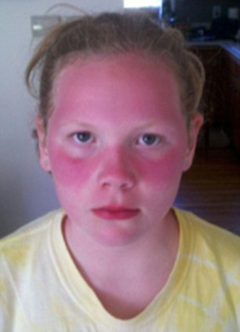
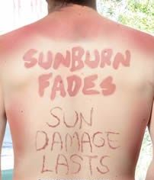
No Hat, No Play- Is this a necessary rule at school?
What do you think about this idea? Write to persuade a reader to agree with your point of view.
Think about:
• if you agree or disagree or if you can see both sides of the topic
• an introduction – clearly say what you think about the topic
• your opinions – give reasons or examples to explain them and be persuasive
• a conclusion – a summary of your main points and a final comment on your opinion
Remember to:
• plan your writing before you begin
• make your writing interesting to read
• write in sentences and stay on the topic
• check your spelling and punctuation
• use words that will persuade your reader
• start a new paragraph for each new idea
• check and edit your writing when you are finished
Found : Google Images
Leanne Williamson 2015

Slide 15
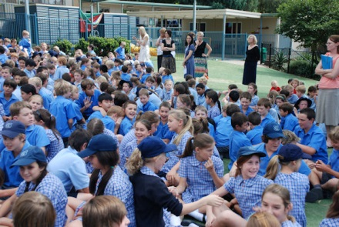
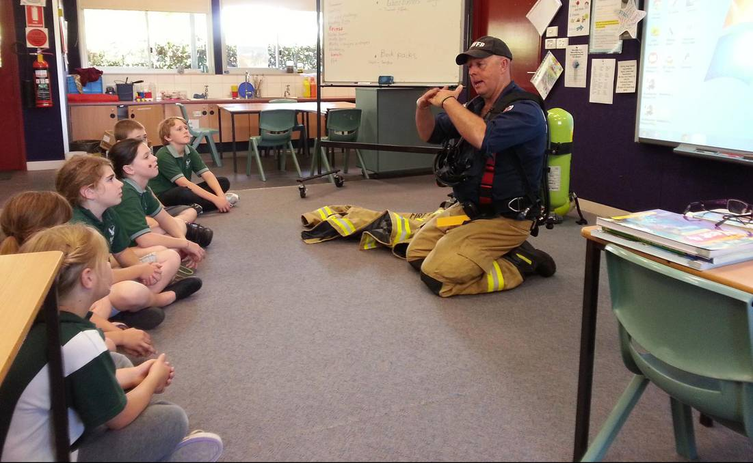
Fire Drills are a waste of time!
What do you think about this idea? Write to persuade a reader to agree with your point of view.
Think about:
• if you agree or disagree or if you can see both sides of the topic
• an introduction – clearly say what you think about the topic
• your opinions – give reasons or examples to explain them and be persuasive
• a conclusion – a summary of your main points and a final comment on your opinion
Remember to:
• plan your writing before you begin
• make your writing interesting to read
• write in sentences and stay on the topic
• check your spelling and punctuation
• use words that will persuade your reader
• start a new paragraph for each new idea
• check and edit your writing when you are finished
Found : Google Images
Leanne Williamson 2015

Slide 16
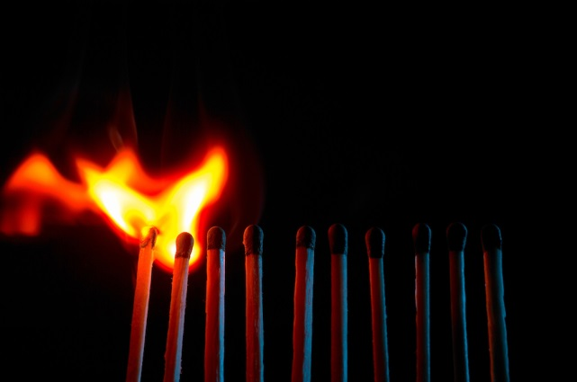
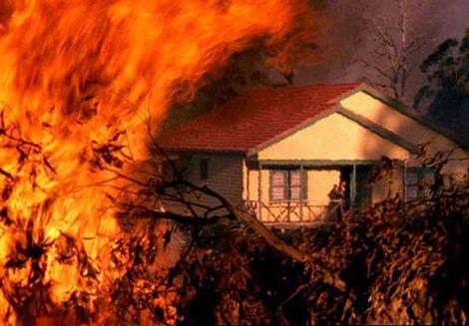
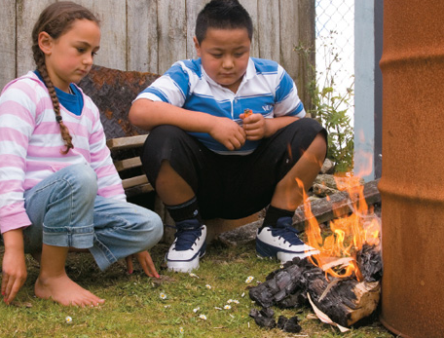
Should we punish Pre-teen bushfire starters in Australia?
What do you think about this idea? Write to persuade a reader to agree with your point of view.
Think about:
• if you agree or disagree or if you can see both sides of the topic
• an introduction – clearly say what you think about the topic
• your opinions – give reasons or examples to explain them and be persuasive
• a conclusion – a summary of your main points and a final comment on your opinion
Remember to:
• plan your writing before you begin
• make your writing interesting to read
• write in sentences and stay on the topic
• check your spelling and punctuation
• use words that will persuade your reader
• start a new paragraph for each new idea
• check and edit your writing when you are finished
Found : Google Images
Leanne Williamson 2015

Slide 17
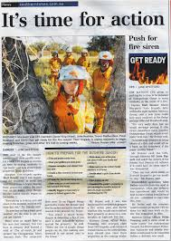
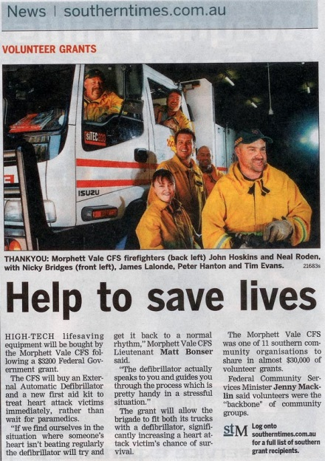
Newspaper Article
Write a bushfire account based on one of the newspaper titles below or create your own headline.
• Untouched in the face of disaster
• Fire awareness saves the family home
• John's survival
• Life after "Ash Wednesday"
Found : Google Images
Leanne Williamson 2015
Notes:
Encourage students to incorporate their knowledge of fire safety procedures in their article based on one of the newspaper headlines. For instance, preparing the home, wearing appropriate clothing and finding a safe place to stay in a bushfire.
View the following website: http://www.abc.net.au/blackfriday/home/default.htm for newspaper articles, etc
Have students analyse the newspaper headlines below for use of emotive language conjuring up images of death, destruction, despair, helplessness and hopelessness.
• Trial by fire
• Sydney is burning
• RSPCA fears wildlife wipe out
• Fire, danger and death
• The "Ash Wednesday" fire disaster
• Tragedy and destruction
• Voice in the ashes
Ask:
List words which come to mind when reading these headlines.
What impressions are you given about bushfires from these headlines?
Why do you think journalists use emotive language in their headlines?
Do these headlines give you an objective understanding of the effects of bushfires?
From reading these headlines do you think anyone survived the bushfires?
Would this be the case? Think of situations you may have read or heard about that show instances of people, animals and homes surviving bushfires.
Do these headlines accurately describe how all people are affected and cope in bushfires?
Impress on children the importance of thinking about the information they read in the newspapers and the importance of not believing everything they read — to take notice of the facts and question emotive language.
Lesson sourced: http://www.cfa.vic.gov.au/kids-schools/primary-school-resources/

