Slide 1
I love a rain-soaked country
A Year 5 English unit
Cultural identity through story-telling
By Jennie Newton and Di Metters

Slide 2
Story Telling We all love a good story and people have been telling stories for ever. Why? Well, for many reasons.
To entertain and amuse each other (especially children)
To pass on important information
To teach people things they need to know to survive
As a way of answering questions about why things are the way they are
As a way of passing on the history of things that are important to us
To pass on traditions and values that are important to our culture
To help people, and children in particular, make wise choices
To persuade people to do things or act in a certain way
To provide guidance for the future
To learn things about other people and cultures
To encourage imagination and creativity
To encourage good listening skills
To settle children
To pass the time

Slide 3
Narrative Structure
Introduction that tells us who, when and where (also called the orientation)
More detailed information is given about the main character (what they are like as a person, their situation in life, and also other important or lesser important characters or events
The main character (protagonist) has a problem (complication) or series of problems
The tension builds as the size of the problem becomes apparent
At the climax of the tension, the main character solves the problem in some way, sometimes with help, sometimes by themselves (resolution)
Things return to ‘normal’ but the main character has learned something from their experience that changes them in some way (coda)
Although not all narratives follow this exactly, it is the usual format

Slide 4
What Will We Be Doing?
In this unit of work, we will be looking at how our Australian cultural identity has been built up through story telling and poetry.
We will explore original Australian story telling
Look at a mini history of Australian story telling for children with some famous children’s authors
Study Misery Guts by Morris Gleitzman
Learn how to ‘read’ a website
Study some classic, iconic Australian poems
Look at the use of Aussie Slang in our literature
Finish with an Australian film

Slide 5
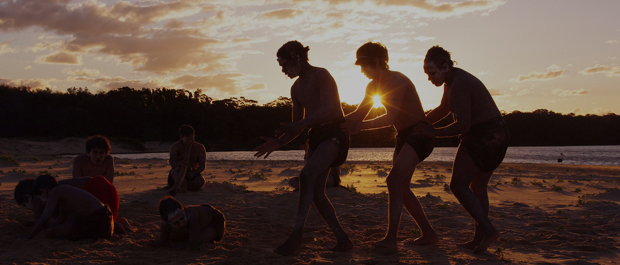
The First and Original Stories
Aboriginal people told their children stories just like us, but instead of writing them down, they passed them on orally, and through art, songs and dance.
http://www.supportingcarers.snaicc.org.au/3.3b.html

Slide 6
What You Have To Do
Explore the website called ‘Dust Echoes’ Dust Echoes
Have a good look around the site
Watch at least 4 of the stories
Take at least 2 quizzes
Make one film clip of your own using the section called /mash it up’ which is at the bottom left of your story screen
Show the film you made to a friend
http://www.supportingcarers.snaicc.org.au/3.3b.html

Slide 7
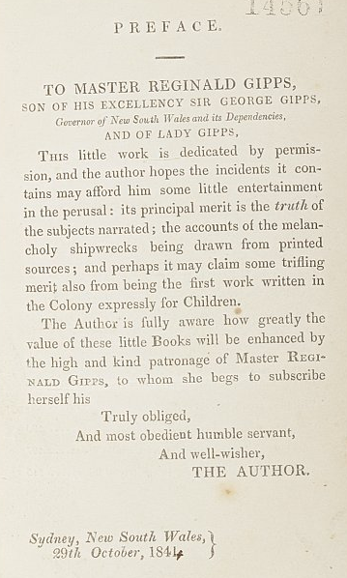
Early European Story Telling
The first book written for children in Australia once European settlement occurred was called ‘A Mother’s Offering to Her Children’ and was written by ‘a lady long resident in New South Wales’. Your teacher may read you some bits from it, but by today’s standards, it is largely inappropriate for children and very ‘politically incorrect’.
This is the ‘preface’. Look at how language has changed since 1844. Can you find some words you don’t know? Why do you think she addressed it Master Gipps? What sort of person do you think she might have been?
National Library of Australia – Digital Collections

Slide 8
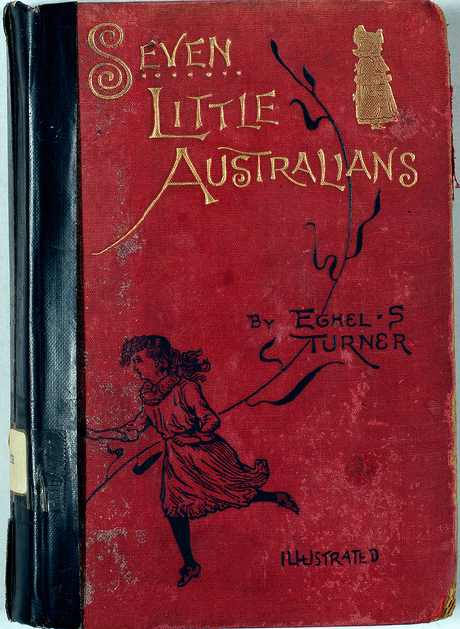
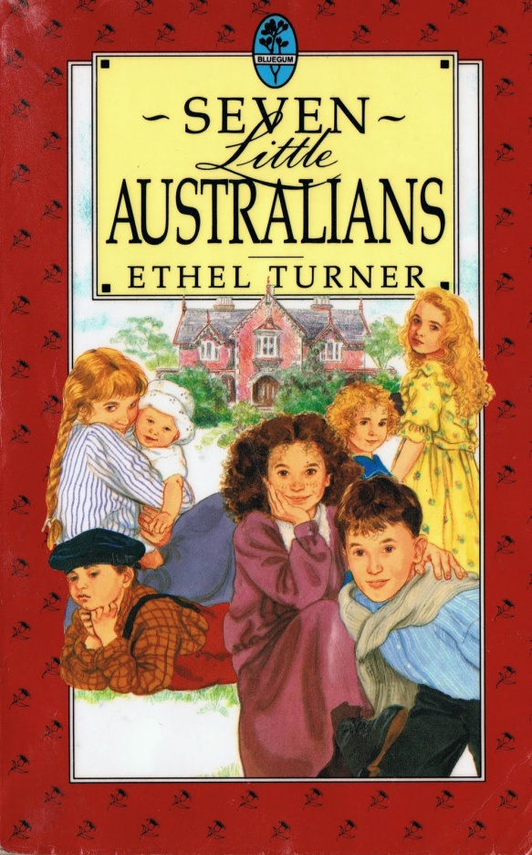
Seven Little Australians
This famous book was published in 1894 and was written by Ethel S. Turner. (1873-1958) It was about the adventures of a family of children living out in the bush. What can you infer from looking at both covers? In what ways have publications of children’s books changed over time?
https://www.youtube.com/watch?v=QBjaP9TC_KM You can watch the first episode of the television series made from the book

Slide 9
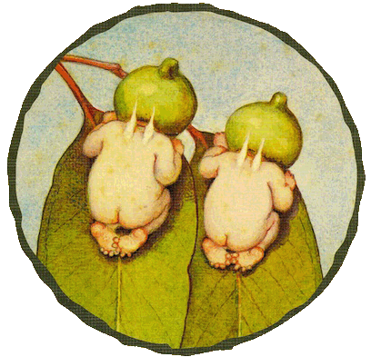
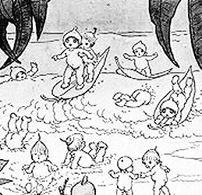
May Gibbs (1877-1969)
Look at the 5 minute video on the web site below, which is about May Gibbs.
Why didn’t she get much recognition in her time?
What difficulties did she face being a female writer/illustrator?
How do her illustrations help to establish our Australian identity?
May Gibbs

Slide 10
Mem Fox (1946 - )
Listen to Mem Fox talking about reading and writing and her life.
Why does she say reading to kids is so important?

Slide 11
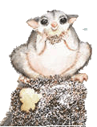
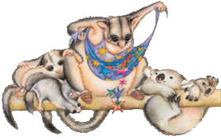
Mem Fox
Mem Fox is one of Australia’s most iconic and well known children’s authors. There would hardly be a child in Australia who hasn’t read one of her books. She is particularly well known for the Australian content of her stories and has collaborated with a range of artists and illustrators to produce a stunning array of children’s stories.
Possum Magic Read Aloud

Slide 12
Reading a Website
When we read websites, we read differently to when we read a book. Surely reading is reading? I hear you ask. When we read novels we read from the top left to the bottom right of each page, but with websites, we need to look at the layout first and see if there are subheadings either across the top of the page, or down the sides.
We read websites in a similar way to the way we read factual books with pictures - our eyes are drawn to some places first, perhaps by a photo, illustration, map etc.
Sometimes colour, or different sized writing is used to attract our attention. On websites, sometimes movement might attract our attention, such as when we run our cursor over something, and something happens, or perhaps by an animation. Even sound or music can be used to attract our attention.
We don’t have as much patience reading websites as we do with books, if pages take too long to load, or the navigation is difficult to follow, sometimes we might be tempted to give up and look elsewhere.

Slide 13
Mem Fox
Explore Mem’s website and see if you answer the following questions:
What is her real name?
How many sisters does she have?
Which is her favourite book?
Why does she have different illustrators and publishers?
Does she only write picture books?
Why does she love the portrait that was painted of her?
Who is Possum Magic dedicated to?
Which are her top five books?
Mem Fox Website

Slide 14
Morris Gleitzman
Watch this ten minute interview from Booktopia with Mr Gleitzman about himself and his writing.

Slide 15
Morris Gleitzman
Have a good look at Mr Gleitzman’s website. You are going to do a scavenger hunt. That means you have to answer some questions, the answers to which you will have to hunt for, through his website. There might be a prize for the person who can answer all the questions first.
How many books are on his ‘bookshelf’ section?
What is the name of his new book?
Which book took the longest to write?
What sections in recipe books did he especially like?
What the full name of the girl from his new book, and what 3 talents did she have?
What does he say is like ‘a backpack full of custard’?
Which country is ‘Quasselstrippe’ published in? Which of his books is it?
What mark did he get for composition in the Spring semester report of 1964?
What does his headmaster say on his Summer report in 1965?
What colour hanger did he put a blue shirt on the other day?
He makes a clever pun (play on words) in the ‘r’ section of his A-Z – what is it?
What job did he want to do when he was a child?
Who is his favourite singer/band?
How old was he when he started writing?
What car does he drive?
Mr Gleitzman’s Website

Slide 16
Australian Children’s Authors Mini-History
Australian Children’s Authors
Although Wikipedia has its limitations, this site is a pretty good one for finding out who our major writers are.
Your teacher will ask you to choose one to research. You will need to read at least one of their books, and know some background about their life. At the end of this unit, you will be asked to do a ‘hot seat’, where you pretend to be that author and take questions from the class about the book you read, and your life.
(yes, you can choose an author from the list who is dead!)
http://www.supportingcarers.snaicc.org.au/3.3b.html

Slide 17
Story Through Poetry
Australia has some wonderful famous poets, who tell stories through their poetry. Banjo Patterson and Henry Lawson were two such poets, and their poetry forged the identity of the Australian bushman/woman more than anyone else. So famous are their works, that they have been turned into books, songs and films which have in turn, influenced people’s beliefs about what it is to be an Aussie. Can you follow the stages of the poem as a narrative?
(Listen to the sound version, before looking at the online one)
https://www.youtube.com/watch?v=fs_-DKUimeo

Slide 18
Poetry Defining the Aussie
Another famous poem is by Dorothea McKellar and is called My Country. It is not a narrative, but it describes what it is about our country that appealed to her. It is a rhyming poem of six stanzas (verses). She wrote it when she was 19 years old, and living in England, which is why it starts with a section about the English countryside. It was written in 1904 and is recited by Dorothea herself. Why is the pronunciation a little ‘odd’? In what way has our spoken language changed since then do you think?
https://www.youtube.com/watch?v=o5bNhQrKay0

Slide 19
Clancy of the Overflow
Another famous narrative poem was Clancy of the Overflow, who was referred to in The Man from Snowy River. You are going to look at two versions of and compare and contrast them. The poem itself compares and contrasts bush and city life – what does the writer think of each? The first is Jack Thompson reading the poem.
https://www.youtube.com/watch?v=o5bNhQrKay0

Slide 20
Clancy of the Overflow
This version has been put to music to become a song. It is performed by Wallis and Matilda.
Which version do you think is more emotive?
Which is more effective?
Which do you think the writer would have preferred if he could see them?
Is this the ‘real’ Australia?
https://www.youtube.com/watch?v=o5bNhQrKay0

Slide 21
Aussie Slang
From listening and watching so far, you will have noticed that there is some language that is peculiar to Australia. This is called slang, or using the vernacular.
In small groups, come up with as slang words as you can. You will have 15 minutes and there will be a prize for the group that comes up with the most words.
https://www.youtube.com/watch?v=o5bNhQrKay0

Slide 22
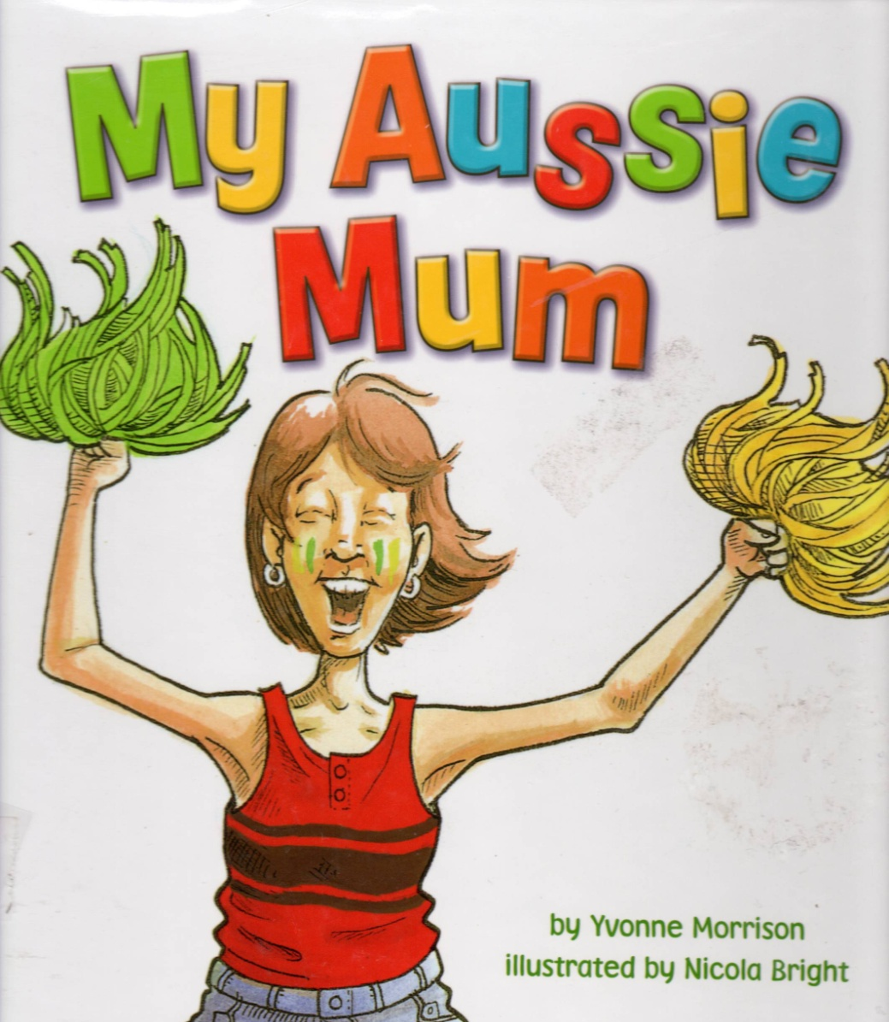
Aussie Slang My Aussie Mum
As your teacher reads you this picture book, see if you can hear any Aussie slang. Write down any that you hear and afterwards work out what they mean.
alldownunder
Koala Net
Use the websites above to put together a Kids Dictionary of Aussie Slang – in other words, if a child was new to Australia, what words do you think it is important for them to know to understand the world of school and friends.
https://www.youtube.com/watch?v=o5bNhQrKay0

Slide 23
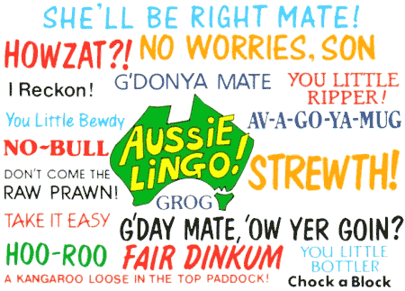
Aussie Slang
Slang changes over time just like the rest of our language. Some words disappear, and new words develop. Your teacher will show you a poem about slang from 1898 that was written by W.T. Goodge in The Bulletin, called, The Australian Slanguage.
See if you can find words you think are no longer used, and also some that are still around and used today.
https://www.youtube.com/watch?v=o5bNhQrKay0

Slide 24
Now for something lighter …
Narrative poetry (odes, ballads, epics) can also be quite funny. Listen to Banjo Paterson’s poem, Mulga Bill.
Watch this one after you have listened to the sound version above
https://www.youtube.com/watch?v=o5bNhQrKay0

Slide 25
Australiana in Film
What sort of Australian person do these characters emulate? Do you think it is realistic? People around the world watched this film, is this a good representation of an Australian person?
https://www.youtube.com/watch?v=o5bNhQrKay0

