Slide 1
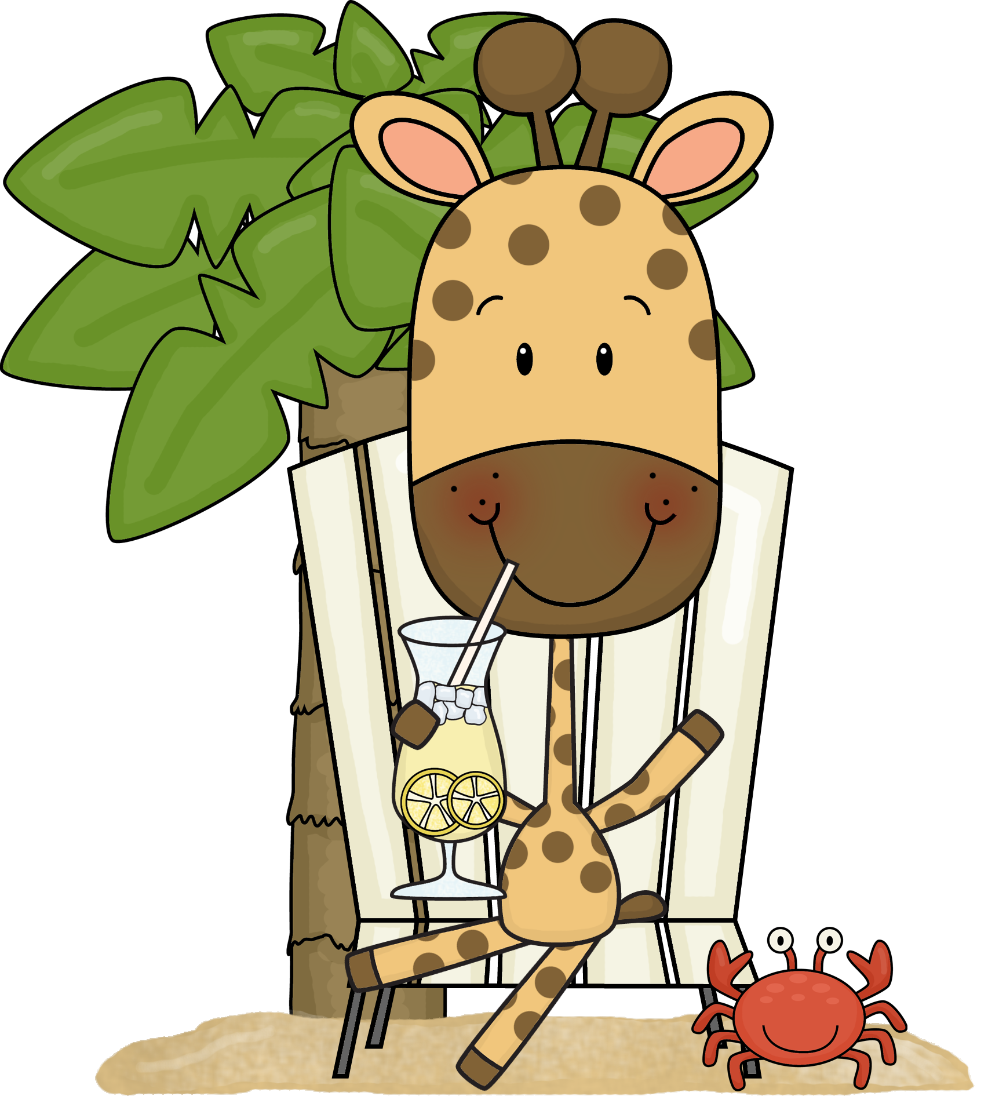
I’m learning to:
Multiplication + Division – Y2
Model and use repeated addition as a strategy for multiplication
Model and use arrays described in terms of ‘rows’ and ‘columns’ as a strategy for multiplication
Model and use groups, arrays and repeated subtraction as strategies for division
Record using drawings, words and numerals

Slide 2
I’m learning to:
Multiplication + Division Y3
Recall multiplication facts for 2X,3X, 5X, 10X
Recognise and use the symbols × and ÷
Link multiplication and division using arrays
Model & apply commutative property for multiplication
Use mental strategies to multiply one-digit numbers by multiples of 10
Use & record a range of mental strategies for multiplication
of two single-digit numbers

Slide 3
I’m learning to:
Multiplication + Division Y4
Recall and use multiplication facts up to 10 × 10 with automaticity
Relate multiplication facts to their inverse division facts
Determine multiples and factors of whole numbers
Use the equals sign to record equivalent number relationships
involving multiplication
Use & record a range of mental & informal written strategies
for multiplication & division of two-digit numbers by a one digit number
Use mental strategies and informal recording methods for
division with remainders

Slide 4
Multiplication + Division Y5
I’m learning to:
Multiplication + Division Y5
Use and record a range of mental and written strategies to multiply by one and two-digit operators
Use the formal algorithm for multiplication by
one & two-digit operators
Use and record a range of mental and written strategies
to divide numbers with three or more digits by a one-digit number, including problems with remainders
Solve word problems and record the strategy used
Interpret remainders in division problems
Use estimation to check answers to calculations

Slide 5
Multiplication + Division Y5
I’m learning to:
Multiplication + Division Y6
Select and apply efficient mental, written and calculator strategies to solve word problems and record the strategy used
Recognise and use grouping symbols
Apply the order of operations in calculations

Slide 6
Fractions - Decimals – Year 4
Fractions - Decimals – Year 3
Model & represent fractions with denominators 2, 3, 4, 5, 8
Count by halves, quarters & thirds, including mixed numerals
Represent fractions on number lines beyond 1
Fractions - Decimals – Year 4
Model and find equivalence between fractions with denominators 2, 4 and 8; 3 and 6; and 5, 10 and 100
Apply the place value system to represent tenths and hundredths as decimals
Make connections between fraction and decimal notation
Model, compare and represent decimals
with one and two decimal places
Represent decimals on number lines
I’m learning to:

Slide 7
I’m learning to:
Fractions - Decimals – Year 5
Compare and order unit fractions with denominators2, 3, 4, 5, 6, 8, 10, 12, 100
Express mixed numerals as improper fractions
Express improper fractions as mixed numerals
Model and represent strategies to add and subtract fractions
with the same denominator
Apply the place value system to represent thousandths as decimals
Compare, order and represent decimals with up to three decimal places

Slide 8
Fractions - Decimals – Y6
Represent, compare & order fractions with denominators 2, 3, 4, 5, 6, 8, 10, 12, 100
Determine, generate and record equivalent fractions
Write fractions in their ‘simplest form’
Add and subtract fractions, mixed numerals, with the same or related denominators
Multiply fractions by whole numbers
Find a simple fraction of a quantity
Use mental, written and calculator strategies to add and subtract decimals with up to three decimal places
Use mental, written and calculator strategies to multiply decimals by
one- and two-digit whole numbers
Use mental, written and calculator strategies to divide decimals by
one-digit whole numbers
Multiply and divide decimals by 10, 100 and 1000
Solve word problems involving fractions and decimals, & money problems
Make connections between equivalent percentages, fractions & decimals
Use mental, written & calculator strategies to calculate
10%, 25% and 50% of quantities, including as discounts
I’m learning to:

Slide 9
I’m learning to:
Addition + Subtraction – Y1
Model addition and subtraction using concrete materials
Recognise and recall combinations of numbers that add to numbers up to 20
Model and apply the commutative property for addition
Record number sentences using drawings, words, numerals and the symbols +, – and =
Use and record a range of mental strategies for addition and subtraction of
^{one- and two-digit numbers}
Use the equals sign to record equivalent number sentences
Addition + Subtraction – Y2
Make connections between addition and subtraction
Use and record a range of mental strategies for
addition and subtraction of two-digit numbers
Solve word problems involving addition and subtraction

Slide 10
I’m learning to:
Addition + Subtraction – Y3
Model and apply the associative property for addition
Use and record a range of mental strategies for addition and subtraction of two-, three- and four- digit numbers
Perform calculations with money, including calculating equivalent amounts using different denominations
Use the equals sign to record equivalent number sentences
Addition + Subtraction – Y4
Use the inverse operation to check addition and subtraction calculations
Use and record a range of mental strategies for addition and subtraction of
two-, three-, four- and five-digit numbers
Use the formal written algorithm for addition and subtraction
Solve word problems, including those involving money

Slide 11
I’m learning to:
Addition + Subtraction – Y5
Select and apply efficient mental, written and calculator strategies for addition and subtraction of numbers of any size
Use estimation to check answers to calculations
Solve word problems and record the strategy used, including problems involving money
^{Create a simple budget}
Addition + Subtraction – Y6
Elect and apply efficient mental, written and calculator strategies to solve word problems and record the strategy used

Slide 12
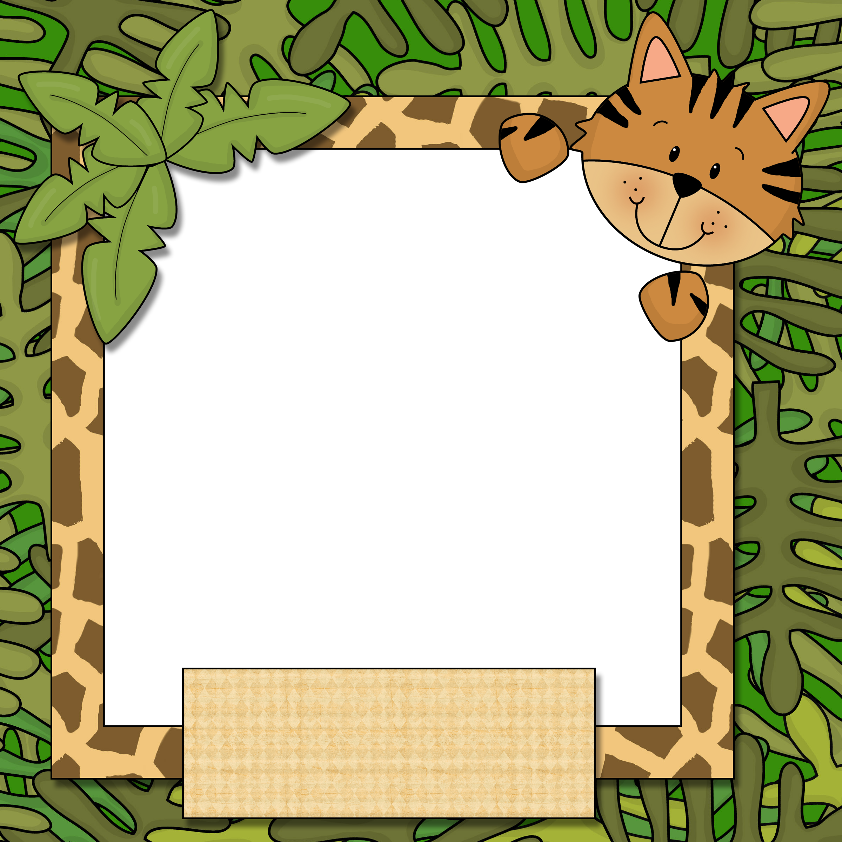
Comprehension – Cluster 9
I’m learning to:
Build understanding by discussing possible consequences and events during reading.
Tell the difference between inferred meaning and literal meaning.
Understand the meaning of a text by getting information from different parts of the text.
Identify visual techniques in a text.
Identify aural techniques in a text.
Identify written techniques in a text.
Understand that texts can present different perspectives.
Identify and interpret main ideas and important information in a text.
Use main ideas and important information to retell a text.

Slide 13
Comprehension – Cluster 10
I’m learning to:
Interpret a text by inferring connections, causes and consequences while reading.
Interpret texts by discussing the differences between literal and inferred meanings.
Respond to texts by discussing the differences between literal and inferred meanings.
Identify ways texts present different perspectives
Compare accuracy and credibility of a text by comparing texts on a similar topic.
Analyse texts by discussing the way language features and structures shape meaning.
Respond to texts by discussing the way language features and structures shape meaning.

Slide 14
I’m learning to:
Comprehension – Cluster 11
Understand how inference is used in a text.
Reread text to find supporting evidence.
Respond to a different point of view in a text.
Look at how audience, purpose and context influence text.
Create a summary that demonstrates thorough understanding of different views and values in a text.
^{Identify} grammatical techniques used in a text & explain their impact on the audience.
Understand how a topic can be presented in a range of texts.

Slide 15
Comprehension – Cluster 12
I’m learning to:
Discuss multiple purposes within the one text.
Use different texts to summarise a topic.
Understand how language features of the text affect the reader.
Understand how visual images create meaning by comparing texts on the same topic.
Justify hidden meaning using evidence.
Interpret text by creating a personal response in a variety of presentations.
Analyse a wide range of text and compare how ideas are presented.
Explain how different texts show different points of view.

Slide 16
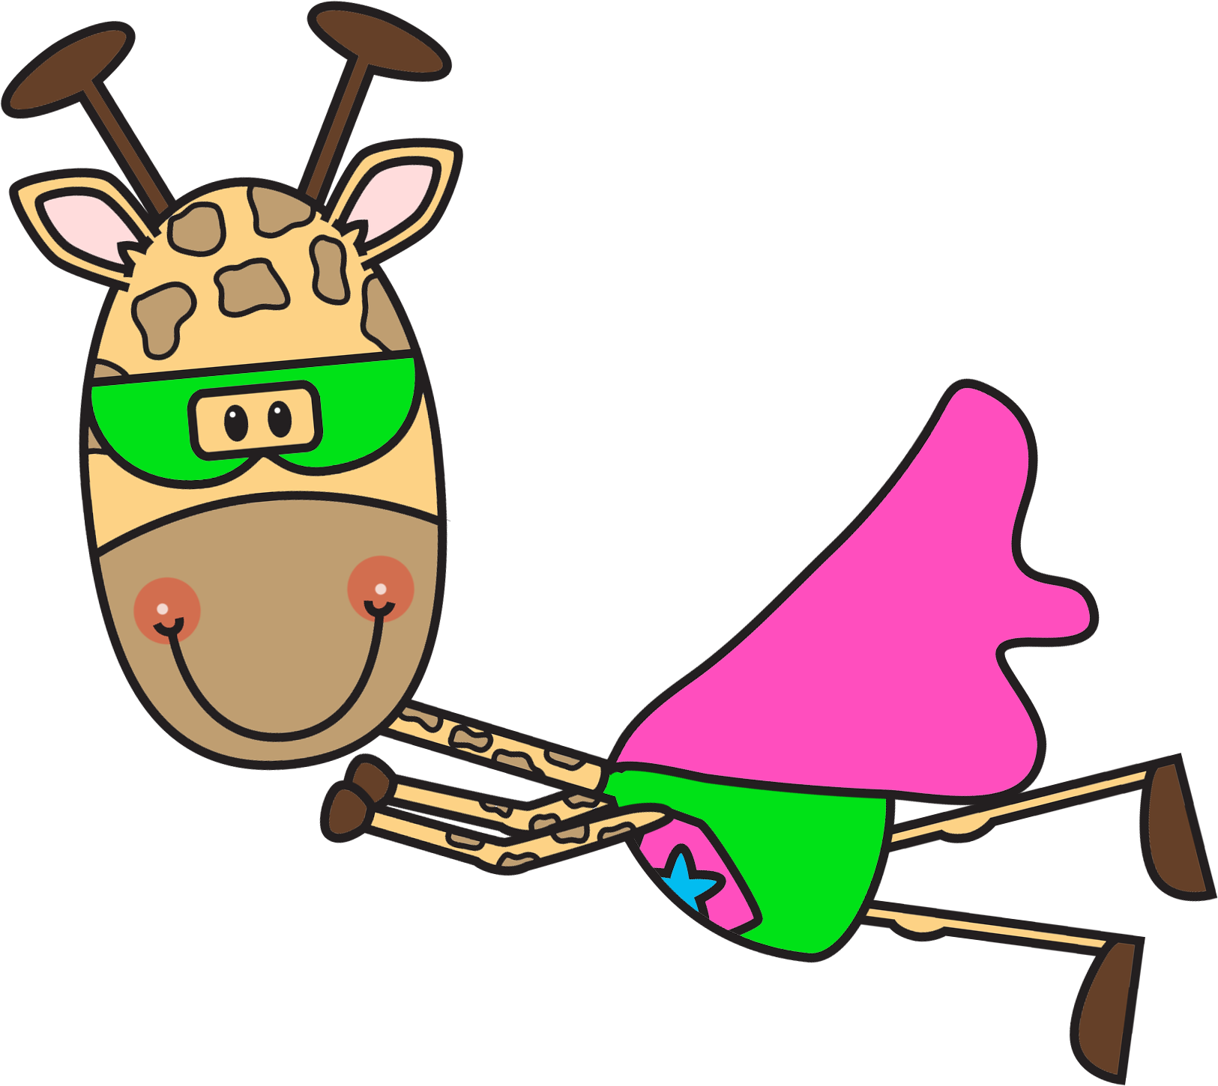
Writing – Cluster 9
Create an imaginative text.
Create an informative text.
Create a persuasive text.
Choose language appropriate to my purpose and audience.
Plan using headings, mindmaps and questions.
Reread to check for accuracy.
Reread to check for consistency of meaning.
Reread to check for relevancy for purpose.
Write using paragraphs that are a group of sentences about a topic.
Use different spelling strategies to spell words
Use computer skills such as spell check and grammar check
Use verbs correctly.
Use adverbs correctly.
Use nouns correctly.
Use adjectives correctly.
Write joined letters and letters of the same size.
Create simple multimodal text digitally
(combination of pictures, text, voice over, sound).
I’m learning to:

Slide 17
Writing – Cluster 10
I’m learning to:
Use personal experience, texts and research to create a
variety of texts for different audiences.
Justify my opinion with evidence.
Find resources and information when planning.
Reread and revise text to check for and improve meaning
Reread and revise to delete unnecessary information and add new information.
Write sentences with different beginnings.
Write sentences with an adjectival clause at the beginning.
Write sentences with an adverbial clause at the beginning.
Write complex sentences.
Use simple and sentence punctuation correctly.
Spell words by thinking about what they mean.
Spell words by knowing how letter combinations look.
Spell words by hearing the sounds in words.
Spell words by knowing the sound of letters.
Use prefixes and suffixes appropriately.
Use pronouns to link ideas and information.
Use conjunctions and connectives to link ideas and information.
Write in neat consistent handwriting.

Slide 18
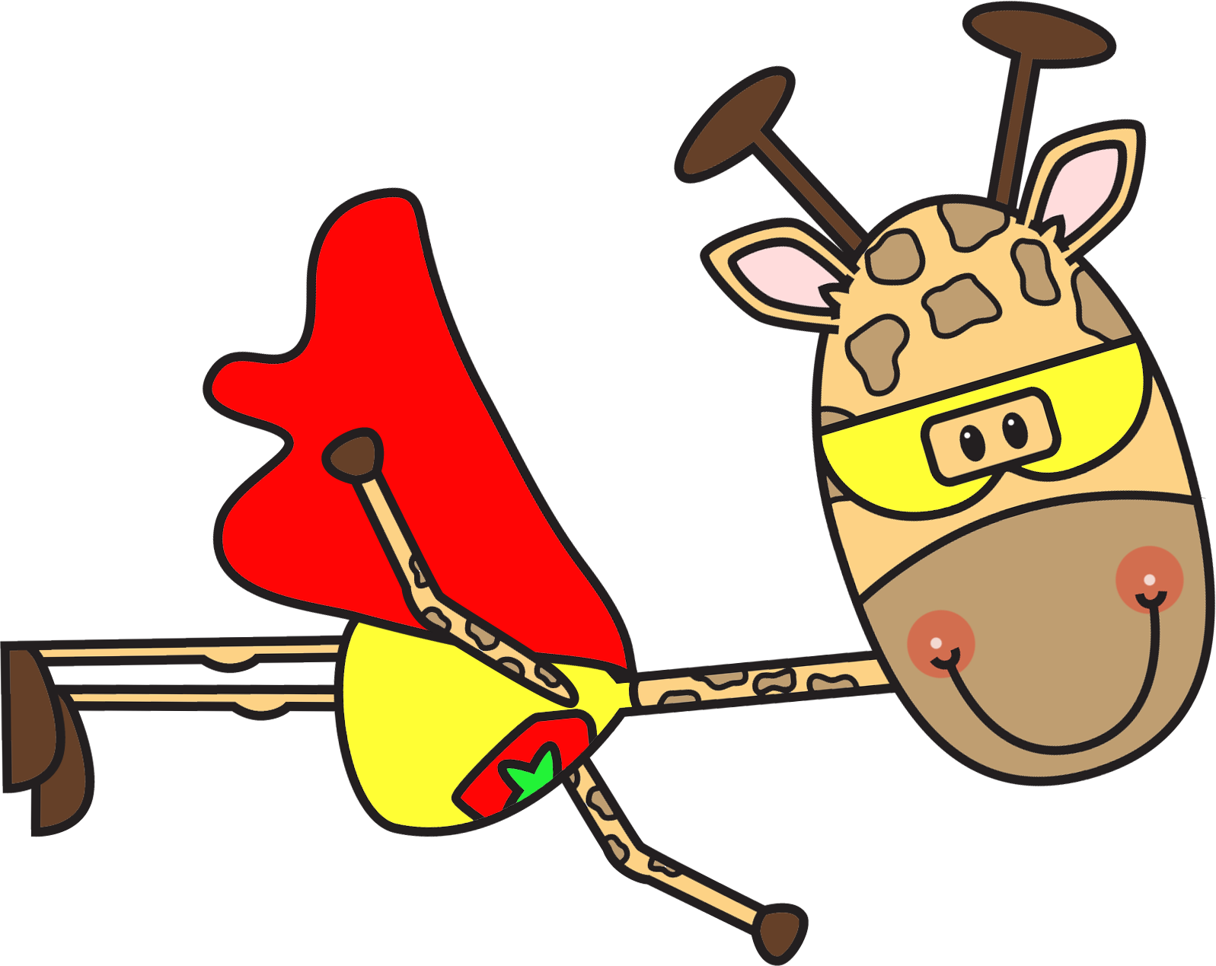
Writing – Cluster 11
I’m learning to:
Write logical well-structured texts for a range of purposes.
Construct a logical well-structured imaginative text.
Construct a logical well-structured informative text.
Construct a logical well-structured persuasive text.
Find, accurately acknowledge and site sources.
Use feedback to edit my writing.
Engage the reader through deliberate choices in language -
- descriptive
- persuasive
- topic
- technical
- evaluative
- emotive
- colloquial

Slide 19
Writing – Cluster 11
I’m learning to:
Use topic sentences.
Organise main and subordinate ideas.
Use quotation marks.
Use colons and semicolons.
Use dashes, sparingly.
Spell new words using generalisations.
Spell new words using meanings of base words.
Spell new words using prefixes and suffixes.
Write fluently with appropriate size.
Write fluently with appropriate spacing.
Use word processing programs confidently.
Use various functions in word processing programs.
Plan and design complex multimodal texts
(combination of pictures, text, voice and sound).

Slide 20
Writing – Cluster 12
I’m learning to:
Write extended texts for wide range of purposes.
Choose the type of text to suit a purpose and audience.
Choose the form of text to suit a purpose and audience.
Create well planned texts.
Write more complex and detailed subject matter.
Use creative language features -
- alliteration
- metaphor
- imagery
- nominalisation
- sentence length
Refine writing in response to feedback, the edit and publish.
Use sophisticated literary devices eg humour & irony to engage an audience.
Use grammatical features such as modality to influence an audience.
Use a variety of sentences starters.
Use a variety of dependent clauses.

Slide 21
Vocabulary – Cluster 8
Explain the terms associated with multimedia
Recognise different words to explain similar ideas e.g. synonyms
Write using different words depending on who will read my writing
Edit my writing using better word choices
I’m learning to:
Use words and groups of words to make my stories more interesting
Use words to change the feeling of my stories
Use what I know about a topic to understand unfamiliar words

Slide 22
Use different words that have the same meaning e.g. synonyms
Use words that relate to the topic in my writing
Use words associated with the use of computers & electronic texts confidently
Use suffixes to change the meaning of words
Use prefixes to change the meaning of words
I’m learning to:
Vocabulary – Cluster 9

Slide 23
Understand that word meaning can change when used in
different texts
Use expanded vocabulary by drawing on
my knowledge of known words and topic words
Use a number of ways to work out the meanings of words
Use dictionaries and thesauruses to find the meaning of
unknown words
I’m learning to:
Vocabulary – Cluster 10

Slide 24
Vocabulary – Cluster 11
I’m learning to:
Construct texts, with appropriate word choices, that consider its audience
Construct texts, with appropriate word choices, that consider its purpose
Understand new words for new concepts
I can use prefixes to find the meaning of new words
Use suffixes to find the meaning of new words
Use prefixes to create new words
Use suffixes to create new words
Edit and review my own writing using improved word choices
Edit and review other people’s writing using improved word choices

Slide 25
Vocabulary – Cluster 12
I’m learning to:
Use new words for new concepts
e.g. blissful for happy
Use appropriate language for
spoken texts that suit a specific topic
Use appropriate language for
written texts that suit a specific topic
Communicate through digital and electronic means
Use the language associated with digital technology & electronic texts
Use the origin of words to make out the meaning of new word

Slide 26
Reading – Cluster 8
I’m learning to:
Read more difficult texts
Read more difficult texts with less familiar
content and vocabulary
Read more difficult texts with longer
descriptions
Engage with longer literary and factual texts
Engage with more difficult literary and
factual texts
Engage with literary and factual texts for
longer periods of time (at least 10 mins)

Slide 27
Reading – Cluster 9
I’m learning to:
Read for longer periods of time (15-20 mins)
Sustain meaning when reading is interrupted
eg reading short novels over several days
Use visuals to help meaning when reading factual texts
eg photographs, tables, charts
Understand how to skim or scan text for specific information
Understand how to use features such as subheadings to locate specific information
Use features such as tabs, drop down menus, subheadings
and scrolling to read and view internet and on-screen texts

Slide 28
Reading – Cluster 10
I’m learning to:
Read short novels with minimal illustrations
Read short novels with unfamiliar content, settings
and characters
Read short novels with difficult and unusual vocabulary
Use different strategies to read unfamiliar words
eg homonym, syllabification
Use topic knowledge to read unfamiliar words
Use vocabulary knowledge to read unfamiliar words
I can use context to read unfamiliar words

Slide 29
Reading – Cluster 11
I’m learning to:
Read for sustained periods of time (20-30 mins)
Engage with a variety of texts
eg. newspapers, TV documentaries, websites
Use a variety of texts to gain information on one topic eg multiple texts, websites, electronic texts

Slide 30
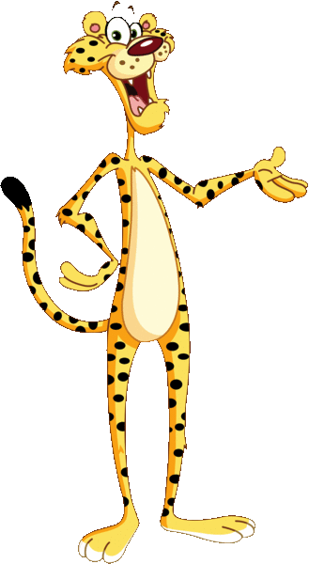
Reading – Cluster 12
I’m learning to:
Read increasingly longer novels and texts
Read, view & use a variety of literary and factual,
print and electronic texts
Read more demanding subject texts with increasing
levels of technicality

Slide 31
Maths Learning Intentions from
The Mathematics K-10 Continuum of Key Ideas poster that describes the content to be developed at each Stage of learning.
Created by Shellie Tancred
Graphics from Scrappin Doodles, iClip Art

