Slide 1
Mad Science!
“With how many things are we on the brink of becoming acquainted, if cowardice or carelessness did not restrain our inquiries.”
Mary Shelley, Frankenstein
A Year 4 English unit
By Jennie Newton and Karen Hodgson

Slide 2
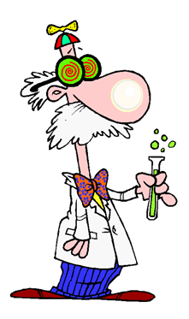
We are going to be studying ‘Mad Science!’ this term and are going to be examining a number of texts
Frankenstein by Mary Shelley
George’s Marvellous Medicine by Roald Dahl
Despicable Me – film
Wallace and Gromit, Cracking Contraptions – short films
Film Posters
Science Kids - website

Slide 3
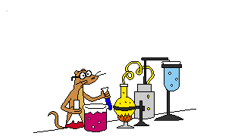
By the end of this unit I hope you can …
Listen to spoken texts and justify your opinions about ideas, characters and events
Interpret and analyse pictures, also justifying your answers
Understand, analyse and make inferences about characters, events and ideas
Recognise and discuss how composers (writers) represent characters in certain ways
Recognise how composers create tension
Identify and explain what composers do to engage readers/viewers
Use some of these skills to create your own Mad Science story

Slide 4
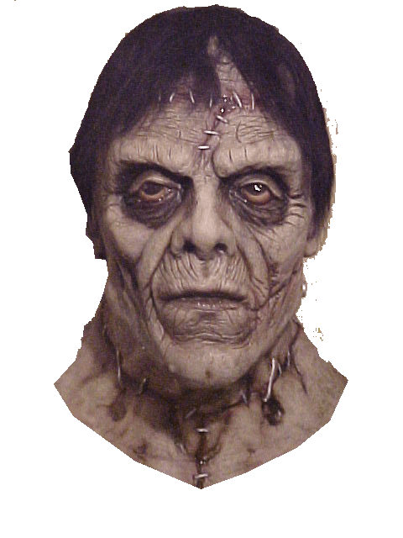
Mad scientists and weird science have long been part of our culture, and that of many other cultures around the world. In Western culture, it was given a big push by the famous work of an author named Mary Shelley – ‘Frankenstein’. She is known as the first science fiction writer. The monster created in this book was not called Frankenstein, that was the name of the scientist who created him, but over time, the name has just kind of stuck.

Slide 5
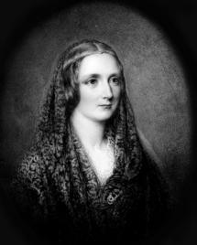
So where did this idea of bringing a monster to life really come from? At the time that Mary Shelly wrote her story, many strange experiments were being performed using electricity which was quite a new phenomenon at this time. But it has been suggested that in her travels, Mary Shelley may have heard about the famous Golem of Czechoslovakia and this may be what her story was based on. Others have suggested it came from a dream she had as a child.

Slide 6
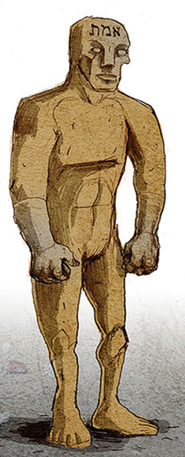
Where did it start?
The Golem
A Jewish Rabbi from Prague was said to have created a ‘golem’ from dirt and mud. He brought it to life using special holy and magic words, and some of these were written on the monster’s forehead. The Rabbi created the monstrous golem in order to protect the Jews of Prague from ‘pogroms’ in 1730. The golem was an enormous monster who was supposed to keep the Jewish people safe from others who were trying to kill them. However the Rabbi could not keep control of the golem, and it started attacking the people it was supposed to be protecting. When the golem got very out of hand, the Rabbi took the special name from off the monster’s forehead and turned the golem back to dust. Supposedly, the dust is still hidden in an attic somewhere in the area.

Slide 7
And then …
Wherever she got the idea from, the book was a hit, and has been produced in many different editions. Because it was written in 1818, the language is very different from that which we use today. Have a look at this piece of writing and ‘translate’ it into today’s language.
‘The child still struggled and loaded me with epithets which carried despair to my heart; I grasped his throat to silence him, and in a moment he lay dead at my feet.
“I gazed on my victim, and my heart swelled with exultation and hellish triumph; clapping my hands, I exclaimed, ‘I too can create desolation; my enemy is not invulnerable; this death will carry despair to him, and a thousand other miseries shall torment and destroy him.’

Slide 8
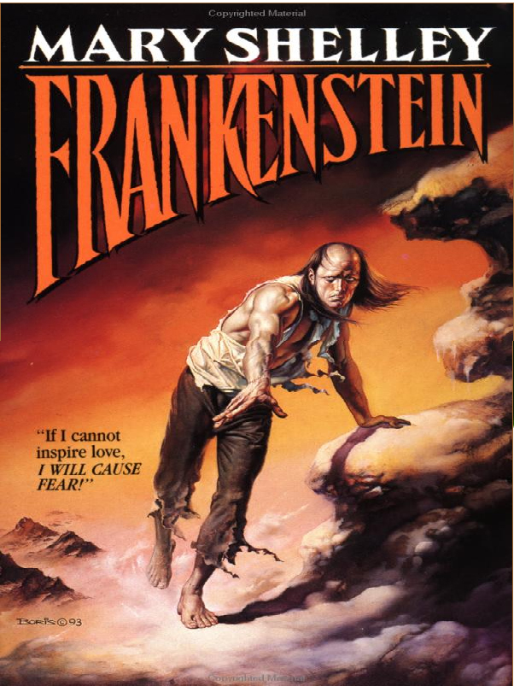
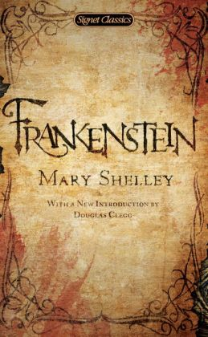
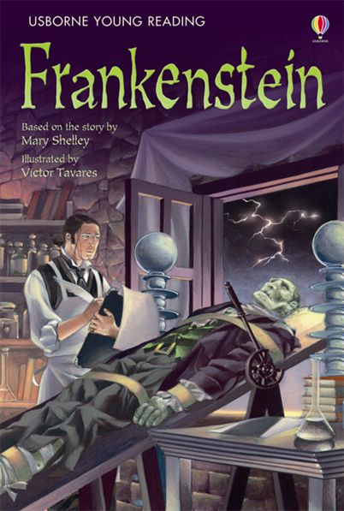
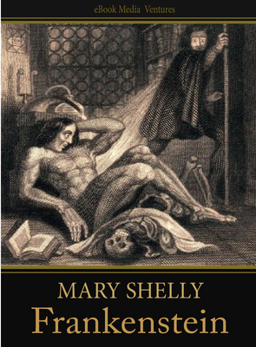
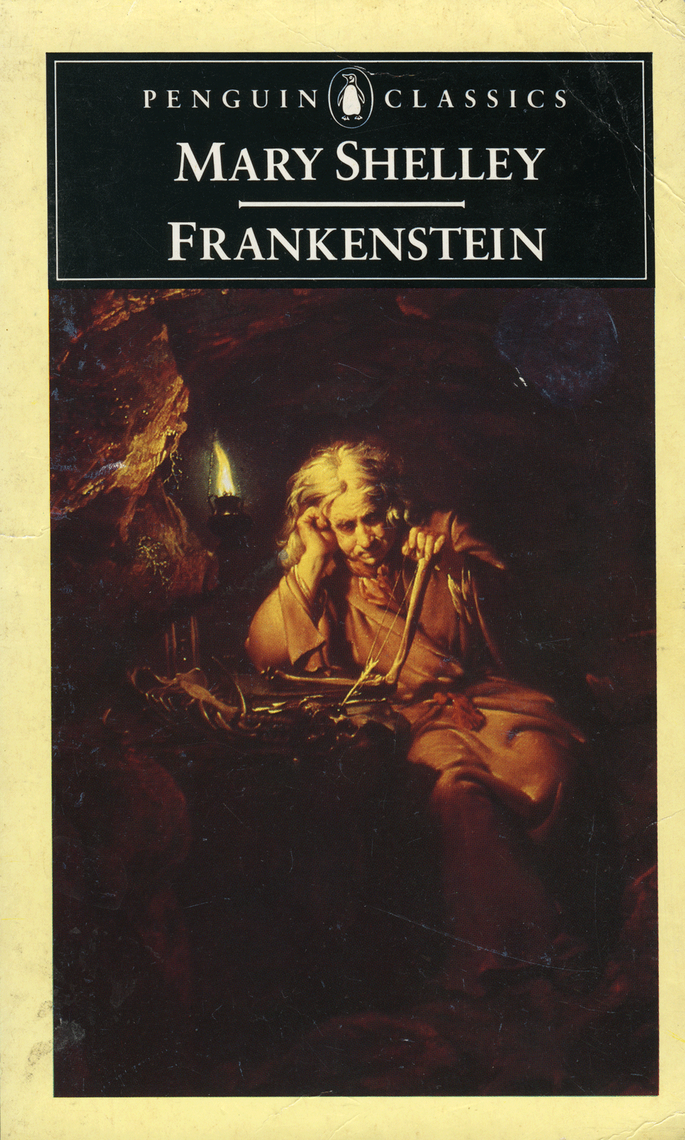
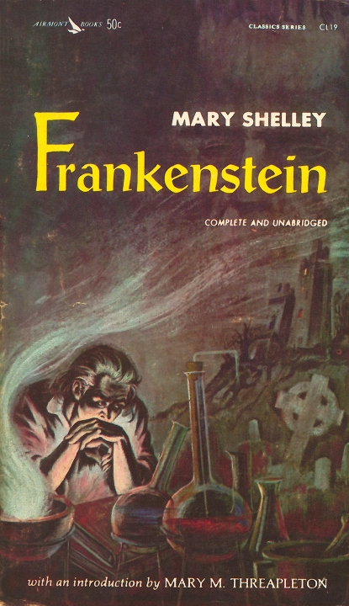
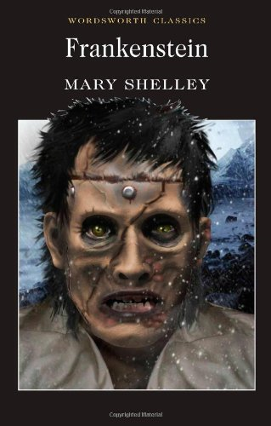
Look at some of the different editions that have been printed. Which do you think is best? Why?

Slide 9
Characterisation
When authors create books and films, they build a ‘picture’ about the character in the mind of the reader. As you study this topic, we are going to be finding out about the tricky ways that composers do this. There is a way to remember:
S speech: what does the character say, and how do they say it?
T thoughts: what is revealed through their thoughts and feelings?
E effects: what is revealed through the character’s effect on other
people? How do other characters feel or behave in reaction to them?
A actions: what does the character do? How do they behave?
L looks: what does the character look like? How do they dress?
https://www.youtube.com/watch?v=B_GVgbykf8A

Slide 10
Characterisation
Look at each of these excerpts and see if you can draw conclusions about the character who is speaking.
S – speech
“It’s not what you like or what you don’t like,’ Grandma snapped. ‘It’s what’s good for you that counts. From now on, you must eat cabbage three times a day. Mountains of cabbage? And if it’s got caterpillars in it, so much the better!” and later … “Let George get it, the lazy little brute!” Grandma shouted. . .
“She’s still going!” shouted Mr Kranky gleefully. “She’s still getting smaller!”
George’s Marvellous Medicine by Roald Dahl
What does this tell us about the sort of person Grandma is? What conclusions can you draw about her?
What is the one word that tells us about how Mr Kranky feels when Grandma shrinks?

Slide 11
Characterisation
Look at each of these excerpts and see if you can draw conclusions about the character.
T – thoughts
“For the first time the feelings of revenge and hatred filled my heart, and I did not strive to control them, but allowing myself to be borne away by the stream, I bent my mind towards injury and death.” Frankenstein by Mary Shelley
How is the creature feeling at this point? What tells you that?
“He would have liked to put a long green snake down the back of her dress but he didn’t have a long green snake.
He would have liked to put six big black rates in the room with her and lock the door but he didn’t have six big black rats.”
How is George feeling about his Grandma? What words give you a clue?

Slide 12
Characterisation
Look at each of these excerpts and see if you can draw conclusions about the character.
E – effects, how do other characters feel or behave in reaction to the character.
“On seeing me, he darted towards me, and tearing the girl from my arms, hastened towards the deeper parts of the wood. I followed speedily, I hardly knew why; but when the man saw me draw near, he aimed a gun, which he carried, at my body and fired. I sank to the ground, and my injurer, with increased swiftness, escaped into the wood.” Frankenstein by Mary Shelley
How are people reacting to seeing the ‘monster’?
“You’re trying to get away from me, aren’t you? She said, pointing a finger straight at George’s face. ‘You’re trying to get away from Grandma.” George took another step backwards.
What does Grandma think about George? How do you know?
What do George’s actions tell you about both himself and Grandma?

Slide 13
Characterisation
Look at each of these excerpts and see if you can draw conclusions about the character.
A Actions – what does the character do? How do they behave?
“Urged by this impulse, I seized on the boy as he passed and drew him towards me. As soon as he beheld my form, he placed his hands before his eyes and uttered a shrill scream; I drew his hand forcibly from his face and said, ‘Child, what is the meaning of this? I do not intend to hurt you; listen to me.” Frankenstein by Mary Shelley
What do the creature’s actions tell you about him? Has he hurt the boy? Do you think he intends to? What do the boy’s reactions tell you about the creature and also the boy?
“You’re trying to get away from me, aren’t you? She said, pointing a finger straight at George’s face. “You’re trying to get away from Grandma.” George took another step backwards.
What does Grandma think about George? How do you know?
What do George’s actions tell you about both himself and Grandma?

Slide 14
Characterisation
Look at each of these excerpts and see if you can draw conclusions about the character.
L Looks – what does the character look like?
“Great God! His yellow skin scarcely covered the work of muscles and arteries beneath; his hair was of a lustrous black, and flowing; his teeth of a pearly whiteness; but these luxuriances only formed a more horrid contrast with his watery eyes, that seemed almost of the same colour as the dun-white sockets in which they were set, his shrivelled complexion and straight black lips..” Frankenstein by Mary Shelley
What does that tell you about the way he looked? What would people’s reactions be when seeing him for the first time? Does his outward appearance match what is inside him?
“She was a selfish grumpy old woman. She had pale brown teeth and small puckered-up mouth like a dog’s bottom.”
What does Mr Dahl tell us about Grandma with that description? Why did he say her mouth was like a dog’s bottom? What made it like that?

Slide 15
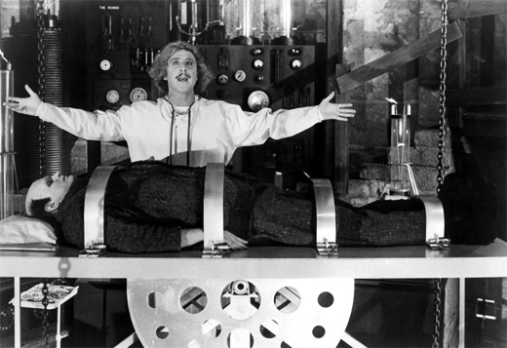
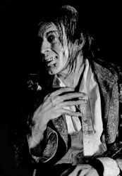
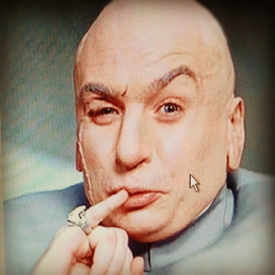
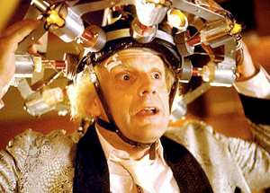
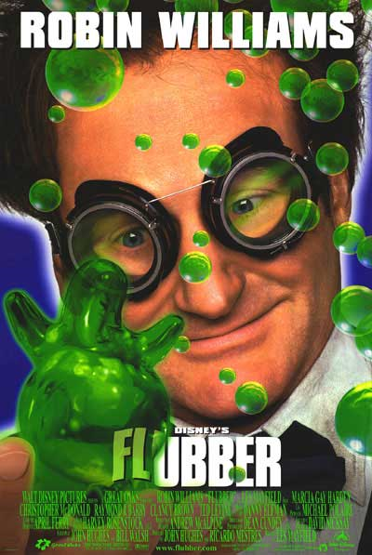
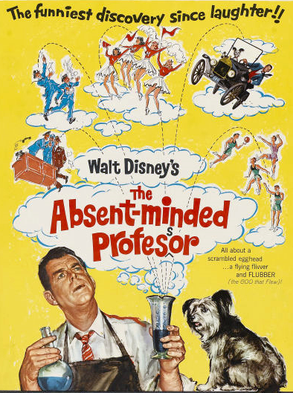
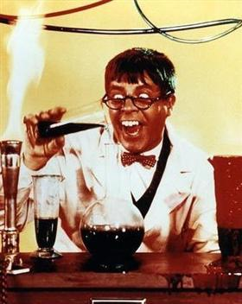
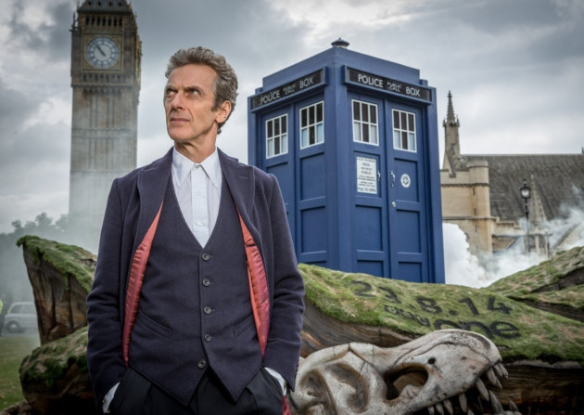
Famous Mad Scientists
Gene Wilder
Young Frankenstein
Christopher Lloyd
Back to the Future
Dr Evil
Austin Powers
Dr Jekyll
Jerry Lewis
The Nutty Professor
Robin William
Flubber
Fred McMurray
The Absent-minded Professor
Peter Capaldi
Dr Who

Slide 16
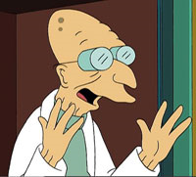
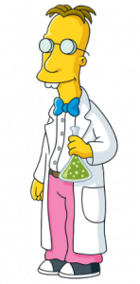
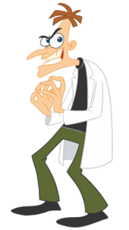
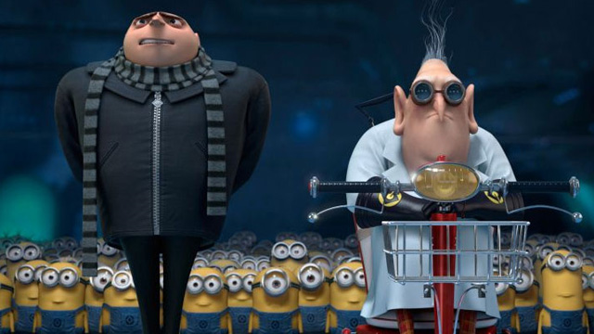
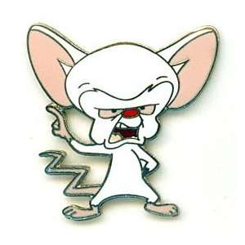
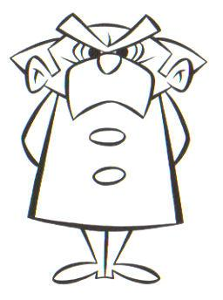
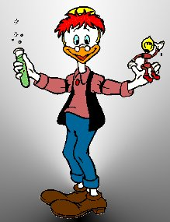
Famous Cartoon Mad Scientists
Professor Hubert Farnsworth
Futurama
Gru and Dr. Nefario
Despicable Me
Professor Frink
The Simpsons
Dr Heinz Doofenshmirtz
Phineas and Pherb
The Brain
Pinky and the Brain
Professor Nutmeg
Felix the Cat
Vector
Despicable Me
Gyro Gearloose
Walt Disney

Slide 17
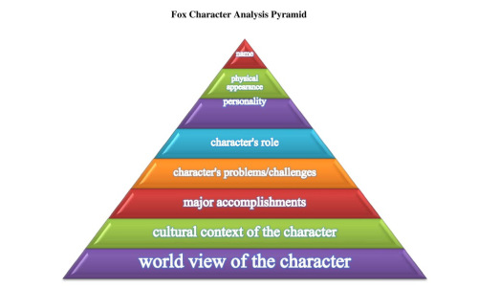
Your Own Mad Scientist
You are going to write your own ‘mad scientist’ story, but before you do that you need to build up a ‘picture’ of your mad scientist. And there is a special way we are going to do that, before you even begin to write your story. All the time we are developing a ‘picture’ of your scientist, be thinking about what the plot might be.
http://foxhugh.com/literary-elements/character-analysis/

Slide 18
Name
You are going to create a HUGE mindmap about your character. The easy part is starting with their name.
Isn’t it funny you never see any female mad scientists? I hope that might be about to change! Think of a great name, and put it in the middle of your page.
Then as we ‘build’ your main character, add information around your mind-map until you have built up a really detailed description and brought your character to life, before you even start writing the story.

Slide 19
Physical Appearance
This will be quite a big part of your mind-map so make sure it is quite detailed.
Beautiful, average or ugly?
Tall, short, thin, medium, wide
Hair and eye colour
Hair – colour, style, peculiarities,
Glasses? Walking stick? Something they always carry (toy)
Nose – huge, small, crooked, acned, freckled, veined, diseased?
Mouth – small, large, crooked, weird teeth, gleaming teeth, sharp teeth, no teeth, a few teeth, just one tooth,
Skin – colour, discoloured, warts, freckles, patches, hairy, dirty, super-clean, weird colour?
Stance – upright and very straight, crooked, bent over, twisted to one side
Movement – how do they walk? Creep, scuttle, stride, pace, drag one leg, tippy-toe, normal, dance along
Clothes – normal, lab coat, all in black, bright colours, super-hero suit, weird (knitted jumpers with reindeer on them)
Speech – impediment?
http://foxhugh.com/literary-elements/character-analysis/

Slide 20
Character’s Role
Is your character trying to …
save the world
ruin the world
come up with an amazing new invention
thwart another evil character
prove a new theory
save someone
destroy someone or something
venture into space and discover something new
venture somewhere in the world to find something new
find something that is lost somewhere in the world
help others
fix a problem that others are suffering from
cause a new problem (maybe by accident then fixing it)
become famous for being bad / good / amazing
make friends
create an amazing ‘thing’
make new life / join two things together
something else more unusual or amazing
http://foxhugh.com/literary-elements/character-analysis/

Slide 21
Major Accomplishments
What have they achieved so far in their life or hope to achieve?
Invented something amazing
Invented a cure for something
Created a weird new form of life
Created a strange weapon
Wrote a book, song, poem, rap
Had their own tv show / website / youtube video
Invented a wonderful new type of food
Painted or sculpted something
Created a new vehicle (think of Gru in Despicable Me with his monstrous ‘car’)
http://foxhugh.com/literary-elements/character-analysis/

Slide 22
Character’s Problems and Challenges
If nothing went wrong, there would be no story, so you need to come up with some problems or challenges that your character faces. They could be small problems that are part of their everyday life (which makes them interesting and gives you a chance to show their character by how they react when things go wrong), or they may be the big challenge that provides the complication in the story.
Bumbling side-kick who ruins things
Other people interfering and thwarting their plans
Getting over a fear of something e.g. spiders, electricity etc.
Talking to people (they are hermits or very shy/nervous/have a speech impediment or bodily impairment)
Getting money or food to live
Finding and kitting out a laboratory
Getting people to believe them / believe in them
Annoying relatives or friends (e.g. mother won’t let them get dirty, or play with friends
Allergy or phobia
http://foxhugh.com/literary-elements/character-analysis/

Slide 23
Major Accomplishments
What have they achieved so far in their life or hope to achieve?
Invented something amazing
Invented a cure for something
Created a weird new form of life
Created a strange weapon
Wrote a book, song, poem, rap
Had their own tv show / website / youtube video
Invented a wonderful new type of food
Painted or sculpted something
Created a new vehicle (think of Gru in Despicable Me with his monstrous ‘car’)
Dream of being the most famous scientist the world has ever known
Dream of creating the most amazing thing known to mankind
Dream of saving the world
Dream of destroying the world
http://foxhugh.com/literary-elements/character-analysis/

Slide 24
Cultural / World Identify
It is so easy with so much American television on our screens to revert to American style stories, but think carefully about the cultural background of your story.
Where is it set? Often it’s easiest to write about things we know, so you could set it somewhere in your own world and not ‘copy’ things that you have already seen in films and on television.
Try to be original and don’t let your story be like anything you have already seen and read.
If your story is set in Australia, then give it some local ‘flavour’.
You also want people to identify with your story and get engrossed, so think about it in the context of the whole world also.
http://foxhugh.com/literary-elements/character-analysis/

Slide 25
Writing Style
You need to decide if you are writing in
First person
You are in the story, and will use the words I, me, and my throughout the story e.g. Frankenstein is written in first person from the point of view of the monster … “There is love in me the likes of which you've never seen. There is rage in me the likes of which should never escape. If I am not satisfied in the one, I will indulge the other.” Mary Shelley
Third person
You are on the outside looking in and will be the narrator, so you will not have the words I, me or me in the story
e.g. George’s Marvellous Medicine is written in third person … “George put the huge saucepan on the table.”
Which ever you choose, you kind of need to stay consistent throughout. Some authors do chop and change, as a way of showing different characters’ points of view and thoughts, but it is generally easier to stick with one, and third person is usually easier to keep with. Just imagine you are a ‘fly on the wall’ watching the events take place, and describe what you see and hear.

Slide 26
Secondary Characters
Batman needed a Robin, Gru needed minions, so all good stories need other characters. You now need to build up a side-kick or some other characters for your story.
Use the same process we went through to create your mad scientist character and create some other characters for your story.
Good writers put as much effort into ‘drawing’ their secondary characters as they do their main character.

Slide 27
Purpose of the Writing
Although you are trying to entertain your reader, remember we are focussing on characterisation. You will be assessed on how well you build your characters, and you show your characters by …
What they say
What they think
What they look like
What they do
How other characters react to them

Slide 28
Important Details
Where is it going to be set (setting)
When is it occurring (past, present, future)
Who is also going to be in the story?
What will the major complication be?
How will the complication be resolved?
How does the character/s change because of their experience?

Slide 29
For example …
Plot:
Misunderstood weird, mad scientist is trying to invent an amazing new machine that will clean up all the rubbish in the world
Setting:
In a laboratory in a space station that is orbiting the Earth
When: In the year 2054
Characters: Professor Pimplepocket and her two trusty side-kicks named Listen and Learn. Listen is very stupid and never listens and Learn is always hitting him with ping-pong paddle. He isn’t very bright either. She also has a talking pet blue-tongue called Lick and a skink called Flick.
Complication:
The machine she creates starts cleaning up everything, including buildings, people etc.
How it is Resolved:
Professor Pimplepocket creates a machine that makes Lick and Flick grow until they are enormous and then they go and eat up the machine that has gone wrong. It all returns to normal and she learns not to mess with things she shouldn’t.

Slide 30
Tip
You can’t really write a good story without a plan. Even if you don’t stick to it and change once you start writing, you still need a plan. If you don’t, guess what happens?
And then … blah blah .. and then … blah blah … and then …
You need to remember:
describe what people are feeling
say what people are thinking
describe what is going on around the action
what setting and events look like
every time someone new speaks, use new line, and speech marks
The best way make sure it is good is to READ IT ALOUD many times as you go, and every time you say, ‘Oh’, that means you need to fix something.
p.s. don’t make it too long either (booorrrring) , about 2 typed pages should do it, in font no larger than size 14 (but quality is more important than quantity)

Slide 31
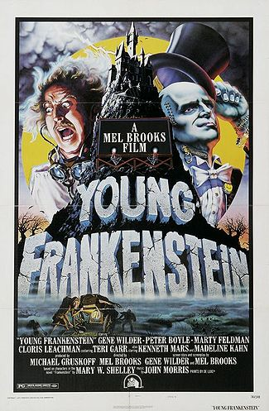
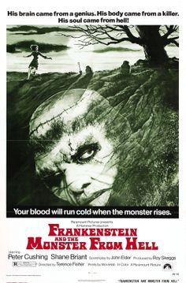
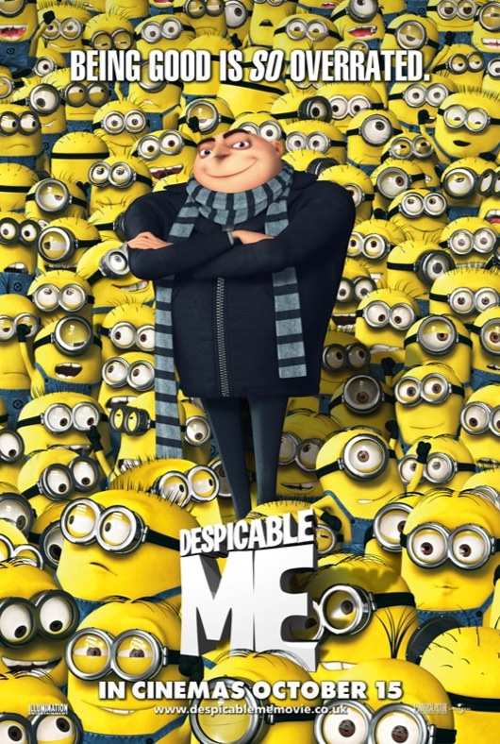
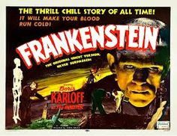
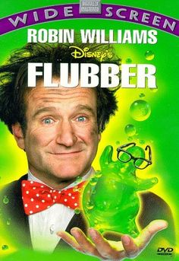
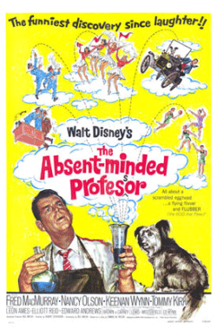
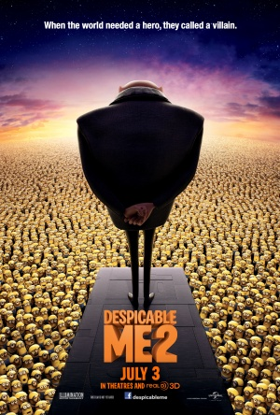
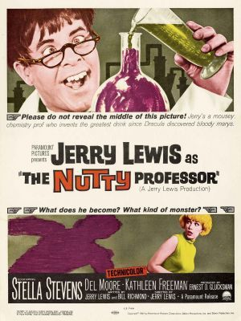
Movie Posters
Have a look at these posters advertising mad scientist movies. Look at the way that colour, images and text have been used together. What part draws your eyes first? Is there framing, or vectors that draw your attention to some parts first? How have things changed over time with movie posters? Where do you think we will go to next?

Slide 32
Roald Dahl
http://www.roalddahl.com/
His parents were from Norway, but he was born in Wales, 1916. The family used to spend the summer holidays on a little Norwegian island, swimming, fishing and going by boat. When Roald was four years old, his father died, so his mother had to organise the trip alone for herself and her six children. At school, he was always homesick. At St. Peter's Prep School, all the letters home were controlled by the headmaster, and afterwards at Repton Public School, he had to wear a horrible school uniform [with braces, waist coat, hat and lots of buttons, all black]. The younger boys were often punished by the headmaster and the older boys called prefects. His headmaster was so cruel, that he made boys pause after each beat to smoke his pipe and talk about sins and wrongdoing, while the boy had to remain kneeling. After ten beats, the victim was told to wash away the blood first, before putting on the trousers.
After school, Roald Dahl didn't go to university, but applied for a job at the Shell company, because he was sure they would send him abroad. He was sent to East Africa, where he got the adventure he wanted: great heat, crocodiles, snakes and safaris. He lived in the jungle, learned to speak Swahili and suffered from malaria. When the second World War broke out, he went to Nairobi to join the Royal Air Force. He was a fighter pilot and shot down German planes and got shot down himself. After 6 months in hospital he flew again.

Slide 33
Roald Dahl
In 1942, he went to Washington as Assistant Air Attaché. There, he started writing short stories. In 1943, he published his first children's book "The Gremlins " with Walt Disney and in 1945 his first book of short stories appeared in the US. His marriage with the actress Patricia Neal was unhappy. He got divorced in 1983 and married Felicity Crosland. He received several awards, such as the Edgar Allan Poe Award.
His books are mostly fantasy, and full of imagination. About his children's stories he said once: "I make my points by exaggerating wildly. That's the only way to get through to children." Roald Dahl is perhaps the most popular and best-selling children's book author. However, these stories are so sarcastic and humorous, that also adults appreciate reading them. Roald Dahl died in November 1990. The Times called him "one of the most widely read and influential writers of our generation"
Excerpts from Wikipedia Roald Dahl

