Slide 1
Multiplication & Division
Problem Solving
Stage Two
Leanne Williamson, 2015 - Problems have been adapted from previous Naplan questions.
Notes:
NSW Syllabus Reference: MA2-6NA – Uses mental and informal written strategies for multiplication and division
NSW Numeracy Continuum Reference: Aspect 5: Multiplication & Division; Repeated abstract units; Multiplication and division as operations.

Slide 2
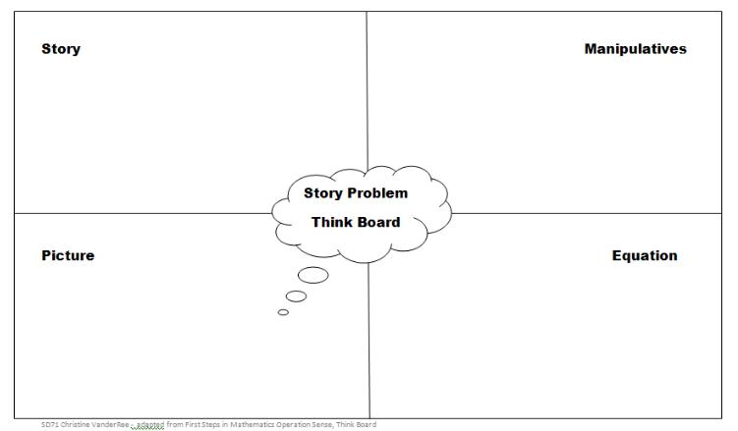
Have students use the following think board to solve the problems……
Leanne Williamson, 2015

Slide 3
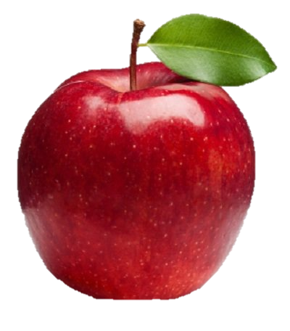
A bag of 3 apples costs $2.00.
What is the largest number of apples that can be bought for $20.00?
Leanne Williamson, 2015

Slide 4
Joanne is packing 43 Cookie Monster cupcakes into boxes. Each full box holds 5 cakes.
What is the smallest number of boxes Joanne needs to pack all the Cookie Monster cupcakes?
Leanne Williamson, 2015

Slide 5
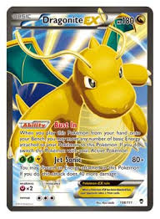
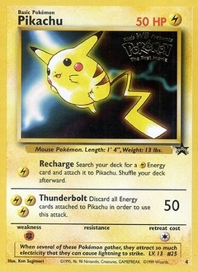
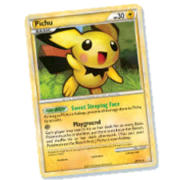
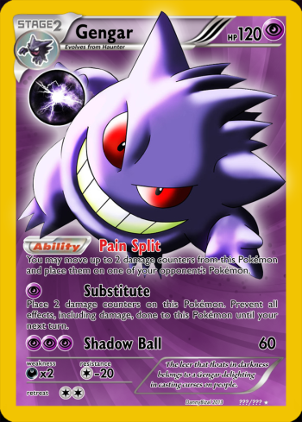
Zac puts trading cards into 4 equal piles. Each pile has 20 cards.
How many trading cards does Zac have altogether?
Leanne Williamson, 2015

Slide 6
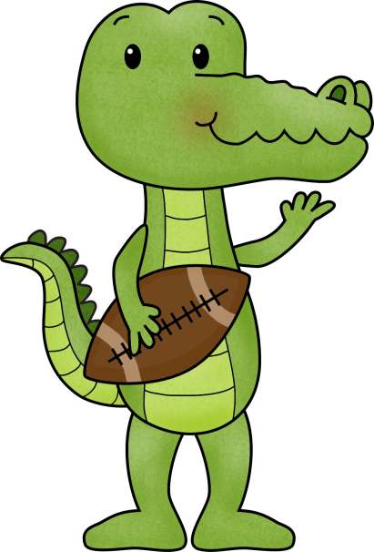
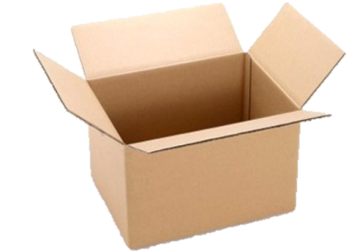
At Thomas Acres Public School there are 10 boxes of footballs. Four boxes have 6 footballs in each box. The other boxes have 5 footballs in each box.
How many footballs does Thomas Acres have altogether?
Leanne Williamson, 2015

Slide 7
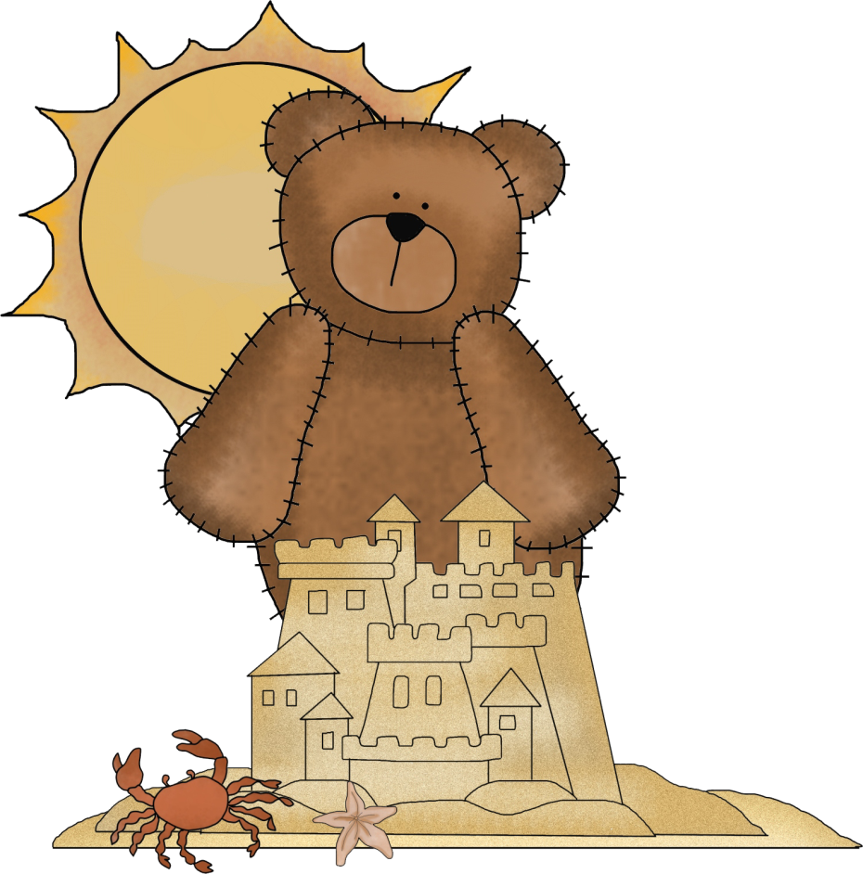
Greg had $32 to spend whilst on his 8 day holiday. He spent exactly the same amount each day. At the
end of the holiday he had no money left.
How much did he spend each day?
Leanne Williamson, 2015

Slide 8
Sarah puts some forks and spoons end to end.
3 forks make the same length as 5 spoons. Each fork is 15 centimetres long.
How many centimetres long is each spoon?
Leanne Williamson, 2015

Slide 9
Zoe made some cookie men.
Each cookie had 2 chocolate buttons for eyes and three red smarties. Zoe used 48 smarties altogether.
How many chocolate buttons did Zoe use?
Leanne Williamson, 2015

Slide 10
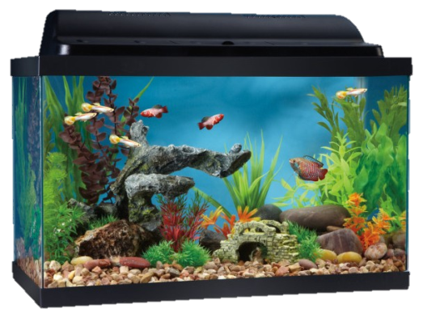
Stephanie had 4 fish tanks. Each tank had 10 fish in it.
She then bought one more tank. She shared all fish equally between the 5 tanks.
How many fish were then in each tank?
Leanne Williamson, 2015

Slide 11
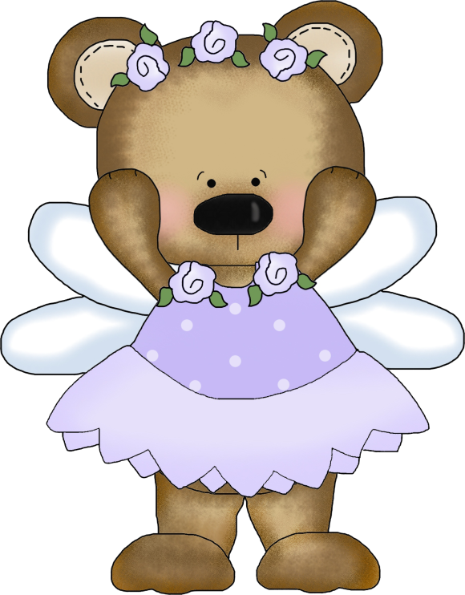
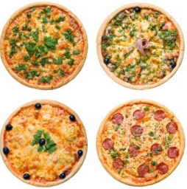
Leanne makes 12 pizzas. She puts 4 pizzas on a tray like this.
Write the number sentence to show how Leanne could work out the number of trays she needs.

Slide 12
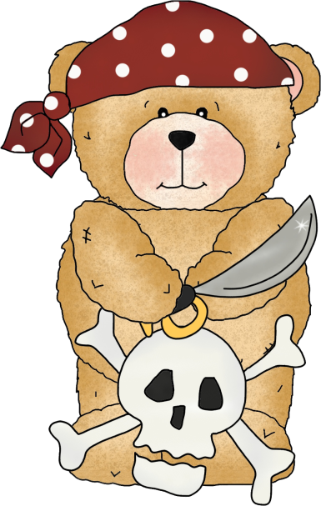
Isaac has this row of 15 cubes.
He divides the row into two sections. One section is 3 cubes longer than the other section.
How many cubes are in each section?
Leanne Williamson, 2015

Slide 13
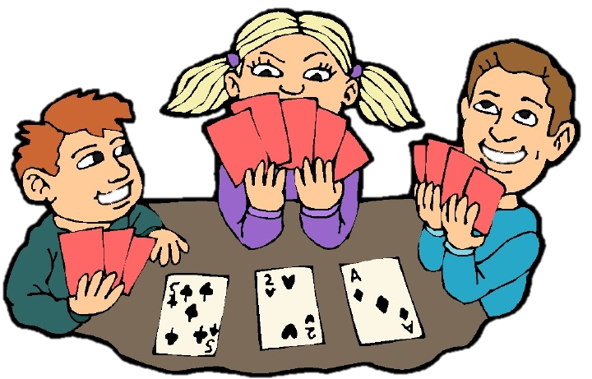
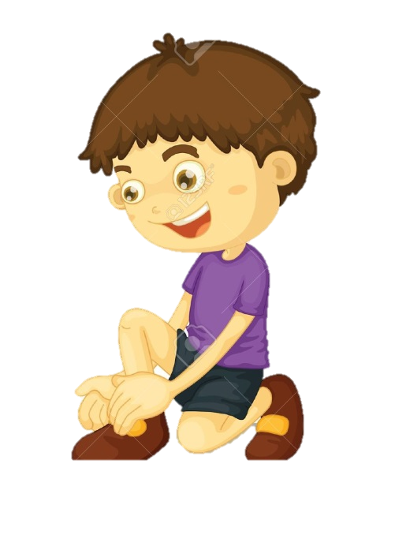
Five students were playing a card game. There were 52 cards. Each child was given 7 cards.
How many cards were left over?
Leanne Williamson, 2015

Slide 14
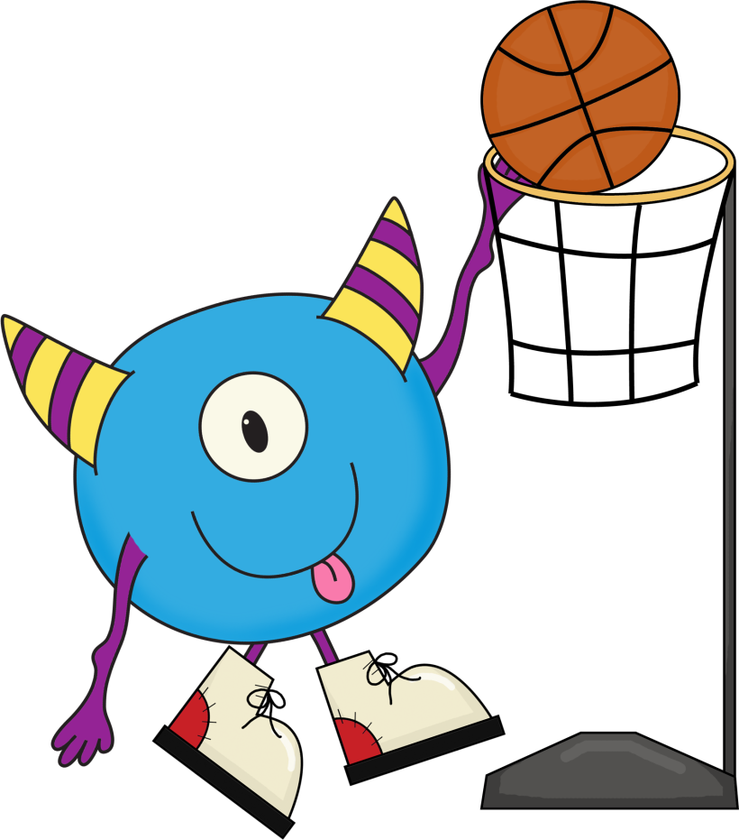
A group of students were in 5 teams.
Team | Number of students
3J | 4
3H | 7
3M | 5
4S | 11
4T | 3
Some students changed teams.
The teams now have an equal number of students.
How many students now in each team?
Leanne Williamson, 2015

Slide 15
Mrs Williamson asks her students to follow these steps.
Think of an even number between 1 and 10.
Halve it.
Add the number you started with.
Multiply by 4.
Divide the number by the number you started with.
What answer should you get?
Leanne Williamson, 2015

Slide 16
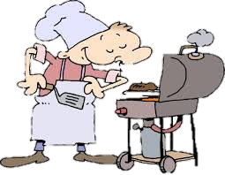
A barbeque was held for 36 students. There were 3 sausages for each student.
How many sausages were there altogether?
Leanne Williamson, 2015

Slide 17
There are 60 boxes of flowers in a van. There are six florists. Seven boxes are delivered to each shop.
How many boxes are left after the van has been to each of the florists.
Leanne Williamson, 2015

