Slide 1
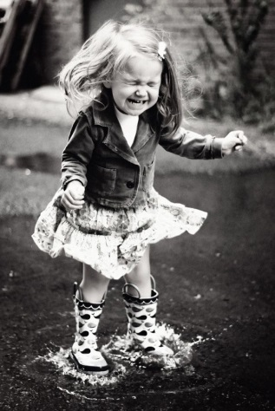
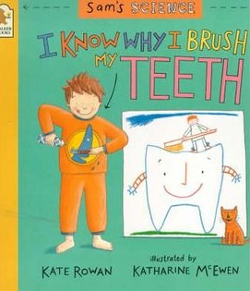
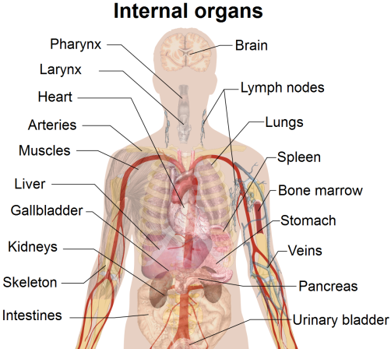
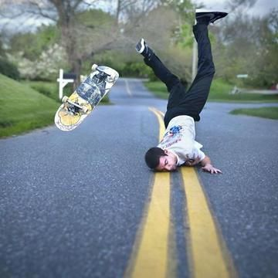
Our Body
Writing Prompts
Leanne Williamson 2015

Slide 2
Inside out……
Choose a character from the movie and write a description of them. Include things such as: their gender, age, body type, hair, eyes, facial features, dress, posture, movements, mannerisms, speech, first impression and their personality.
Sourced : Google images
Leanne Williamson 2015

Slide 3
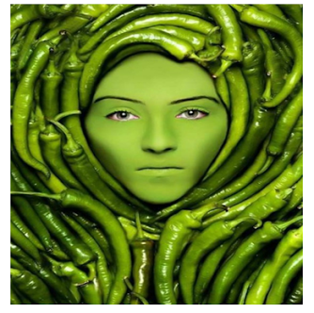
My Personality……
If you had to describe your personality as a type of food, what food would you be? Why?
Found: http://classroommagic.blogspot.com.au
Leanne Williamson 2015

Slide 4
The Boss!
Which part of your body do you think is ‘the boss’? Explain.
Sourced : Google images
Leanne Williamson 2015

Slide 5
What a trip…
Now that you know about the path that food takes when you eat it, pretend to be your favourite food as it travels through your digestive system. Describe what happens to your food as it reaches each of the digestive system parts.
Use lots of adjectives to make your piece exciting to the reader! Be sure you mention each of these parts in your piece: mouth, oesophagus, stomach, small intestine and large intestine. Write in first person.
Sourced : Google images
Leanne Williamson 2015

Slide 6
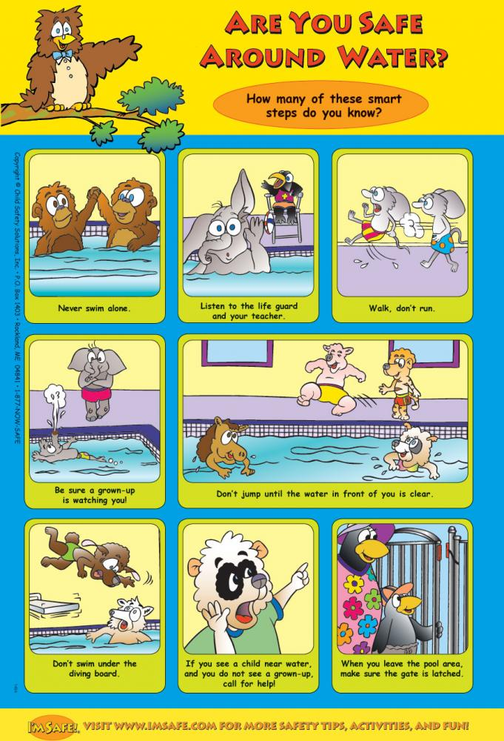
Make a list.......
Many people go swimming in their own pool, in public pools or at the beach. Even if you are a very good swimmer, it is important to remember some safety rules.
Make a list of some safety rules to remember around water and then design a poster which advertises them.
Sourced : Google images
Leanne Williamson 2015

Slide 7
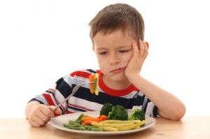
Eat your dinner!
Write to convince this boy why he should eat his dinner.
Leanne Williamson 2015

Slide 8
Emotions!
People experience a range of emotions throughout their lives.
Choose an emotion and write about a time you experienced it. Don’t forget too include: when, where, who and what.
Found: https://www.youtube.com/watch?v=o5c1gIzQoPI&list=PLPCp3Td3qajAL1eUT0pUCqQJ2VwnRfn-O&index=2
Leanne Williamson 2015
Notes:
Read the story or have students view the movie trailer before completing this task.

Slide 9
Respiratory System…….
Write a paragraph about what you learnt about the respiratory system.
Sourced : https://www.youtube.com/watch?v=ydX8Lw4q2Mk
Leanne Williamson 2015

Slide 10
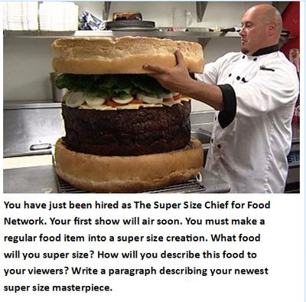
Write a description of your newest super sized food creation.
Found : http://classroommagic.blogspot.com.au
Leanne Williamson 2015

Slide 11
Persuasive
Writing……..
Found: http://monkeybaa.com.au/wp-content/uploads/2013/02/NAPLAN-Persasive-writing-overview.pdf
Leanne Williamson 2015
Notes:
See guide for other ideas and examples : http://monkeybaa.com.au/wp-content/uploads/2013/02/NAPLAN-Persasive-writing-overview.pdf

Slide 12
Creative Writing…..
Tell the story about what was happening when this picture was taken. What emotions were racing through her body?
Found on mcpactions.com
Leanne Williamson 2015

Slide 13
Healthy food advertisement….
Create your own healthy food advertisement.
Sourced : Google images
Leanne Williamson 2015

Slide 14
How to brush your teeth!
Write a procedure to inform someone else how to brush their teeth.
Sourced : Google images
Leanne Williamson 2015
Notes:
Read the story: I know why I brush my teeth by Kate Rowan. It can be purchased from: http://www.amazon.com/Sams-Science-Know-Brush-Teeth/dp/0763605042
Use the following visuals for any student who may need assistance: ( sourced from:
http://www.setbc.org/pictureset/resource.aspx?id=361)

Slide 15
Persuasive
Writing……..
Found: http://monkeybaa.com.au/wp-content/uploads/2013/02/NAPLAN-Persasive-writing-overview.pdf
Leanne Williamson 2015

Slide 16
Nervous System…….
Write a paragraph about what you learnt about the nervous system.
Found: https://www.youtube.com/watch?v=sjyI4CmBOA0
Leanne Williamson 2015

Slide 17
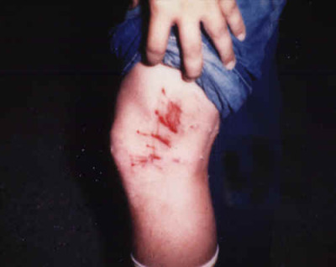
Creative Writing…..
Tell the story about what was happening when this picture was taken.
Sourced: http://babyblanketcoughsyrupcarnival.tumblr.com/post/79799575164/dog-bite
Leanne Williamson 2015

Slide 18
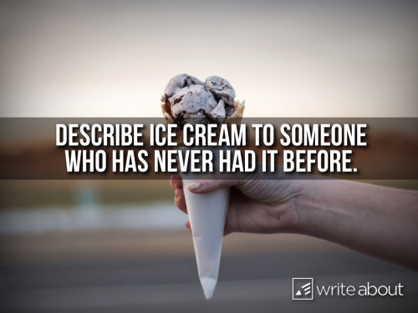
Delicious ice cream!
Found: http://photoprompts.tumblr.com
Leanne Williamson 2015

Slide 19
Safety gear is important!
Explain why it is important to wear safety gear.
Found: http://www.cuded.com
Leanne Williamson 2015

Slide 20
Creative Writing…..
Although the message on his voicemail was scratchy, _____________heard the words “ _________________” and decided to investigate.
Write what happened next.
Sourced: https://www.pinterest.com/pin/212443307394450837/

Slide 21
Angry, angry, angry….
Those are some angry birds. Write about a time that you have been angry?
How did you behave when you felt angry?
How should have you behaved?
Sourced: https://www.youtube.com/watch?v=-eyig_V-_5o&list=PL30AC3EC130A71392
Leanne Williamson 2015

Slide 22
Persuasive
Writing……..
Found: http://monkeybaa.com.au/wp-content/uploads/2013/02/NAPLAN-Persasive-writing-overview.pdf
Leanne Williamson 2015

Slide 23
World’s newest lollies! (candy)
Explain how to make it or convince the world to buy it.
Found: http://photoprompts.tumblr.com
Leanne Williamson 2015

Slide 24
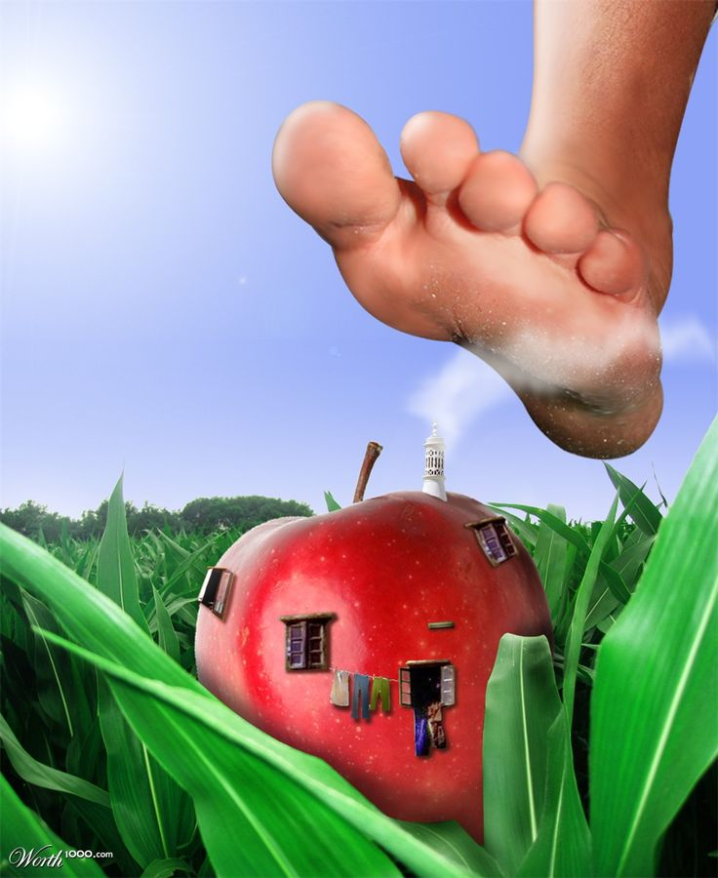
Creative Writing….
Tell the story about what was happening when this picture was taken.
Found on http://www.worth1000.com
Leanne Williamson 2015
Notes:
What is a literary recount?
A literary recount is similar to a factual recount. Both types of recounts give details about what happened, including who was involved, when and where the event took place, and what may have resulted. A literary recount can be about real or fictional events and characters.
A literary recount is different from a factual recount because it includes more than just facts. A literary recount:
retells a series of events with characters
gives facts and feelings about the events
often uses dialogue between characters
creates an emotional connection with the reader
uses descriptive language.
Examples of a literary recount
Literary recounts include more emotional connections between the reader and the story than factual recounts. Some examples of literary recounts are:
short stories and novels
biographies and letters
fables, myths and legends
plays, films and television programmes
poems and songs
picture books.
Structure of a literary recount
A literary recount must begin with a title or a heading. The title should relate to the text, but can be creative.
The introductory paragraph is called the orientation. In this paragraph the setting and characters are introduced. This may also give the reader a general idea of what the text will be about, or may contain background information that helps to explain the first scene of the text.
The body of the text contains the sequence of events. The sequence of events is usually written in chronological order (the order they occurred). The purpose of these events is to tell the story. This includes what happened, how characters (or people) within the text felt about the events, and how any problems were dealt with.
The concluding paragraph is called the reorientation. This paragraph sums up the recount. This is where the sequence of events ends and any issues or problems are completely resolved by the characters. The emotional responses of the characters involved may also be included in this s
Source: http://www.skwirk.com/p-c_s-6_u-124_t-340_c-1179/WA/6/Literary-recountsLiterary-text-typesText-typesEnglish/

