Slide 1
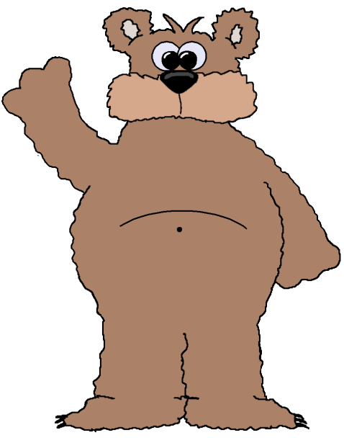
Patterns & Algebra
Problem Solving
Stage Two
Leanne Williamson, 2015 - selected problems have been adapted from previous Naplan questions.
Notes:
NSW Syllabus Reference: MA2-8NA : Generalises properties of odd and even numbers, generates number patterns, and completes simple number sentences by calculating missing values.
NSW Numeracy Continuum Reference: Aspect 3: Pattern and number Structure – Number Properties.

Slide 2
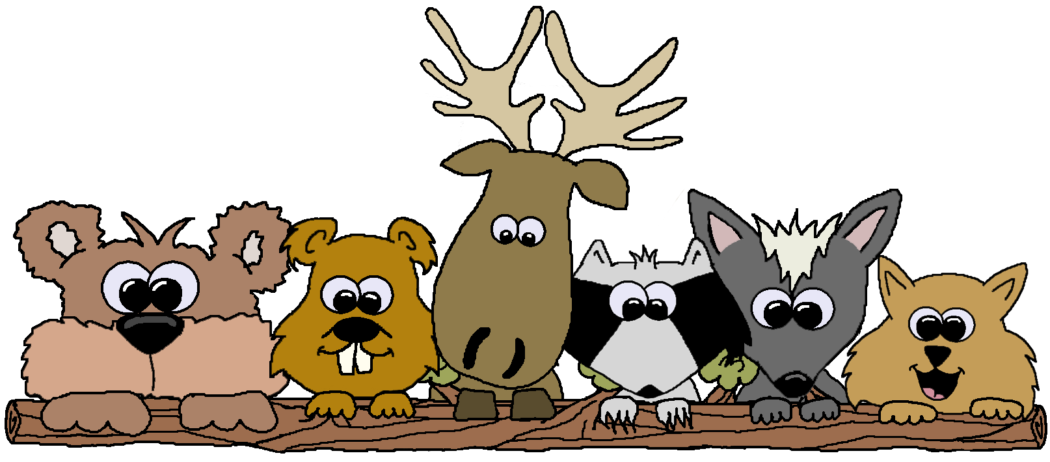
Sarah has shaded boxes in a counting pattern starting at 4.
What is the next number Sarah should shade in this
pattern? .
1 | 2 | 3 | 4 | 5 | 6 | 7 | 8 | 9 | 10
11 | 12 | 13 | 14 | 15 | 16 | 17 | 18 | 19 | 20
21 | 22 | 23 | 24 | 25 | 26 | 27 | 28 | 29 | 30
31 | 32 | 33 | 34 | 35 | 36 | 37 | 38 | 39 | 40
Leanne Williamson, 2015

Slide 3
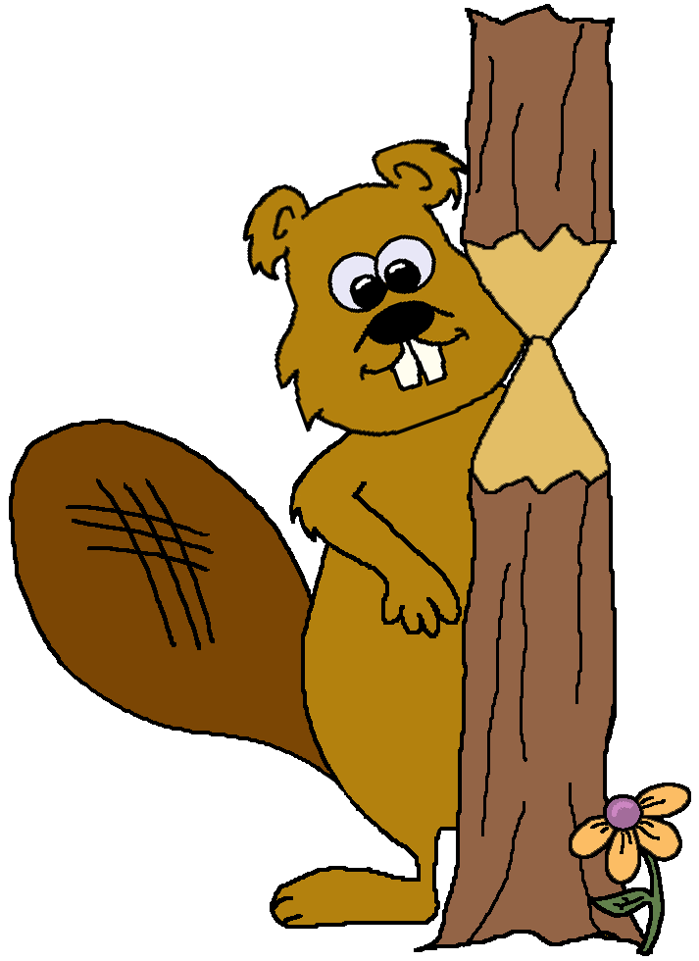
46, 40, 34,
What is the next number in this counting pattern?
?
Leanne Williamson, 2015

Slide 4
Zac is thinking of a number. The number is less than 12. When the number is divided by 2 the answer is an odd number. When it is divided by 3 the answer is an even number.
What number is Zac thinking of?
Leanne Williamson, 2015
Notes:
Use the Newman’s prompts as a whole class to model how to start thinking about solving the problem. When you reach questions 3 and 4 that deal with how to work the problem out, ask students what problem solving approach they might take. Some may suggest guess, or trial and error. Discuss with the students how they could use the process of elimination to assist in solving this problem. “We know the number is less than 12, let’s write those numbers on the board. It says the number can be divided by 2, let’s circle all those numbers and eliminate (cross out) the others. It says the number can be divided by 3, out of the numbers we already have circled, which one(s) can also be divided by 3. That only leaves 6. Let’s test the number 6 to make sure we are correct. When we divide 6 by 2, is the answer odd? Yes. When we divide 6 by 3, is the answer even? Yes. 6 is our answer.”
Source: http://www.schools.nsw.edu.au/learning/7-12assessments/naplan/teachstrategies/yr2015/index.php?id=nn_paal_s2a_14

Slide 5
Dana made 4 tree designs using sticks. There is a pattern
In the way that the tree grows.
Dana continues the pattern in the same way. How many
sticks will tree 5 have?
Leanne Williamson, 2015

Slide 6
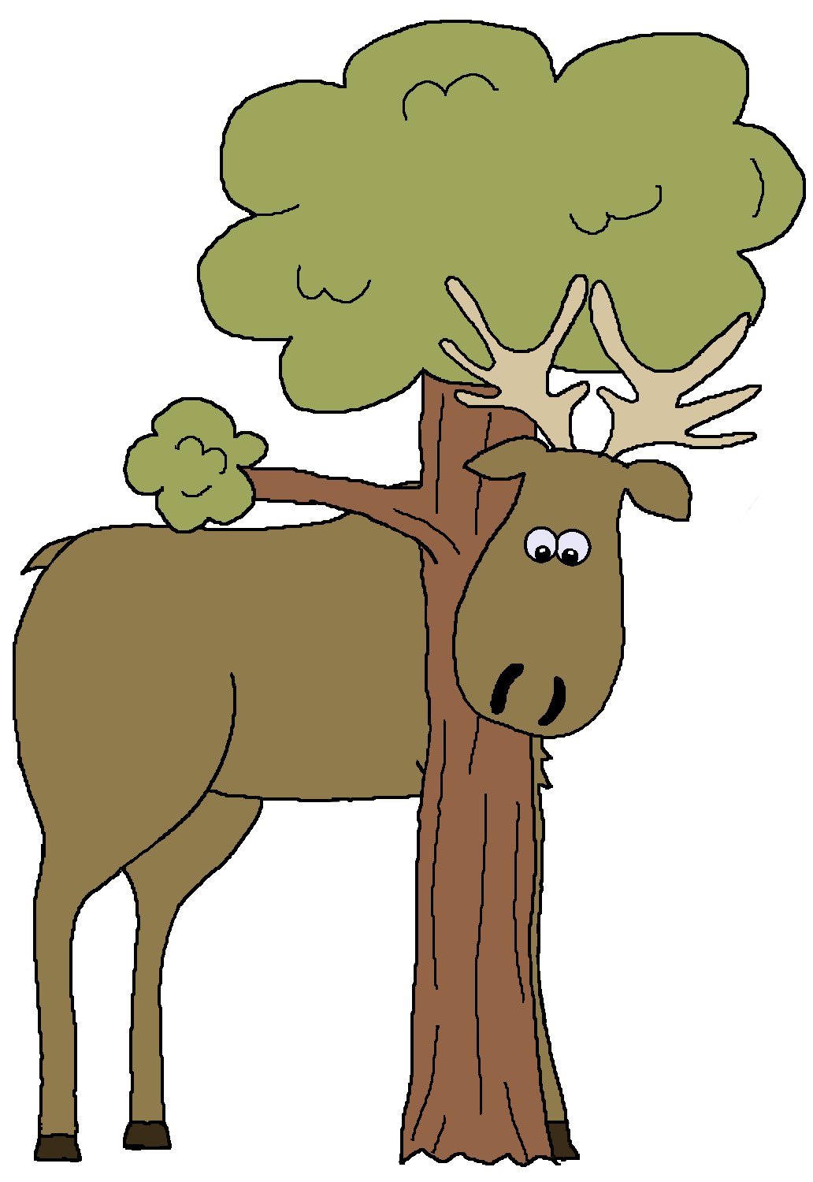
27 students in 3J had one vote each for class captain.
They voted for Ben, Erin or Justin.
Ben got 3 more votes than Erin.
Ben got 6 more votes than Justin.
How many votes did Ben get?
Leanne Williamson, 2015

Slide 7
The seating plan for a hall makes this pattern.
Key
1 seat
Row 1
Row 2
Row 3
If the pattern continues, how many seats are in
Row 6?
Leanne Williamson, 2015

Slide 8
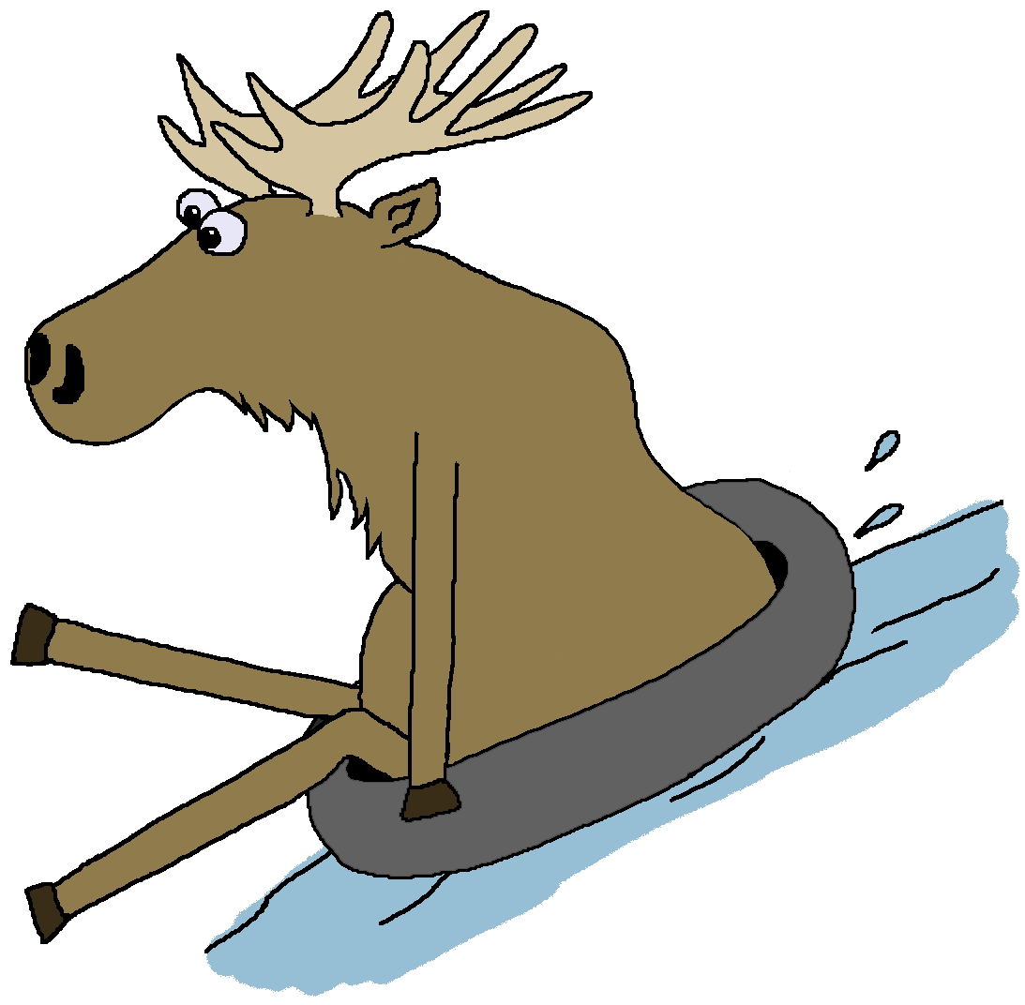
Tyler started at 10 and made this number pattern.
10, 11, 13, 16, 20, 25, ?
What is the next number in the pattern?
Leanne Williamson, 2015

Slide 9
Write a number in the box to make the number sentence correct.
63 - = 38
Leanne Williamson, 2015

Slide 10
Emily has shaded boxes in a counting pattern starting at 6.
What is the next number Emily should shade in this
pattern? .
1 | 2 | 3 | 4 | 5 | 6 | 7 | 8 | 9 | 10
11 | 12 | 13 | 14 | 15 | 16 | 17 | 18 | 19 | 20
21 | 22 | 23 | 24 | 25 | 26 | 27 | 28 | 29 | 30
31 | 32 | 33 | 34 | 35 | 36 | 37 | 38 | 39 | 40
Leanne Williamson, 2015

Slide 11
This is part of a map of High Street. Felix lives at number 2 which is the 1st house on the north side.
What is the 18th house in High street on the north side?
Leanne Williamson, 2015

Slide 12
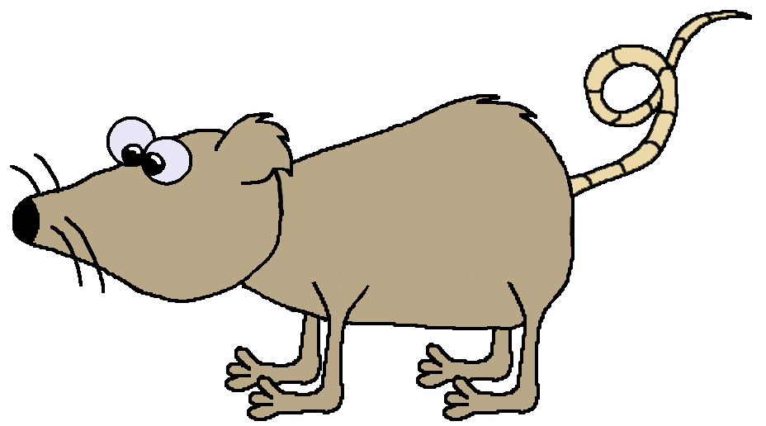
Flynn joins cubes to make these models that look like steps.
How many cubes would Flynn need for a 6-step model?
Leanne Williamson, 2015

Slide 13
Joanne put her dolls in height order. The heights made a pattern.
What is the height of doll 4?
Leanne Williamson, 2015

Slide 14
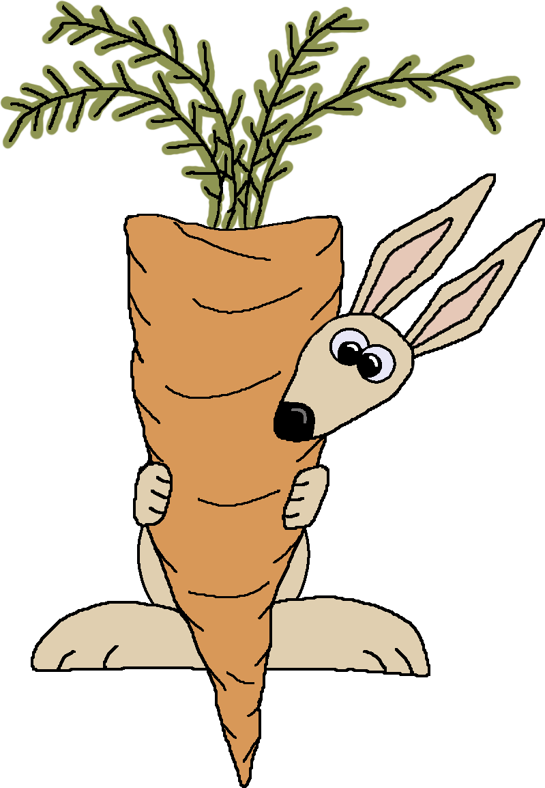
Which letter is in the square and also in the triangle, but not in the circle?
Leanne Williamson, 2015

Slide 15
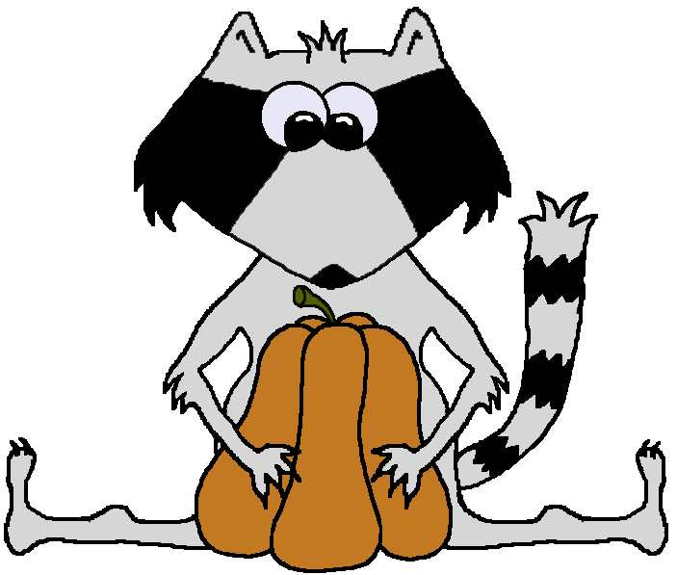
Write a number in the box to make the number sentence correct.
42 - = 25
Leanne Williamson, 2015

Slide 16
This picture shows the prices of some ice creams at Suzie’s Ice cream shop.
Each extra scoop of ice cream costs the same amount of money.
How much will one ice cream with 5 scoops cost?
Leanne Williamson, 2015

Slide 17
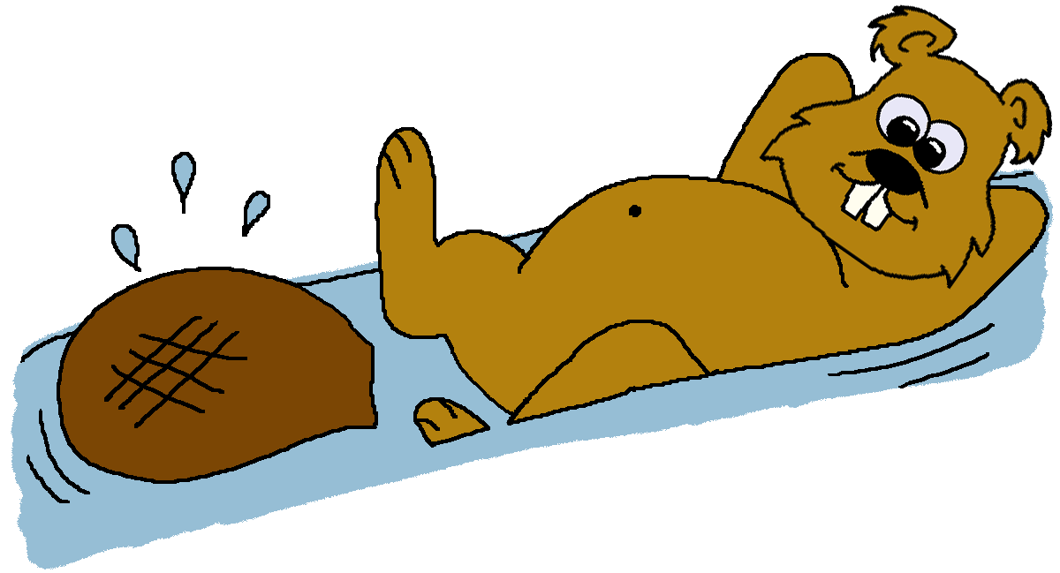
Ben started with a number. He added 3 to it. He doubled the answer, then subtracted 4. He then had 26.
What number did Ben start with?
Leanne Williamson, 2015
Notes:
Use the Newman’s prompts as a whole class to model how to start thinking about solving the problem. When you reach questions 3 and 4 that deal with how to work the problem out, ask students what problem solving approach they might take. Some may suggest guess, or trial and error. Present the information from the question stem in number sentence form.
Introduce students to the process of working backwards. If we start on the right with the number we know, 26. We can then do each process in reverse, using the opposite operation, to find Ben’s starting number. Work with the students to solve the problem, 26 + 4 = 30 ÷ 2 = 15 – 3 = 12. Ben’s number was 12.
Source: http://www.schools.nsw.edu.au/learning/7-12assessments/naplan/teachstrategies/yr2015/index.php?id=nn_paal_s2a_14

