Slide 1
Reading Clusters 1-8
Learning Intentions
“Sail” through the Reading clusters
with
“Sailing” Learning Intentions!
Print
Laminate
Display
Embed into Teaching - Learning
Created by Shellie Tancred

Slide 2
Reading – Cluster 1
I am learning to:
Recognise my name
Join in shared reading with repeated parts Look at books and other print material
Tell a story using pictures
Try to read words in the environment

Slide 3
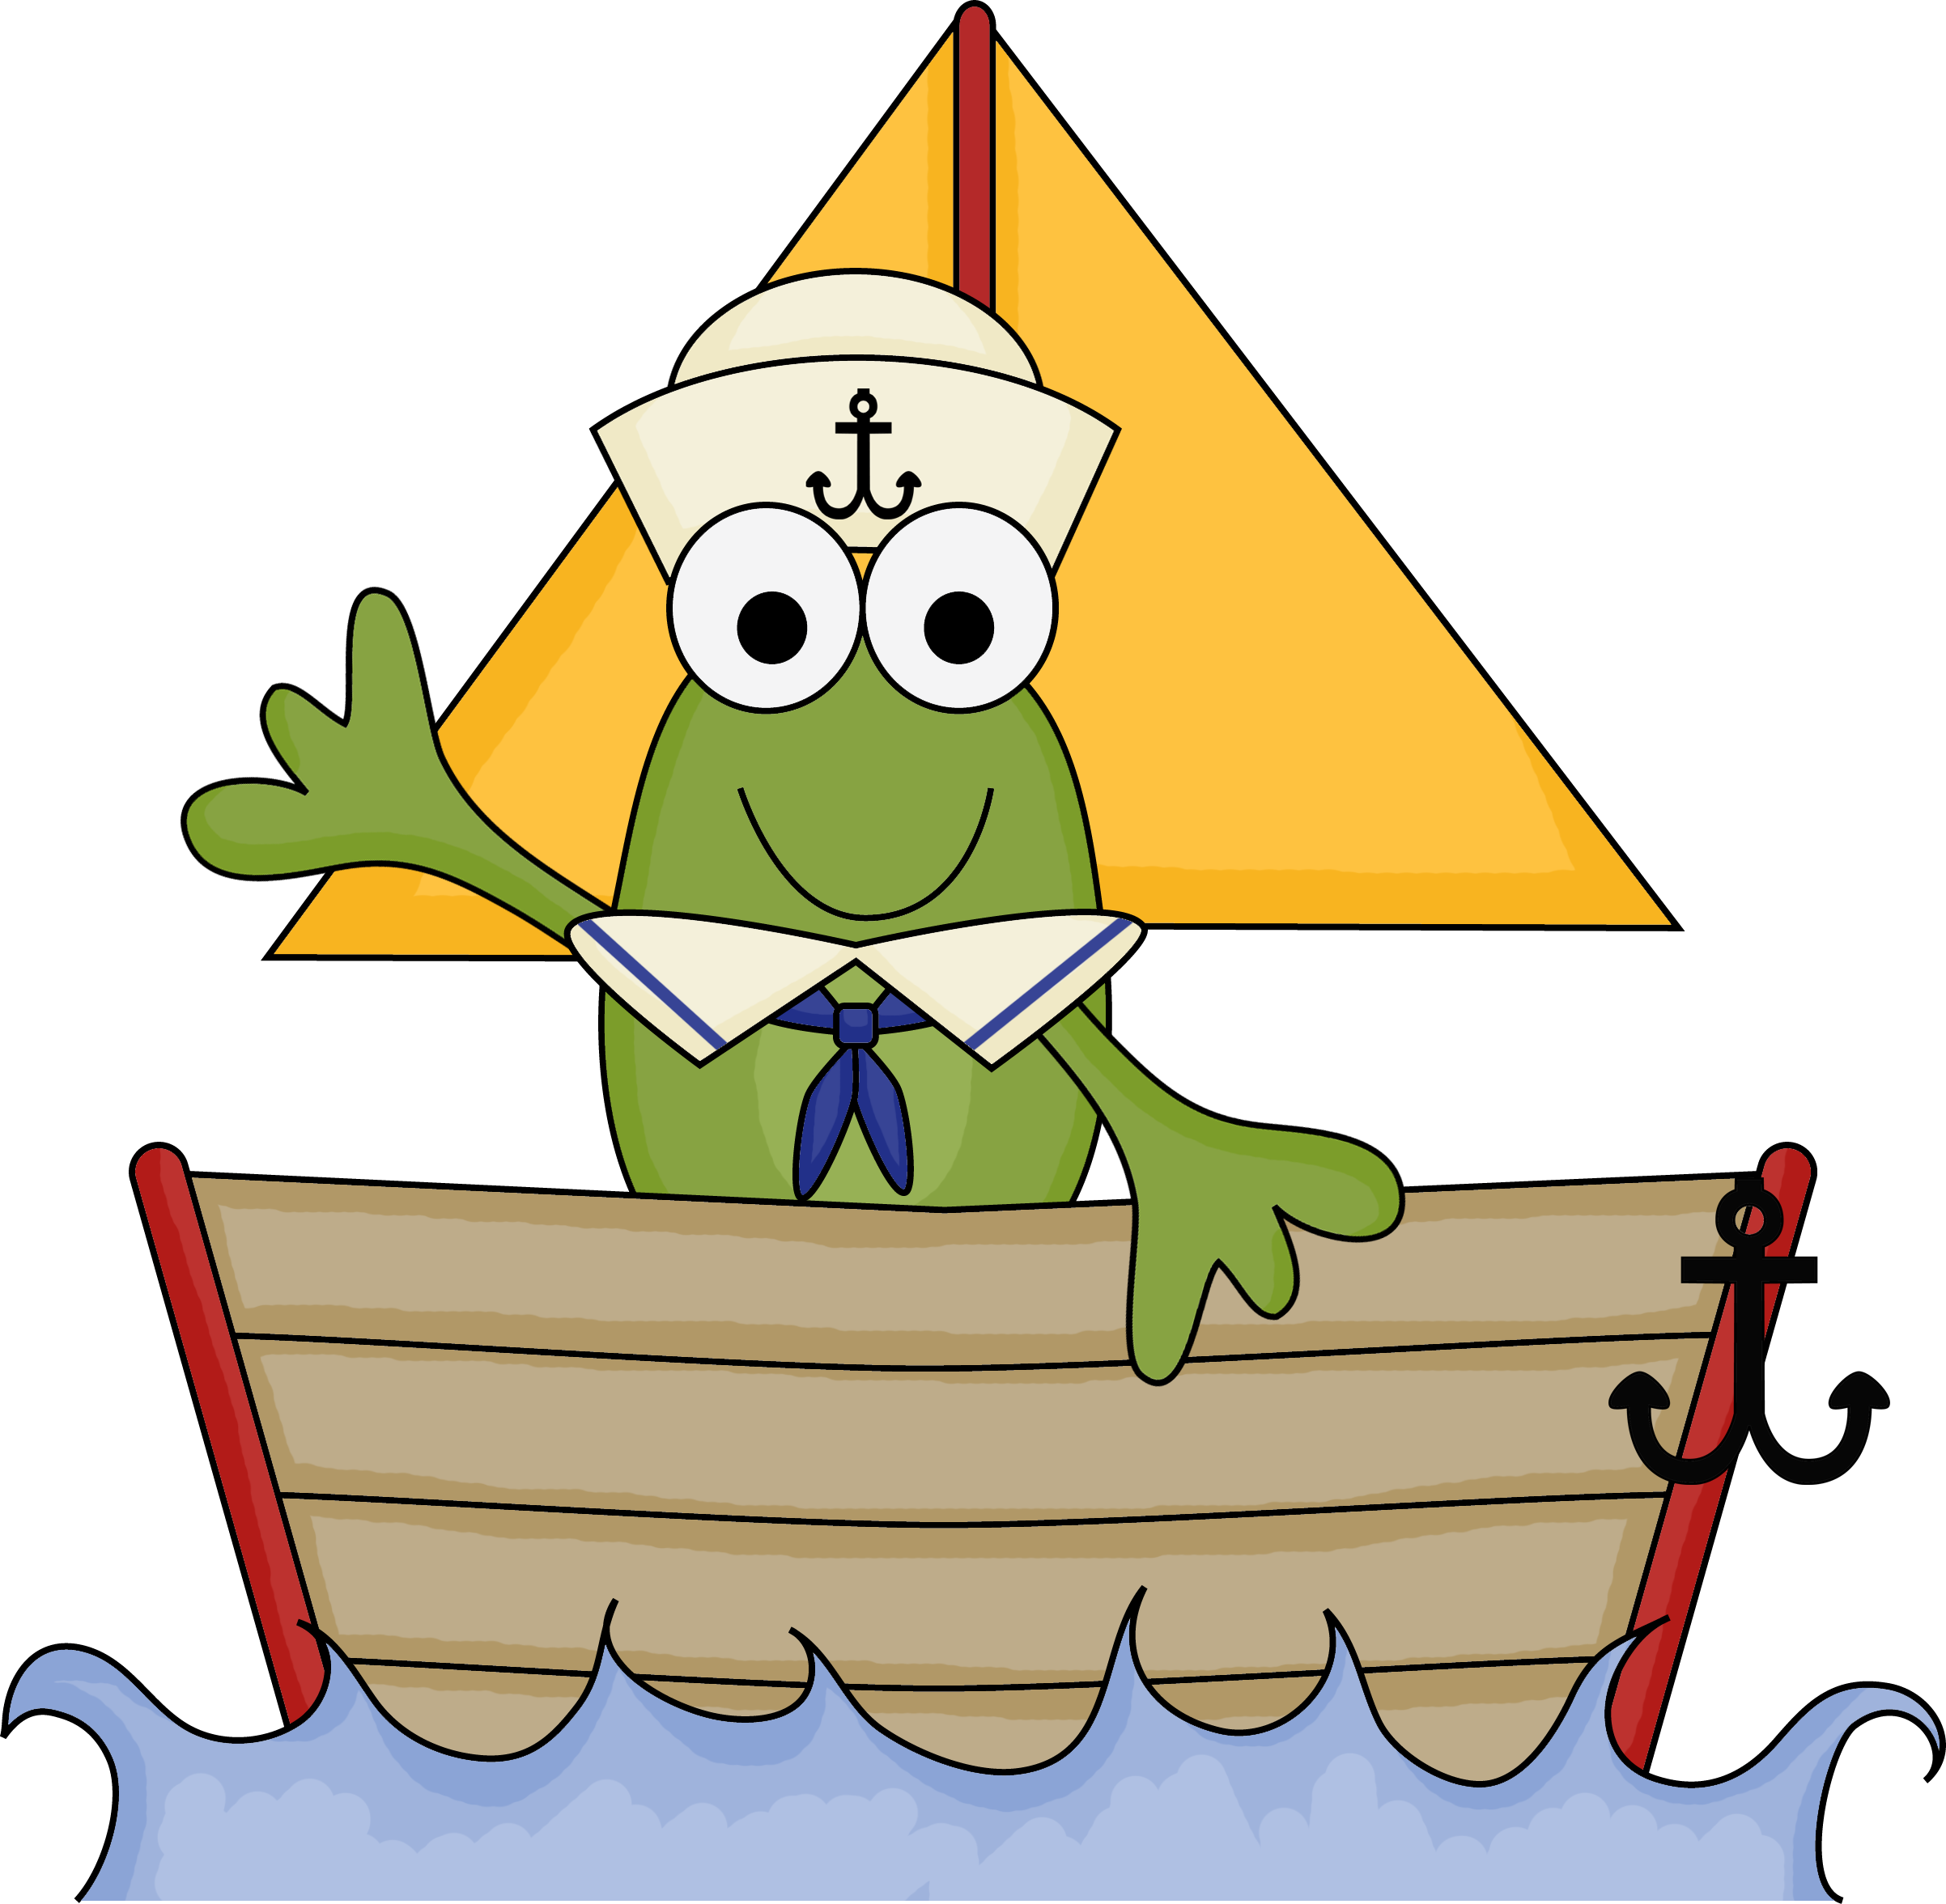
Reading – Cluster 2
I am learning to:
Read one or two words in the environment
read some words in a sentence correctly
Hold a book the right way up
Tell the difference between words and pictures
Point to each word as I read it
Read some common words in simple books eg my, I
Read with fluency and rhythm some of the time

Slide 4
Reading – Cluster 3
I am learning to:
Read one or more sentences correctly in the
environment
Read one or more sentences correctly in
simple books
Use the context to predict meaning in books
Read words by sounding out
Read more simple books
Read with fluency and rhythm more often

Slide 5
Reading – Cluster 4
I am learning to:
Read most/all of a more difficult book
Read with fluency and rhythm
Stop reading when I make a mistake and it doesn’t
make sense
Read aloud with fluency and intonation

Slide 6
Reading – Cluster 5
I am learning to:
Read books with different kinds of sentences
I can read books with several lines of text per page
Recognise and work out unknown words quickly
when reading
Stop reading when I make a mistake and try to fix it
Read fluently
Read accurately
Read using punctuation eg take a breath at a full
stop, take a quick rest at a comma

Slide 7
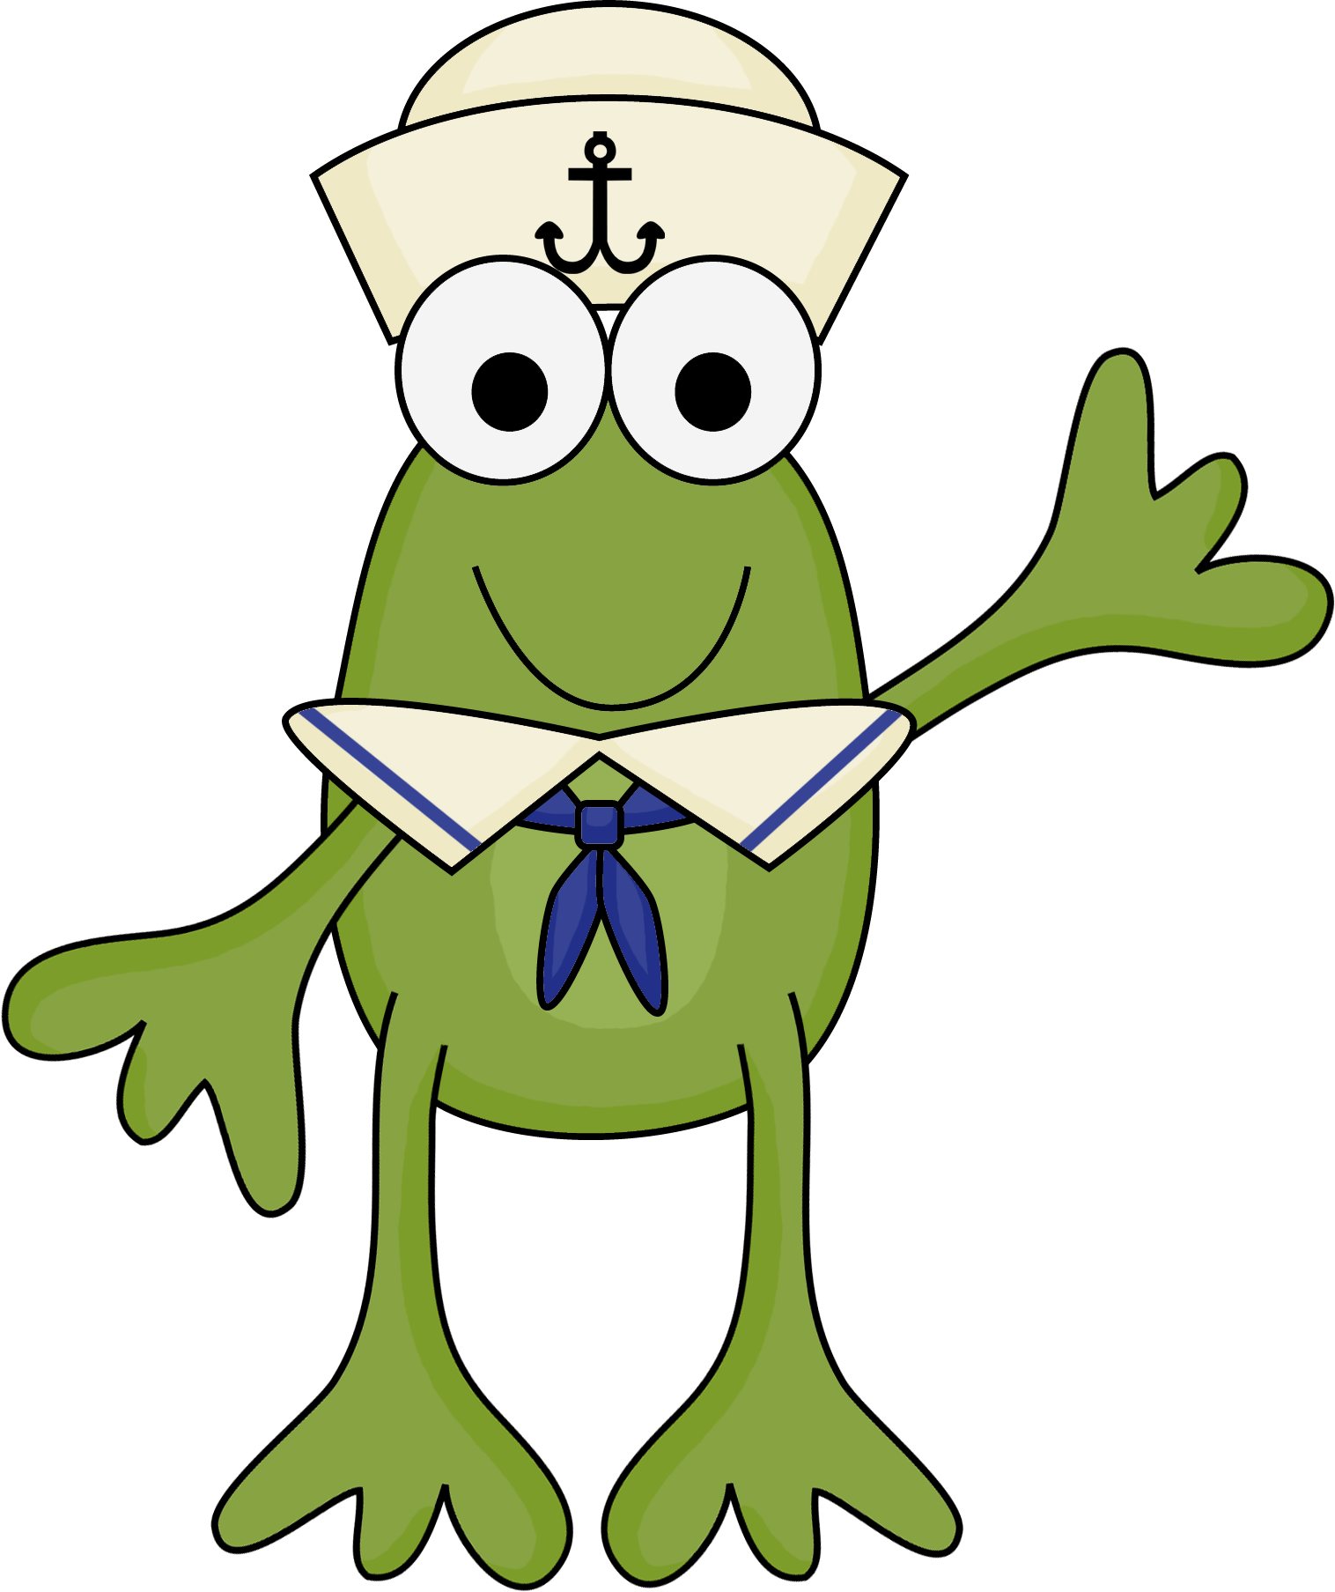
Reading – Cluster 6
I am learning to:
Understand that different types of text means that I might need to read it a different way
eg books left to right, factual texts with a diagram
Fix my mistakes when reading
Read aloud with fluency and phrasing
Make changes when reading aloud to enhance
meaning and expression
eg speed, volume, pitch and pronunciation

Slide 8
Reading – Cluster 7
I am learning to:
Understand how illustrations help the meaning
of the text
Understand how diagrams, tables, maps and graphs
help the meaning of the text
Automatically use a variety of strategies to help me
read fluently and with phrasing
eg meaning, grammar and letter/sound match ups.
Read different texts in different ways
eg books left to right, factual texts with a diagram
Change my expression when reading aloud

Slide 9
Reading – Cluster 8
I am learning to:
Read more difficult texts
Read more difficult texts with less familiar content
and vocabulary
Read more difficult texts with longer descriptions
Engage with longer literary and factual texts
Engage with more difficult literary and factual texts
Engage with literary and factual texts for
at least 10 mins

Slide 10
“Sail” through the Reading clusters
with
“Sailing” Learning Intentions!
Created by Shellie Tancred
Graphics from Scrappin Doodles, iClip Art

