Slide 1
Time
Problem Solving
Stage Two
Leanne Williamson, 2015 - Some problems have been adapted from previous Naplan questions.
Notes:
NSW Syllabus Reference: MA2-13MG: Reads and records time in one – minute intervals and converts between hours, minutes and seconds.
NSW Literacy Continuum Reference: REAC9M2: Reading texts, Cluster 9, Marker 2: Uses visual representations, e.g. photographs, tables, charts to enhance meaning when reading factual texts.
Other Literacy Continuum Markers: COMC9M3: Comprehension, Cluster 9, Marker 3: Builds understanding about the meaning of a text by actively seeking information from different parts of a text.

Slide 2
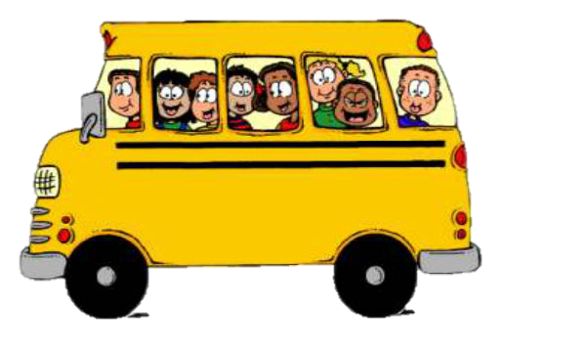
A bus took some students to camp. It left school at 9:00am.
The bus trip took one and a quarter hours. What time the bus get to the camp?
Leanne Williamson, 2015

Slide 3
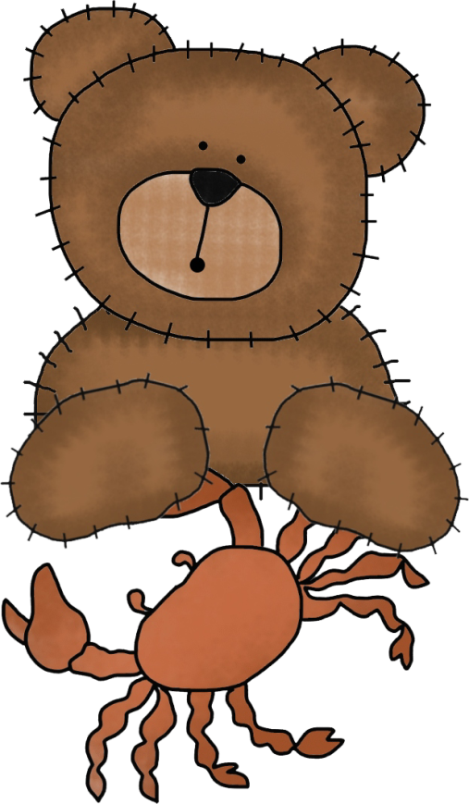
Year 3 students go on a trip. This is the plan for the day.
Start time | Activity
9.45am | Leave school by bus
10.30am | Arrive at aquarium
11.30am | Morning tea
11.45am | Feed the seals
12.45pm | Lunch at the park
1.30pm | See movie “Under the sea”
2.45pm | Leave by bus
3.30pm | Arrive back at school
At 1:00pm where will the student be?
Leanne Williamson, 2015

Slide 4
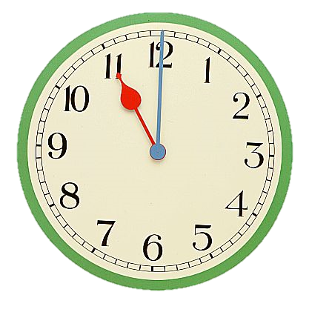
These clocks show two times in the morning.
How many minutes are there between the two times?
Leanne Williamson, 2015

Slide 5
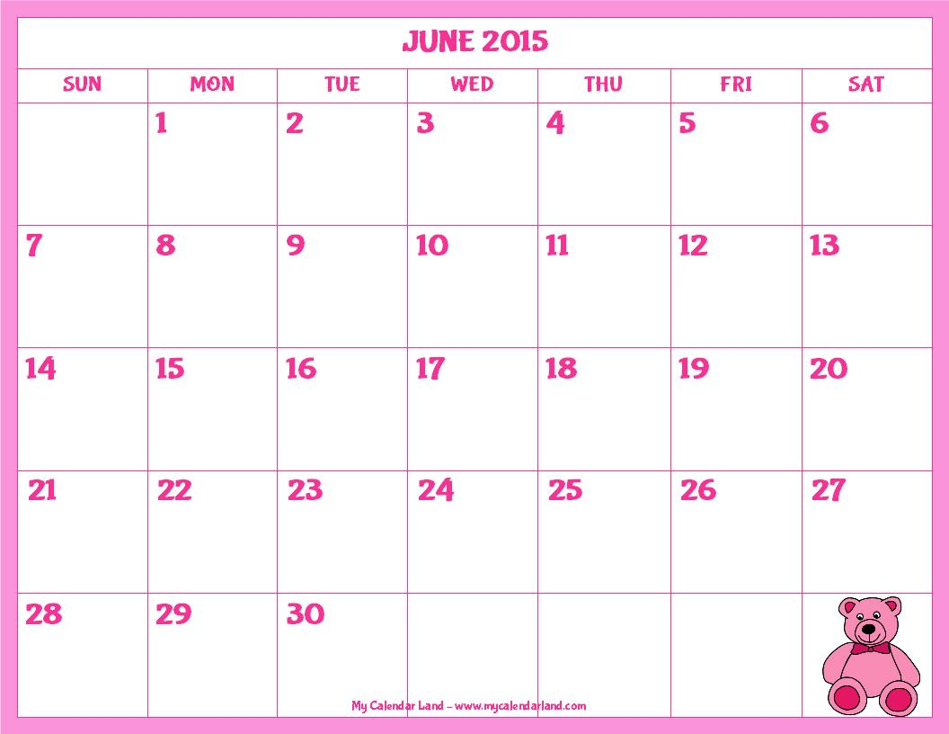
Stephanie went to the dentist on the 8th of June. She has to visit the dentist again in exactly two weeks.
When will Stephanie visit the dentist again?.
Leanne Williamson, 2015

Slide 6
A bus took some students to the zoo. It left school at 8:00am.
The bus trip took one and a half hours. What time the bus get to the zoo?
Leanne Williamson, 2015

Slide 7
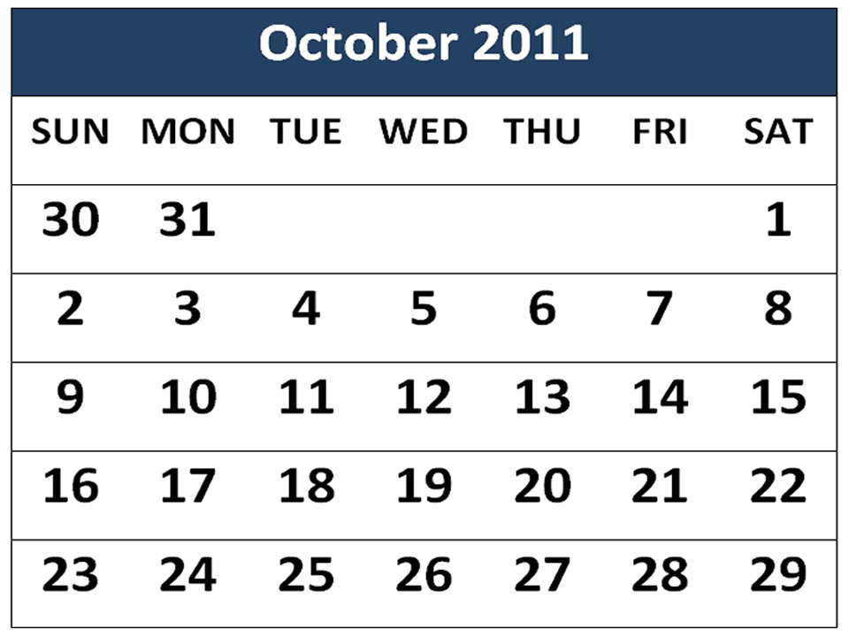
What date is the third Sunday of the month on this calendar?
Leanne Williamson, 2015

Slide 8
Emma is exactly 3 years old. Her brother Shaun is exactly 17 months old.
How many months older than Shaun is Emma?
Leanne Williamson, 2015

Slide 9
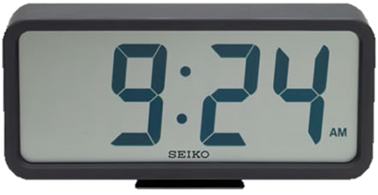
These clocks show two times in the morning.
How many minutes are there between the two times?
Leanne Williamson, 2015

Slide 10
Tim is making a calendar. The 3rd of July is a Friday.
What day is the 27th of July?
Leanne Williamson, 2015

Slide 11
Greg got out of the pool at 3:25pm after a one hour and ten minute swim.
What time did he start swimming?
Leanne Williamson, 2015

Slide 12
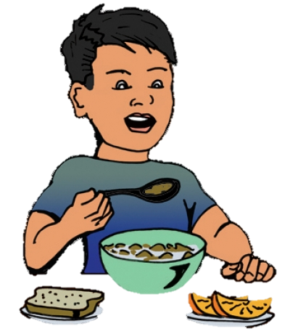
Justin woke up at 6:15am and started eating his breakfast. He took 24 minutes to eat his breakfast.
What time did he finish
eating?
Leanne Williamson, 2015

Slide 13
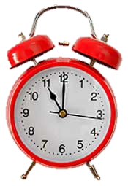
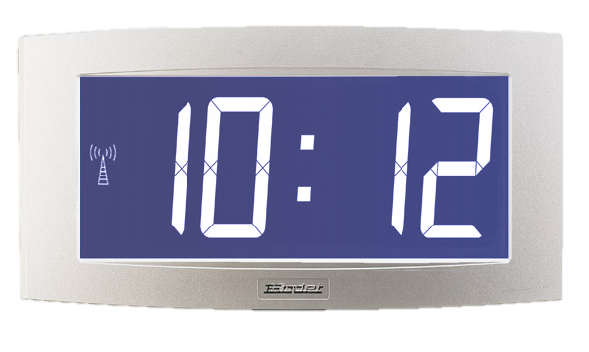
These clocks show two times in the morning.
How many minutes are there between the two times?
Leanne Williamson, 2015

Slide 14
Amy’s birthday is on the 29th of January. Her brother’s birthday is five days later.
Which day of the week was her brother’s birthday in 2014?
Leanne Williamson, 2015

Slide 15
Leilana had a hair appointment at 3:45pm. The hairdresser took 27 minutes to cut her hair.
What time did she
finish?
Leanne Williamson, 2015

Slide 16
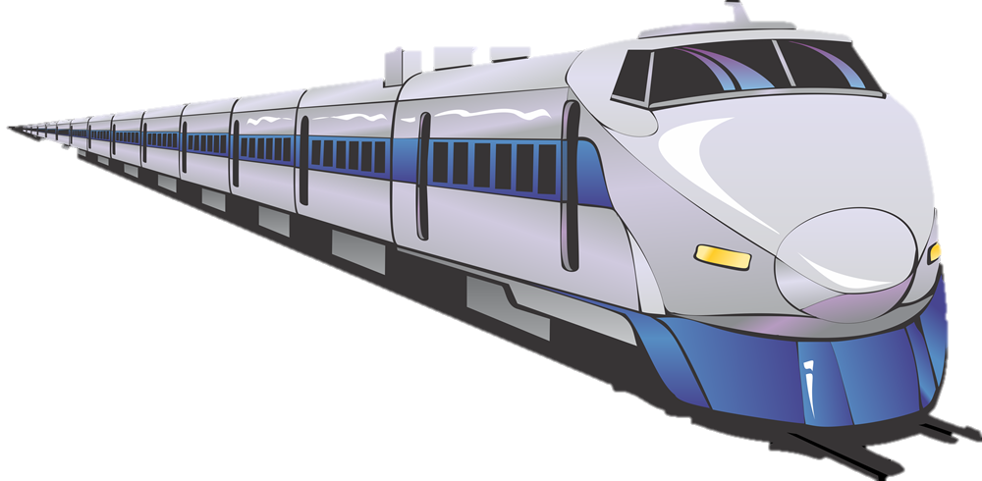
A train left Sydney at 6:30am and 8½ hours later reached Melbourne.
What time did the train arrive?
Leanne Williamson, 2015

