Slide 1
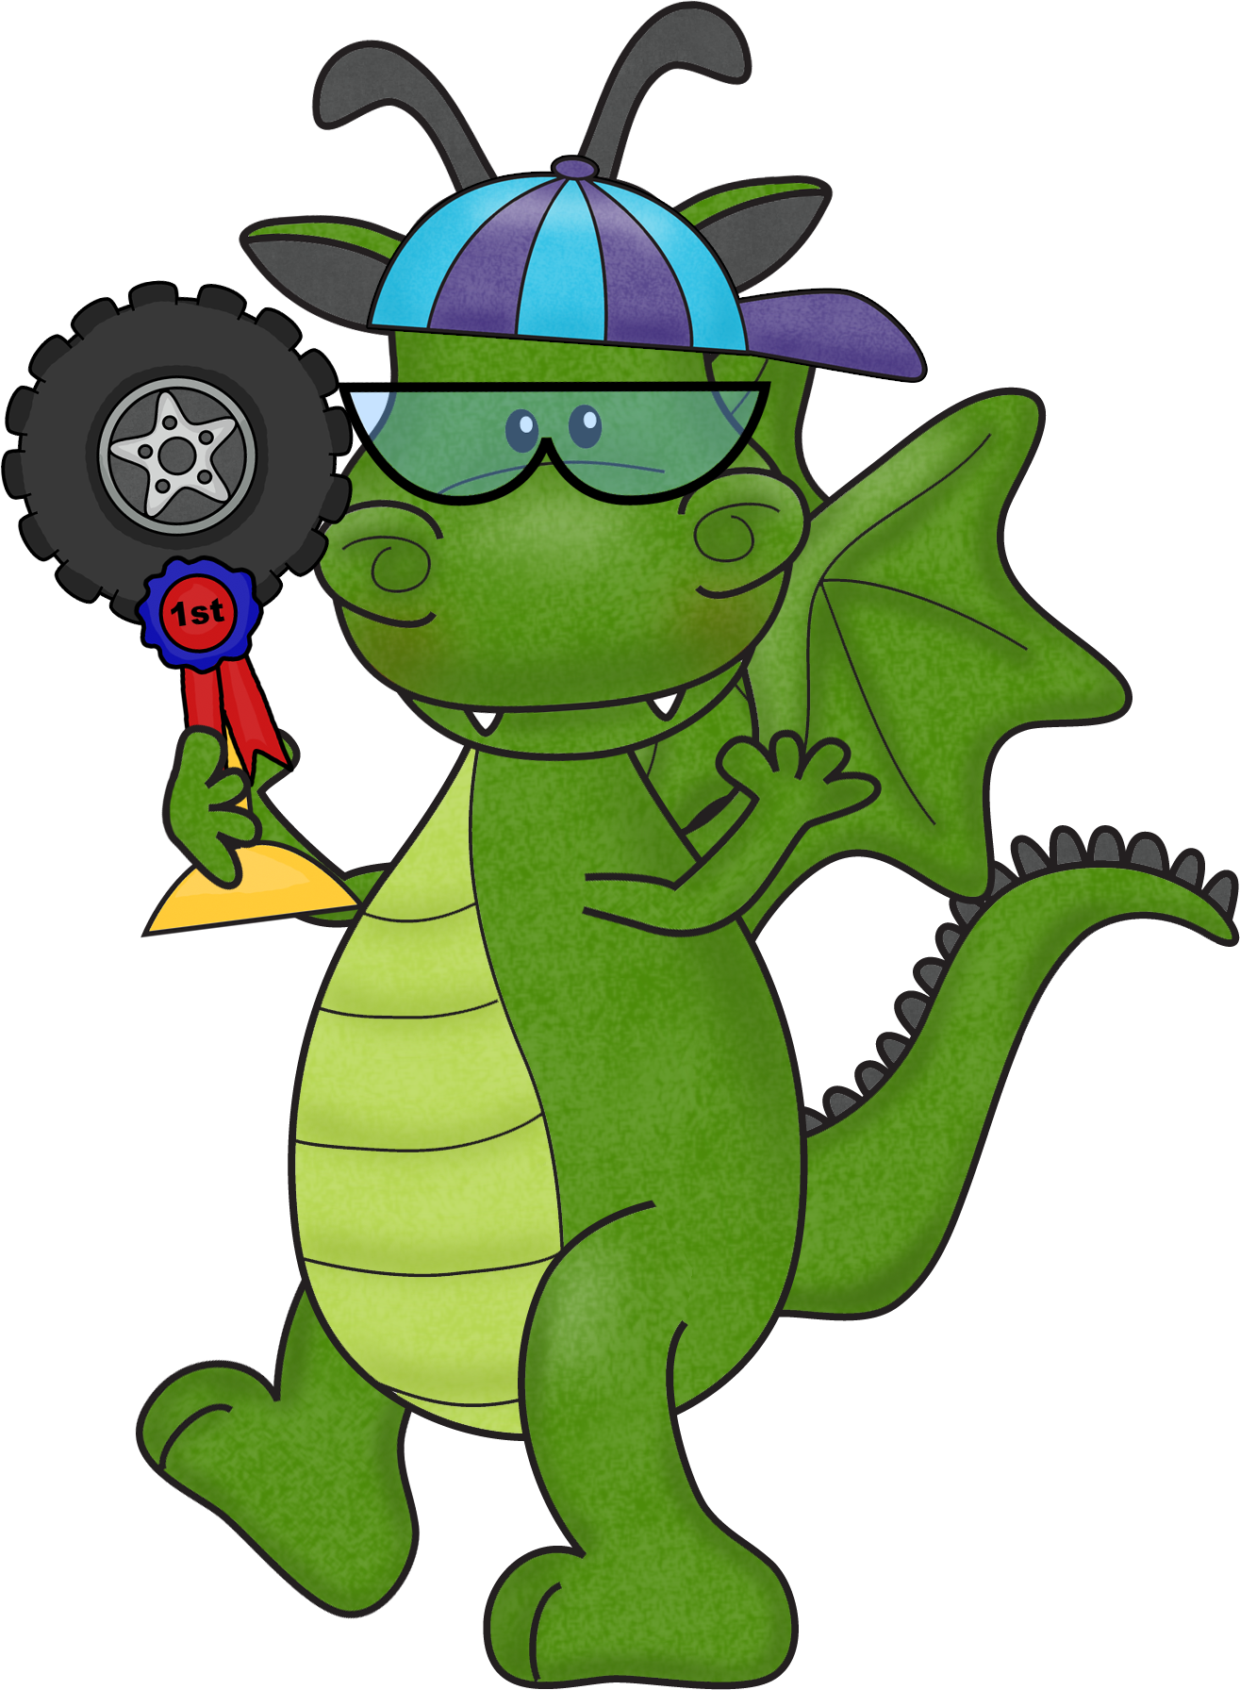
Writing Clusters 1-8
Learning Intentions
“Racing Car” Learning Intentions
inspire students
to “race” towards
becoming a
Writing Champ!
Print
Laminate
Display
Embed into Teaching - Learning
Created by Shellie Tancred

Slide 2
Writing – Cluster 1
I am learning to:
I can try to write.
I can try to write my name.
I can hold a pencil to draw.

Slide 3
Writing – Cluster 2
I am learning to:
Try to write my whole name.
Write at least one word about a story or a picture.
Write from left to right.
Use finger spaces.
Tell someone about what I will write.
Tell someone about what I wrote or drew.
Try to use a mouse and keyboard.

Slide 4
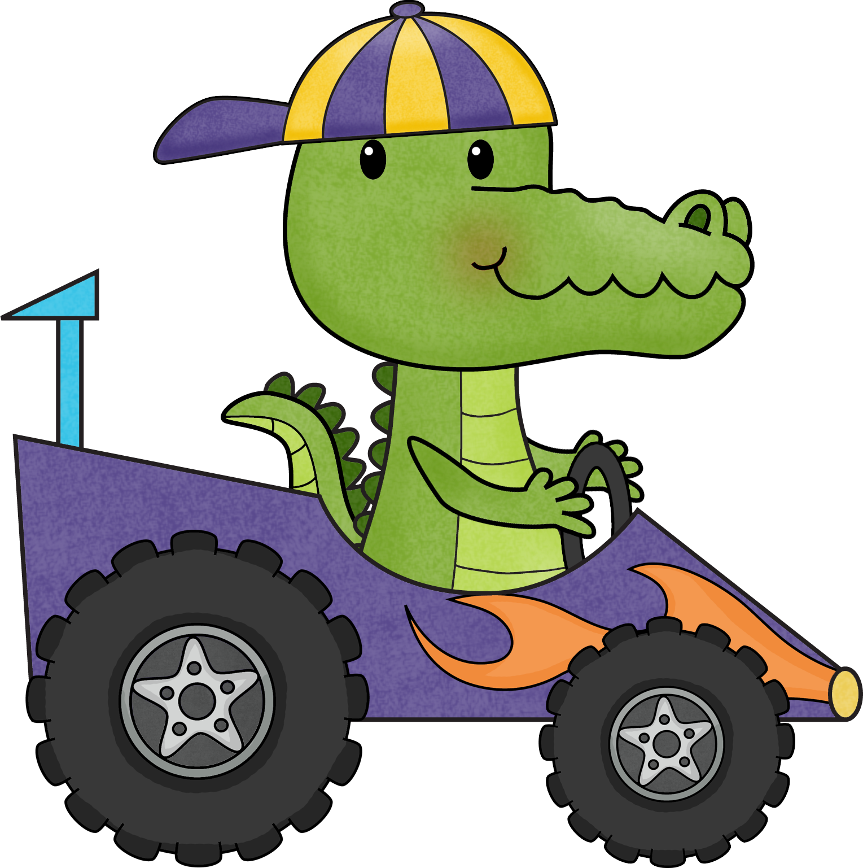
Writing – Cluster 3
I am learning to:
Write my first name correctly.
Try to write a sentence.
Use my own ideas to write.
Tell someone about my writing.
Sound out the words when I write.
Start to write some common words.

Slide 5
Writing – Cluster 3
I am learning to:
Describe something. (big cat)
Write about “how”, “when”, “where” or “why”.
Understand how to hold a pencil correctly.
Show you where my paper should be when I write.
Understand how to sit properly.
Try to use the computer to write.

Slide 6
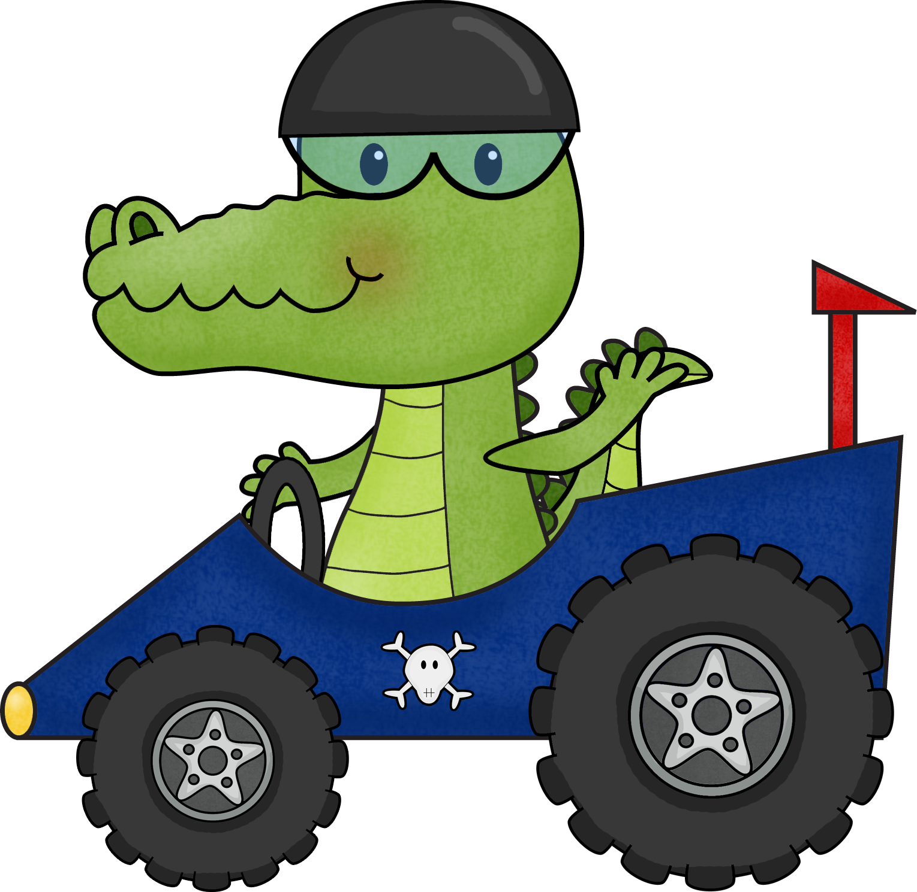
Writing – Cluster 4
I am learning to:
Write one or more sentences.
Spell some words.
Form most of my letters correctly.
Use full stops and capital letters.
Write my ideas.
Read my own writing aloud to see if it makes sense.
Tell you who I am writing for and why.

Slide 7
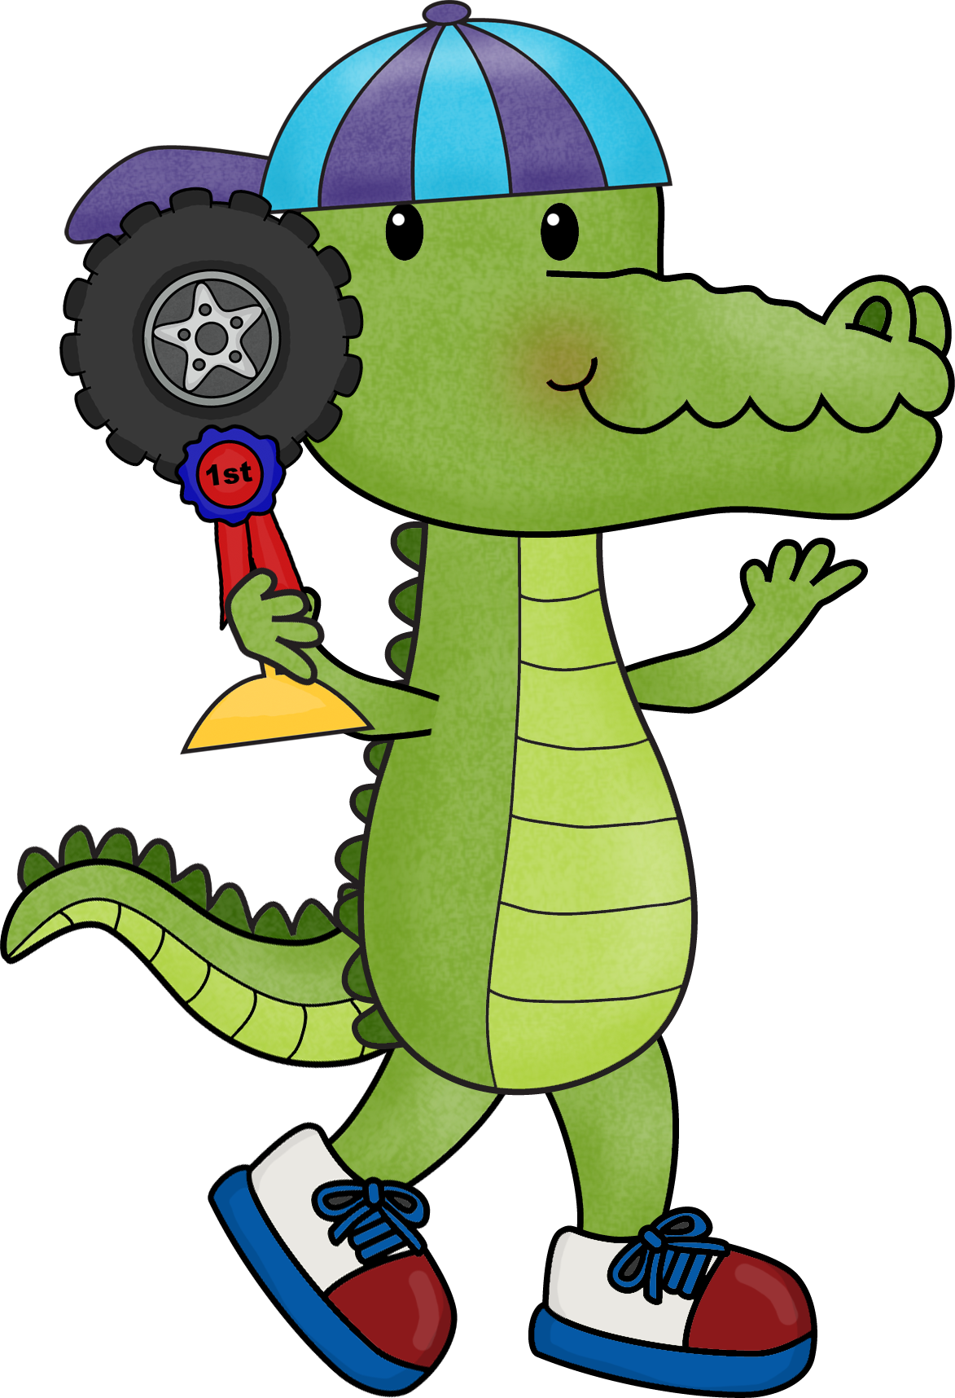
Writing – Cluster 4
I am learning to:
Try to spell the common words that my teacher uses.
Use joining words to link my ideas.
Use pronouns - I, he, she, they
Hold my pencil correctly.
Put my paper in the right place when I am writing.
Sit properly when I write.
Fix my pencil grip, paper or how I am sitting.
Use the computer to write with my teacher’s help.

Slide 8
Writing – Cluster 5
I am learning to:
Use Word Wall words to write my own sentences.
Write stories with my friends.
Write 4 – 5 sentences on topics.
Reread my own work.
Fix it to make sense.
Use capital letters and full stops in the right places.
Use spaces between words.

Slide 9
Writing – Cluster 5
I am learning to:
Try to use a ? and a !
I can write simple sentences with a verb.
Join 2 simple sentences with a joining word
- because, and
Use adjectives to describe nouns and
make my writing interesting.
Write my capital letters correctly.
Write my lower case letters correctly.

Slide 10
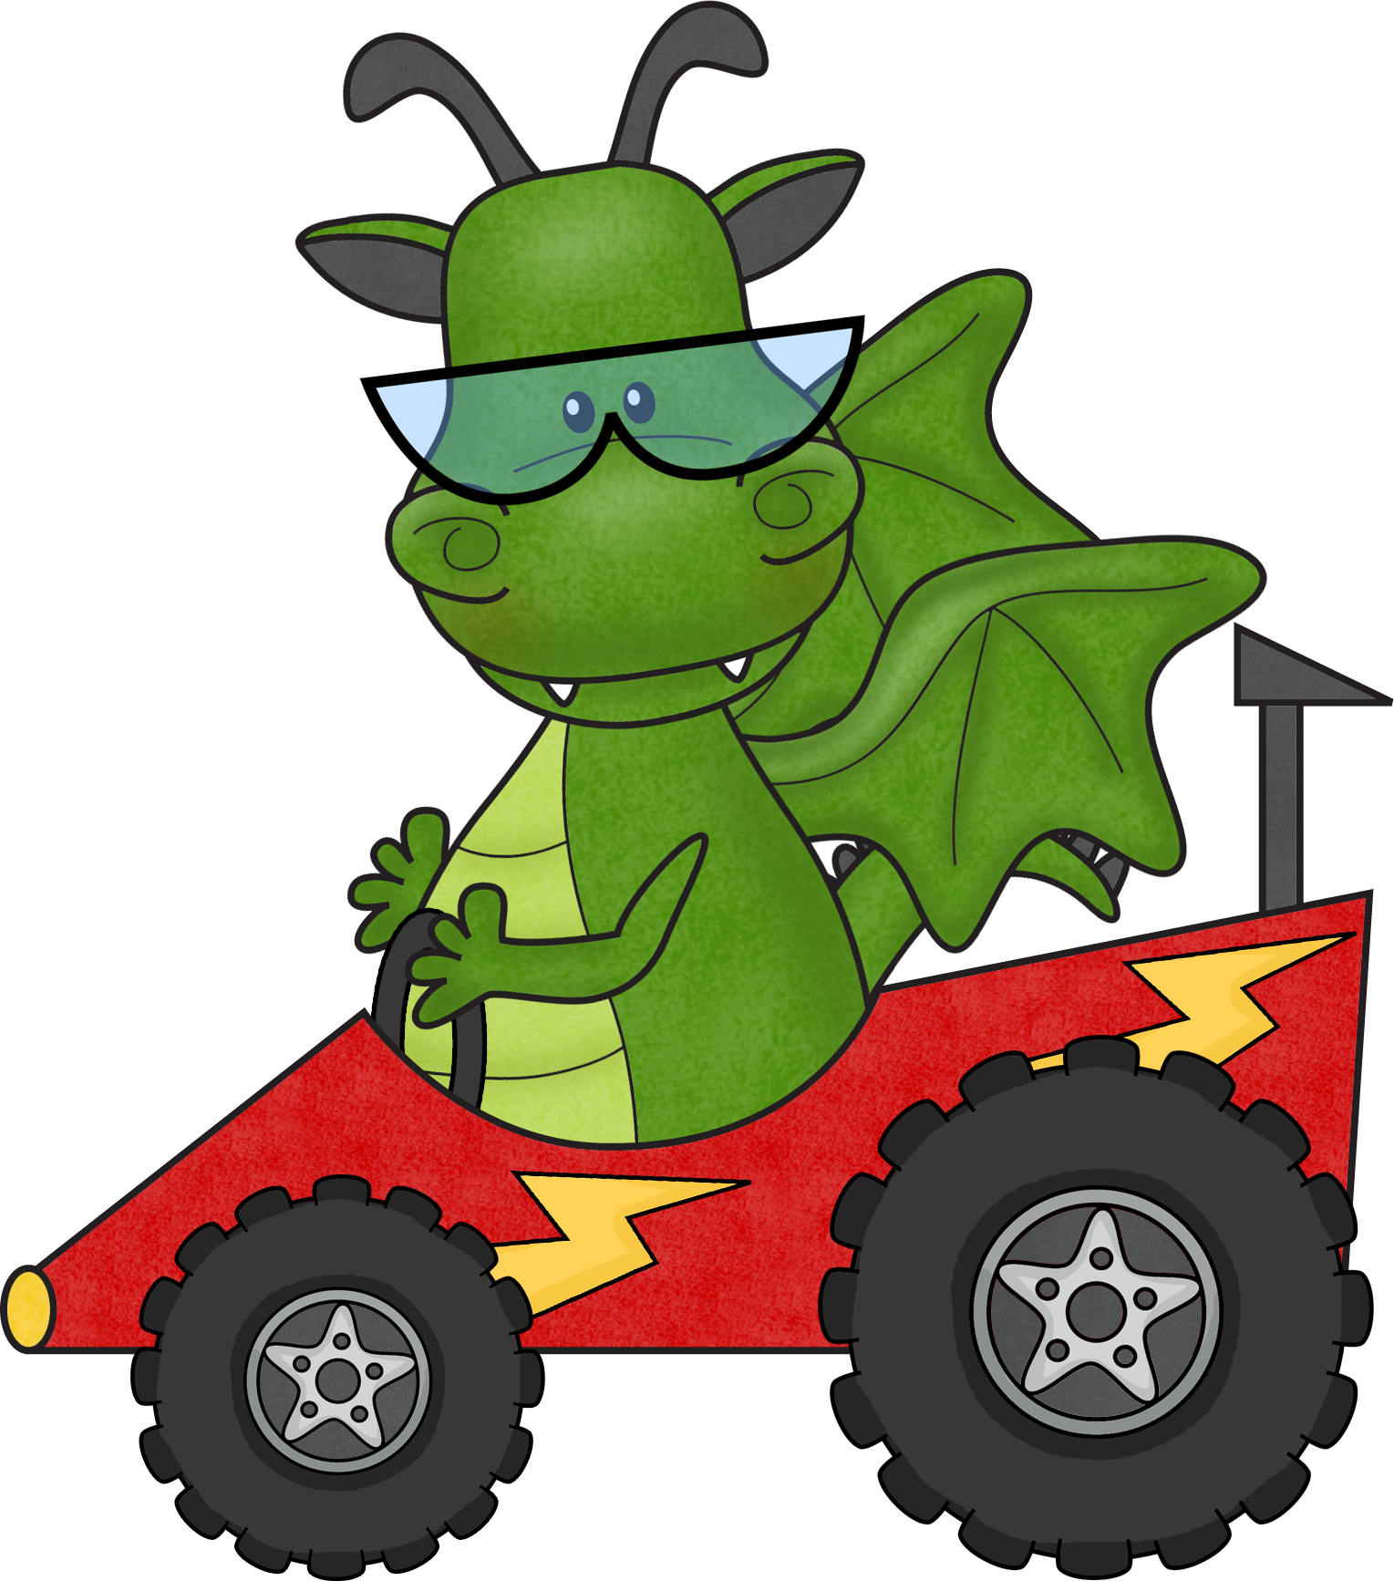
I am learning to:
Writing – Cluster 6
Write 5 or more sentences about familiar topics.
Try to use paragraphs in my writing.
Try to use headings in my writing.
Proof read my writing to check that it makes sense.
Show that I have edited my writing to check that it makes sense.
Spell high frequency and topic words.

Slide 11
Writing – Cluster 6
I am learning to:
Use full stops, exclamation marks and question marks. Write my ideas in order so that they make sense.
Make my writing more interesting by trying to
use complex sentences.
Hold my pencil correctly.
Place my paper correctly to write.
Write quickly and neatly.
Correct my writing on the computer.

Slide 12
Writing – Cluster 7
I am learning to:
Plan my writing by making notes, drawing diagrams or planning a sequence of events or information.
Tell my teacher why I am writing.
Tell my teacher who will be reading my writing.
Spell regular words.
Have a go at spelling difficult words.
Apply spelling rules to my writing.
Use contraction apostrophes, e.g. don’t.

Slide 13
Writing – Cluster 7
I am learning to:
Use simple punctuation.
Use capital letters for proper nouns.
Write a short recount and report correctly.
Use different types of verbs
- relating, action, feeling, thinking and saying verbs.
Choose the correct tense within a sentence,
so that my nouns and verbs match.
Use a computer to create writing that includes pictures.

Slide 14
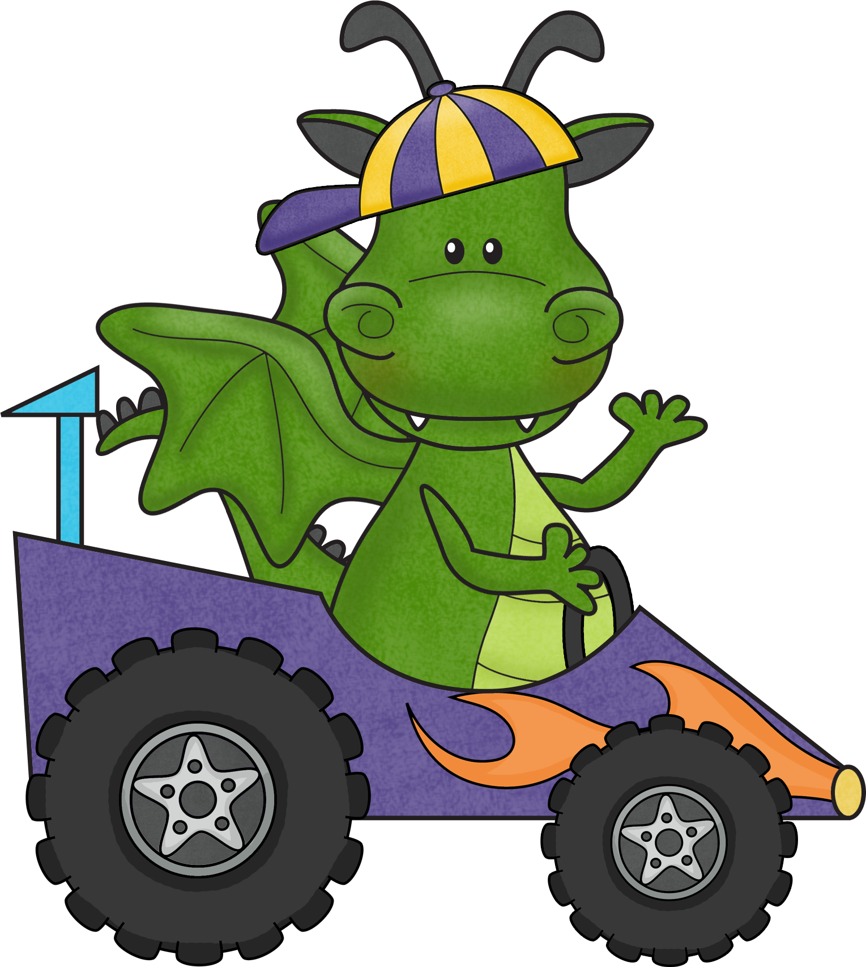
Writing – Cluster 8
I am learning to:
Create texts that are at least one page long.
Write for different reasons to explain and express
my ideas for a variety of audiences.
Experiment with writing and publish my work using
different mediums and modes
- plays, songs, e-mail, Power Point, etc.
Revise, edit and proofread my own writing.

Slide 15
Writing – Cluster 8
I am learning to:
Write explanation texts.
Write persuasive texts.
Use different spelling strategies to spell tricky words.
Use quotation marks.
Use commas in lists.
Write sentences that make sense to others.
Write quickly and neatly.

Slide 16
Created by Shellie Tancred
“Racing Car” Learning Intentions
inspire students
to “race” towards
becoming a
Writing Champ!
Graphics from Scrappin Doodles, iClip Art

