Slide 1
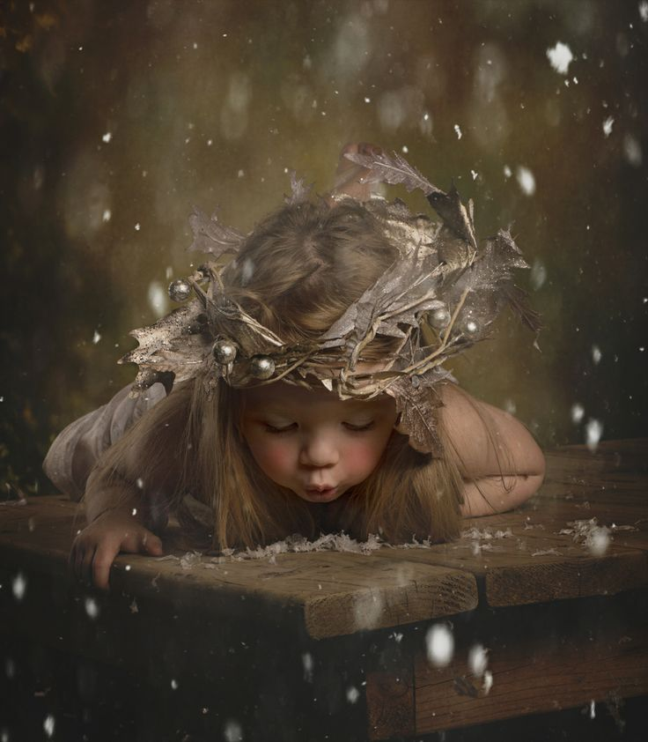
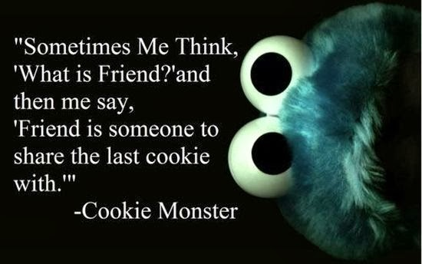
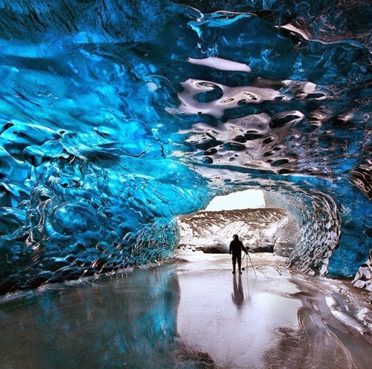
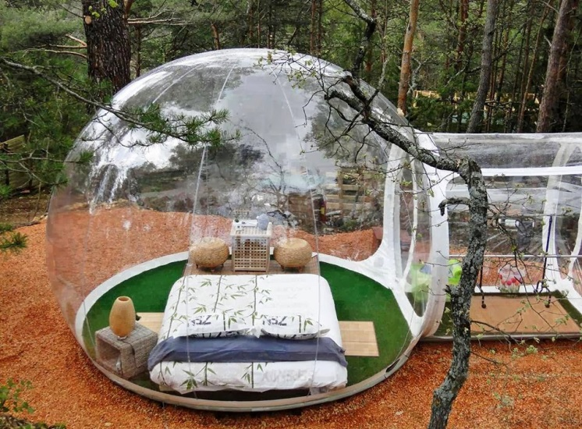
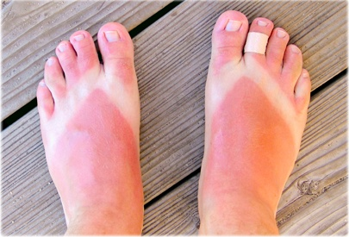
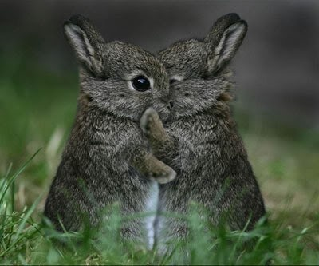
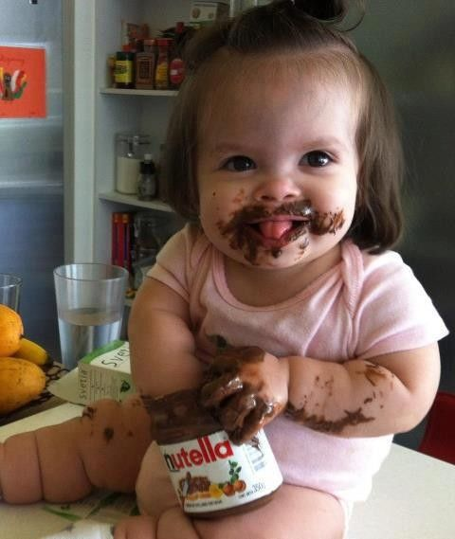
Writing Prompts
Steph Westwood 2014

Slide 2
Explain what Cookie Monster means, and tell whether or not you agree with him, and why.
Steph Westwood 2014

Slide 3
You have just discovered this ice cave.
* Explain why your parents should allow you to play in the cave.
or
* Explain why you don't think children should be allowed to play in the cave.
Steph Westwood 2014

Slide 4
Write a description about spending a night in this "camping bubble".
(include your 5 senses)
What can you hear, see, taste smell, touch?
Steph Westwood 2014

Slide 5
What happened here?
Watch the video and list all the things that happened because a Little Bug went Kachoo .
Steph Westwood 2014

Slide 6
What are three things you can tell about the person who these feet belong to?
Steph Westwood 2014

Slide 7
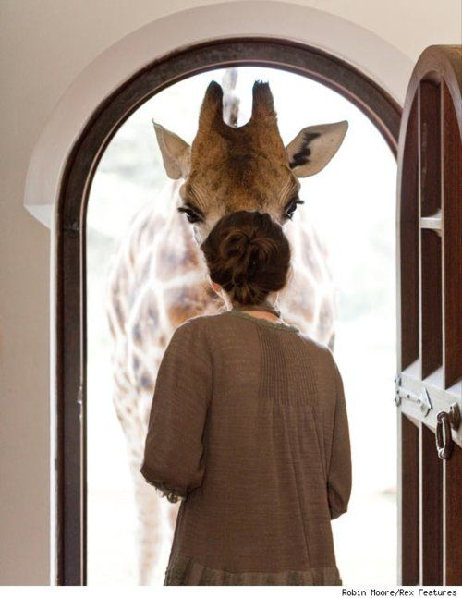
Imagine my surprise when I opened the door and saw a giraffe standing there!
Steph Westwood 2014

Slide 8
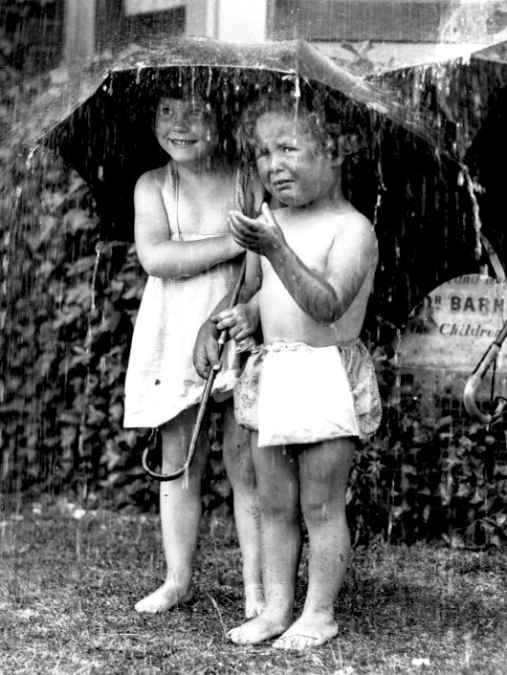
Rain
What do you like to do when it rains?
Steph Westwood 2014

Slide 9
Wishes
*MAKING WISHES ON FAIRY DUST!
If you could make a wish, what would you wish for?
Steph Westwood 2014

Slide 10
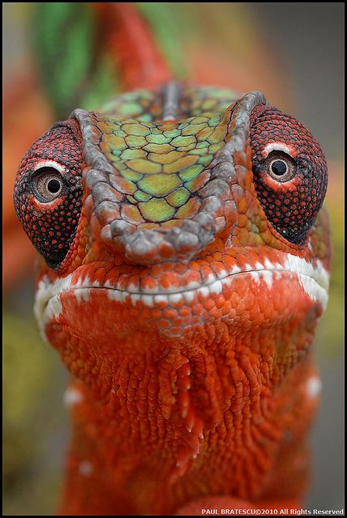
Description
Write a description of this Panther Chameleon
Steph Westwood 2014

Slide 11
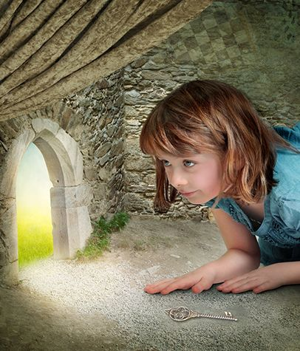
The Little Door
The little girl bent down to look through the tiny door at the back of the room. She couldn't believe what she saw!
What happens next?
Steph Westwood 2014

Slide 12
Best Friends
Write about having a best friend.
Steph Westwood 2014

Slide 13
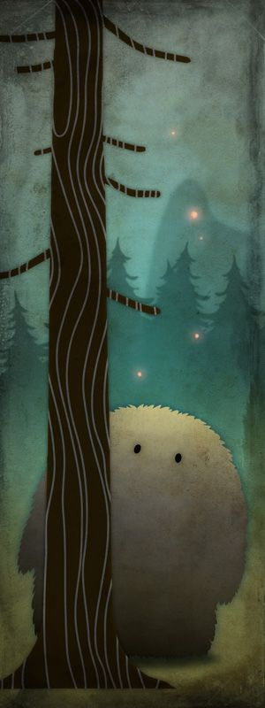
This is Tisipels, a shy character who lives in the forest. Since he has very smelly fur, he unfortunately has very few friends.
Think of 5 ways he can make friends. Write a list.
Steph Westwood 2014

Slide 14
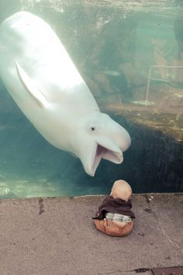
Describe what is happening.
Steph Westwood 2014

Slide 15
Be this little girl.
Tell the story about what was happening when this picture was taken.
Steph Westwood 2014

Slide 16
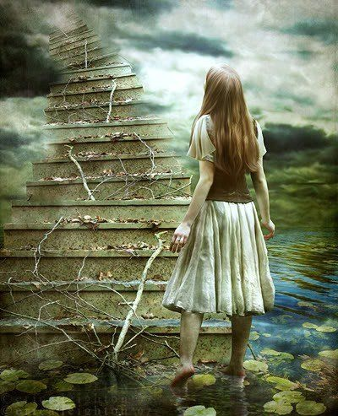
What do you think you will find at the top of the stairs?
Steph Westwood 2014

Slide 17
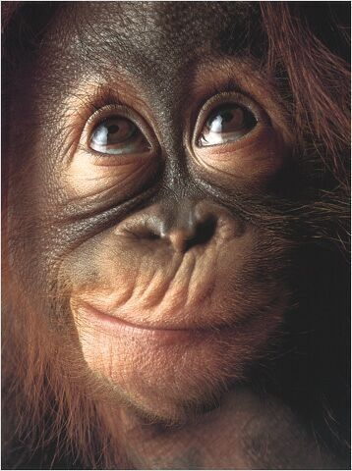
Write a caption for this picture.
What is he thinking?
Steph Westwood 2014

