Slide 1
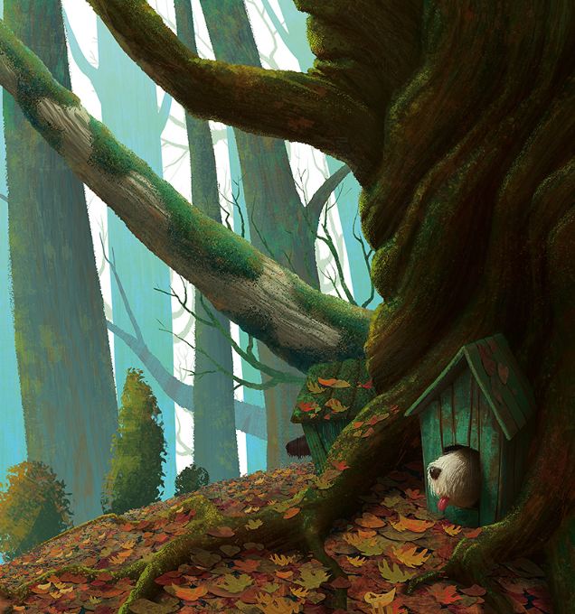
Toby’s large, shaggy head cautiously peeped out of his front door. You see, Toby wasn’t the only one that lived in the forest, but he loved the smell of the forest, especially first thing in the morning. He could almost taste the fresh, leafy goodness on his slobbering tongue as he dangled it out of his yawning mouth.
He could hear a rustling noise getting closer and closer. Someone or something else was awake. …
Continue this story………
Remember to:
•plan your story before you start
•write in sentences
•pay attention to the words you choose, your spelling and punctuation, and paragraphs
Make sure that in your writing you have more than one sentence that uses two adjectives before a noun.
Remember to use a comma separate the adjectives because they are in a list.
•check and edit your writing when you have finished.
Inspiration and image from Lend Me Your Literacy
Steph Westwood 2015
Notes:
Remember to:
•plan your story before you start
•write in sentences
•pay attention to the words you choose, your spelling and punctuation, and paragraphs
•check and edit your writing when you have finished.
Click on the PDF to access worksheets for students.
Criteria for assessing learning
(These criteria would normally be communicated to students with the activity.) Students will be assessed on their ability to:
Plan, draft and edit their own writing
Use written language features and conventions appropriate to a narrative text
Use a variety of verbs, adjectives and conjunctions
Use a multi-strategy approach to spelling.

Slide 2
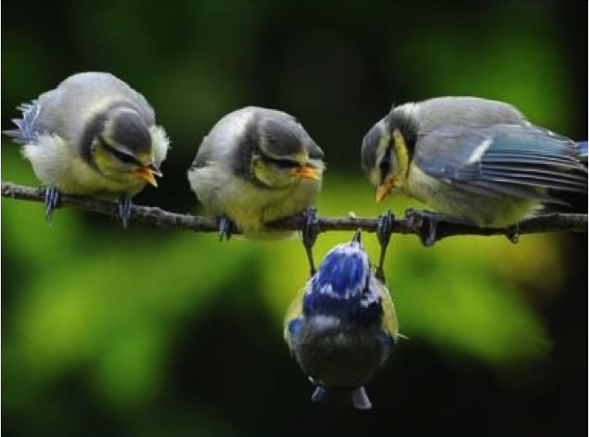
Well?
Write a conversation between the birds.
Remember to:
Use a comma start a speaker’s words.
Use quotation marks before and after a speaker’s words.
Use capital letters for a speaker’s first word.
Start a new paragraph every time a new person speaks.
Place the punctuation inside the quotation marks.
Image found on Pinterest via empressofdirt.net
Steph Westwood 2015
Notes:
Remember to:
•plan your story before you start
•write in sentences
•pay attention to the words you choose, your spelling and punctuation, and paragraphs
Conversation Rules
Use a comma to start a speaker’s words. Example -- Katy said, “I love ice cream!”
Use quotation marks before and after a speaker’s words. Example -- “I scored a goal,” said Tommy.
Use capital letters for a speaker’s first word. Example -- Mr. Jones said, “Look at this giant pumpkin.”
Start a new paragraph every time a new person speaks.
Example -- “Mom! Where is my backpack?” said Billy.
Mom replied, “It’s still in the car.”
“Can you get it for me?” yelled Billy.
“No!” shouted Mom. “I’m making dinner.”
Place the punctuation inside the quotation marks.
•check and edit your writing when you have finished.
Click on the PDF to access worksheets for students.
Students will be assessed on their ability to:
Plan, draft and edit their own writing
Use written language features and conventions appropriate to a narrative text
Use a variety of verbs, adjectives and conjunctions
Use a multi-strategy approach to spelling.

Slide 3
Adventures
It's not what happens to you, but how you react to it that matters.’ Epictetus
These were the words that his father had said to him when he was a boy.
Finish this story………….
Remember to:
•plan your story before you start
•write in sentences
•pay attention to the words you choose, your spelling and punctuation, and paragraphs
Make sure that in your writing you have more than one sentence that uses two adjectives before a noun.
Remember to use a comma separate the adjectives because they are in a list.
•check and edit your writing when you have finished.
Image found on Pinterest via noupe.com
Steph Westwood 2015
Notes:
Remember to:
•plan your story before you start
•write in sentences
•pay attention to the words you choose, your spelling and punctuation, and paragraphs
Make sure that in your writing you have more than one sentence that uses two adjectives before a noun.
Remember to use a comma separate the adjectives because they are in a list.
•check and edit your writing when you have finished.
Click on the PDF to access worksheets for students.
Criteria for assessing learning
(These criteria would normally be communicated to students with the activity.) Students will be assessed on their ability to:
Plan, draft and edit their own writing
Use written language features and conventions appropriate to a narrative text
Use a variety of verbs, adjectives and conjunctions
Use a multi-strategy approach to spelling.

Slide 4
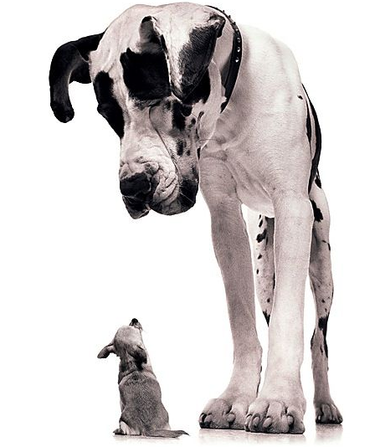
You are
so big!
Write a conversation between the dogs.
Remember to:
Use a comma start a speaker’s words.
Use quotation marks before and after a speaker’s words.
Use capital letters for a speaker’s first word.
Start a new paragraph every time a new person speaks.
Place the punctuation inside the quotation marks.
Image found on Pinterest via ideasbyjivey.com
Steph Westwood 2015
Notes:
Remember to:
•plan your story before you start
•write in sentences
•pay attention to the words you choose, your spelling and punctuation, and paragraphs
Conversation Rules
Use a comma to start a speaker’s words. Example -- Katy said, “I love ice cream!”
Use quotation marks before and after a speaker’s words. Example -- “I scored a goal,” said Tommy.
Use capital letters for a speaker’s first word. Example -- Mr. Jones said, “Look at this giant pumpkin.”
Start a new paragraph every time a new person speaks.
Example -- “Mom! Where is my backpack?” said Billy.
Mom replied, “It’s still in the car.”
“Can you get it for me?” yelled Billy.
“No!” shouted Mom. “I’m making dinner.”
Place the punctuation inside the quotation marks.
•check and edit your writing when you have finished.
Click on the PDF to access worksheets for students.
Criteria for assessing learning
(These criteria would normally be communicated to students with the activity.) Students will be assessed on their ability to:
Plan, draft and edit their own writing
Use written language features and conventions appropriate to a narrative text
Use a variety of verbs, adjectives and conjunctions
Use a multi-strategy approach to spelling.

Slide 5
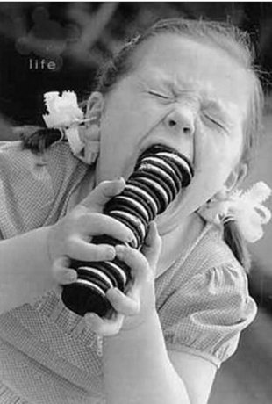
Cookies
Tell about your favourite cookie.
Tell why it is the best and why everyone should buy some.
If you like it can be a storyboard for an advertisement.
Remember to:
•plan your story before you start
•write in sentences
•pay attention to the words you choose, your spelling and punctuation, and paragraphs
Make sure that in your writing you have more than one sentence that uses two adjectives before a noun.
Remember to use a comma separate the adjectives because they are in a list.
•check and edit your writing when you have finished.
Image found on Pinterest via pinterest.com
Steph Westwood 2015
Notes:
Remember to:
•plan your story before you start
•write in sentences
•pay attention to the words you choose, your spelling and punctuation, and paragraphs
Make sure that in your writing you have more than one sentence that uses two adjectives before a noun.
Remember to use a comma separate the adjectives because they are in a list.
•check and edit your writing when you have finished.
draft, revise and publish a persuasive text
use appropriate written language and structure features for a persuasive text
express a point of view in writing with supporting statements
use a range of strategies to spell familiar and unfamiliar words.
Click on the PDF to access worksheets for students.
Criteria for assessing learning
(These criteria would normally be communicated to students with the activity.) Students will be assessed on their ability to:
Plan, draft and edit their own writing
Use written language features and conventions appropriate to a persuasive text
Use a variety of verbs, adjectives and conjunctions
Use a multi-strategy approach to spelling.
draft, revise and publish a persuasive text
express a point of view in writing with supporting statements

Slide 6
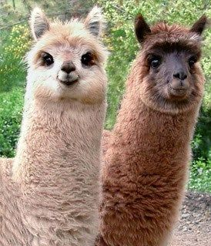
Who Me?
Write a conversation between the two llamas.
Remember to:
Use a comma start a speaker’s words.
Use quotation marks before and after a speaker’s words.
Use capital letters for a speaker’s first word.
Start a new paragraph every time a new person speaks.
Place the punctuation inside the quotation marks.
Image found on Pinterest via cheezburger.com
Steph Westwood 2015
Notes:
Remember to:
•plan your story before you start
•write in sentences
•pay attention to the words you choose, your spelling and punctuation, and paragraphs
Conversation Rules
Use a comma to start a speaker’s words. Example -- Katy said, “I love ice cream!”
Use quotation marks before and after a speaker’s words. Example -- “I scored a goal,” said Tommy.
Use capital letters for a speaker’s first word. Example -- Mr. Jones said, “Look at this giant pumpkin.”
Start a new paragraph every time a new person speaks.
Example -- “Mom! Where is my backpack?” said Billy.
Mom replied, “It’s still in the car.”
“Can you get it for me?” yelled Billy.
“No!” shouted Mom. “I’m making dinner.”
Place the punctuation inside the quotation marks.
•check and edit your writing when you have finished.
Click on the PDF to access worksheets for students.
Criteria for assessing learning
(These criteria would normally be communicated to students with the activity.) Students will be assessed on their ability to:
Plan, draft and edit their own writing
Use written language features and conventions appropriate to a narrative text
Use a variety of verbs, adjectives and conjunctions
Use a multi-strategy approach to spelling.

Slide 7
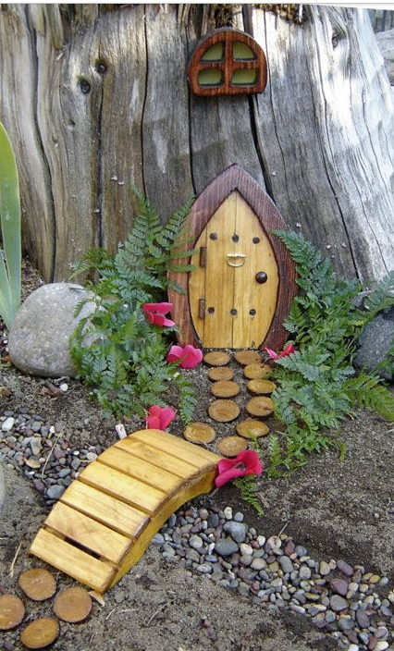
Fairy Tale
Tell a story using this setting.
Where is this?
Who lives here?
Tell about their adventure.
Remember to:
•plan your story before you start
•write in sentences
•pay attention to the words you choose, your spelling and punctuation, and paragraphs
Make sure that in your writing you have more than one sentence that uses two adjectives before a noun.
Remember to use a comma separate the adjectives because they are in a list.
•check and edit your writing when you have finished.
Image found on Pinterest via arquitetura-pessoal.tumblr.com
Steph Westwood 2015
Notes:
Remember to:
•plan your story before you start
•write in sentences
•pay attention to the words you choose, your spelling and punctuation, and paragraphs
Make sure that in your writing you have more than one sentence that uses two adjectives before a noun.
Remember to use a comma separate the adjectives because they are in a list.
•check and edit your writing when you have finished.
Click on the PDF to access worksheets for students.
Criteria for assessing learning
(These criteria would normally be communicated to students with the activity.) Students will be assessed on their ability to:
Plan, draft and edit their own writing
Use written language features and conventions appropriate to a narrative text
Use a variety of verbs, adjectives and conjunctions
Use a multi-strategy approach to spelling.

Slide 8
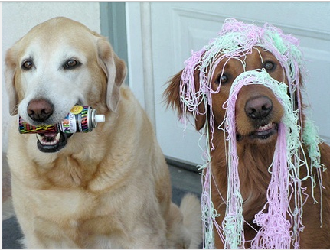
Oops ☺
Write a conversation between the two dogs and their owner.
You might want to
create a Chatterpix.
Remember to:
Use a comma start a speaker’s words.
Use quotation marks before and after a speaker’s words.
Use capital letters for a speaker’s first
word.
Start a new paragraph every time a
new person speaks.
Place the punctuation inside the
quotation marks.
Image found on Pinterest via buzzfeed.com
Steph Westwood 2015
Notes:
Remember to:
•plan your story before you start
•write in sentences
•pay attention to the words you choose, your spelling and punctuation, and paragraphs
Conversation Rules
Use a comma to start a speaker’s words. Example -- Katy said, “I love ice cream!”
Use quotation marks before and after a speaker’s words. Example -- “I scored a goal,” said Tommy.
Use capital letters for a speaker’s first word. Example -- Mr. Jones said, “Look at this giant pumpkin.”
Start a new paragraph every time a new person speaks.
Example -- “Mom! Where is my backpack?” said Billy.
Mom replied, “It’s still in the car.”
“Can you get it for me?” yelled Billy.
“No!” shouted Mom. “I’m making dinner.”
Place the punctuation inside the quotation marks.
•check and edit your writing when you have finished.
Click on the PDF to access worksheets for students.
Criteria for assessing learning
(These criteria would normally be communicated to students with the activity.) Students will be assessed on their ability to:
Plan, draft and edit their own writing
Use written language features and conventions appropriate to a narrative text
Use a variety of verbs, adjectives and conjunctions
Use a multi-strategy approach to spelling.

Slide 9
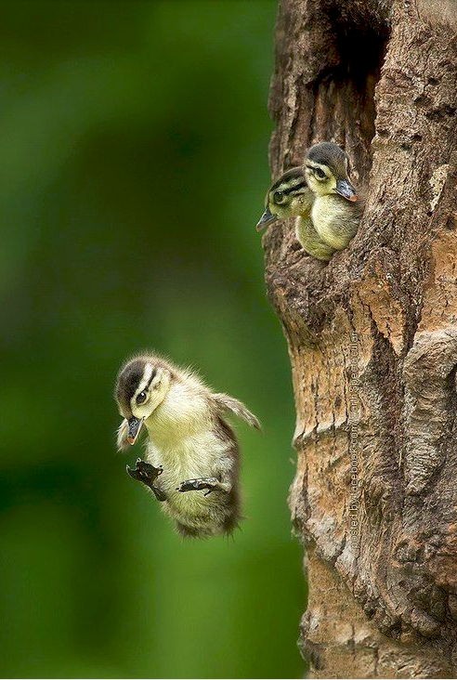
I Can Fly! ….
Write about a time when you thought you could do something but it turned out all wrong.
You could make a comic!
Remember to:
•plan your story before you start
•write in sentences
•pay attention to the words you choose, your spelling and punctuation, and paragraphs
Make sure that in your writing you have more than one sentence that uses two adjectives before a noun.
Remember to use a comma separate the adjectives because they are in a list.
•check and edit your writing when you have finished.
Image found on Pinterest via tassels.tumblr.com
Steph Westwood 2015
Notes:
Remember to:
•plan your story before you start
•write in sentences
•pay attention to the words you choose, your spelling and punctuation, and paragraphs
Make sure that in your writing you have more than one sentence that uses two adjectives before a noun.
Remember to use a comma separate the adjectives because they are in a list.
•check and edit your writing when you have finished.
Click on the PDF to access worksheets for students.
Criteria for assessing learning
(These criteria would normally be communicated to students with the activity.) Students will be assessed on their ability to:
Plan, draft and edit their own writing
Use written language features and conventions appropriate to a narrative text
Use a variety of verbs, adjectives and conjunctions
Use a multi-strategy approach to spelling.

Slide 10
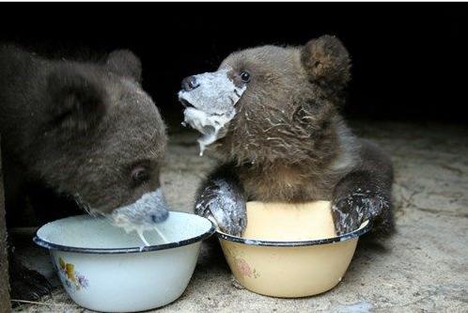
Yummy in my Tummy!
Write a conversation between the two bears.
Remember to:
Use a comma start a speaker’s words.
Use quotation marks before and after a speaker’s words.
Use capital letters for a speaker’s first word.
Start a new paragraph every time a new person speaks.
Place the punctuation inside the quotation marks.
Image found on Pinterest via icanhas.cheezburger.com
Steph Westwood 2015
Notes:
Remember to:
•plan your story before you start
•write in sentences
•pay attention to the words you choose, your spelling and punctuation, and paragraphs
Conversation Rules
Use a comma to start a speaker’s words. Example -- Katy said, “I love ice cream!”
Use quotation marks before and after a speaker’s words. Example -- “I scored a goal,” said Tommy.
Use capital letters for a speaker’s first word. Example -- Mr. Jones said, “Look at this giant pumpkin.”
Start a new paragraph every time a new person speaks.
Example -- “Mom! Where is my backpack?” said Billy.
Mom replied, “It’s still in the car.”
“Can you get it for me?” yelled Billy.
“No!” shouted Mom. “I’m making dinner.”
Place the punctuation inside the quotation marks.
•check and edit your writing when you have finished.
Click on the PDF to access worksheets for students.
Criteria for assessing learning
(These criteria would normally be communicated to students with the activity.) Students will be assessed on their ability to:
Plan, draft and edit their own writing
Use written language features and conventions appropriate to a narrative text
Use a variety of verbs, adjectives and conjunctions
Use a multi-strategy approach to spelling.

Slide 11
A Bridge to Far
When you cross the bridge you arrive in a mysterious town. Describe the town and the people you meet there.
Remember to:
•plan your story before you start
•write in sentences
•pay attention to the words you choose, your spelling and punctuation, and paragraphs
Make sure that in your writing you have more than one sentence that uses two adjectives before a noun.
Remember to use a comma separate the adjectives because they are in a list.
•check and edit your writing when you have finished.
Image found on Pinterest via posh-and-pretty.tumblr.com
Steph Westwood 2015
Notes:
Remember to:
•plan your story before you start
•write in sentences
•pay attention to the words you choose, your spelling and punctuation, and paragraphs
Make sure that in your writing you have more than one sentence that uses two adjectives before a noun.
Remember to use a comma separate the adjectives because they are in a list.
•check and edit your writing when you have finished.
Click on the PDF to access worksheets for students.
Criteria for assessing learning
(These criteria would normally be communicated to students with the activity.) Students will be assessed on their ability to:
Plan, draft and edit their own writing
Use written language features and conventions appropriate to a narrative text
Use a variety of verbs, adjectives and conjunctions
Use a multi-strategy approach to spelling.

