Slide 1
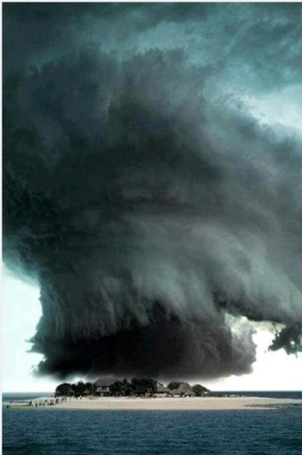
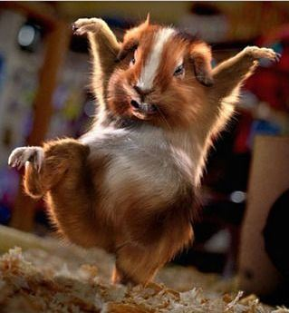
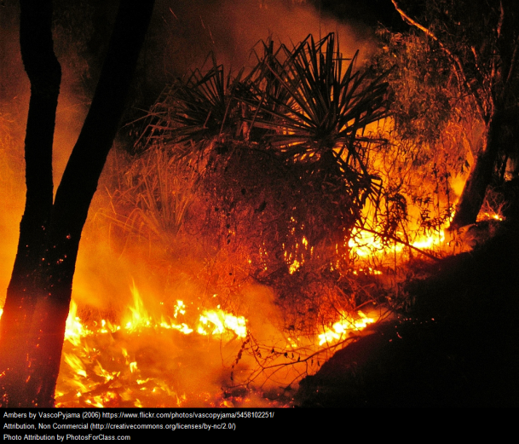
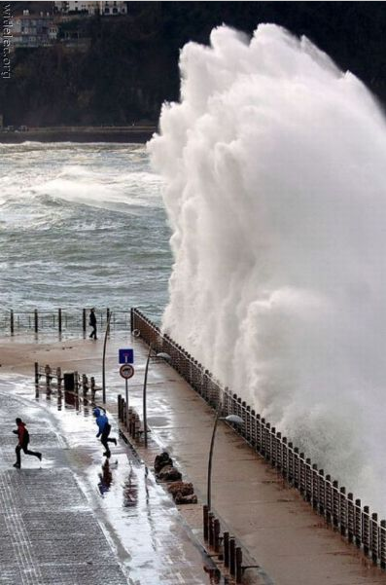
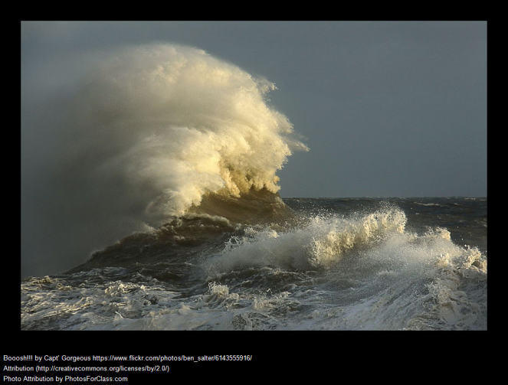
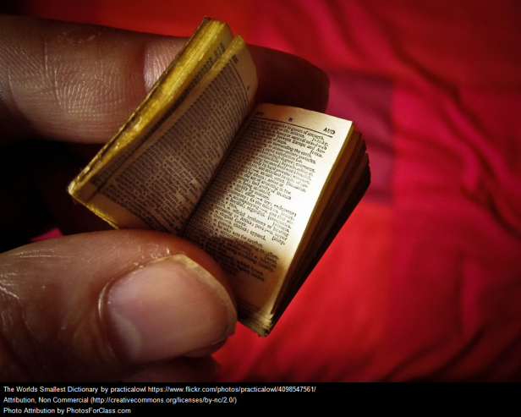
Writing Prompts 12

Slide 2
Storm at Sea
From the perspective of a fish, write a story about a storm taking place out at sea.
Retell what happened in Diary form.
Remember to:
•plan your story before you start
•write in sentences
•pay attention to the words you choose, your spelling, punctuation, and paragraphs
•check and edit your writing when you have finished.
Steph Westwood 2016
Notes:
A Diary is a book in which one keeps a daily record of events and experiences
Diary Format
One common convention when keeping a diary is to write the date at the top of each entry. Diaries are often organized chronologically by date.
Remember to think about:
• writing in a chronological order. Start with events that happened early in the day, and end with events that took place last thing in the evening.
• writing the entries in the first person. Use ‘I’, ‘we’, ‘us’, ‘we’re’, ‘they’, etc
• making your entries detailed, but avoid over describing what is not needed.
• talking about events that involved you, or your familiar, or close friends. Avoid talking about strangers, and events you were not involved in.
• if you are feeling sad, explain what is making you feel sad. If you are happy, write down why. Include your emotions in your diary. Do not be afraid to write about your thoughts
and feelings
Remind students to:
*Write neatly.
* Include everything needed. Don’t leave out any steps.
*Pay attention to spelling and punctuation.
*Use WOW words and interesting connectors.
*Check and edit work so that it is clear to the reader
Outcomes
EN3-2A composes, edits and presents well-structured and coherent texts
EN3-5B discusses how language is used to achieve a widening range of purposes for a widening range of audiences and contexts
EN3-4A draws on appropriate strategies to accurately spell familiar and unfamiliar words when composing texts
EN3-6B uses knowledge of sentence structure, grammar, punctuation and vocabulary to respond to and compose clear and cohesive texts in different media and technologies
EN3-7C thinks imaginatively, creatively, interpretively and critically about information and ideas and identifies connections between texts when responding to and composing texts
Criteria for assessing learning
(These criteria would normally be communicated to students with the activity.) Students will be assessed on their ability to:
Use appropriate written language features for the selected audience
Express a point of view in writing with some supporting statements
Draft, revise and publish a diary.
Use grammatical features, sentence structure and appropriate punctuation.
Consistently make informed attempts at spelling using a multi-strategy approach.

Slide 3
Since the enormous wave was heading straight for us, we knew that we were going to have to fight for our lives.
Complete this story.
Remember to:
•plan your story before you start
•write in sentences
•pay attention to the words you choose, your spelling, punctuation, and paragraphs
•check and edit your writing when you have finished.
Inspiration and image found on izismile.com
Steph Westwood 2016
Notes:
Work Sample Comment Grade B
_______________ has demonstrated thorough knowledge and understanding of the structure and features of a narrative. An interesting storyline with good sequencing of events and an engaging complication has been used. Humour has been included and the language is descriptive. To improve ____________________ could include more complex sentences. ______________________ response demonstrates characteristics of work typically produced by a student performing at a grade B Standard.
Work Sample Comment Grade C
_____________ has demonstrated sound knowledge and understanding of the structure and features of a narrative. There is an orientation and a complication but the resolution is more of a conclusion than a means of addressing the issues faced. Some creativity is evident but there is minimal use of descriptive language and no character development. Direct speech has been used appropriately and there is some use of repetition for dramatic effect but some words have been
overused. To improve, _____________ could include figurative language and develop a stronger resolution. ______________ response demonstrates characteristics of work typically produced by a student performing at a grade C
Standard
At Stage 3 students:
They create a variety of sequenced texts for different purposes and audiences. When writing, they demonstrate understanding of grammar, select specific vocabulary and use accurate spelling and punctuation, editing their work to provide structure and meaning.
*Use complex and technical language
*Include simple and complex sentences
*Include visual aids to complement text, e.g. diagrams, charts
*Include annotated sketches and drawings using scale to indicate size
*Make reference to variables
*Identify form of recording data
*Identify selection of tools for success and efficiency.
Description of activity
Students plan, draft and write a narrative using visual stimulus as a starting point.
Imaginative Text
Creates an imaginative text using appropriate text structure, e.g. in a narrative, orients the reader, includes a complication and a resolution
Uses simple vocabulary and some appropriately selected descriptive and topic-specific words
Spells most common words correctly
Uses simple, compound and complex sentences to extend ideas
Employs editing strategies
Correctly uses familiar punctuation.
Outcomes
EN3-2A composes, edits and presents well-structured and coherent texts
EN3-4A draws on appropriate strategies to accurately spell familiar and unfamiliar words when composing texts
EN3-5B discusses how language is used to achieve a widening range of purposes for a widening range of audiences and contexts
EN3-6B uses knowledge of sentence structure, grammar, punctuation and vocabulary to respond to and compose clear and cohesive texts in different media and technologies
EN3-7C thinks imaginatively, creatively, interpretively and critically about information and ideas and identifies connections between texts when responding to and composing texts
Criteria for assessing learning
(These criteria would normally be communicated to students with the activity.) Students will be assessed on their ability to:
Plan, draft and edit their own writing
Use written language features and conventions appropriate to a narrative text
Use a variety of verbs, adjectives and conjunctions
Use a multi-strategy approach to spelling.

Slide 4
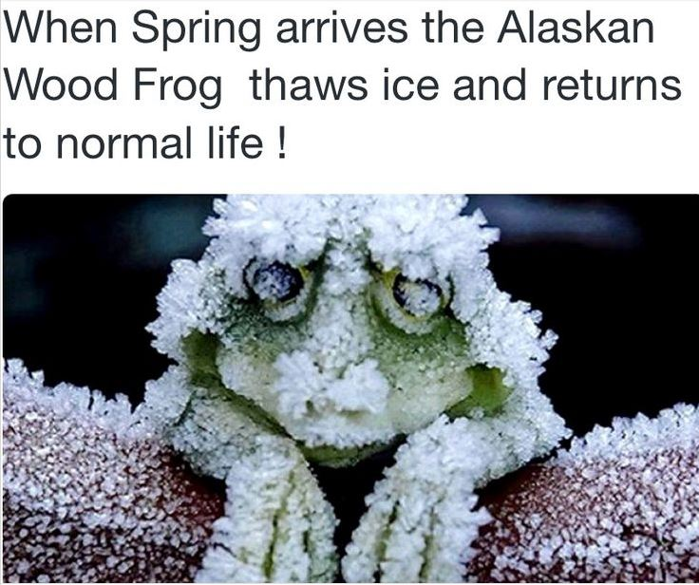
Write a diary entry for a week in the life of the thawing Alaskan Wood Frog.
Remember to:
•plan your story before you start
•write in sentences
•pay attention to the words you choose, your spelling and punctuation, and paragraphs
•check and edit your writing when you have finished.
Inspiration and image from Twitter
Steph Westwood 2015
Notes:
A Diary is a book in which one keeps a daily record of events and experiences
Diary Format
One common convention when keeping a diary is to write the date at the top of each entry. Diaries are often organized chronologically by date.
Remember to think about:
• writing in a chronological order. Start with events that happened early in the day, and end with events that took place last thing in the evening.
• writing the entries in the first person. Use ‘I’, ‘we’, ‘us’, ‘we’re’, ‘they’, etc
• making your entries detailed, but avoid over describing what is not needed.
• talking about events that involved you, or your familiar, or close friends. Avoid talking about strangers, and events you were not involved in.
• if you are feeling sad, explain what is making you feel sad. If you are happy, write down why. Include your emotions in your diary. Do not be afraid to write about your thoughts
and feelings
Remind students to:
*Write neatly.
* Include everything needed. Don’t leave out any steps.
*Pay attention to spelling and punctuation.
*Use WOW words and interesting connectors.
*Check and edit work so that it is clear to the reader
Outcomes
EN3-2A composes, edits and presents well-structured and coherent texts
EN3-5B discusses how language is used to achieve a widening range of purposes for a widening range of audiences and contexts
EN3-4A draws on appropriate strategies to accurately spell familiar and unfamiliar words when composing texts
EN3-6B uses knowledge of sentence structure, grammar, punctuation and vocabulary to respond to and compose clear and cohesive texts in different media and technologies
EN3-7C thinks imaginatively, creatively, interpretively and critically about information and ideas and identifies connections between texts when responding to and composing texts
Criteria for assessing learning
(These criteria would normally be communicated to students with the activity.) Students will be assessed on their ability to:
Use appropriate written language features for the selected audience
Express a point of view in writing with some supporting statements
Draft, revise and publish a diary.
Use grammatical features, sentence structure and appropriate punctuation.
Consistently make informed attempts at spelling using a multi-strategy approach.

Slide 5
Natural Disaster
You have just been told that in half an hour a huge natural disaster will hit.
What will you do? Choose your disaster and write out your evacuation plan.
Remember to:
•plan your story before you start
•write in sentences
•pay attention to the words you choose, your spelling, punctuation, and paragraphs
•check and edit your writing when you have finished.
Inspiration and image from inspiringideas.inspireworthy.com
Steph Westwood 2016
Notes:
Work Sample Comment Grade B
_______________ has demonstrated thorough knowledge and understanding of the structure and features of a narrative. An interesting storyline with good sequencing of events and an engaging complication has been used. Humour has been included and the language is descriptive. To improve ____________________ could include more complex sentences. The evacuation plan is extremely detailed and sequenced in the correct order. ______________________ response demonstrates characteristics of work typically produced by a student performing at a grade B Standard.
Work Sample Comment Grade C
_____________ has demonstrated sound knowledge and understanding of the structure and features of a narrative. There is an orientation and a complication but the resolution is more of a conclusion than a means of addressing the issues faced. Some creativity is evident but there is minimal use of descriptive language and no character development. Direct speech has been used appropriately and there is some use of repetition for dramatic effect but some words have been
overused. To improve, _____________ could include figurative language and develop a stronger resolution. ______________ response demonstrates characteristics of work typically produced by a student performing at a grade C
Standard
At Stage 3 students:
They create a variety of sequenced texts for different purposes and audiences. When writing, they demonstrate understanding of grammar, select specific vocabulary and use accurate spelling and punctuation, editing their work to provide structure and meaning.
*Use complex and technical language
*Include simple and complex sentences
*Include visual aids to complement text, e.g. diagrams, charts
*Include annotated sketches and drawings using scale to indicate size
*Make reference to variables
*Identify form of recording data
*Identify selection of tools for success and efficiency.
Description of activity
Students plan, draft and write a narrative using visual stimulus as a starting point.
Imaginative Text
Creates an imaginative text using appropriate text structure, e.g. in a narrative, orients the reader, includes a complication and a resolution
Uses simple vocabulary and some appropriately selected descriptive and topic-specific words
Spells most common words correctly
Uses simple, compound and complex sentences to extend ideas
Employs editing strategies
Correctly uses familiar punctuation.
Outcomes
EN3-2A composes, edits and presents well-structured and coherent texts
EN3-4A draws on appropriate strategies to accurately spell familiar and unfamiliar words when composing texts
EN3-5B discusses how language is used to achieve a widening range of purposes for a widening range of audiences and contexts
EN3-6B uses knowledge of sentence structure, grammar, punctuation and vocabulary to respond to and compose clear and cohesive texts in different media and technologies
EN3-7C thinks imaginatively, creatively, interpretively and critically about information and ideas and identifies connections between texts when responding to and composing texts
Criteria for assessing learning
(These criteria would normally be communicated to students with the activity.) Students will be assessed on their ability to:
Plan, draft and edit their own writing
Use written language features and conventions appropriate to a narrative text
Use a variety of verbs, adjectives and conjunctions
Use a multi-strategy approach to spelling.

Slide 6
"I swear it was this tall and it walked like this."
Tell the story from the perspective of the guinea pig. Include the setting, lots of details, precise verbs and use dialog in the story. Finish with a picture to illustrate your story.
Remember to:
•plan your story before you start
•write in sentences
•pay attention to the words you choose, your spelling and punctuation, and paragraphs
Make sure that in your writing you have more than one sentence that uses two adjectives before a noun.
Remember to use a comma separate the adjectives because they are in a list.
•check and edit your writing when you have finished.
Inspiration and image from Skool Aid Products- Writing Prompts
Steph Westwood 2015
Notes:
‘Persuasive texts need to make a point, or persuade the reader to agree with a particular point of view. As such, their introductions need to be clear and summarise the main message. The writer may use a title that is bold, inspiring or controversial. They must engage the reader and their emotions so that they want to keep on reading.’ Merryn Whitfield
Work Sample Comment Grade B
________________ has demonstrated a high level of competence in analysing and creating visual texts. The techniques and target audience for each advertisement have been identified and appropriate terminology has been used. The advertisement concept design demonstrates a thorough understanding of emotive language, visual images and persuasive techniques to appeal to the target audience. ___________________ response demonstrates characteristics of work typically produced by a student performing at a grade B standard.
Work Sample Comment Grade C
____________________ has demonstrated an adequate level of competence in analysing and creating visual texts. Some techniques in the advertisements provided have been identified and there is an awareness of the target audience but more detailed analysis would strengthen the response. _______________________ response demonstrates characteristics of work typically produced by a student performing at a grade C standard.
Remind students to:
*Write neatly.
* Include everything needed. Don’t leave out any steps.
*Use descriptive words.
*Pay attention to spelling and punctuation.
*Use WOW words and interesting connectors.
* Check and edit work so that it is clear to the reader
Outcomes
EN3-2A composes, edits and presents well-structured and coherent texts
EN3-5B discusses how language is used to achieve a widening range of purposes for a widening range of audiences and contexts
EN3-4A draws on appropriate strategies to accurately spell familiar and unfamiliar words when composing texts
EN3-6B uses knowledge of sentence structure, grammar, punctuation and vocabulary to respond to and compose clear and cohesive texts in different media and technologies
EN3-7C thinks imaginatively, creatively, interpretively and critically about information and ideas and identifies connections between texts when responding to and composing texts
EN3-1A communicates effectively for a variety of audiences and purposes using increasingly challenging topics, ideas, issues and language forms and features
-plan, rehearse and deliver presentations, selecting and sequencing appropriate content and multimodal elements for defined audiences and purposes, making appropriate choices for modality and emphasis (ACELY1700, ACELY1710)
Criteria for assessing learning
(These criteria would normally be communicated to students with the activity.)
Students will be assessed on their ability to:
Plan, draft , edit and write a persuasive text and storyboard a film
Demonstrate an understanding of characters and plot in a literary text
Use written language features and conventions appropriate to this text
Use detail to help a reader imagine what is being described
Use a range of adjectives to describe an image
Use a variety of verbs, adjectives and conjunctions
Use a multi-strategy approach to spelling.

Slide 7
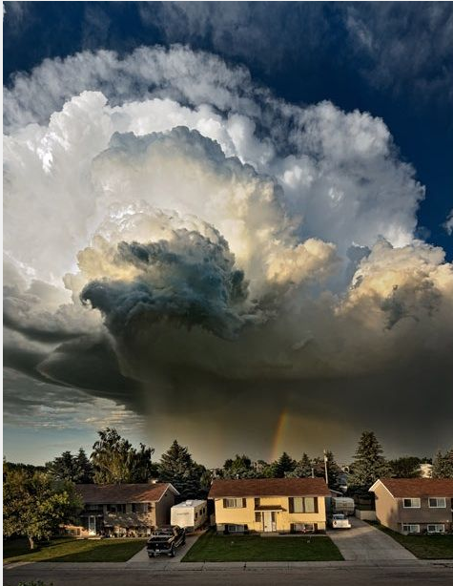
Description
Write a description of this storm brewing. What can you hear, feel, smell, see?
Steph Westwood 2016
Notes:
Work Sample Comment Grade B
________________ has demonstrated a thorough knowledge and understanding of the content in a well-organised, creative description. There is evidence of a variety of sentence structures, with appropriate paragraphing and effective use of imagery including simile and metaphor. There is excellent use of descriptive language including sophisticated noun groupings. __________________ needs to further develop editing skills in order to identify minor grammatical errors.
________________________ response demonstrates characteristics of work typically produced by a student performing at a grade B standard.
Work Sample Comment Grade C
______________ has demonstrated sound knowledge and understanding of the structure and features of a literary description. Detail has been included to help the reader imagine what is being described. _____________ has attempted to use metaphors and imagery, and a variety of strategies has been used to spell common words accurately. _________________ response demonstrates characteristics of work typically produced by a student performing at a grade C standard.
Description of activity
Students plan, draft and compose an imaginative text. They focus on using language features to create a strong sense of place, character and/or atmosphere.
At Stage 3 students:
They create a variety of sequenced texts for different purposes and audiences. When writing, they demonstrate understanding of grammar, select specific vocabulary and use accurate spelling and punctuation, editing their work to provide structure and meaning.
*Use complex and technical language
*Include simple and complex sentences
*Include visual aids to complement text, e.g. diagrams, charts
*Include annotated sketches and drawings using scale to indicate size
*Make reference to variables
*Identify form of recording data
*Identify selection of tools for success and efficiency.
Imaginative Text
Creates an imaginative text using appropriate text structure, e.g. in a narrative, orients the reader, includes a complication and a resolution
Uses simple vocabulary and some appropriately selected descriptive and topic-specific words
Spells most common words correctly
Uses simple, compound and complex sentences to extend ideas
Employs editing strategies
Correctly uses familiar punctuation.
Outcomes
EN3-2A composes, edits and presents well-structured and coherent texts
EN3-5B discusses how language is used to achieve a widening range of purposes for a widening range of audiences and contexts
EN3-4A draws on appropriate strategies to accurately spell familiar and unfamiliar words when composing texts
EN3-6B uses knowledge of sentence structure, grammar, punctuation and vocabulary to respond to and compose clear and cohesive texts in different media and technologies
Criteria for assessing learning
(These criteria would normally be communicated to students with the activity.) Students will be assessed on their ability to:
plan, draft and write literary description
use detail to help a reader imagine what is being described
use a range of adjectives to describe an image
consistently make informed attempts at spelling using a multi-strategy approach.

Slide 8
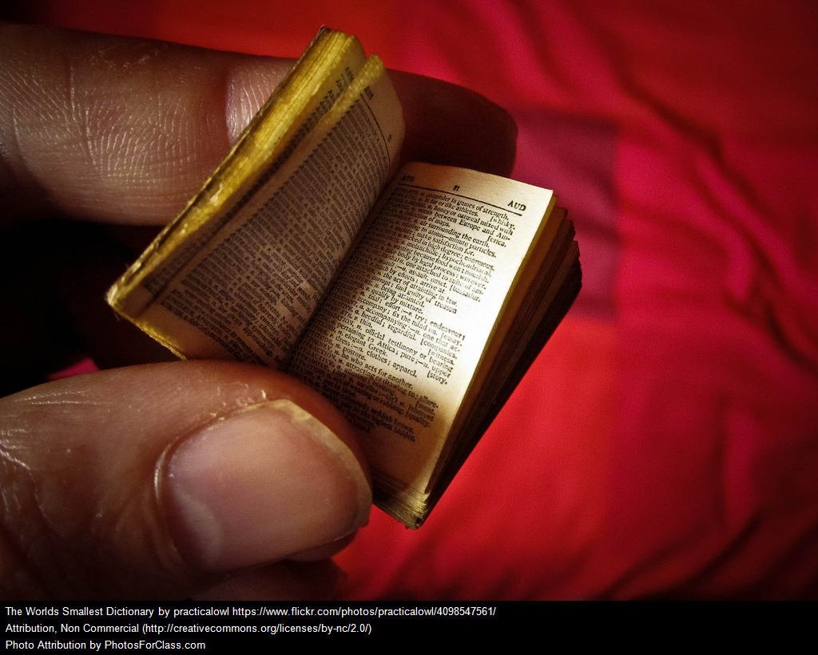
Write a story that starts with a word you pick out of a dictionary at random.
Remember to:
•plan your story before you start
•write in sentences
•pay attention to the words you choose, your spelling and punctuation, and paragraphs
Make sure that in your writing you have more than one sentence that uses two adjectives before a noun.
Remember to use a comma separate the adjectives because they are in a list.
•check and edit your writing when you have finished.
Steph Westwood 2016
Notes:
Work Sample Comment Grade B
_______________ has demonstrated thorough knowledge and understanding of the structure and features of a narrative. An interesting storyline with good sequencing of events and an engaging complication has been used. Humour has been included and the language is descriptive. To improve ____________________ could include more complex sentences. ______________________ response demonstrates characteristics of work typically produced by a student performing at a grade B Standard.
Work Sample Comment Grade C
_____________ has demonstrated sound knowledge and understanding of the structure and features of a narrative. There is an orientation and a complication but the resolution is more of a conclusion than a means of addressing the issues faced. Some creativity is evident but there is minimal use of descriptive language and no character development. Direct speech has been used appropriately and there is some use of repetition for dramatic effect but some words have been
overused. To improve, _____________ could include figurative language and develop a stronger resolution. ______________ response demonstrates characteristics of work typically produced by a student performing at a grade C
Standard
At Stage 3 students:
They create a variety of sequenced texts for different purposes and audiences. When writing, they demonstrate understanding of grammar, select specific vocabulary and use accurate spelling and punctuation, editing their work to provide structure and meaning.
*Use complex and technical language
*Include simple and complex sentences
*Include visual aids to complement text, e.g. diagrams, charts
*Include annotated sketches and drawings using scale to indicate size
*Make reference to variables
*Identify form of recording data
*Identify selection of tools for success and efficiency.
Description of activity
Students plan, draft and write a narrative using visual stimulus as a starting point.
Imaginative Text
Creates an imaginative text using appropriate text structure, e.g. in a narrative, orients the reader, includes a complication and a resolution
Uses simple vocabulary and some appropriately selected descriptive and topic-specific words
Spells most common words correctly
Uses simple, compound and complex sentences to extend ideas
Employs editing strategies
Correctly uses familiar punctuation.
Outcomes
EN3-2A composes, edits and presents well-structured and coherent texts
EN3-4A draws on appropriate strategies to accurately spell familiar and unfamiliar words when composing texts
EN3-5B discusses how language is used to achieve a widening range of purposes for a widening range of audiences and contexts
EN3-6B uses knowledge of sentence structure, grammar, punctuation and vocabulary to respond to and compose clear and cohesive texts in different media and technologies
EN3-7C thinks imaginatively, creatively, interpretively and critically about information and ideas and identifies connections between texts when responding to and composing texts
Criteria for assessing learning
(These criteria would normally be communicated to students with the activity.) Students will be assessed on their ability to:
Plan, draft and edit their own writing
Use written language features and conventions appropriate to a narrative text
Use a variety of verbs, adjectives and conjunctions
Use a multi-strategy approach to spelling.

Slide 9
Lava is on its way to your town. You have been given 20 minutes to pack up and leave. What would you take with you and why?
Remember to:
•plan your story before you start
•write in sentences
•pay attention to the words you choose, your spelling ,punctuation, and paragraphs
•check and edit your writing when you have finished.
Inspiration and image from Pinterest
Steph Westwood 2016
Notes:
‘Persuasive texts need to make a point, or persuade the reader to agree with a particular point of view. As such, their introductions need to be clear and summarise the main message. The writer may use a title that is bold, inspiring or controversial. They must engage the reader and their emotions so that they want to keep on reading.’ Merryn Whitfield
Remind students to:
*Write neatly.
* Include everything needed. Don’t leave out any steps.
*Use descriptive words.
*Pay attention to spelling and punctuation.
*Use WOW words and interesting connectors.
* Check and edit work so that it is clear to the reader
Outcomes
EN3-2A composes, edits and presents well-structured and coherent texts
EN3-5B discusses how language is used to achieve a widening range of purposes for a widening range of audiences and contexts
EN3-4A draws on appropriate strategies to accurately spell familiar and unfamiliar words when composing texts
EN3-6B uses knowledge of sentence structure, grammar, punctuation and vocabulary to respond to and compose clear and cohesive texts in different media and technologies
EN3-7C thinks imaginatively, creatively, interpretively and critically about information and ideas and identifies connections between texts when responding to and composing texts
EN3-1A communicates effectively for a variety of audiences and purposes using increasingly challenging topics, ideas, issues and language forms and features
-plan, rehearse and deliver presentations, selecting and sequencing appropriate content and multimodal elements for defined audiences and purposes, making appropriate choices for modality and emphasis (ACELY1700, ACELY1710)
Criteria for assessing learning
(These criteria would normally be communicated to students with the activity.)
Students will be assessed on their ability to:
Plan, draft , edit and write a persuasive text and storyboard a film
Create a movie clip
Demonstrate an understanding of characters and plot in a literary text
Use written language features and conventions appropriate to this text
Use detail to help a reader imagine what is being described
Use a range of adjectives to describe an image
Use a variety of verbs, adjectives and conjunctions
Use a multi-strategy approach to spelling.

Slide 10
Select a native animal that lives in the Australian bush.
Write an entreaty from your animal to protect it from the ravages of bushfire. Your animal will need to describe where it lives and how bushfires pose a threat to its survival
Remember to:
•plan your story before you start
•write in sentences
•pay attention to the words you choose, your spelling ,punctuation, and paragraphs
•check and edit your writing when you have finished.
Steph Westwood 2016
Notes:
‘Persuasive texts need to make a point, or persuade the reader to agree with a particular point of view. As such, their introductions need to be clear and summarise the main message. The writer may use a title that is bold, inspiring or controversial. They must engage the reader and their emotions so that they want to keep on reading.’ Merryn Whitfield
Work Sample Comment Grade B
________________ has demonstrated a high level of competence in analysing and creating visual texts. The techniques and target audience for each advertisement have been identified and appropriate terminology has been used. The advertisement concept design demonstrates a thorough understanding of emotive language, visual images and persuasive techniques to appeal to the target audience. ___________________ response demonstrates characteristics of work typically produced by a student performing at a grade B standard.
Work Sample Comment Grade C
____________________ has demonstrated an adequate level of competence in analysing and creating visual texts. Some techniques in the advertisements provided have been identified and there is an awareness of the target audience but more detailed analysis would strengthen the response. _______________________ response demonstrates characteristics of work typically produced by a student performing at a grade C standard.
Remind students to:
*Write neatly.
* Include everything needed. Don’t leave out any steps.
*Use descriptive words.
*Pay attention to spelling and punctuation.
*Use WOW words and interesting connectors.
* Check and edit work so that it is clear to the reader
Outcomes
EN3-2A composes, edits and presents well-structured and coherent texts
EN3-5B discusses how language is used to achieve a widening range of purposes for a widening range of audiences and contexts
EN3-4A draws on appropriate strategies to accurately spell familiar and unfamiliar words when composing texts
EN3-6B uses knowledge of sentence structure, grammar, punctuation and vocabulary to respond to and compose clear and cohesive texts in different media and technologies
EN3-7C thinks imaginatively, creatively, interpretively and critically about information and ideas and identifies connections between texts when responding to and composing texts
EN3-1A communicates effectively for a variety of audiences and purposes using increasingly challenging topics, ideas, issues and language forms and features
-plan, rehearse and deliver presentations, selecting and sequencing appropriate content and multimodal elements for defined audiences and purposes, making appropriate choices for modality and emphasis (ACELY1700, ACELY1710)
Criteria for assessing learning
(These criteria would normally be communicated to students with the activity.)
Students will be assessed on their ability to:
Plan, draft , edit and write a persuasive text and storyboard a film
Create a movie clip
Demonstrate an understanding of characters and plot in a literary text
Use written language features and conventions appropriate to this text
Use detail to help a reader imagine what is being described
Use a range of adjectives to describe an image
Use a variety of verbs, adjectives and conjunctions
Use a multi-strategy approach to spelling.

Slide 11
Inspiration and image from Photo Prompts Tumblr
Steph Westwood 2015
Notes:
‘Persuasive texts need to make a point, or persuade the reader to agree with a particular point of view. As such, their introductions need to be clear and summarise the main message. The writer may use a title that is bold, inspiring or controversial. They must engage the reader and their emotions so that they want to keep on reading.’ Merryn Whitfield
Work Sample Comment Grade B
________________ has demonstrated a high level of competence in analysing and creating visual texts. The techniques and target audience for each advertisement have been identified and appropriate terminology has been used. The advertisement concept design demonstrates a thorough understanding of emotive language, visual images and persuasive techniques to appeal to the target audience. ___________________ response demonstrates characteristics of work typically produced by a student performing at a grade B standard.
Work Sample Comment Grade C
____________________ has demonstrated an adequate level of competence in analysing and creating visual texts. Some techniques in the advertisements provided have been identified and there is an awareness of the target audience but more detailed analysis would strengthen the response. _______________________ response demonstrates characteristics of work typically produced by a student performing at a grade C standard.
Remind students to:
*Write neatly.
* Include everything needed. Don’t leave out any steps.
*Use descriptive words.
*Pay attention to spelling and punctuation.
*Use WOW words and interesting connectors.
* Check and edit work so that it is clear to the reader
Outcomes
EN3-2A composes, edits and presents well-structured and coherent texts
EN3-5B discusses how language is used to achieve a widening range of purposes for a widening range of audiences and contexts
EN3-4A draws on appropriate strategies to accurately spell familiar and unfamiliar words when composing texts
EN3-6B uses knowledge of sentence structure, grammar, punctuation and vocabulary to respond to and compose clear and cohesive texts in different media and technologies
EN3-7C thinks imaginatively, creatively, interpretively and critically about information and ideas and identifies connections between texts when responding to and composing texts
EN3-1A communicates effectively for a variety of audiences and purposes using increasingly challenging topics, ideas, issues and language forms and features
-plan, rehearse and deliver presentations, selecting and sequencing appropriate content and multimodal elements for defined audiences and purposes, making appropriate choices for modality and emphasis (ACELY1700, ACELY1710)
Criteria for assessing learning
(These criteria would normally be communicated to students with the activity.)
Students will be assessed on their ability to:
draft, revise and publish a written text
justify a point of view with supporting evidence
use language features and conventions appropriate for a persuasive text.
analyse visual texts
develop a concept design for an advertisement
demonstrate an awareness of the target audience.

