Slide 1
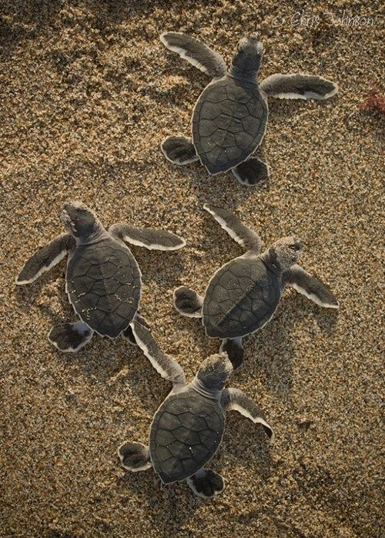
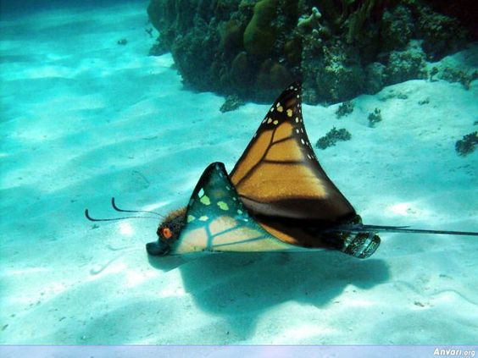
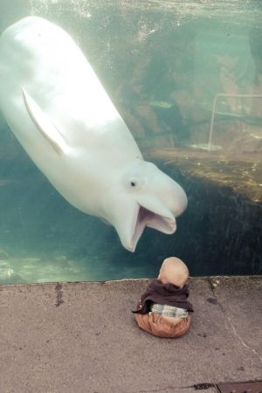
Writing Prompts 14

Slide 2
Remember to:
•plan your story before you start
•write in sentences
•pay attention to the words you choose, your spelling and punctuation, and paragraphs
Make sure that in your writing you have more than one sentence that uses two adjectives before a noun.
Remember to use a comma separate the adjectives because they are in a list.
•check and edit your writing when you have finished.
Steph Westwood 2016
Notes:
Remember to:
•plan your story before you start
•write in sentences
•pay attention to the words you choose, your spelling and punctuation, and paragraphs
*meaning of sentences can be enriched through the use of noun groups/phrases and verb groups/phrases and prepositional phrases
•check and edit your writing when you have finished.
Outcomes
EN3-2A composes, edits and presents well-structured and coherent texts
EN3-5B discusses how language is used to achieve a widening range of purposes for a widening range of audiences and contexts
EN3-4A draws on appropriate strategies to accurately spell familiar and unfamiliar words when composing texts
EN3-6B uses knowledge of sentence structure, grammar, punctuation and vocabulary to respond to and compose clear and cohesive texts in different media and technologies
EN3-7C thinks imaginatively, creatively, interpretively and critically about information and ideas and identifies connections between texts when responding to and composing texts
EN3-1A communicates effectively for a variety of audiences and purposes using increasingly challenging topics, ideas, issues and language forms and features
-plan, rehearse and deliver presentations, selecting and sequencing appropriate content and multimodal elements for defined audiences and purposes, making appropriate choices for modality and emphasis (ACELY1700, ACELY1710)
Criteria for assessing learning
(These criteria would normally be communicated to students with the activity.) Students will be assessed on their ability to:
Plan, draft , edit and write an imaginative text
Demonstrate an understanding of characters and plot in a literary text
Use written language features and conventions appropriate to this text
Use detail to help a reader imagine what is being described
Use a range of adjectives to describe an image
Use a variety of verbs, adjectives and conjunctions
Use a multi-strategy approach to spelling.
Identify elements of their writing that need improvement and review using feedback from teacher and peers

Slide 3
Steph Westwood 2016
Notes:
Remember to:
•plan your story before you start
•write in sentences
•pay attention to the words you choose, your spelling and punctuation, and paragraphs
*meaning of sentences can be enriched through the use of noun groups/phrases and verb groups/phrases and prepositional phrases
•check and edit your writing when you have finished.
Outcomes
EN3-2A composes, edits and presents well-structured and coherent texts
EN3-5B discusses how language is used to achieve a widening range of purposes for a widening range of audiences and contexts
EN3-4A draws on appropriate strategies to accurately spell familiar and unfamiliar words when composing texts
EN3-6B uses knowledge of sentence structure, grammar, punctuation and vocabulary to respond to and compose clear and cohesive texts in different media and technologies
EN3-7C thinks imaginatively, creatively, interpretively and critically about information and ideas and identifies connections between texts when responding to and composing texts
EN3-1A communicates effectively for a variety of audiences and purposes using increasingly challenging topics, ideas, issues and language forms and features
-plan, rehearse and deliver presentations, selecting and sequencing appropriate content and multimodal elements for defined audiences and purposes, making appropriate choices for modality and emphasis (ACELY1700, ACELY1710)
Criteria for assessing learning
(These criteria would normally be communicated to students with the activity.) Students will be assessed on their ability to:
Plan, draft , edit and write an imaginative text
Demonstrate an understanding of characters and plot in a literary text
Use written language features and conventions appropriate to this text
Use detail to help a reader imagine what is being described
Use a range of adjectives to describe an image
Use a variety of verbs, adjectives and conjunctions
Use a multi-strategy approach to spelling.
Identify elements of their writing that need improvement and review using feedback from teacher and peers

Slide 4
Adventures
Who is the girl?
Why is she riding on the fish?
Does she know that fish?
How did she get there?
Where are they going?
Remember to:
•plan your story before you start
•write in sentences
•pay attention to the words you choose, your spelling and punctuation, and paragraphs
Make sure that in your writing you have more than one sentence that uses two adjectives before a noun.
Remember to use a comma separate the adjectives because they are in a list.
•check and edit your writing when you have finished.
Image found on Pinterest via imgfave.com
Steph Westwood 2015
Notes:
Remember to:
•plan your story before you start
•write in sentences
•pay attention to the words you choose, your spelling and punctuation, and paragraphs
*meaning of sentences can be enriched through the use of noun groups/phrases and verb groups/phrases and prepositional phrases
•check and edit your writing when you have finished.
Outcomes
EN3-2A composes, edits and presents well-structured and coherent texts
EN3-5B discusses how language is used to achieve a widening range of purposes for a widening range of audiences and contexts
EN3-4A draws on appropriate strategies to accurately spell familiar and unfamiliar words when composing texts
EN3-6B uses knowledge of sentence structure, grammar, punctuation and vocabulary to respond to and compose clear and cohesive texts in different media and technologies
EN3-7C thinks imaginatively, creatively, interpretively and critically about information and ideas and identifies connections between texts when responding to and composing texts
EN3-1A communicates effectively for a variety of audiences and purposes using increasingly challenging topics, ideas, issues and language forms and features
-plan, rehearse and deliver presentations, selecting and sequencing appropriate content and multimodal elements for defined audiences and purposes, making appropriate choices for modality and emphasis (ACELY1700, ACELY1710)
Criteria for assessing learning
(These criteria would normally be communicated to students with the activity.) Students will be assessed on their ability to:
Plan, draft , edit and write an imaginative text
Demonstrate an understanding of characters and plot in a literary text
Use written language features and conventions appropriate to this text
Use detail to help a reader imagine what is being described
Use a range of adjectives to describe an image
Use a variety of verbs, adjectives and conjunctions
Use a multi-strategy approach to spelling.
Identify elements of their writing that need improvement and review using feedback from teacher and peers

Slide 5
Training
An Octopus
You have been tasked to train an octopus to play dead.
Write down the step-by-step instructions you would use to train your octopus.
Use some lessons from the video as your guide.
Remember to:
Write a procedure in chronological order
*Use numbers to indicate sequence in a procedure
*Use action verbs and commands
*Use adverbial phrases and adjectives as appropriate to the text
* check and edit your writing when you have finished.
Steph Westwood 2016
Notes:
Remember to:
•plan your story before you start
•write in sentences
•pay attention to the words you choose, your spelling and punctuation, and paragraphs
*meaning of sentences can be enriched through the use of noun groups/phrases and verb groups/phrases and prepositional phrases
•check and edit your writing when you have finished.
Outcomes
EN3-2A composes, edits and presents well-structured and coherent texts
EN3-5B discusses how language is used to achieve a widening range of purposes for a widening range of audiences and contexts
EN3-4A draws on appropriate strategies to accurately spell familiar and unfamiliar words when composing texts
EN3-6B uses knowledge of sentence structure, grammar, punctuation and vocabulary to respond to and compose clear and cohesive texts in different media and technologies
EN3-7C thinks imaginatively, creatively, interpretively and critically about information and ideas and identifies connections between texts when responding to and composing texts
EN3-1A communicates effectively for a variety of audiences and purposes using increasingly challenging topics, ideas, issues and language forms and features
-plan, rehearse and deliver presentations, selecting and sequencing appropriate content and multimodal elements for defined audiences and purposes, making appropriate choices for modality and emphasis (ACELY1700, ACELY1710)
Criteria for assessing learning
(These criteria would normally be communicated to students with the activity.) Students will be assessed on their ability to:
Write a procedure in chronological order
Use numbers to indicate sequence in a procedure
Use action verbs and commands
Use adverbial phrases and adjectives as appropriate to the text
Apply knowledge of spelling conventions and strategies
Use joined letters in the NSW Foundation style
Demonstrate basic desktop publishing skills using a computer.
Identify elements of their writing that need improvement and review using feedback from teacher and peers

Slide 6
Octopus'
World Cup
Forecast
What will become of Paul, the predicting octopus?
Write a short, creative story about how Paul will use his talents next!.
Remember to:
plan your information and thoughts before you start
•write in sentences
•pay attention to the words you choose, your spelling, punctuation, and paragraphs
•check and edit your writing when you have finished.
Steph Westwood 2016
Notes:
Remember to:
•plan your story before you start
•write in sentences
•pay attention to the words you choose, your spelling and punctuation, and paragraphs
*meaning of sentences can be enriched through the use of noun groups/phrases and verb groups/phrases and prepositional phrases
•check and edit your writing when you have finished.
Outcomes
EN3-2A composes, edits and presents well-structured and coherent texts
EN3-5B discusses how language is used to achieve a widening range of purposes for a widening range of audiences and contexts
EN3-4A draws on appropriate strategies to accurately spell familiar and unfamiliar words when composing texts
EN3-6B uses knowledge of sentence structure, grammar, punctuation and vocabulary to respond to and compose clear and cohesive texts in different media and technologies
EN3-7C thinks imaginatively, creatively, interpretively and critically about information and ideas and identifies connections between texts when responding to and composing texts
EN3-1A communicates effectively for a variety of audiences and purposes using increasingly challenging topics, ideas, issues and language forms and features
-plan, rehearse and deliver presentations, selecting and sequencing appropriate content and multimodal elements for defined audiences and purposes, making appropriate choices for modality and emphasis (ACELY1700, ACELY1710)
Criteria for assessing learning
(These criteria would normally be communicated to students with the activity.) Students will be assessed on their ability to:
Plan, draft , edit and write an imaginative text
Demonstrate an understanding of characters and plot in a literary text
Use written language features and conventions appropriate to this text
Use detail to help a reader imagine what is being described
Use a range of adjectives to describe an image
Use a variety of verbs, adjectives and conjunctions
Use a multi-strategy approach to spelling.
Identify elements of their writing that need improvement and review using feedback from teacher and peers

Slide 7
Follow Me!
Write a conversation between the baby turtles.
What do you think they might be saying? What thoughts and feelings would they be having?
Remember to:
Use a comma start a speaker’s words.
Use quotation marks before and after a speaker’s words.
Use capital letters for a speaker’s first word.
Start a new paragraph every time a new person speaks.
Place the punctuation inside the quotation marks.
Image found on Pinterest
Steph Westwood 2016
Notes:
Remember to:
•plan your story before you start
•write in sentences
•pay attention to the words you choose, your spelling and punctuation, and paragraphs
*meaning of sentences can be enriched through the use of noun groups/phrases and verb groups/phrases and prepositional phrases
•check and edit your writing when you have finished.
Conversation Rules
Use a comma to start a speaker’s words. Example -- Katy said, “I love ice cream!”
Use quotation marks before and after a speaker’s words. Example -- “I scored a goal,” said Tommy.
Use capital letters for a speaker’s first word. Example -- Mr. Jones said, “Look at this giant pumpkin.”
Start a new paragraph every time a new person speaks.
Example -- “Mom! Where is my backpack?” said Billy.
Mom replied, “It’s still in the car.”
“Can you get it for me?” yelled Billy.
“No!” shouted Mom. “I’m making dinner.”
Place the punctuation inside the quotation marks.
•check and edit your writing when you have finished.
Outcomes
EN3-2A composes, edits and presents well-structured and coherent texts
EN3-5B discusses how language is used to achieve a widening range of purposes for a widening range of audiences and contexts
EN3-4A draws on appropriate strategies to accurately spell familiar and unfamiliar words when composing texts
EN3-6B uses knowledge of sentence structure, grammar, punctuation and vocabulary to respond to and compose clear and cohesive texts in different media and technologies
EN3-7C thinks imaginatively, creatively, interpretively and critically about information and ideas and identifies connections between texts when responding to and composing texts
EN3-1A communicates effectively for a variety of audiences and purposes using increasingly challenging topics, ideas, issues and language forms and features
-plan, rehearse and deliver presentations, selecting and sequencing appropriate content and multimodal elements for defined audiences and purposes, making appropriate choices for modality and emphasis (ACELY1700, ACELY1710)
Criteria for assessing learning
(These criteria would normally be communicated to students with the activity.) Students will be assessed on their ability to:
Plan, draft , edit and write an imaginative text
Demonstrate an understanding of characters and plot in a literary text
Use written language features and conventions appropriate to this text
Use detail to help a reader imagine what is being described
Use a range of adjectives to describe an image
Use a variety of verbs, adjectives and conjunctions
Use a multi-strategy approach to spelling.
Identify elements of their writing that need improvement and review using feedback from teacher and peers

Slide 8
Image found on Pinterest
Steph Westwood 2016
Notes:
Remember to:
•plan your story before you start
•write in sentences
•pay attention to the words you choose, your spelling and punctuation, and paragraphs
*meaning of sentences can be enriched through the use of noun groups/phrases and verb groups/phrases and prepositional phrases
•check and edit your writing when you have finished.
Outcomes
EN3-2A composes, edits and presents well-structured and coherent texts
EN3-5B discusses how language is used to achieve a widening range of purposes for a widening range of audiences and contexts
EN3-4A draws on appropriate strategies to accurately spell familiar and unfamiliar words when composing texts
EN3-6B uses knowledge of sentence structure, grammar, punctuation and vocabulary to respond to and compose clear and cohesive texts in different media and technologies
EN3-7C thinks imaginatively, creatively, interpretively and critically about information and ideas and identifies connections between texts when responding to and composing texts
EN3-1A communicates effectively for a variety of audiences and purposes using increasingly challenging topics, ideas, issues and language forms and features
-plan, rehearse and deliver presentations, selecting and sequencing appropriate content and multimodal elements for defined audiences and purposes, making appropriate choices for modality and emphasis (ACELY1700, ACELY1710)
Criteria for assessing learning
(These criteria would normally be communicated to students with the activity.) Students will be assessed on their ability to:
Plan, draft , edit and write an imaginative text
Demonstrate an understanding of characters and plot in a literary text
Use written language features and conventions appropriate to this text
Use detail to help a reader imagine what is being described
Use a range of adjectives to describe an image
Use a variety of verbs, adjectives and conjunctions
Use a multi-strategy approach to spelling.
Identify elements of their writing that need improvement and review using feedback from teacher and peers

Slide 9
What do you already know about this animal?
Identify this animal and write at least three things that animal does that set it apart from other animals.
Do you think these behaviours help the animal survive?
Don’t forget to support your thoughts with facts.
Image found on Pinterest
Steph Westwood 2016
Notes:
Remind students to:
•plan your story before you start
•write in sentences
•pay attention to the words you choose, your spelling and punctuation, and paragraphs
*meaning of sentences can be enriched through the use of noun groups/phrases and verb groups/phrases and prepositional phrases
•check and edit your writing when you have finished.
Outcomes
EN3-2A composes, edits and presents well-structured and coherent texts
EN3-5B discusses how language is used to achieve a widening range of purposes for a widening range of audiences and contexts
EN3-4A draws on appropriate strategies to accurately spell familiar and unfamiliar words when composing texts
EN3-6B uses knowledge of sentence structure, grammar, punctuation and vocabulary to respond to and compose clear and cohesive texts in different media and technologies
EN3-7C thinks imaginatively, creatively, interpretively and critically about information and ideas and identifies connections between texts when responding to and composing texts
Criteria for assessing learning
(These criteria would normally be communicated to students with the activity.) Students will be assessed on their ability to:
Logically sequence information
Use appropriate language for an explanation
Explain chosen animals behaviours
Express a point of view in writing with supporting statements
Use grammatical features, sentence structure and punctuation appropriate for an explanation
Consistently make informed attempts at spelling using a multi-strategy approach.
Identify elements of their writing that need improvement and review using feedback from teacher and peers

Slide 10
When you look at this image, think about what could actually happen in a real life setting, and what would only happen in a fantasy setting. List your ideas in a T-chart
You might want to
create a Chatterpix.
Image found on Pinterest
Steph Westwood 2015
Notes:
Remember to:
•plan your story before you start
•write in sentences
•pay attention to the words you choose, your spelling and punctuation, and paragraphs
•plan your story before you start
•write in sentences
•pay attention to the words you choose, your spelling and punctuation, and paragraphs
*meaning of sentences can be enriched through the use of noun groups/phrases and verb groups/phrases and prepositional phrases
•check and edit your writing when you have finished.
•check and edit your writing when you have finished.
Outcomes
EN3-2A composes, edits and presents well-structured and coherent texts
EN3-5B discusses how language is used to achieve a widening range of purposes for a widening range of audiences and contexts
EN3-4A draws on appropriate strategies to accurately spell familiar and unfamiliar words when composing texts
EN3-6B uses knowledge of sentence structure, grammar, punctuation and vocabulary to respond to and compose clear and cohesive texts in different media and technologies
EN3-7C thinks imaginatively, creatively, interpretively and critically about information and ideas and identifies connections between texts when responding to and composing texts
EN3-1A communicates effectively for a variety of audiences and purposes using increasingly challenging topics, ideas, issues and language forms and features
-plan, rehearse and deliver presentations, selecting and sequencing appropriate content and multimodal elements for defined audiences and purposes, making appropriate choices for modality and emphasis (ACELY1700, ACELY1710)
Criteria for assessing learning
(These criteria would normally be communicated to students with the activity.) Students will be assessed on their ability to:
Plan, draft , edit and write an imaginative text
Demonstrate an understanding of characters and plot in a literary text
Use written language features and conventions appropriate to this text
Use detail to help a reader imagine what is being described
Use a range of adjectives to describe an image
Use a variety of verbs, adjectives and conjunctions
Use a multi-strategy approach to spelling.
Identify elements of their writing that need improvement and review using feedback from teacher and peers

Slide 11
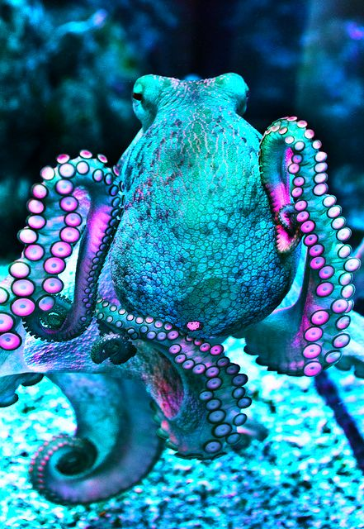
Rainbow of Colours
Many animals are masters of disguise. Some change their skin colour. Others shape themselves in ways that help them look like their surroundings. These different forms of camouflage help animals survive.
The type of camouflage an animal develops depends mostly on its predators and its environment. Animals change in different ways to trick their predators. In most cases, their camouflage is designed to match their environment. This helps them become more difficult for their predators to spot.
Write an informational report about an under the sea creature that is a master of disguise. What adaptations does this creature have to find food and avoid its predators.
Image found on Pinterest
Steph Westwood 2016
Notes:
Remember to:
•plan your story before you start
•write in sentences
•pay attention to the words you choose, your spelling and punctuation, and paragraphs
•check and edit your writing when you have finished.
Outcomes
EN3-2A composes, edits and presents well-structured and coherent texts
EN3-5B discusses how language is used to achieve a widening range of purposes for a widening range of audiences and contexts
EN3-4A draws on appropriate strategies to accurately spell familiar and unfamiliar words when composing texts
EN3-6B uses knowledge of sentence structure, grammar, punctuation and vocabulary to respond to and compose clear and cohesive texts in different media and technologies
EN3-7C thinks imaginatively, creatively, interpretively and critically about information and ideas and identifies connections between texts when responding to and composing texts
EN3-1A communicates effectively for a variety of audiences and purposes using increasingly challenging topics, ideas, issues and language forms and features
-plan, rehearse and deliver presentations, selecting and sequencing appropriate content and multimodal elements for defined audiences and purposes, making appropriate choices for modality and emphasis (ACELY1700, ACELY1710)
Criteria for assessing learning
(These criteria would normally be communicated to students with the activity.) Students will be assessed on their ability to:
Plan, draft , edit and write an imaginative text
Demonstrate an understanding of characters and plot in a literary text
Use written language features and conventions appropriate to this text
Use detail to help a reader imagine what is being described
Use a range of adjectives to describe an image
Use a variety of verbs, adjectives and conjunctions
Use a multi-strategy approach to spelling.
Identify elements of their writing that need improvement and review using feedback from teacher and peers

Slide 12
A World Inside a Water Droplet
Imagine that you loved in this water droplet. What type of sea creature would you be?
What adaptations would you need to have developed to live here?
How did you get there?
Image found on Pinterest
Steph Westwood 2016
Notes:
Remember to:
•plan your story before you start
•write in sentences
•pay attention to the words you choose, your spelling and punctuation, and paragraphs
•check and edit your writing when you have finished.
Outcomes
EN3-2A composes, edits and presents well-structured and coherent texts
EN3-5B discusses how language is used to achieve a widening range of purposes for a widening range of audiences and contexts
EN3-4A draws on appropriate strategies to accurately spell familiar and unfamiliar words when composing texts
EN3-6B uses knowledge of sentence structure, grammar, punctuation and vocabulary to respond to and compose clear and cohesive texts in different media and technologies
EN3-7C thinks imaginatively, creatively, interpretively and critically about information and ideas and identifies connections between texts when responding to and composing texts
EN3-1A communicates effectively for a variety of audiences and purposes using increasingly challenging topics, ideas, issues and language forms and features
-plan, rehearse and deliver presentations, selecting and sequencing appropriate content and multimodal elements for defined audiences and purposes, making appropriate choices for modality and emphasis (ACELY1700, ACELY1710)
Criteria for assessing learning
(These criteria would normally be communicated to students with the activity.) Students will be assessed on their ability to:
Plan, draft , edit and write an imaginative text
Demonstrate an understanding of characters and plot in a literary text
Use written language features and conventions appropriate to this text
Use detail to help a reader imagine what is being described
Use a range of adjectives to describe an image
Use a variety of verbs, adjectives and conjunctions
Use a multi-strategy approach to spelling.
Identify elements of their writing that need improvement and review using feedback from teacher and peers

Slide 13
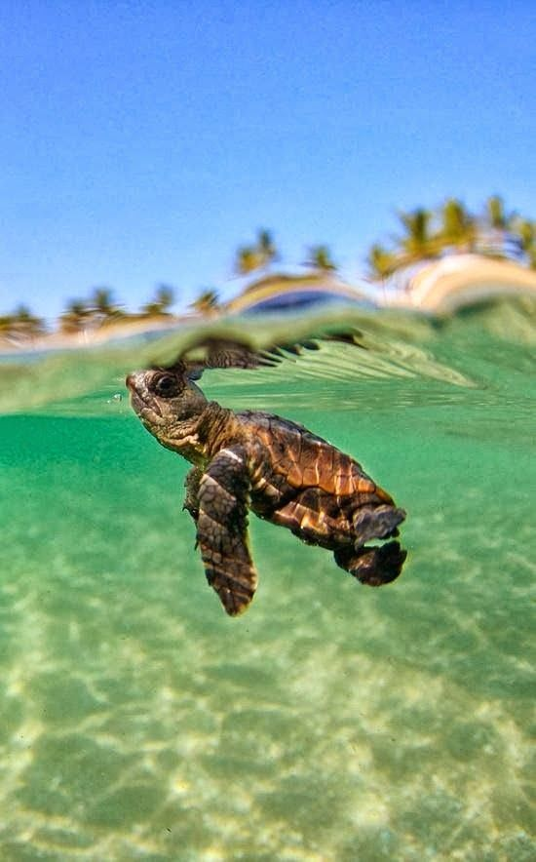
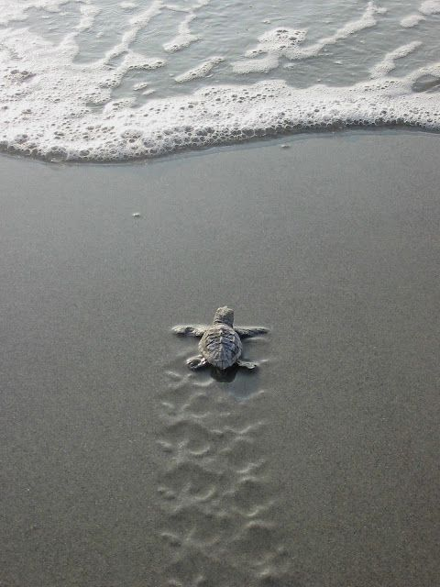
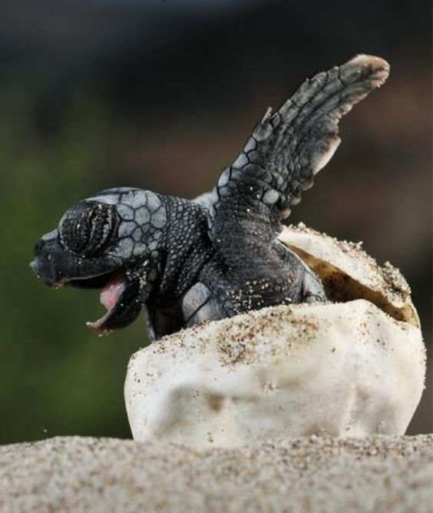
I think I can! ….
Tell the story of the Baby Turtle’s journey
to the water.
Image found on Pinterest and Pinterest
Steph Westwood 2015
Notes:
Remember to:
•plan your story before you start
•write in sentences
•pay attention to the words you choose, your spelling and punctuation, and paragraphs
•check and edit your writing when you have finished.
Outcomes
EN3-2A composes, edits and presents well-structured and coherent texts
EN3-5B discusses how language is used to achieve a widening range of purposes for a widening range of audiences and contexts
EN3-4A draws on appropriate strategies to accurately spell familiar and unfamiliar words when composing texts
EN3-6B uses knowledge of sentence structure, grammar, punctuation and vocabulary to respond to and compose clear and cohesive texts in different media and technologies
EN3-7C thinks imaginatively, creatively, interpretively and critically about information and ideas and identifies connections between texts when responding to and composing texts
EN3-1A communicates effectively for a variety of audiences and purposes using increasingly challenging topics, ideas, issues and language forms and features
-plan, rehearse and deliver presentations, selecting and sequencing appropriate content and multimodal elements for defined audiences and purposes, making appropriate choices for modality and emphasis (ACELY1700, ACELY1710)
Criteria for assessing learning
(These criteria would normally be communicated to students with the activity.) Students will be assessed on their ability to:
Plan, draft , edit and write an imaginative text
Demonstrate an understanding of characters and plot in a literary text
Use written language features and conventions appropriate to this text
Use detail to help a reader imagine what is being described
Use a range of adjectives to describe an image
Use a variety of verbs, adjectives and conjunctions
Use a multi-strategy approach to spelling.
Identify elements of their writing that need improvement and review using feedback from teacher and peers

Slide 14
Why,
Hello There!
Write a conversation between the whale and the baby.
Remember to:
Use a comma start a speaker’s words.
Use quotation marks before and after a speaker’s words.
Use capital letters for a speaker’s first word.
Start a new paragraph every time a new person speaks.
Place the punctuation inside the quotation marks.
Image found on Pinterest
Steph Westwood 2015
Notes:
Remember to:
•plan your story before you start
•write in sentences
•pay attention to the words you choose, your spelling and punctuation, and paragraphs
Conversation Rules
Use a comma to start a speaker’s words. Example -- Katy said, “I love ice cream!”
Use quotation marks before and after a speaker’s words. Example -- “I scored a goal,” said Tommy.
Use capital letters for a speaker’s first word. Example -- Mr. Jones said, “Look at this giant pumpkin.”
Start a new paragraph every time a new person speaks.
Example -- “Mom! Where is my backpack?” said Billy.
Mom replied, “It’s still in the car.”
“Can you get it for me?” yelled Billy.
“No!” shouted Mom. “I’m making dinner.”
Place the punctuation inside the quotation marks.
•check and edit your writing when you have finished.
Outcomes
EN3-2A composes, edits and presents well-structured and coherent texts
EN3-5B discusses how language is used to achieve a widening range of purposes for a widening range of audiences and contexts
EN3-4A draws on appropriate strategies to accurately spell familiar and unfamiliar words when composing texts
EN3-6B uses knowledge of sentence structure, grammar, punctuation and vocabulary to respond to and compose clear and cohesive texts in different media and technologies
EN3-7C thinks imaginatively, creatively, interpretively and critically about information and ideas and identifies connections between texts when responding to and composing texts
EN3-1A communicates effectively for a variety of audiences and purposes using increasingly challenging topics, ideas, issues and language forms and features
-plan, rehearse and deliver presentations, selecting and sequencing appropriate content and multimodal elements for defined audiences and purposes, making appropriate choices for modality and emphasis (ACELY1700, ACELY1710)
Criteria for assessing learning
(These criteria would normally be communicated to students with the activity.) Students will be assessed on their ability to:
Plan, draft , edit and write an imaginative text
Demonstrate an understanding of characters and plot in a literary text
Use written language features and conventions appropriate to this text
Use detail to help a reader imagine what is being described
Use a range of adjectives to describe an image
Use a variety of verbs, adjectives and conjunctions
Use a multi-strategy approach to spelling.
Identify elements of their writing that need improvement and review using feedback from teacher and peers

Slide 15
Revenge of the Shark!
What did the fisherman do to the shark to make him seek revenge?
or
Write a sequel Revenge of the Shark 2
Steph Westwood 2016
Notes:
Remember to:
•plan your story before you start
•write in sentences
•pay attention to the words you choose, your spelling and punctuation, and paragraphs
•check and edit your writing when you have finished.
Outcomes
EN3-2A composes, edits and presents well-structured and coherent texts
EN3-5B discusses how language is used to achieve a widening range of purposes for a widening range of audiences and contexts
EN3-4A draws on appropriate strategies to accurately spell familiar and unfamiliar words when composing texts
EN3-6B uses knowledge of sentence structure, grammar, punctuation and vocabulary to respond to and compose clear and cohesive texts in different media and technologies
EN3-7C thinks imaginatively, creatively, interpretively and critically about information and ideas and identifies connections between texts when responding to and composing texts
EN3-1A communicates effectively for a variety of audiences and purposes using increasingly challenging topics, ideas, issues and language forms and features
-plan, rehearse and deliver presentations, selecting and sequencing appropriate content and multimodal elements for defined audiences and purposes, making appropriate choices for modality and emphasis (ACELY1700, ACELY1710)
Criteria for assessing learning
(These criteria would normally be communicated to students with the activity.) Students will be assessed on their ability to:
Plan, draft , edit and write an imaginative text
Demonstrate an understanding of characters and plot in a literary text
Use written language features and conventions appropriate to this text
Use detail to help a reader imagine what is being described
Use a range of adjectives to describe an image
Use a variety of verbs, adjectives and conjunctions
Use a multi-strategy approach to spelling.
Identify elements of their writing that need improvement and review using feedback from teacher and peers

