Slide 1
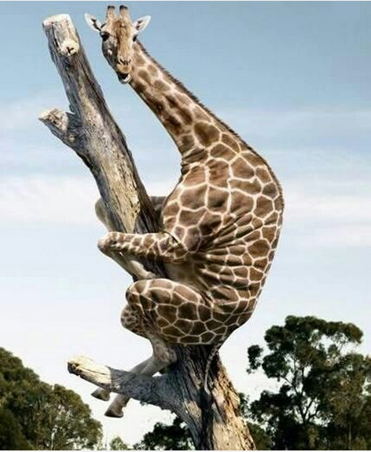
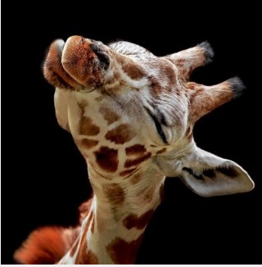
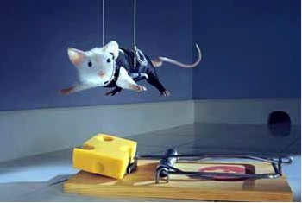
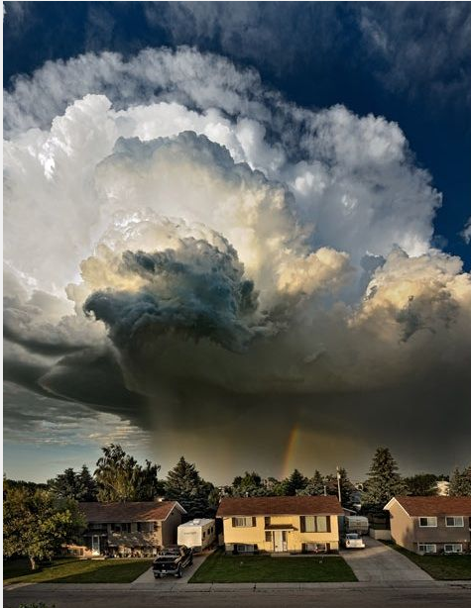
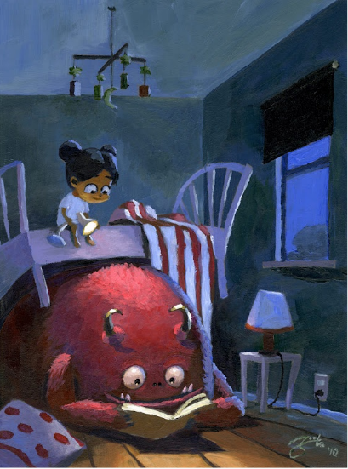
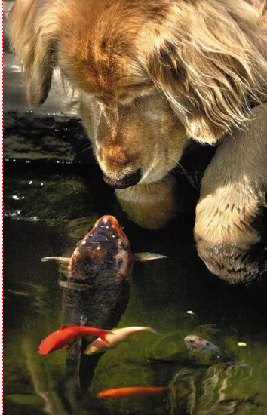
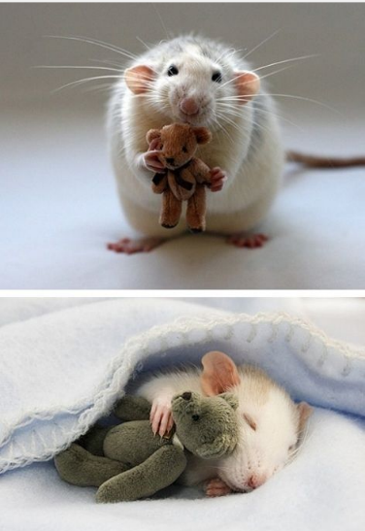
Writing Prompts
Steph Westwood 2014

Slide 2
What is this Giraffe doing? Why?
Where do you think he is?
Found on images.piccsy.com
Steph Westwood 2014

Slide 3
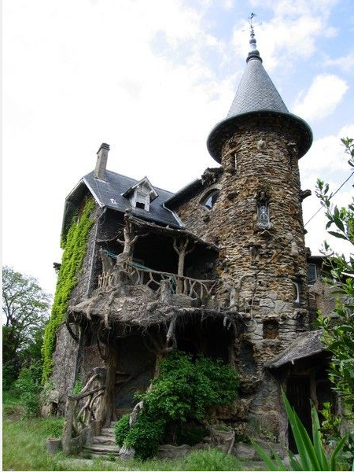
You have just discovered this old house.
* Explain why your parents should allow you to play here
or
* Invent a mythical creature who lives in this house.
Steph Westwood 2014

Slide 4
Write a description about spending your holidays here.
(include your 5 senses)
What can you hear, see, taste smell, touch?
Found on writingprompts.tumblr.com
Steph Westwood 2014

Slide 5
What happened here?
Watch the video and retell the story of Bigger than Alexander.
Steph Westwood 2014

Slide 6
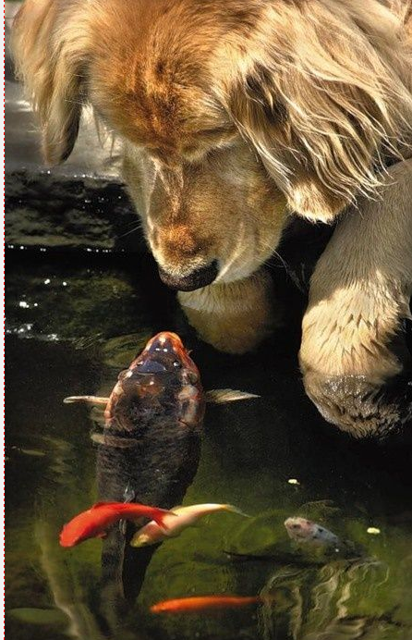
What are three things that the fish might be telling the golden retriever?
Found on kids-and-pets.tumblr.com
Steph Westwood 2014

Slide 7
Imagine my surprise when I looked out the plane window and saw this!
Write about who might live there.
Found on fantasyflights.tumblr.com
Steph Westwood 2014

Slide 8
Ooops……..caught
Write a short story to explain why the mouse is where he is.
Steph Westwood 2014

Slide 9
You Cant See Me ☺
I have my blue collar on that makes me invisible.
What would you do if you had this magic collar?
Steph Westwood 2014

Slide 10
Description
Write a description of this storm brewing. What can you hear, feel, smell, see?
Steph Westwood 2014

Slide 11
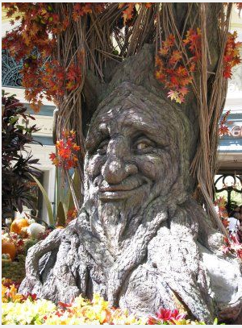
The Talking Tree
Imagine finding a talking tree.
Write your conversation.
Found on foodshethought.blogspot.ca
Steph Westwood 2014

Slide 12
Best Friends
Do you have a best friend like this? Write about your friend.
Found on cuteoverload.com
Steph Westwood 2014

Slide 13
"Bedtime Story"
by Goro Fujita.
Think of 5 ways you can make friends with a monster under your bed. Write a list.
Found on imgfave.tumblr.com
Steph Westwood 2014

Slide 14
Describe what might have happened .
Steph Westwood 2014

Slide 15
Be this giraffe.
Tell the story about what was happening when this picture was taken.
Steph Westwood 2014

Slide 16
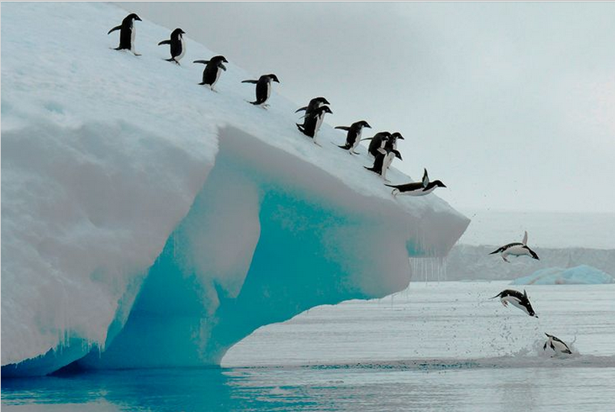
What is a day of school like for a penguin?
Found on retina.smithsonianmag.com
Steph Westwood 2014

Slide 17
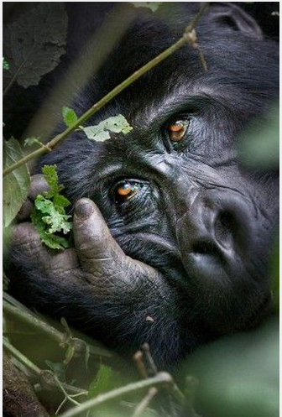
Write a caption for this picture.
What is he thinking?
Found on verycoolphotoblog.com
Steph Westwood 2014

Slide 18
Tell this story
What is he thinking?
Found on writingprompts.tumblr.com
Steph Westwood 2014

