Slide 1
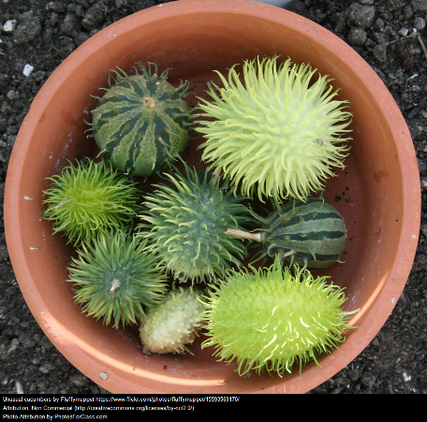
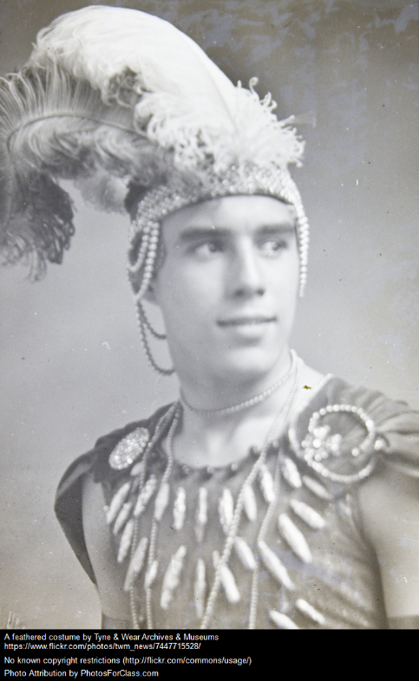
Writing Prompts
Steph Westwood 2015
Notes:
Remember to:
•plan your story before you start
•write in sentences
•pay attention to the words you choose, your spelling and punctuation, and paragraphs
•check and edit your writing when you have finished.

Slide 2
One day you wake up and you find out that you are invisible. What escapades do you get up to now that no one can see you?
Found on 1000bookmarks.tumblr.com
Steph Westwood 2015
Notes:
Remind students to:
*Write neatly.
* Include everything needed. Don’t leave out any steps.
*Use descriptive words.
*Pay attention to spelling and punctuation.
*Use WOW words and interesting connectors.
* Check and edit their work so that it is clear to the reader

Slide 3
Get Me Out of Here!
Tell the story about what was happening when this picture was taken.
Remember to:
•plan your story before you start
•write in sentences
•pay attention to the words you choose, your spelling and punctuation, and paragraphs
•check and edit your writing when you have finished.
Found on pieway.com
Steph Westwood 2015
Notes:
Remind students to:
*Write neatly.
* Include everything needed. Don’t leave out any steps.
*Use descriptive words.
*Pay attention to spelling and punctuation.
*Use WOW words and interesting connectors.
* Check and edit their work so that it is clear to the reader

Slide 4
Mud, Glorious Mud
Use these words in your writing.
1.TROUBLEMAKERS or MISCHIEF-MAKERS
2.WAITED or FROZE
and
3. MUD or DIRT.
Remember to:
•plan your story before you start
•write in sentences
•pay attention to the words you choose, your spelling and punctuation, and paragraphs
•check and edit your writing when you have finished.
Found on najboljamamanasvetu.comon
Steph Westwood 2015
Notes:
Remind students to:
*Write neatly.
* Include everything needed. Don’t leave out any steps.
*Use descriptive words.
*Pay attention to spelling and punctuation.
*Use WOW words and interesting connectors.
* Check and edit their work so that it is clear to the reader

Slide 5
Giggles
Tell the story about what was happening when this picture was taken.
Remember to:
•plan your story before you start
•write in sentences
•pay attention to the words you choose, your spelling and punctuation, and paragraphs
•check and edit your writing when you have finished.
Found on dancewithizzy.com
Steph Westwood 2015
Notes:
Remind students to:
*Write neatly.
* Include everything needed. Don’t leave out any steps.
*Use descriptive words.
*Pay attention to spelling and punctuation.
*Use WOW words and interesting connectors.
* Check and edit their work so that it is clear to the reader

Slide 6
Tell the story about what was happening when this picture was taken.
Remember to:
•plan your story before you start
•write in sentences
•pay attention to the words you choose, your spelling and punctuation, and paragraphs
•check and edit your writing when you have finished.
Found on eduplace.com
Steph Westwood 2015
Notes:
Remind students to:
*Write neatly.
* Include everything needed. Don’t leave out any steps.
*Use descriptive words.
*Pay attention to spelling and punctuation.
*Use WOW words and interesting connectors.
* Check and edit their work so that it is clear to the reader

Slide 7
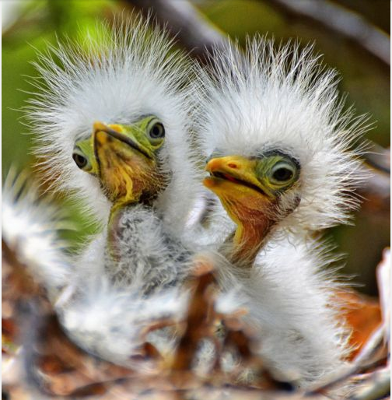
Ugly or Cute?
Convince me of your thoughts.
Remember to:
•plan your story before you start
•write in sentences
•pay attention to the words you choose, your spelling and punctuation, and paragraphs
•check and edit your writing when you have finished.
Found on fairy-wren.tumblr.com
Steph Westwood 2015
Notes:
Remind students to:
*Write neatly.
* Include everything needed. Don’t leave out any steps.
*Use descriptive words.
*Pay attention to spelling and punctuation.
*Use WOW words and interesting connectors.
* Check and edit their work so that it is clear to the reader

Slide 8
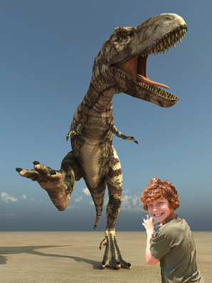
My Unusual Pet.
Write a story about an unusual pet.
Think about a T-Rex, flea, gorilla, hippopotamus, crocodile. Animals that would not normally be considered a pet.
Remember to:
•plan your story before you start
•write in sentences
•pay attention to the words you choose, your spelling, punctuation, and paragraphs
•check and edit your writing when you have finished.
Found on blog.writeathome.com
Steph Westwood 2015
Notes:
Remind students to:
*Write neatly.
* Include everything needed. Don’t leave out any steps.
*Use descriptive words.
*Pay attention to spelling and punctuation.
*Use WOW words and interesting connectors.
* Check and edit their work so that it is clear to the reader

Slide 9
Remember to:
•plan your story before you start
•write in sentences
•pay attention to the words you choose, your spelling, punctuation, and paragraphs
•check and edit your writing when you have finished.
Found on writingprompts.tumblr.comblog.writeathome.com
Steph Westwood 2015
Notes:
In an Acrostic poem the first letter of each line forms a word. Write an Acrostic poem that tells about your feelings as you watch the Europeans approach and reflects the mood and story of Syron’s painting.
Remember you are writing from the perspective of an Aboriginal person watching the Europeans approach your land.
Use an interactive Acrostic poem tool or follow these steps to write an Acrostic poem:
Select one of the emotions you have identified.
Using a computer program or a pen and paper write the word down the side of a page
Use each letter as the start of a word or short phrase that tells more about how you would feel if you were one of the Aboriginal people in Syron’s painting. Your words might also capture ideas from Syron’s painting.
Colour the word you started with.
Here is an example of an Acrostic poem written in response to Syron’s painting. It began with the emotion of fear:
Frightened as I watch the red
Europeans moving through the blueness to my land.
Anger at my loss
Remembering the past.
Source: http://lrrpublic.cli.det.nsw.edu.au/lrrSecure/Sites/Web/13651/13657/convict_first_Aust_nw3.htm
Additional teaching notes can be sourced from: http://lrrpublic.cli.det.nsw.edu.au/lrrSecure/Sites/Web/13651/13657/index.htm

Slide 10
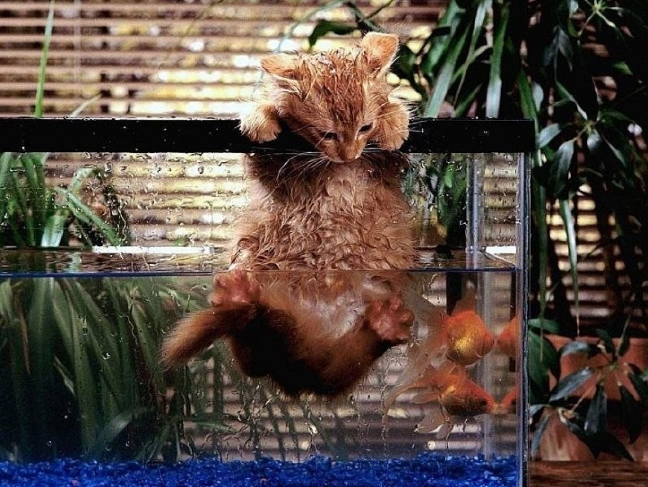
Work with a Partner.
Tell this story, where one of you writes from the perspective of the cat and the other from the perspective of the fish. Design this into a comic strip.
Remember to:
•plan your story before you start
•write in sentences
•pay attention to the words you choose, your spelling, punctuation, and paragraphs
•check and edit your writing when you have finished.
Found on images.slidesharecdn.com
Steph Westwood 2015
Notes:
Remind students to:
*Write neatly.
* Include everything needed. Don’t leave out any steps.
*Use descriptive words.
*Pay attention to spelling and punctuation.
*Use WOW words and interesting connectors.
* Check and edit their work so that it is clear to the reader

Slide 11
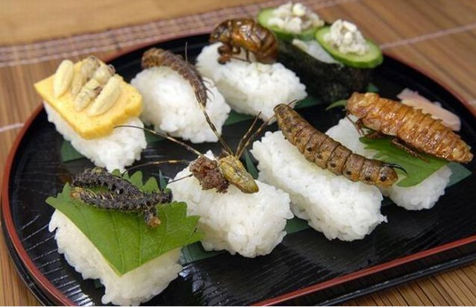
Dinner is served!
How do you react? Where might you be to have this as your dinner?
Remember to:
•plan your story before you start
•write in sentences
•pay attention to the words you choose, your spelling, punctuation, and paragraphs
•check and edit your writing when you have finished.
Found on writeabout.com
Steph Westwood 2015
Notes:
Every culture has its own set of traditional foods. As you ponder this writing idea, keep in mind the following questions:
– what makes people so hesitant to try new foods?
– why do foods vary so widely between cultures?
– why do the most ”special” foods often seem the ”yuckiest?”
– what foods from your culture might be scary for people to eat? why?
– is it ever okay to reject a plate of food that someone has put in front of you?
CREATED BY: NIKKI HANSEN ATTRIBUTION : ORIGINALLY FOUND AT BIT.LY/18TS0C3
Remind students to:
*Write neatly.
* Include everything needed. Don’t leave out any steps.
*Use descriptive words.
*Pay attention to spelling and punctuation.
*Use WOW words and interesting connectors.
* Check and edit their work so that it is clear to the reader

Slide 12
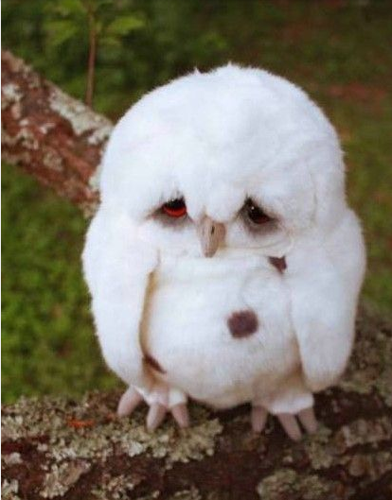
Why So Sad?
Think about the last time you were sad. What happened? How did you become happy again?
Remember to:
•plan your story before you start
•write in sentences
•pay attention to the words you choose, your spelling, punctuation, and paragraphs
•check and edit your writing when you have finished.
Found on on buzzfeed.com
Steph Westwood 2015
Notes:
Remind students to:
*Write neatly.
* Include everything needed. Don’t leave out any steps.
*Use descriptive words.
*Pay attention to spelling and punctuation.
*Use WOW words and interesting connectors.
* Check and edit their work so that it is clear to the reader

Slide 13
Make a Wish
What would you make a wish for?
Remember to:
•plan your story before you start
•write in sentences
•pay attention to the words you choose, your spelling, punctuation, and paragraphs
•check and edit your writing when you have finished.
Steph Westwood 2015
Notes:
Remind students to:
*Write neatly.
* Include everything needed. Don’t leave out any steps.
*Use descriptive words.
*Pay attention to spelling and punctuation.
*Use WOW words and interesting connectors.
* Check and edit their work so that it is clear to the reader

Slide 14
What is better?
A pen or pencil?
Think about the last time you were sad. What happened? How did you become happy again?
Remember to:
•plan your story before you start
•write in sentences
•pay attention to the words you choose, your spelling, punctuation, and paragraphs
•check and edit your writing when you have finished.
Steph Westwood 2015
Notes:
What is persuasive writing?
Persuasive writing intends to convince the reader of a stated opinion or belief. Persuasive writing has two main genres:
Argument/Exposition Arguments attempt to persuade the reader to agree with a certain viewpoint and sometimes they also want action to be taken – they exhort people to take action.
Discussion Discussions present two or more perspectives on an issue and can conclude with a recommendation or prediction.
NB. NAPLaN uses Persuasive to cover both Argument and Discussion.
Why is learning persuasive writing important?
Persuasive texts are part of our daily lives. Children learn at an early age to express their opinion and then to consider other opinions or points of view. Television, newspapers, radio, internet, social media and magazines make strong use of persuasive texts and in our daily exchanges we use persuasive language to express opinions and try to convince others. Learning how to create systematic and ordered persuasive texts empowers young people to express an opinion, be involved in decision making and be critical users of English language. What do students need to know about persuasive writing? To effectively use persuasive texts, students need to know about the text structure - the statement of position, reasons and examples to elaborate their position and a conclusion re-stating their position. They need to know about how language is used to structure the text and the language and terms used in an argument to persuade. Students also need to develop an understanding of how different audiences and purposes of persuasive writing determines the language choices they make.
What do writers need to know to make appropriate choices for persuasive texts?
The language in a persuasive text is influenced by:
Purpose – What do I want my writing to do/achieve? eg persuade
Audience – Who am I writing to? eg teacher, other students, the principal
Identity – Who am I writing as? eg a scientist, a biased voice, an upset parent
Attitude – How do I want/need to make them feel? eg concerned
Source: http://www.decd.sa.gov.au/northernadelaide/files/links/Persuasive_Writing_FINA_1.pdf
Remind students to:
*Write neatly.
* Include everything needed. Don’t leave out any steps.
*Use descriptive words.
*Pay attention to spelling and punctuation.
*Use WOW words and interesting connectors.
* Check and edit their work so that it is clear to the reader

Slide 15
Storm at Sea
From the perspective of a fish, write a story about a storm taking place out at sea.
Remember to:
•plan your story before you start
•write in sentences
•pay attention to the words you choose, your spelling, punctuation, and paragraphs
•check and edit your writing when you have finished.
Steph Westwood 2015
Notes:
Remind students to:
*Write neatly.
* Include everything needed. Don’t leave out any steps.
*Use descriptive words.
*Pay attention to spelling and punctuation.
*Use WOW words and interesting connectors.
* Check and edit their work so that it is clear to the reader

Slide 16
Convince your parents to let you keep this cute little guy!
Remember to:
•plan your story before you start
•write in sentences
•pay attention to the words you choose, your spelling, punctuation, and paragraphs
•check and edit your writing when you have finished.
Found on birdsanimals17.blogspot.com
Steph Westwood 2015
Notes:
Remind students to:
*Write neatly.
* Include everything needed. Don’t leave out any steps.
*Use descriptive words.
*Pay attention to spelling and punctuation.
*Use WOW words and interesting connectors.
* Check and edit their work so that it is clear to the reader

Slide 17
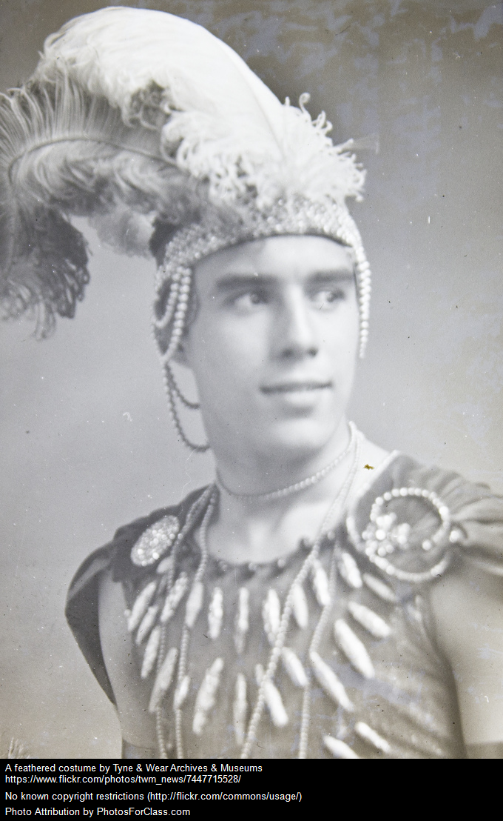
This is the new fashion trend at school.
Do you join in, or steer clear? Why?
Remember to:
•plan your story before you start
•write in sentences
•pay attention to the words you choose, your spelling, punctuation, and paragraphs
•check and edit your writing when you have finished.
Steph Westwood 2015
Notes:
What is persuasive writing?
Persuasive writing intends to convince the reader of a stated opinion or belief. Persuasive writing has two main genres:
Argument/Exposition Arguments attempt to persuade the reader to agree with a certain viewpoint and sometimes they also want action to be taken – they exhort people to take action.
Discussion Discussions present two or more perspectives on an issue and can conclude with a recommendation or prediction.
NB. NAPLaN uses Persuasive to cover both Argument and Discussion.
Why is learning persuasive writing important?
Persuasive texts are part of our daily lives. Children learn at an early age to express their opinion and then to consider other opinions or points of view. Television, newspapers, radio, internet, social media and magazines make strong use of persuasive texts and in our daily exchanges we use persuasive language to express opinions and try to convince others. Learning how to create systematic and ordered persuasive texts empowers young people to express an opinion, be involved in decision making and be critical users of English language. What do students need to know about persuasive writing? To effectively use persuasive texts, students need to know about the text structure - the statement of position, reasons and examples to elaborate their position and a conclusion re-stating their position. They need to know about how language is used to structure the text and the language and terms used in an argument to persuade. Students also need to develop an understanding of how different audiences and purposes of persuasive writing determines the language choices they make.
What do writers need to know to make appropriate choices for persuasive texts?
The language in a persuasive text is influenced by:
Purpose – What do I want my writing to do/achieve? eg persuade
Audience – Who am I writing to? eg teacher, other students, the principal
Identity – Who am I writing as? eg a scientist, a biased voice, an upset parent
Attitude – How do I want/need to make them feel? eg concerned
Source: http://www.decd.sa.gov.au/northernadelaide/files/links/Persuasive_Writing_FINA_1.pdf
Remind students to:
*Write neatly.
* Include everything needed. Don’t leave out any steps.
*Use descriptive words.
*Pay attention to spelling and punctuation.
*Use WOW words and interesting connectors.
* Check and edit their work so that it is clear to the reader

Slide 18
What will food of the future be like? What evidence supports your claim/opinion?
Remember to:
•plan your story before you start
•write in sentences
•pay attention to the words you choose, your spelling, punctuation, and paragraphs
•check and edit your writing when you have finished.
Steph Westwood 2015
Notes:
What is persuasive writing?
Persuasive writing intends to convince the reader of a stated opinion or belief. Persuasive writing has two main genres:
Argument/Exposition Arguments attempt to persuade the reader to agree with a certain viewpoint and sometimes they also want action to be taken – they exhort people to take action.
Discussion Discussions present two or more perspectives on an issue and can conclude with a recommendation or prediction.
NB. NAPLaN uses Persuasive to cover both Argument and Discussion.
Why is learning persuasive writing important?
Persuasive texts are part of our daily lives. Children learn at an early age to express their opinion and then to consider other opinions or points of view. Television, newspapers, radio, internet, social media and magazines make strong use of persuasive texts and in our daily exchanges we use persuasive language to express opinions and try to convince others. Learning how to create systematic and ordered persuasive texts empowers young people to express an opinion, be involved in decision making and be critical users of English language. What do students need to know about persuasive writing? To effectively use persuasive texts, students need to know about the text structure - the statement of position, reasons and examples to elaborate their position and a conclusion re-stating their position. They need to know about how language is used to structure the text and the language and terms used in an argument to persuade. Students also need to develop an understanding of how different audiences and purposes of persuasive writing determines the language choices they make.
What do writers need to know to make appropriate choices for persuasive texts?
The language in a persuasive text is influenced by:
Purpose – What do I want my writing to do/achieve? eg persuade
Audience – Who am I writing to? eg teacher, other students, the principal
Identity – Who am I writing as? eg a scientist, a biased voice, an upset parent
Attitude – How do I want/need to make them feel? eg concerned
Source: http://www.decd.sa.gov.au/northernadelaide/files/links/Persuasive_Writing_FINA_1.pdf
Remind students to:
*Write neatly.
* Include everything needed. Don’t leave out any steps.
*Use descriptive words.
*Pay attention to spelling and punctuation.
*Use WOW words and interesting connectors.
* Check and edit their work so that it is clear to the reader

Slide 19
Surprise!
This is your new doctor...
Remember to:
•plan your story before you start
•write in sentences
•pay attention to the words you choose, your spelling, punctuation, and paragraphs
•check and edit your writing when you have finished.
Found on vimeo.com
Steph Westwood 2015
Notes:
Remind students to:
*Write neatly.
* Include everything needed. Don’t leave out any steps.
*Use descriptive words.
*Pay attention to spelling and punctuation.
*Use WOW words and interesting connectors.
* Check and edit their work so that it is clear to the reader

Slide 20
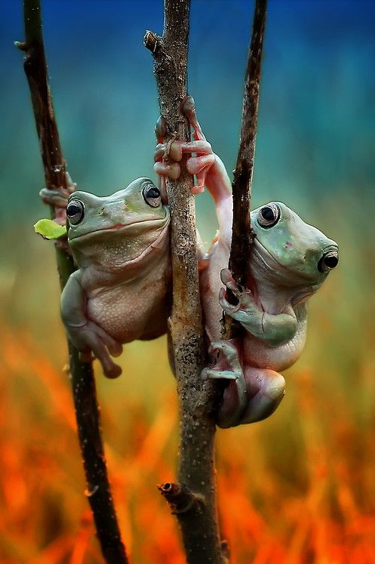
You and your best friend are frogs for a day.
What will you do? Tell a story about your adventure.
Remember to:
•plan your story before you start
•write in sentences
•pay attention to the words you choose, your spelling, punctuation, and paragraphs
•check and edit your writing when you have finished.
Found on n-a-t-u-r-a-l-e-z-a.tumblr.com
Steph Westwood 2015
Notes:
Remind students to:
*Write neatly.
* Include everything needed. Don’t leave out any steps.
*Use descriptive words.
*Pay attention to spelling and punctuation.
*Use WOW words and interesting connectors.
* Check and edit their work so that it is clear to the reader

Slide 21
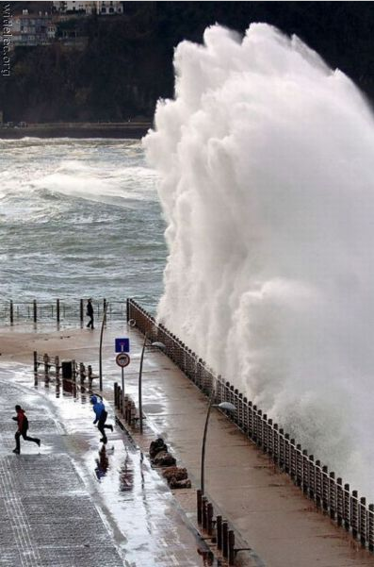
Since the enormous wave was heading straight for us , we knew that we were going to have to fight for our lives.
Complete this story.
Remember to:
•plan your story before you start
•write in sentences
•pay attention to the words you choose, your spelling, punctuation, and paragraphs
•check and edit your writing when you have finished.
Found on izismile.com
Steph Westwood 2015
Notes:
Remind students to:
*Write neatly.
* Include everything needed. Don’t leave out any steps.
*Use descriptive words.
*Pay attention to spelling and punctuation.
*Use WOW words and interesting connectors.
* Check and edit their work so that it is clear to the reader

Slide 22
What kind of food do you think this shark eats? Use specific evidence to support your claim.
Remember to:
•plan your story before you start
•write in sentences
•pay attention to the words you choose, your spelling, punctuation, and paragraphs
•check and edit your writing when you have finished.
Found on imgdex.com
Steph Westwood 2015
Notes:
What is an informative text?
An informative text is a factual text, which means it provides information about something. It is used as a way to gain a better understanding about a living or non-living subject.
These reports
uses facts to explain something
gives details about a topic
does not contain personal views
is usually written, but can also be presented orally (spoken).
Topics, or subjects, found in information reports can be about one specific thing or a group of things.
Structure of an Informative Text
Formal reports usually follow a very specific structure. The first part of an information report is the title, or heading, of the report. This will tell the reader what topic is covered in the report.
The first introductory paragraph, known as the classification, explains the aspects of the topic that will be covered in the report.
The following information is contained in the body paragraphs. This is where the topic of the report is covered in more detail. These paragraphs use factual information to give the reader a better understanding of the topic. Often, these paragraphs are broken up by sub-headings to help organise the information.
The conclusion of an information report gives any final details or facts about the topic. It may also be used to review what the report was about.
Visual elements are important because they help the reader to understand the topic better. Visual elements can include drawings, photographs, graphs, maps or diagrams.
A glossary is often put at the end of an information report. A glossary is a list of technical words used in the report and their definitions.
The bibliography is a list of resources like books, magazines and websites, which were used to help write the information report.
Information reports are generally written in the present tense.
Source: Informative texts: http://www.skwirk.com/p-c_s-6_u-124_t-339_c-1172/information-reports/wa/information-reports/text-types/factual-text-types
Remind students to:
*Write neatly.
* Include everything needed. Don’t leave out any steps.
*Use informative and subject specific words.
*Pay attention to spelling and punctuation.
*Use WOW words and interesting connectors.
* Check and edit their work so that it is clear to the reader

