Slide 1
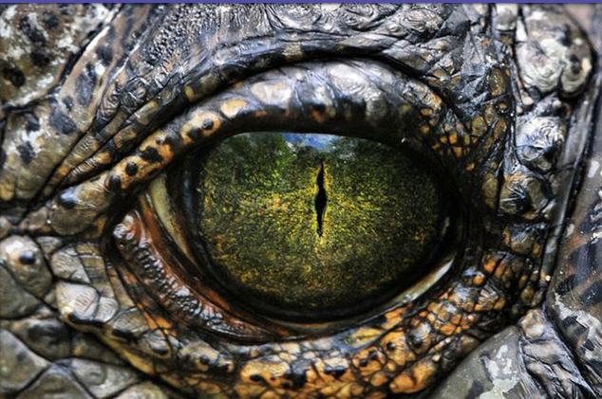
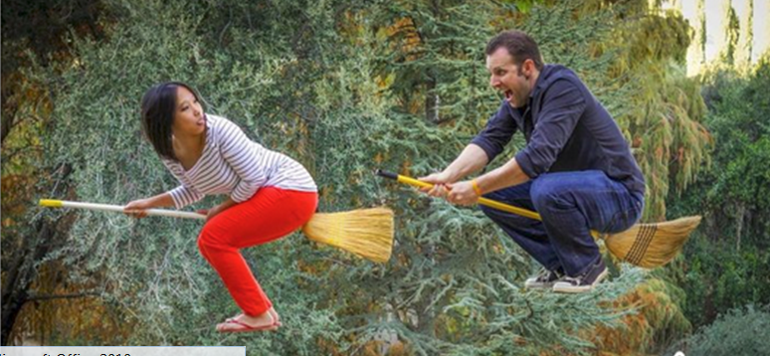
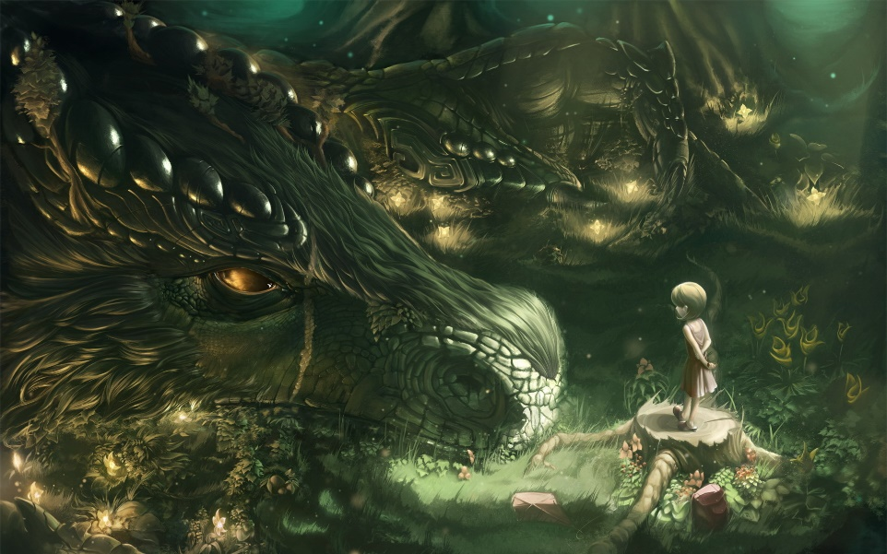
Writing Prompts
6
Steph Westwood 2015
Notes:
Remember to:
•plan your story before you start
•write in sentences
•pay attention to the words you choose, your spelling and punctuation, and paragraphs
•check and edit your writing when you have finished.

Slide 2
You have stumbled upon a wand and an instruction manual. You can do pretty much anything with this magical device, but it is probably best to keep it semi-secret for the time being. Describe your first couple of weeks with this new found life hack.
Use the Fantasy Name Generator to create at least two names that you like.
Remember to:
•plan your story before you start
•write in sentences
•pay attention to the words you choose, your spelling and punctuation, and paragraphs
•check and edit your writing when you have finished.
Found on Dragon Writing Prompts
Image found ignitelight.tumblr.com
Steph Westwood 2015
Notes:
Remind students to:
*Write neatly.
* Include everything needed. Don’t leave out any steps.
*Use descriptive words.
*Pay attention to spelling and punctuation.
*Use WOW words and interesting connectors.
* Check and edit their work so that it is clear to the reader

Slide 3
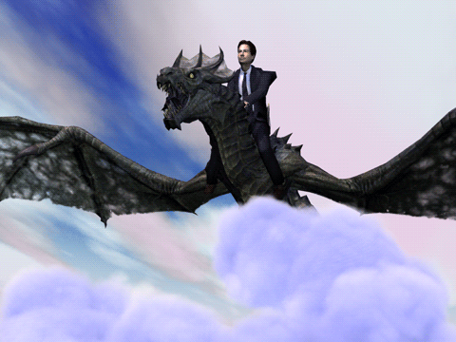
You live in a world where cars are obsolete because dragons take everybody around.
How does this change traffic patterns and roads?
Are you still late to school because of your "vehicle?"
Remember to:
•plan your story before you start
•write in sentences
•pay attention to the words you choose, your spelling and punctuation, and paragraphs
•check and edit your writing when you have finished.
Found on giffy
Steph Westwood 2015
Notes:
Remind students to:
*Write neatly.
* Include everything needed. Don’t leave out any steps.
*Use descriptive words.
*Pay attention to spelling and punctuation.
*Use WOW words and interesting connectors.
* Check and edit their work so that it is clear to the reader

Slide 4
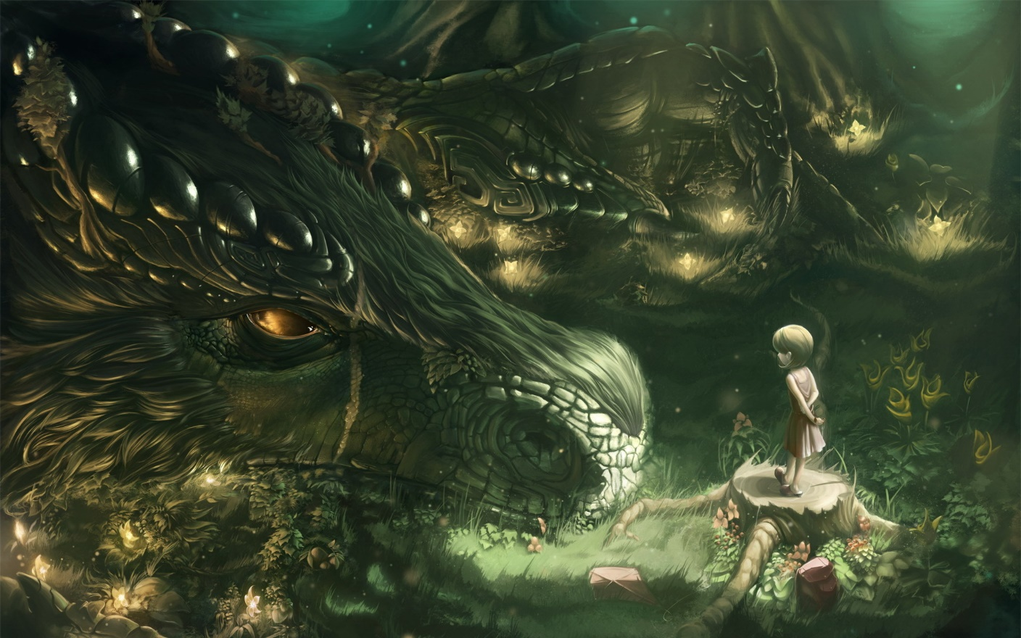
He can hear you!
With his large, delicate ears, the dragon could hear sounds from far away.
One day, …
Remember to:
•plan your story before you start
•write in sentences
•pay attention to the words you choose, your spelling and punctuation, and paragraphs
•check and edit your writing when you have finished.
Found on dragon image
Steph Westwood 2015
Notes:
Remind students to:
*Write neatly.
* Include everything needed. Don’t leave out any steps.
*Use descriptive words.
*Pay attention to spelling and punctuation.
*Use WOW words and interesting connectors.
* Check and edit their work so that it is clear to the reader

Slide 5
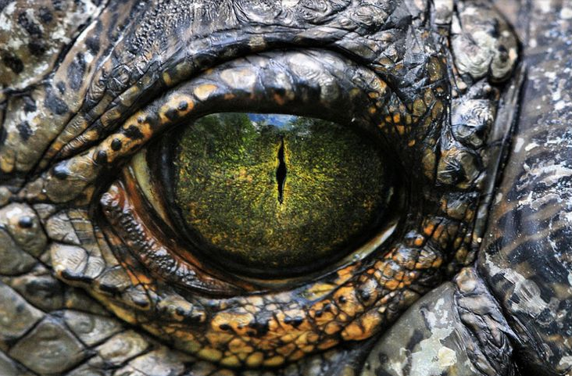
In the stifling depths of the murky swamp, it lay there. Waiting.
Without warning the eye, as green as the grass on a newly mown lawn, flickered open. It was dappled throughout with gold, like the brightest galaxies shimmering in the sky at night. The creature lay there. Waiting…
Remember to:
•plan your story before you start
•write in sentences
•pay attention to the words you choose, your spelling and punctuation, and paragraphs
•check and edit your writing when you have finished.
Found on phandroid.com
Steph Westwood 2015
Notes:
Remind students to:
*Write neatly.
* Include everything needed. Don’t leave out any steps.
*Use descriptive words.
*Pay attention to spelling and punctuation.
*Use WOW words and interesting connectors.
* Check and edit their work so that it is clear to the reader

Slide 6
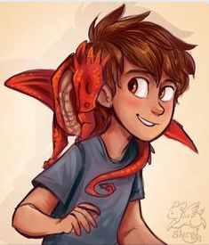
It wrapped itself around my head and its' thoughts seemed to say, "Don't leave me here alone."
Remember to:
•plan your story before you start
•write in sentences
•pay attention to the words you choose, your spelling and punctuation, and paragraphs
•check and edit your writing when you have finished.
Found on sharpie91.deviantart.com
Steph Westwood 2015
Notes:
Remind students to:
*Write neatly.
* Include everything needed. Don’t leave out any steps.
*Use descriptive words.
*Pay attention to spelling and punctuation.
*Use WOW words and interesting connectors.
* Check and edit their work so that it is clear to the reader

Slide 7
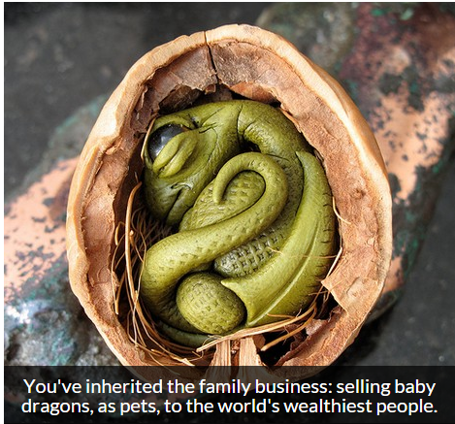
Use words like:
dragon, fearsome
baby, likeable
pet, trained
Remember to:
•plan your story before you start
•write in sentences
•pay attention to the words you choose, your spelling and punctuation, and paragraphs
•check and edit your writing when you have finished.
CREATED BY: NIKKI HANSEN ATTRIBUTION : FLICKR - RED CROW: BABY DRAGON
Steph Westwood 2015
Notes:
Remind students to:
*Write neatly.
* Include everything needed. Don’t leave out any steps.
*Use descriptive words.
*Pay attention to spelling and punctuation.
*Use WOW words and interesting connectors.
* Check and edit their work so that it is clear to the reader

Slide 8
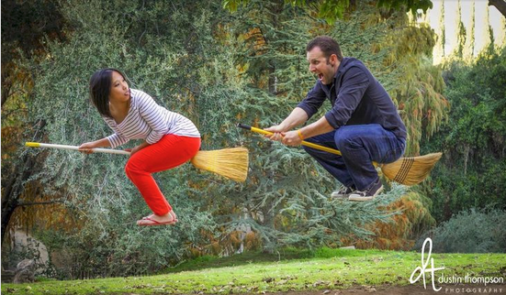
My Unusual Parents.
I always knew my parents were weird but that day..
Remember to:
•plan your story before you start •pay attention to the words you choose, your spelling, punctuation, and paragraphs •write in sentences •check and edit your writing when you have finished.
Found on blog.writeathome.com
Steph Westwood 2015
Notes:
Remind students to:
*Write neatly.
* Include everything needed. Don’t leave out any steps.
*Use descriptive words.
*Pay attention to spelling and punctuation.
*Use WOW words and interesting connectors.
* Check and edit their work so that it is clear to the reader

Slide 9
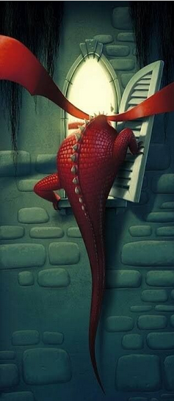
Write about what you see.
Where do you think the dragon might be going? Or is he returning?
Remember to:
•plan your story before you start
•write in sentences
•pay attention to the words you choose, your spelling, punctuation, and paragraphs
•check and edit your writing when you have finished.
https://www.pinterest.com/chrismcneal/photo-journal-prompts/
Steph Westwood 2015
Notes:
Remind students to:
*Write neatly.
* Include everything needed. Don’t leave out any steps.
*Use descriptive words.
*Pay attention to spelling and punctuation.
*Use WOW words and interesting connectors.
* Check and edit their work so that it is clear to the reader

Slide 10
Write about what you see.
Remember to:
•plan your story before you start
•write in sentences
•pay attention to the words you choose, your spelling, punctuation, and paragraphs
•check and edit your writing when you have finished.
Steph Westwood 2015
Notes:
Remind students to:
*Write neatly.
* Include everything needed. Don’t leave out any steps.
*Use descriptive words.
*Pay attention to spelling and punctuation.
*Use WOW words and interesting connectors.
* Check and edit their work so that it is clear to the reader

Slide 11
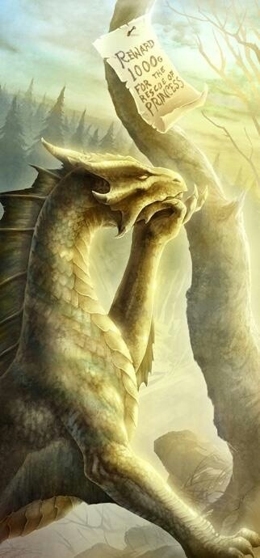
Write a story about the day the dragon saves the princess from the horrible knight!
Remember to:
•plan your story before you start
•write in sentences
•pay attention to the words you choose, your spelling, punctuation, and paragraphs
•check and edit your writing when you have finished.
Found https://www.pinterest.com/dbellman/random-things/
Steph Westwood 2015
Notes:
Remind students to:
*Write neatly.
* Include everything needed. Don’t leave out any steps.
*Use descriptive words.
*Pay attention to spelling and punctuation.
*Use WOW words and interesting connectors.
* Check and edit their work so that it is clear to the reader

Slide 12
Work with a Partner.
Tell this story, where one of you writes from the perspective of the boy and the other from the perspective of the dragon..
Remember to:
•plan your story before you start
•write in sentences
•pay attention to the words you choose, your spelling, punctuation, and paragraphs
•check and edit your writing when you have finished.
Found on breathlessmelodyart.deviantart.com
Steph Westwood 2015
Notes:
Remind students to:
*Write neatly.
* Include everything needed. Don’t leave out any steps.
*Use descriptive words.
*Pay attention to spelling and punctuation.
*Use WOW words and interesting connectors.
* Check and edit their work so that it is clear to the reader

Slide 13
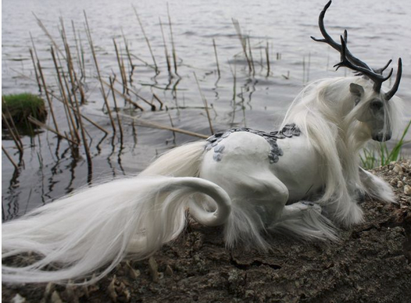
You found this creature in the forest. Now what will happen?
Remember to:
•plan your story before you start
•write in sentences
•pay attention to the words you choose, your spelling, punctuation, and paragraphs
•check and edit your writing when you have finished.
Found on scenceable.deviantart.com
Steph Westwood 2015
Notes:
Remind students to:
*Write neatly.
* Include everything needed. Don’t leave out any steps.
*Use descriptive words.
*Pay attention to spelling and punctuation.
*Use WOW words and interesting connectors.
* Check and edit their work so that it is clear to the reader

Slide 14
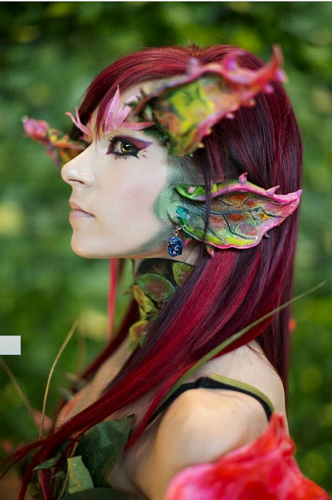
One morning you wake up and you have started to turn into a dragon….. What do you do? How do you feel?
Remember to:
•plan your story before you start
•write in sentences
•pay attention to the words you choose, your spelling, punctuation, and paragraphs
•check and edit your writing when you have finished.
Found on kerli.buzznet.com
Steph Westwood 2015
Notes:
Remind students to:
*Write neatly.
* Include everything needed. Don’t leave out any steps.
*Use descriptive words.
*Pay attention to spelling and punctuation.
*Use WOW words and interesting connectors.
* Check and edit their work so that it is clear to the reader

Slide 15
Tell this story
Remember to:
•plan your story before you start
•write in sentences
•pay attention to the words you choose, your spelling, punctuation, and paragraphs
•check and edit your writing when you have finished.
Found on s3.photobucket.com
Steph Westwood 2015
Notes:
Remind students to:
*Write neatly.
* Include everything needed. Don’t leave out any steps.
*Use descriptive words.
*Pay attention to spelling and punctuation.
*Use WOW words and interesting connectors.
* Check and edit their work so that it is clear to the reader

