Slide 1
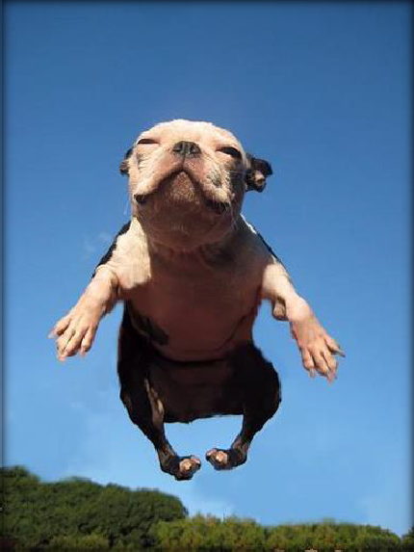
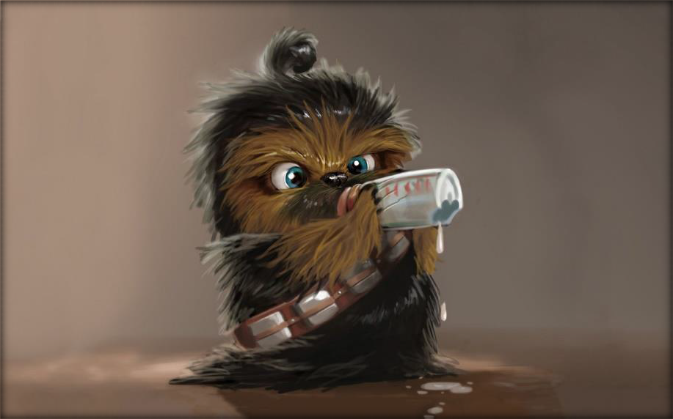
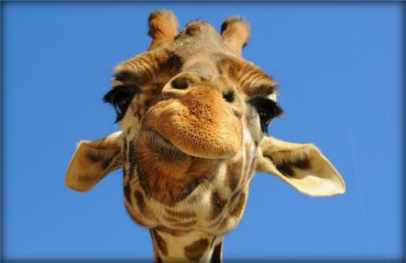
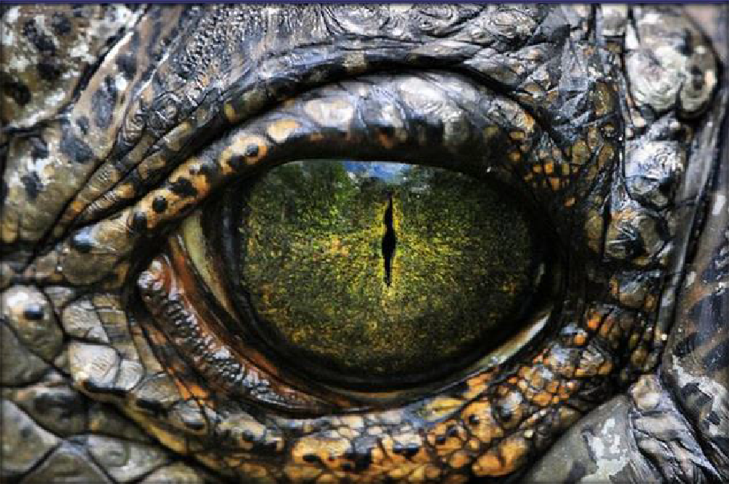
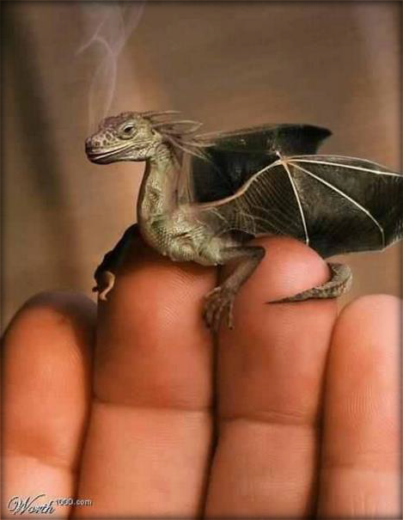

Writing Prompts
7
Steph Westwood 2015

Slide 2

My Favourite Colour.
is the best colour.
I like it because ……………..
Remember to:
•plan your story before you start
•write in sentences
•pay attention to the words you choose, your spelling and
punctuation.
•check and edit your writing when you have finished.

Slide 3

New Species of Dog
Description:
What would you call it?
How does it move?
What can it do?
Would you want one?
Remember to:
•plan your story before you start
•write in sentences
•pay attention to the words you choose, your spelling and punctuation, and paragraphs. (Each question is a paragraph.)
Found on google images
•check and edit your writing when you have

Slide 4
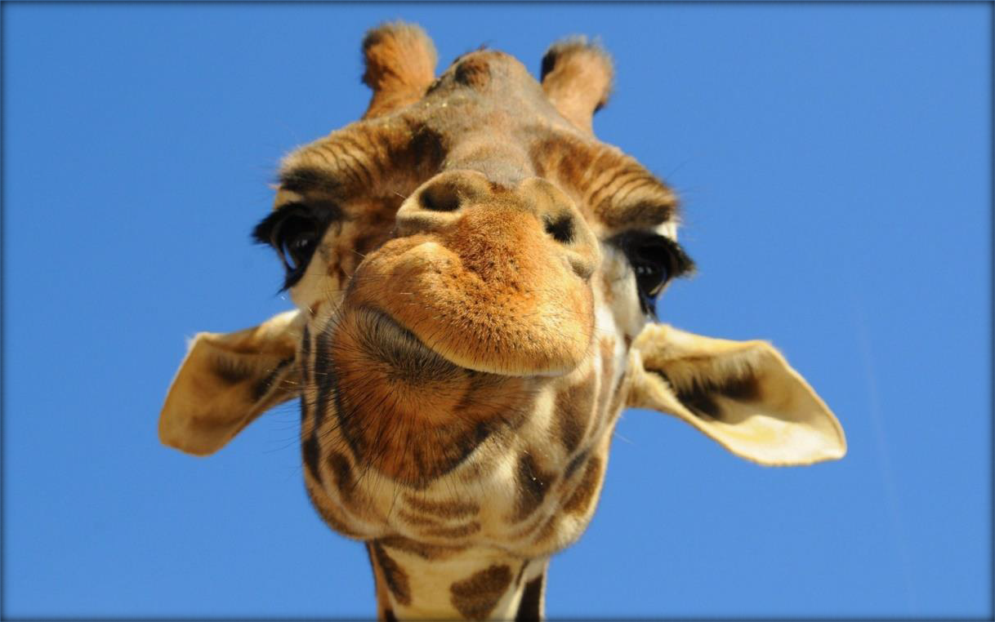
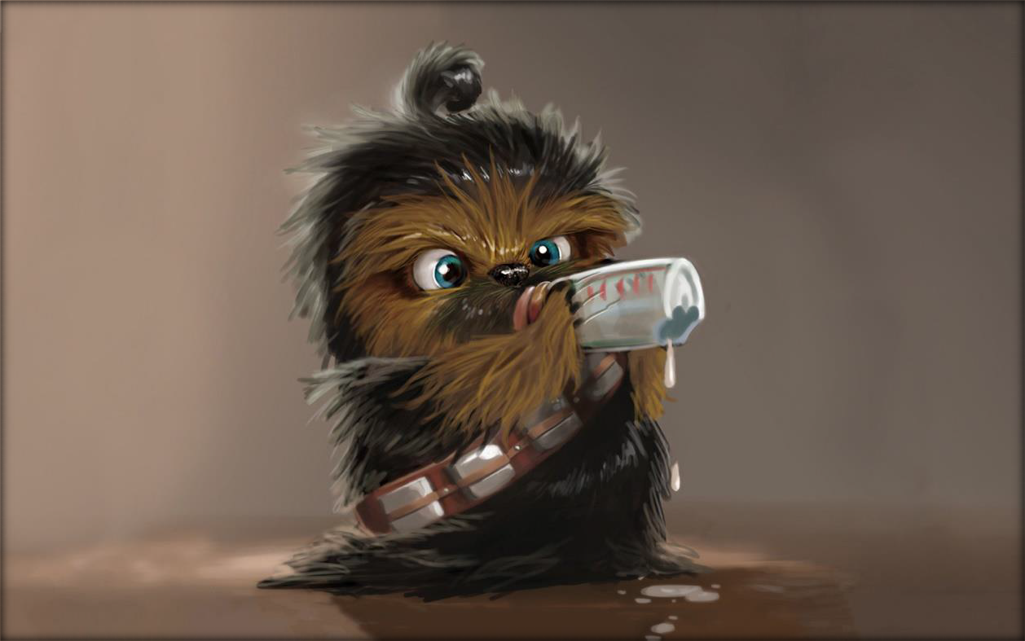
Which one would you like to have as a pet?
Remember to:
•plan your story before you start
•write in sentences
•pay attention to the words you choose, your spelling and punctuation
•check and edit your writing when you have finished.
Found on dragon image
Steph Westwood 2015

Slide 5
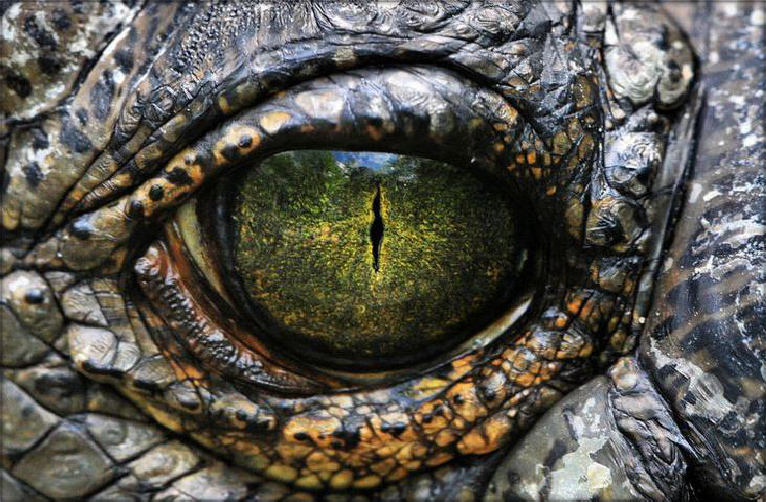
Write about this eye.
Who does it belong to?
What can it see?
Remember to:
•plan your story before you start
•write in sentences
•pay attention to the words you choose, your spelling and punctuation, and paragraphs
•check and edit your writing when you have finished.
Found on phandroid.com

Slide 6
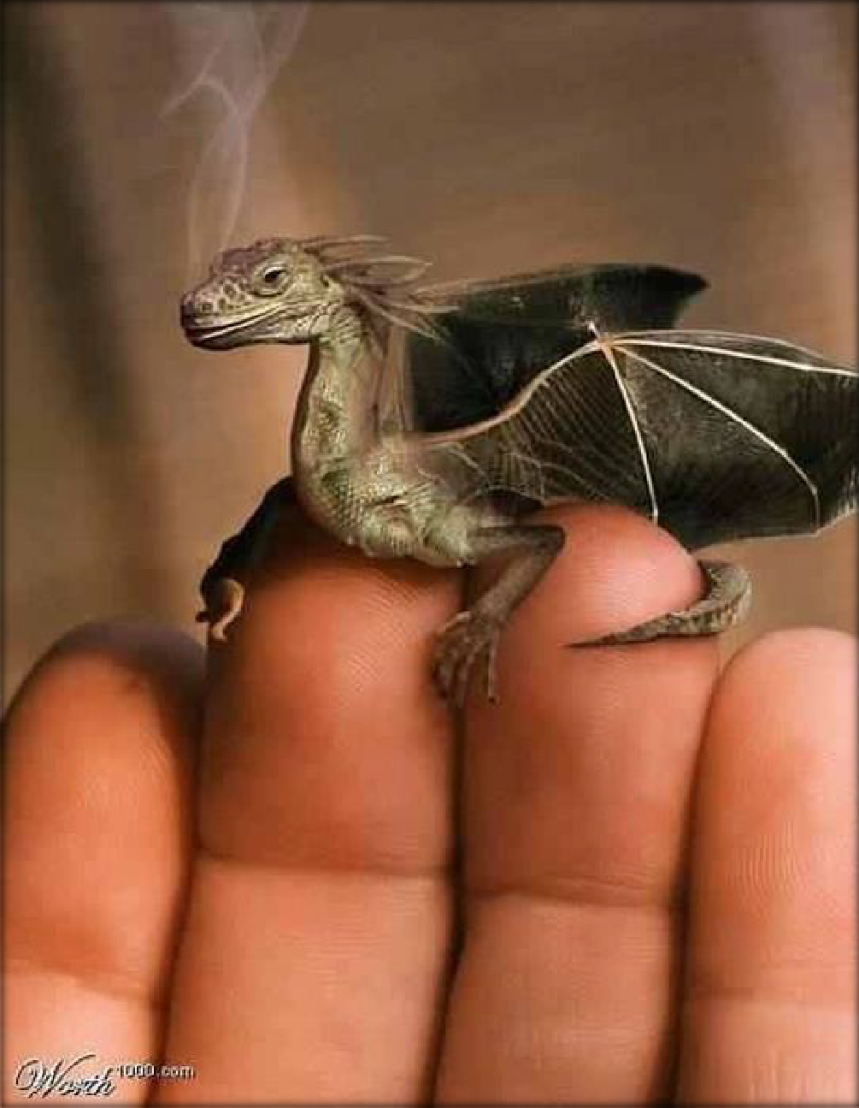
Give your dragon a name.
List two things that he can do?
List three favourite foods of your tiny magical dragon.
Image found on Pinterest via playbuzz.com

Slide 7
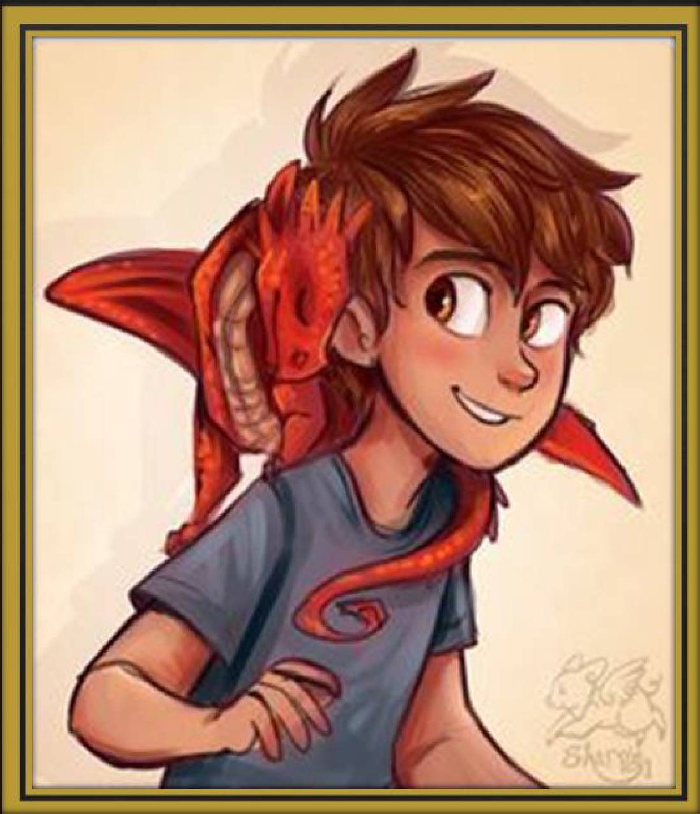
List 3 things to play with your dragon who lives in a shoe.
Image found on Pinterest via sharpie91.deviantart.com

Slide 8
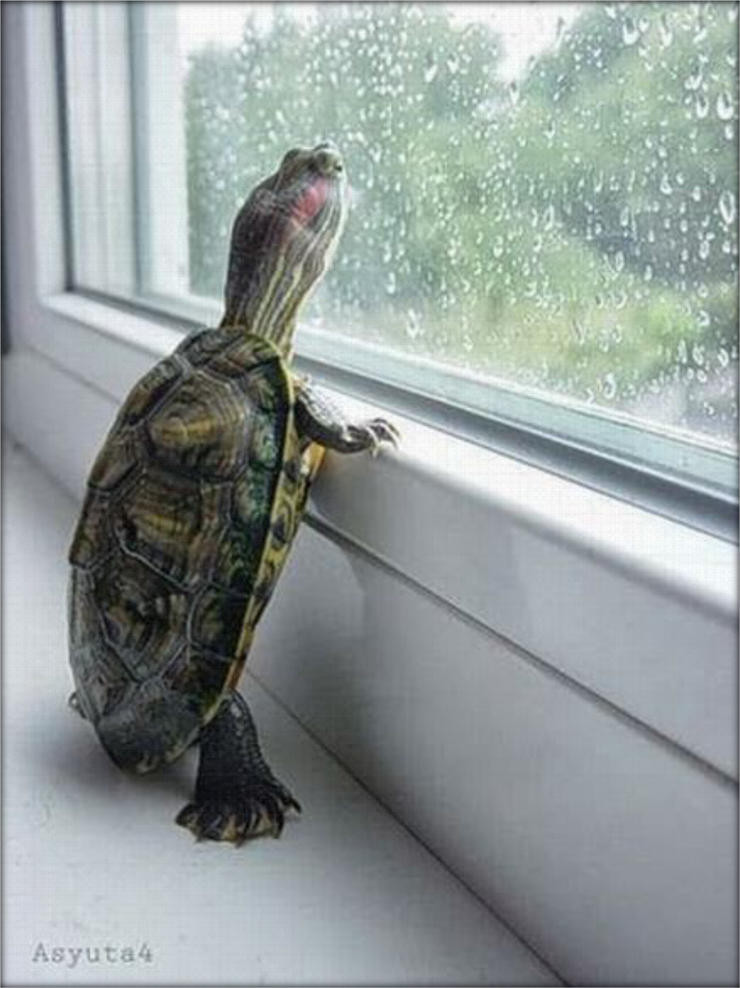
Where is the turtle?
What is the turtle thinking?
Why do you think so?
Remember to:
•plan your story before you start
•write in sentences
•pay attention to the words you choose, your spelling and punctuation,
and paragraphs
•check and edit your writing when you have finished.
Image found on Pinterest via buzzfeed.com

Slide 9

What can you see?
How do you feel?
What magical power would this creature have?
Remember to:
•plan your story before you start
•write in sentences
•pay attention to the words you choose,
your spelling and punctuation,
and paragraphs
•check and edit your writing when you have finished.
Steph Westwood 2015

