Slide 1
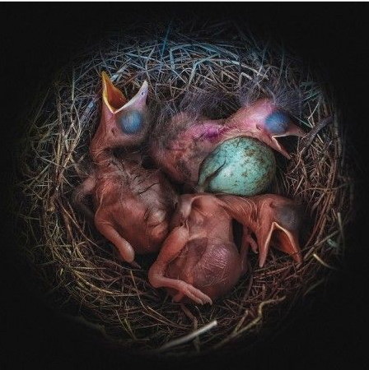
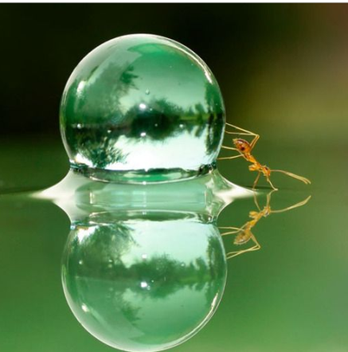
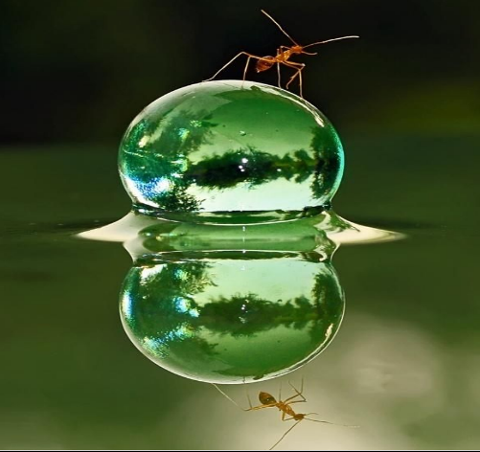
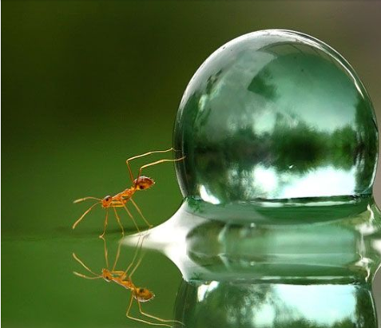
Writing Prompts
8
Steph Westwood 2015
Notes:
Remember to:
•plan your story before you start
•write in sentences
•pay attention to the words you choose, your spelling and punctuation, and paragraphs
•check and edit your writing when you have finished.

Slide 2
You're the youngest person to ever become a guardian angel - at the age of 12 years old. You are assigned to children of all ages throughout all of time.
Use the Fantasy Name Generator to create
at least two names that you like.
Remember to:
•plan your story before you start
•write in sentences
•pay attention to the words you choose, your spelling and punctuation, and paragraphs
•check and edit your writing when you have finished.
Image found on Pinterest via marijkevanooijen.blogspot.com
Steph Westwood 2015

Slide 3
Why aren't baby birds born with their feathers?
Remember to:
•plan your story before you start
•write in sentences
•pay attention to the words you choose, your spelling and punctuation, and paragraphs
•check and edit your writing when you have finished.
Image found on Pinterest via writeabout.com
Steph Westwood 2015
Notes:
Remind students to:
*Write neatly.
* Include everything needed. Don’t leave out any steps.
*Use descriptive words.
*Pay attention to spelling and punctuation.
*Use WOW words and interesting connectors.
* Check and edit their work so that it is clear to the reader

Slide 4
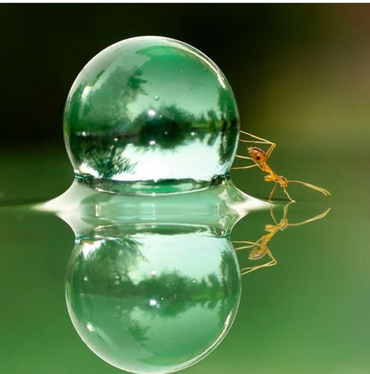
Tell this story.
Remember to:
•plan your story before you start
•write in sentences
•pay attention to the words you choose, your spelling and punctuation, and paragraphs
•check and edit your writing when you have finished.
Image found on Pinterest via blooming-inspiration.tumblr.com
Steph Westwood 2015
Notes:
Remind students to:
*Write neatly.
* Include everything needed. Don’t leave out any steps.
*Use descriptive words.
*Pay attention to spelling and punctuation.
*Use WOW words and interesting connectors.
* Check and edit their work so that it is clear to the reader

Slide 5
There are hungry piranhas in the water.
How will this man get to the shore safely?
Remember to:
•plan your story before you start
•write in sentences
•pay attention to the words you choose, your spelling and punctuation, and paragraphs
•check and edit your writing when you have finished.
Image found on Pinterest via designspotter.com
Steph Westwood 2015
Notes:
Remind students to:
*Write neatly.
* Include everything needed. Don’t leave out any steps.
*Use descriptive words.
*Pay attention to spelling and punctuation.
*Use WOW words and interesting connectors.
* Check and edit their work so that it is clear to the reader

Slide 6
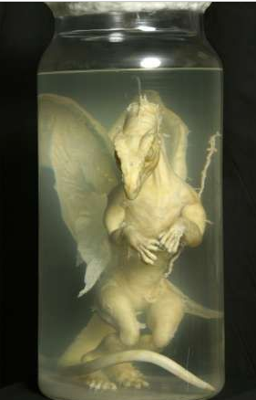
What is this? Where was it found? How did it get there? Use at least 10 action verbs, 10 adjectives, and 10 descriptive phrases. Answer the Who, What, Why, When, Where, and How questions.
Remember to:
•plan your story before you start
•write in sentences
•pay attention to the words you choose, your spelling and punctuation, and paragraphs
•check and edit your writing when you have finished.
Image found on Pinterest via rense.com
Steph Westwood 2015
Notes:
Remind students to:
*Write neatly.
* Include everything needed. Don’t leave out any steps.
*Use descriptive words.
*Pay attention to spelling and punctuation.
*Use WOW words and interesting connectors.
* Check and edit their work so that it is clear to the reader

Slide 7
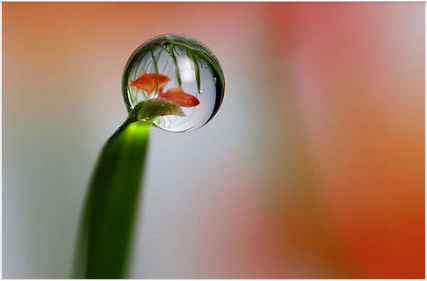
I laid down on the grass to rest my head. I heard the tiny sound of water swishing and splashing. I turned over and to my surprise...
Use words like:
golden, droplets, sunshine,
mirrored, microscopic
Remember to:
•plan your story before you start
•write in sentences
•pay attention to the words you choose, your spelling and punctuation, and paragraphs
•check and edit your writing when you have finished
Image found on Pinterest via thewholegardenwillbow.wordpress.com
Steph Westwood 2015
Notes:
Remind students to:
*Write neatly.
* Include everything needed. Don’t leave out any steps.
*Use descriptive words.
*Pay attention to spelling and punctuation.
*Use WOW words and interesting connectors.
* Check and edit their work so that it is clear to the reader

Slide 8
Above and below.
Where would you rather be and why?
Remember to:
•plan your story before you start •pay attention to the words you choose, your spelling, punctuation, and paragraphs •write in sentences •check and edit your writing when you have finished.
Image found on Pinterest via hqwallbase.com
Steph Westwood 2015
Notes:
Remind students to:
*Write neatly.
* Include everything needed. Don’t leave out any steps.
*Use descriptive words.
*Pay attention to spelling and punctuation.
*Use WOW words and interesting connectors.
* Check and edit their work so that it is clear to the reader

Slide 9
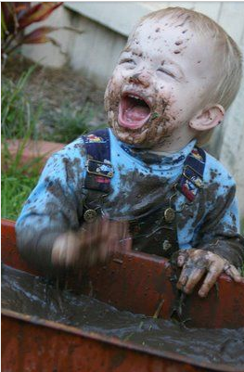
Mud, Glorious Mud
When was the last time you played in the mud.
Use your 5 senses to describe mud.
Remember to:
•plan your story before you start
•write in sentences
•pay attention to the words you choose, your spelling, punctuation, and paragraphs
•check and edit your writing when you have finished.
Image found on Pinterest via alexhughescraft.blogspot.com.au
Steph Westwood 2015
Notes:
Remind students to:
*Write neatly.
* Include everything needed. Don’t leave out any steps.
*Use descriptive words.
*Pay attention to spelling and punctuation.
*Use WOW words and interesting connectors.
* Check and edit their work so that it is clear to the reader

Slide 10
Write about what you see.
Remember to:
•plan your story before you start
•write in sentences
•pay attention to the words you choose, your spelling, punctuation, and paragraphs
•check and edit your writing when you have finished.
Steph Westwood 2015
Notes:
Remind students to:
*Write neatly.
* Include everything needed. Don’t leave out any steps.
*Use descriptive words.
*Pay attention to spelling and punctuation.
*Use WOW words and interesting connectors.
* Check and edit their work so that it is clear to the reader

Slide 11
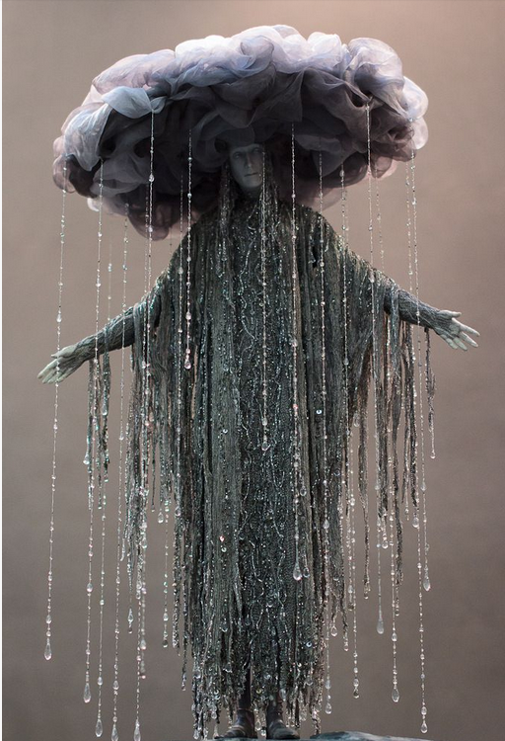
Rain, hail or Shine
What if you were the weather for a day? What would the forecast be?
Remember to:
•plan your story before you start
•write in sentences
•pay attention to the words you choose, your spelling, punctuation, and paragraphs
•check and edit your writing when you have finished.
Image found on Pinterest via og-sottot.livejournal.com
Steph Westwood 2015
Notes:
Remind students to:
*Write neatly.
* Include everything needed. Don’t leave out any steps.
*Use descriptive words.
*Pay attention to spelling and punctuation.
*Use WOW words and interesting connectors.
* Check and edit their work so that it is clear to the reader

Slide 12
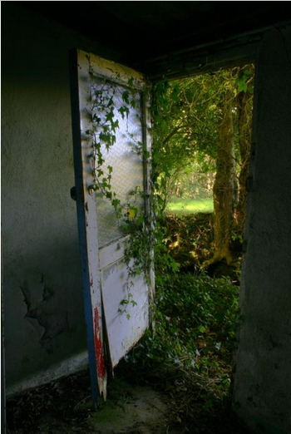
Imagine that you have been transported to this location. LIST everything you SEE, HEAR, SMELL and TASTE while you are there.
Remember to:
•plan your story before you start
•write in sentences
•pay attention to the words you choose, your spelling, punctuation, and paragraphs
•check and edit your writing when you have finished.
Image found on Pinterest via bloglovin.com
Steph Westwood 2015
Notes:
Remind students to:
*Write neatly.
* Include everything needed. Don’t leave out any steps.
*Use descriptive words.
*Pay attention to spelling and punctuation.
*Use WOW words and interesting connectors.
* Check and edit their work so that it is clear to the reader

Slide 13
Tell the story about what was happening when this picture was taken.
Remember to:
•plan your story before you start
•write in sentences
•pay attention to the words you choose, your spelling, punctuation, and paragraphs
•check and edit your writing when you have finished.
Image found on Pinterest via lavorolowcost.blogspot.it
Steph Westwood 2015
Notes:
Remind students to:
*Write neatly.
* Include everything needed. Don’t leave out any steps.
*Use descriptive words.
*Pay attention to spelling and punctuation.
*Use WOW words and interesting connectors.
* Check and edit their work so that it is clear to the reader

Slide 14
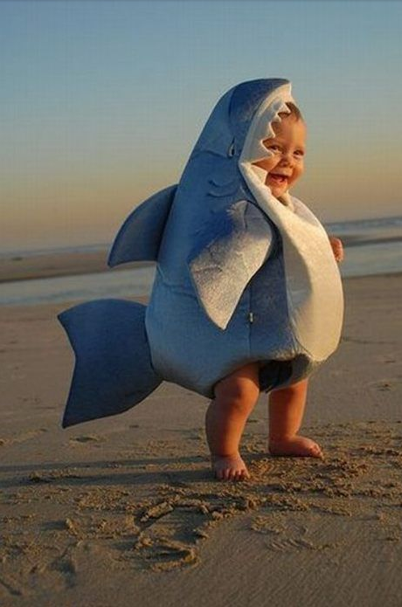
What if one morning you woke up and found you had been turned into an animal.
What animal would it be?
Remember to:
•plan your story before you start
•write in sentences
•pay attention to the words you choose, your spelling, punctuation, and paragraphs
•check and edit your writing when you have finished.
Image found on Pinterest via hemetapicture.com
Steph Westwood 2015
Notes:
Remind students to:
*Write neatly.
* Include everything needed. Don’t leave out any steps.
*Use descriptive words.
*Pay attention to spelling and punctuation.
*Use WOW words and interesting connectors.
* Check and edit their work so that it is clear to the reader

Slide 15
Work with a Partner.
What do you think will happen next?
Remember to:
•plan your story before you start
•write in sentences
•pay attention to the words you choose, your spelling, punctuation, and paragraphs
•check and edit your writing when you have finished.
Image found on Pinterest via indulgy.com
Steph Westwood 2015
Notes:
Remind students to:
*Write neatly.
* Include everything needed. Don’t leave out any steps.
*Use descriptive words.
*Pay attention to spelling and punctuation.
*Use WOW words and interesting connectors.
* Check and edit their work so that it is clear to the reader

Slide 16
Do you remember the first time you learned to do something (like riding a bike, or tying your shoes)?
What was it like?
Were you afraid?
Remember to:
•plan your story before you start
•write in sentences
•pay attention to the words you choose, your spelling, punctuation, and paragraphs
•check and edit your writing when you have finished.
Image found on Pinterest via zsazsabellagio.blogspot.com
Steph Westwood 2015
Notes:
Remind students to:
*Write neatly.
* Include everything needed. Don’t leave out any steps.
*Use descriptive words.
*Pay attention to spelling and punctuation.
*Use WOW words and interesting connectors.
* Check and edit their work so that it is clear to the reader

Slide 17
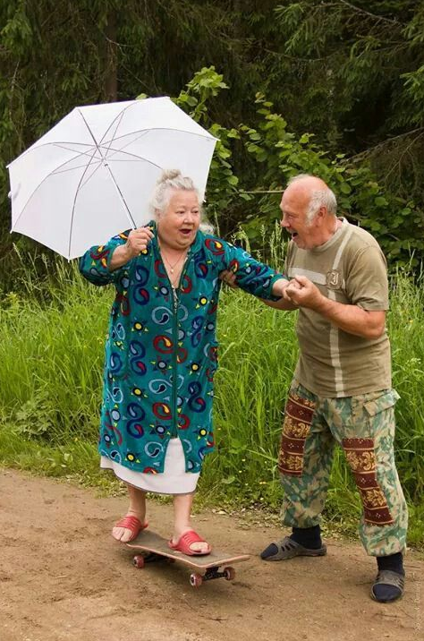
What can you see.
What do you think might happen?
Remember to:
•plan your story before you start
•write in sentences
•pay attention to the words you choose, your spelling, punctuation, and paragraphs
•check and edit your writing when you have finished.
Image found on Pinterest via viralnova.com
Steph Westwood 2015
Notes:
Remind students to:
*Write neatly.
* Include everything needed. Don’t leave out any steps.
*Use descriptive words.
*Pay attention to spelling and punctuation.
*Use WOW words and interesting connectors.
* Check and edit their work so that it is clear to the reader

Slide 18
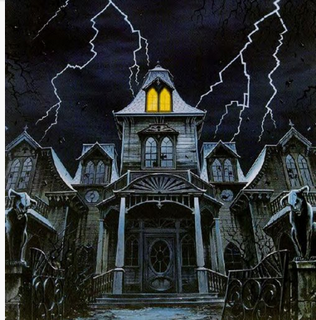
Write a real estate ad for a haunted house.
Remember to:
•plan your story before you start
•write in sentences
•pay attention to the words you choose, your spelling, punctuation, and paragraphs
•check and edit your writing when you have finished.
Image found on Pinterest via thepolkadotowl.blogspot.com
Steph Westwood 2015
Notes:
Remind students to:
*Write neatly.
* Include everything needed. Don’t leave out any steps.
*Use descriptive words.
*Pay attention to spelling and punctuation.
*Use WOW words and interesting connectors.
* Check and edit their work so that it is clear to the reader

Slide 19
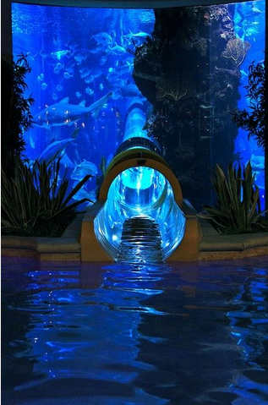
Why was this passageway built?
Where do you think it leads?
Remember to:
•plan your story before you start
•write in sentences
•pay attention to the words you choose, your spelling, punctuation, and paragraphs
•check and edit your writing when you have finished.
Image found on Pinterest via imgur.com
Steph Westwood 2015
Notes:
Remind students to:
*Write neatly.
* Include everything needed. Don’t leave out any steps.
*Use descriptive words.
*Pay attention to spelling and punctuation.
*Use WOW words and interesting connectors.
* Check and edit their work so that it is clear to the reader
It is a Water Slide Through Shark Tank In Vegas

Slide 20
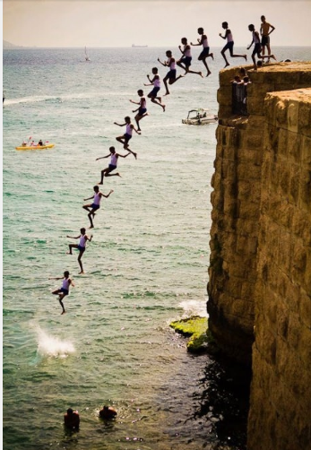
What can you see.
What will happen in the water?
Remember to:
•plan your story before you start
•write in sentences
•pay attention to the words you choose, your spelling, punctuation, and paragraphs
•check and edit your writing when you have finished.
Image found on Pinterest via 9gag.com
Steph Westwood 2015
Notes:
Remind students to:
*Write neatly.
* Include everything needed. Don’t leave out any steps.
*Use descriptive words.
*Pay attention to spelling and punctuation.
*Use WOW words and interesting connectors.
* Check and edit their work so that it is clear to the reader

Slide 21
Tell this story.
Describe why it is so much fun to jump in a puddle.
Remember to:
•plan your story before you start
•write in sentences
•pay attention to the words you choose, your spelling, punctuation, and paragraphs
•check and edit your writing when you have finished.
Image found on Pinterest via mcpactions.com
Steph Westwood 2015
Notes:
Remind students to:
*Write neatly.
* Include everything needed. Don’t leave out any steps.
*Use descriptive words.
*Pay attention to spelling and punctuation.
*Use WOW words and interesting connectors.
* Check and edit their work so that it is clear to the reader

